Slide 1


Emerging technologies to enhance individual cat management
John L Read

Slide 2
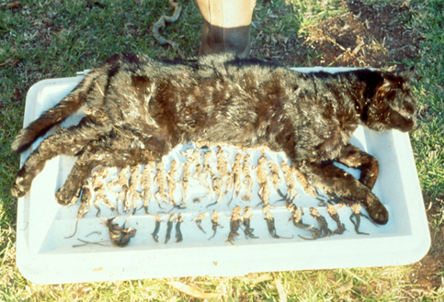
What animals are preferred cat prey ?
24 Ctenophorus pictus, 3 Pogona vitticeps
1 Tympanocryptis intima, 1 Tympanocryptis lineata,
3 Ctenotus schomburgkii, 1 Mus domesticus, 1 Poephilla gutatta

Slide 3
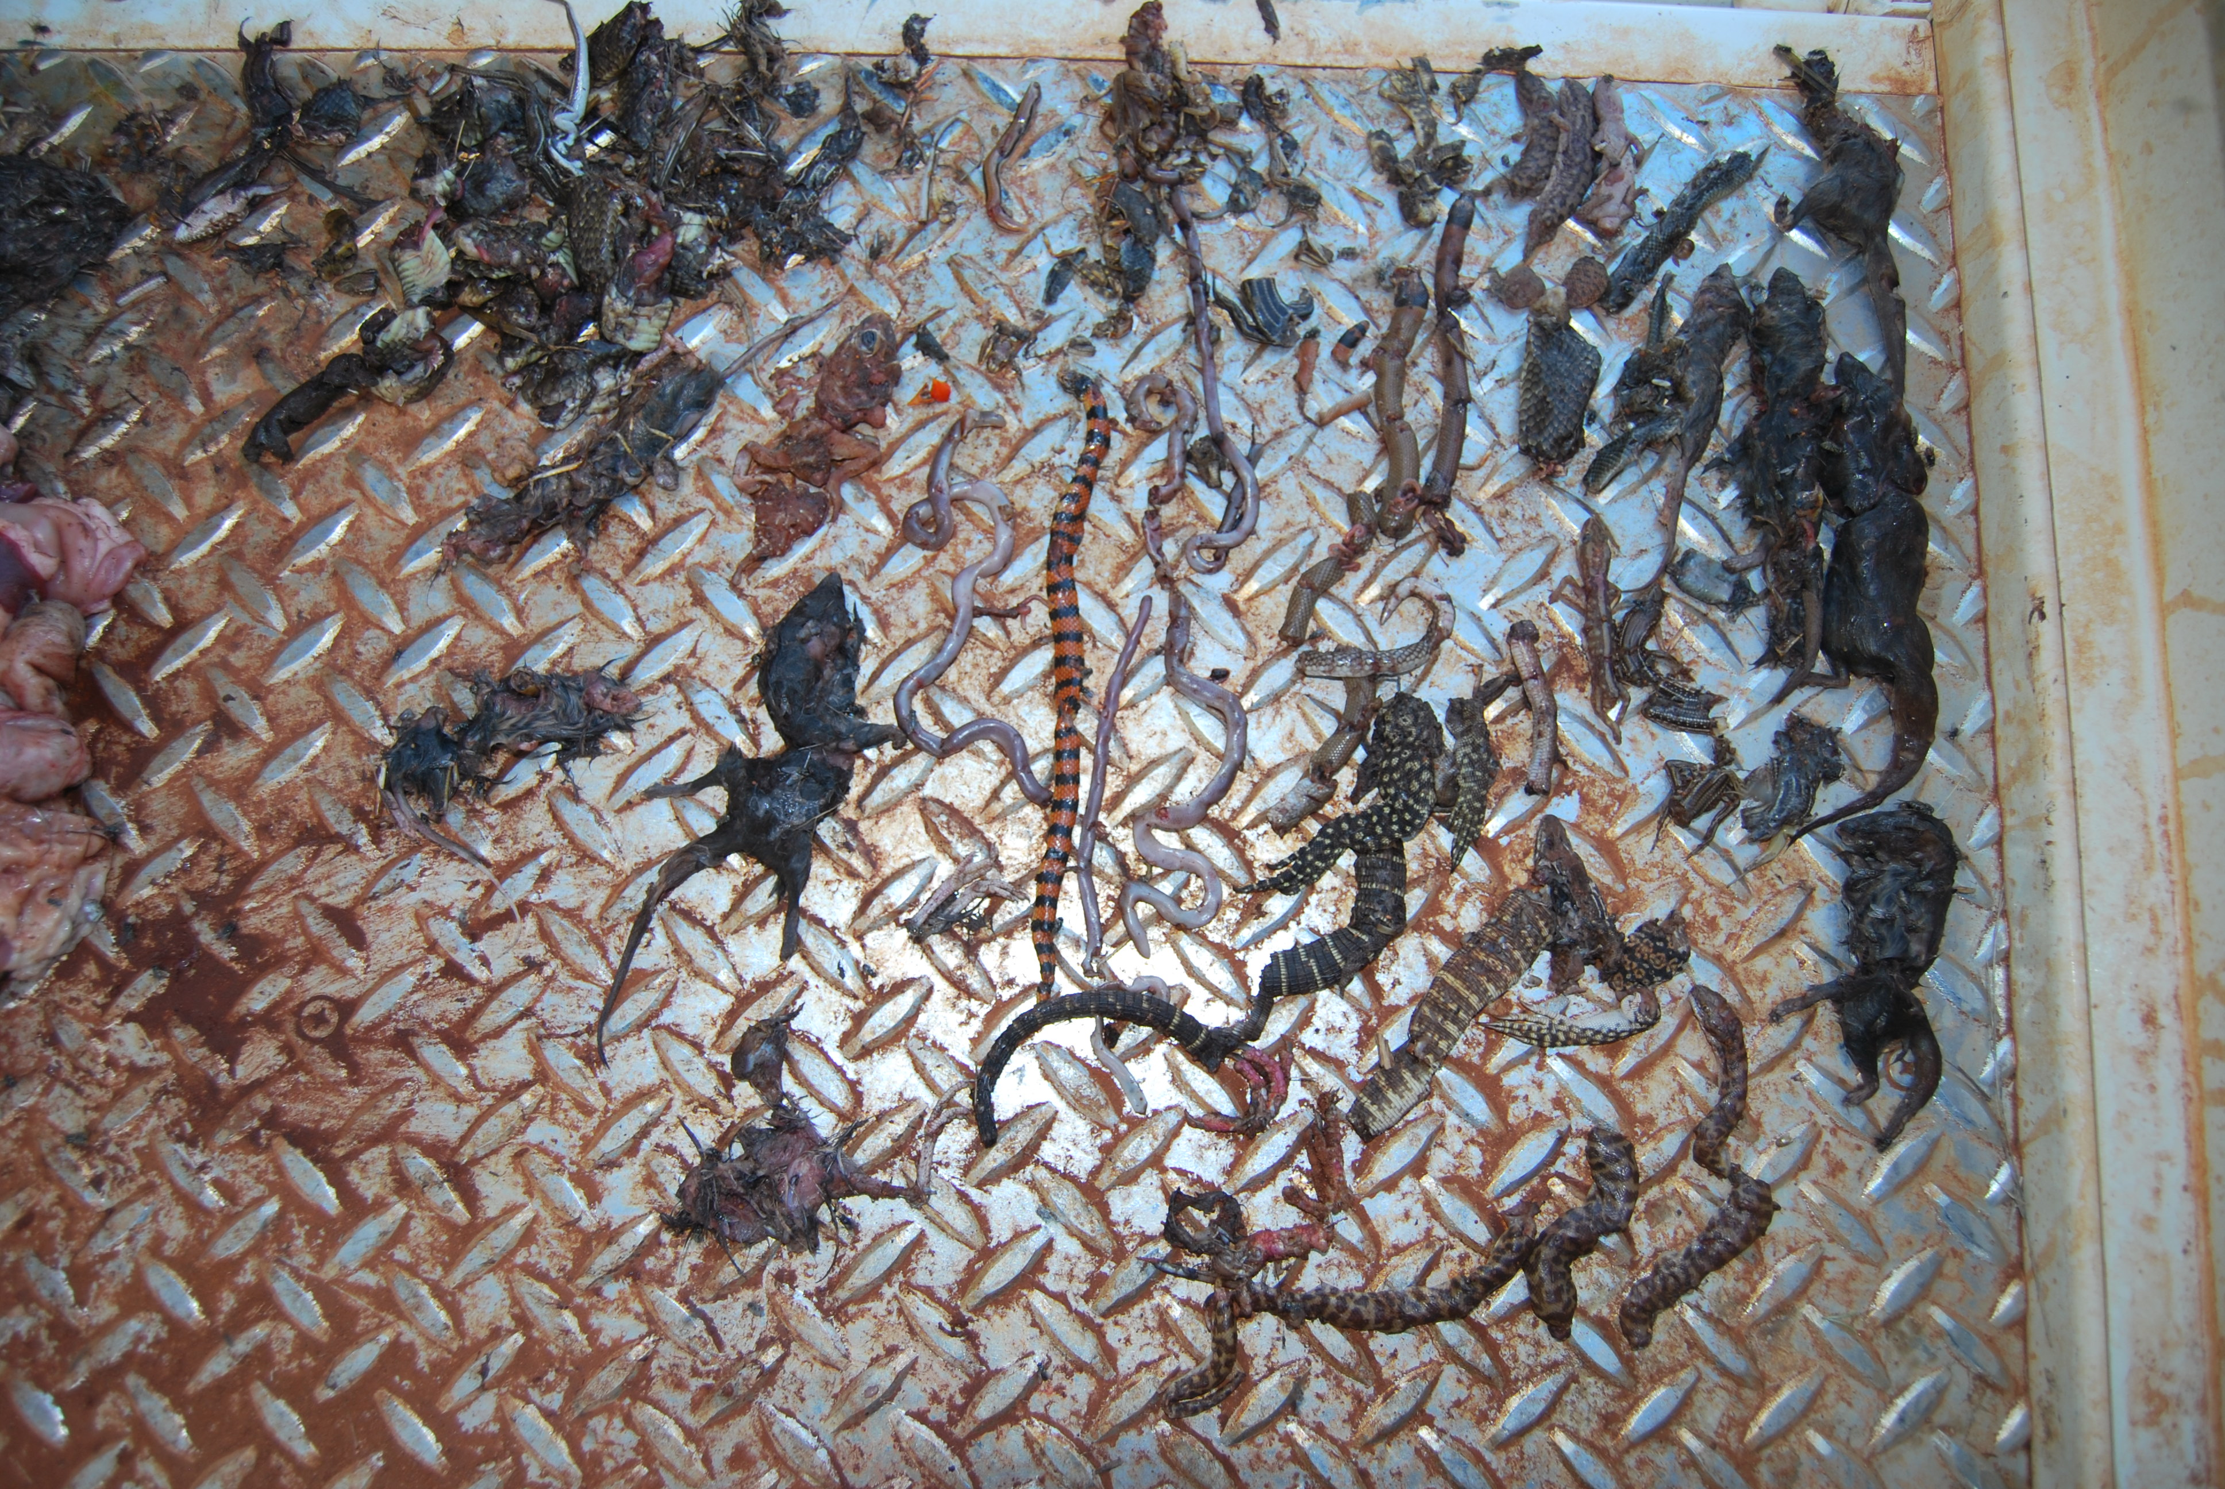
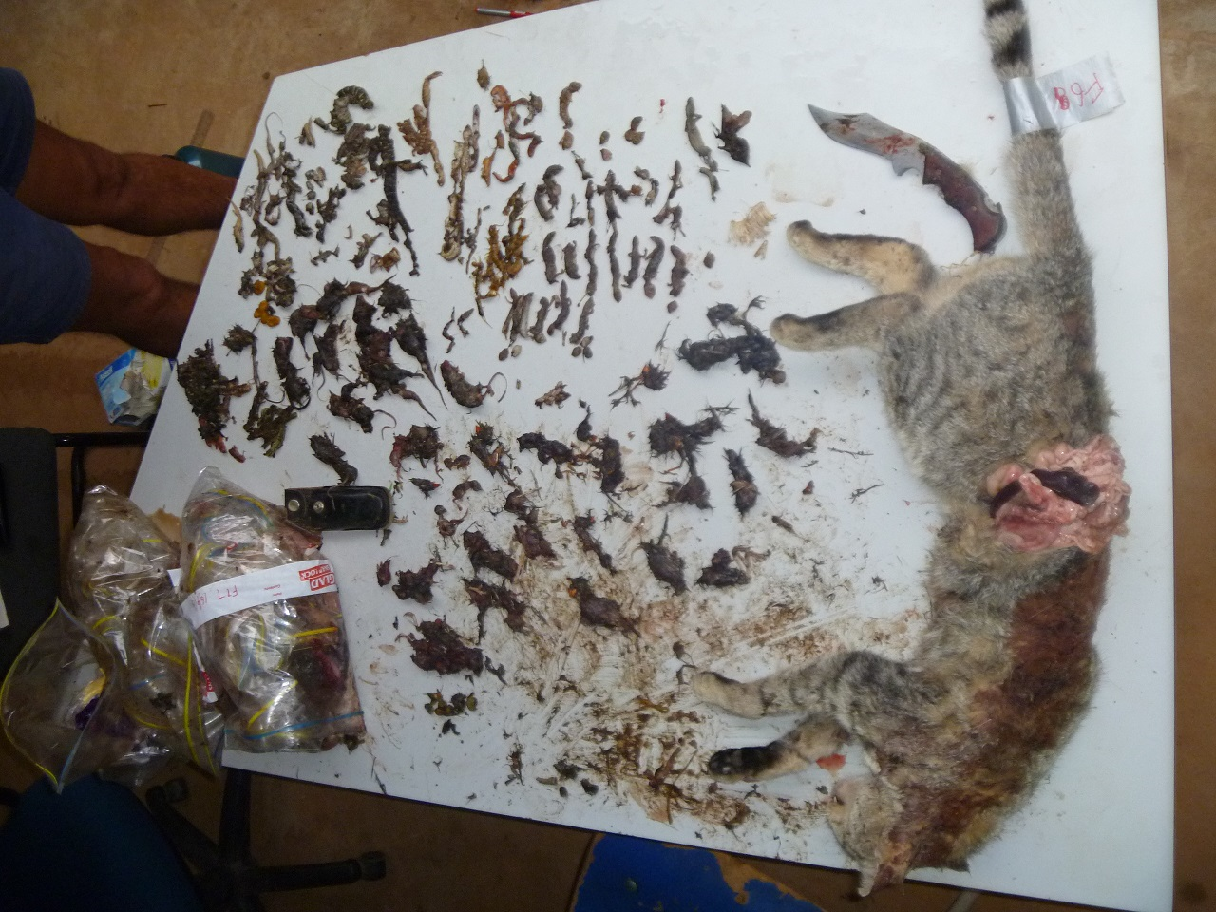
Cat prey selectivity
Are (Painted) Dragons at high risk?
27 year study
Dissected 2,293 feral cats
Identified 3,234 vertebrate prey items
Compared with relative abundance from >70,000 regional vertebrate records
John Read, Katherine Moseby, Hugh McGregor subm. to Wildlife Research

Slide 4
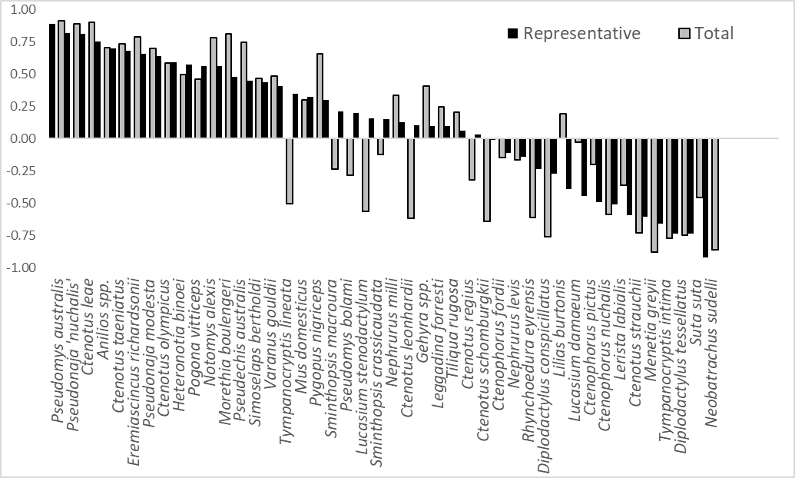
41% of C. pictus from 1 of 2,293 cats

Slide 5
Catastrophic cats:
Individuals that learn to hunt challenging prey
DNA confirmed ten of 41 chuditch reintroduced to Flinders Ranges were killed by just 4 feral cats.
Cat number | Sex | Weight (kg) | Quoll attacks
1 | M | 4.3 | 2
2 | M | 5.0 | 3
3 | M | 4.1 | 3
4 | M | 3.7 | 2
Frequency of male and female weights for cats (including quoll killers) captured during the western quoll reintroduction into the Flinders Ranges National Park in South Australia.
Moseby, K.E., Peacock, D.E. and Read, J.L (2015)

Slide 6
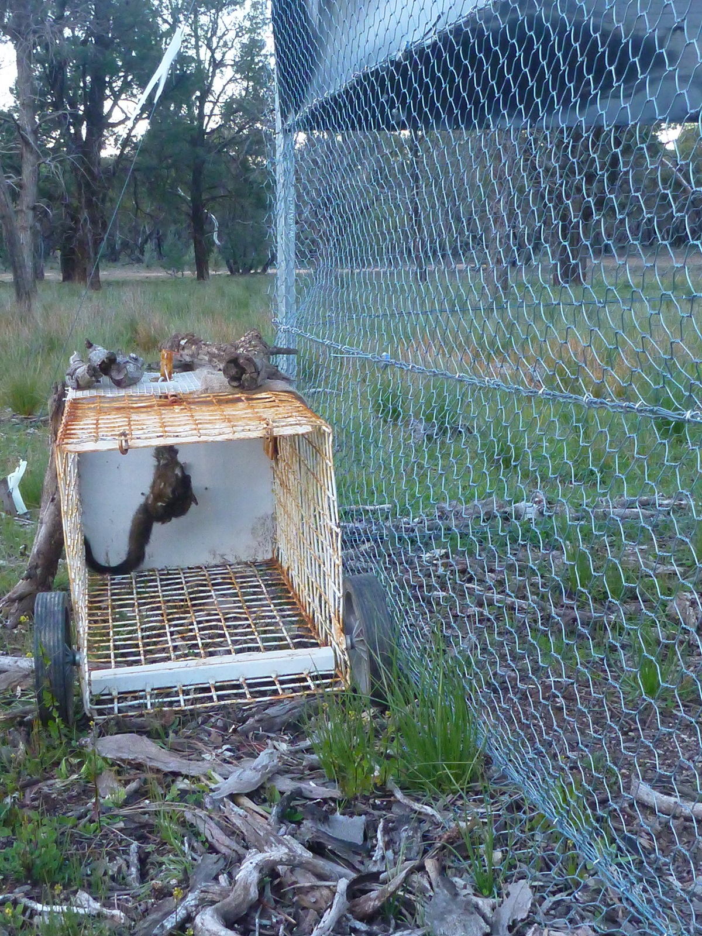
Catastrophic cats:
Require specific management tools
Ten of 41 chuditch reintroduced to Flinders Ranges killed by 4 feral cats.
Chuditch killers were typically only trapped at cached chuditch carcasses
Cat number | Sex | Weight (kg) | Quoll attacks
1 | M | 4.3 | 2
2 | M | 5.0 | 3
3 | M | 4.1 | 3
4 | M | 3.7 | 2
Frequency of male and female weights for cats (including quoll killers) captured during the western quoll reintroduction into the Flinders Ranges National Park in South Australia.
Moseby, K.E., Peacock, D.E. and Read, J.L (2015)

Slide 7
Focussed on hunting Painted Dragons
Probably not interested in rabbit (or quoll) bait!

Slide 8
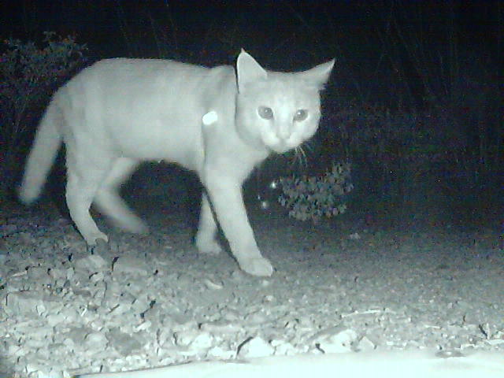
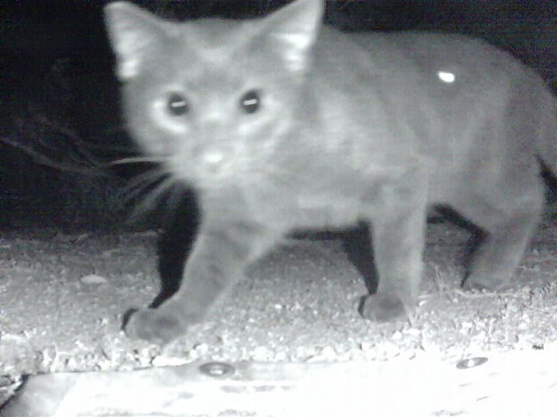
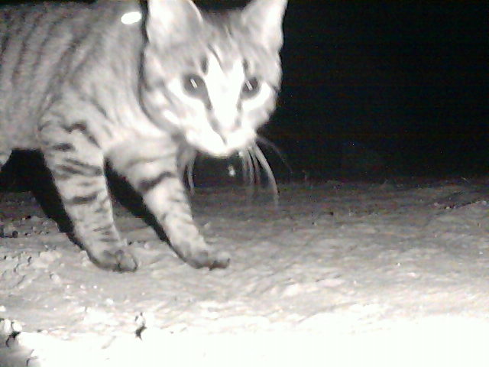
Curious

Slide 9
Curious
Easy to trap

Slide 10
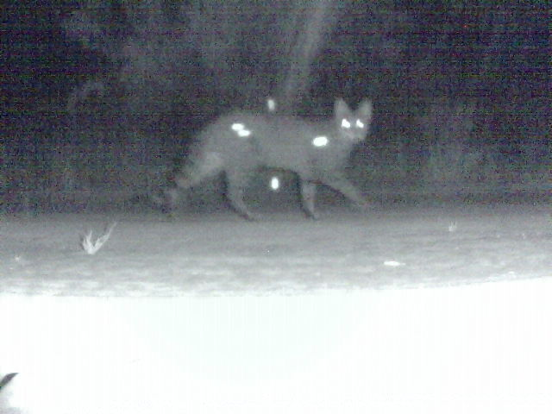
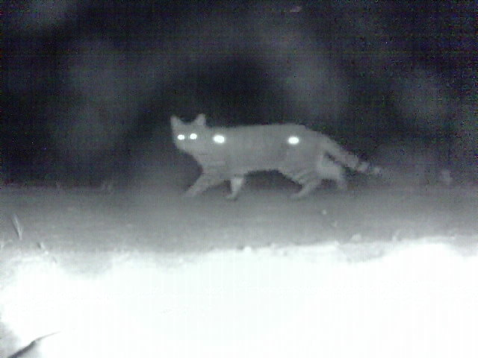
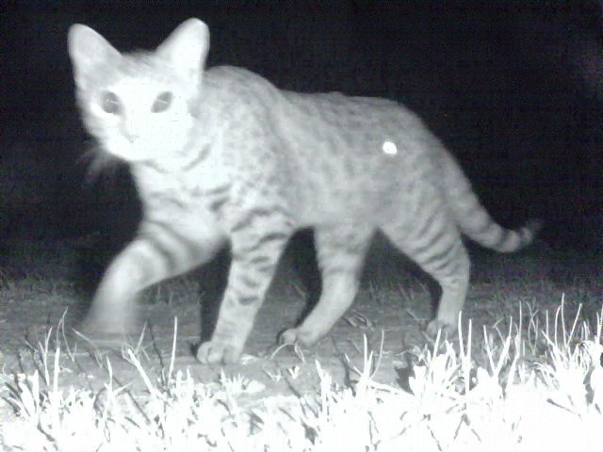
Curious
Aware

Slide 11
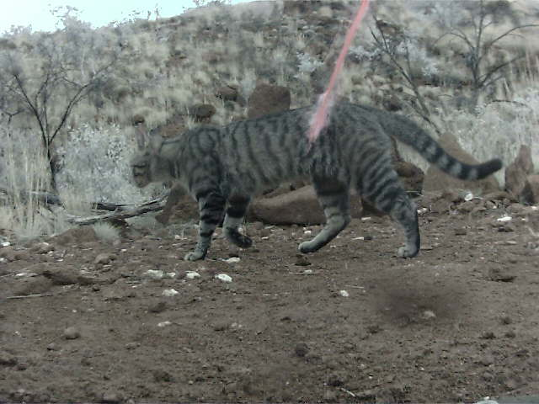
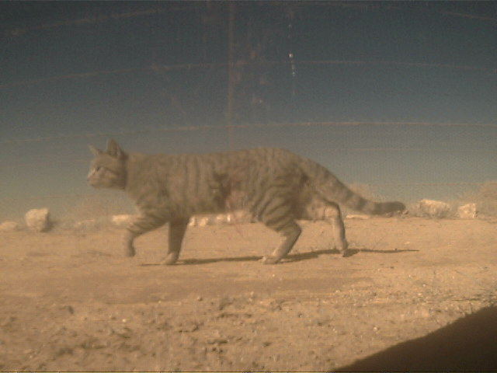
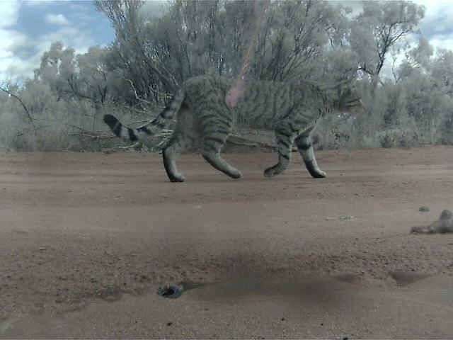
Curious
Aware
Oblivious

Slide 12
Curious
Aware
Oblivious
Easy to Felixer

Slide 13
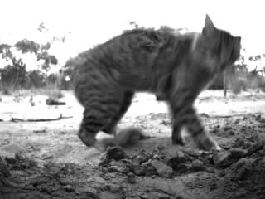
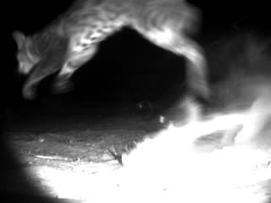
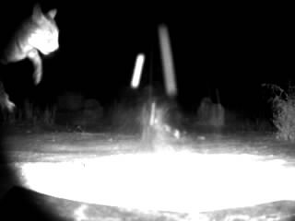
Curious
Aware
Oblivious
Alarmed

Slide 14
So cats differ in their prey selection & alertness
But the WAFCWG is concerned with management
Do cats vary in response to control tools?

Slide 15
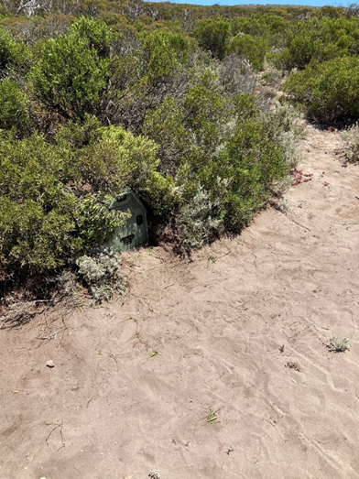
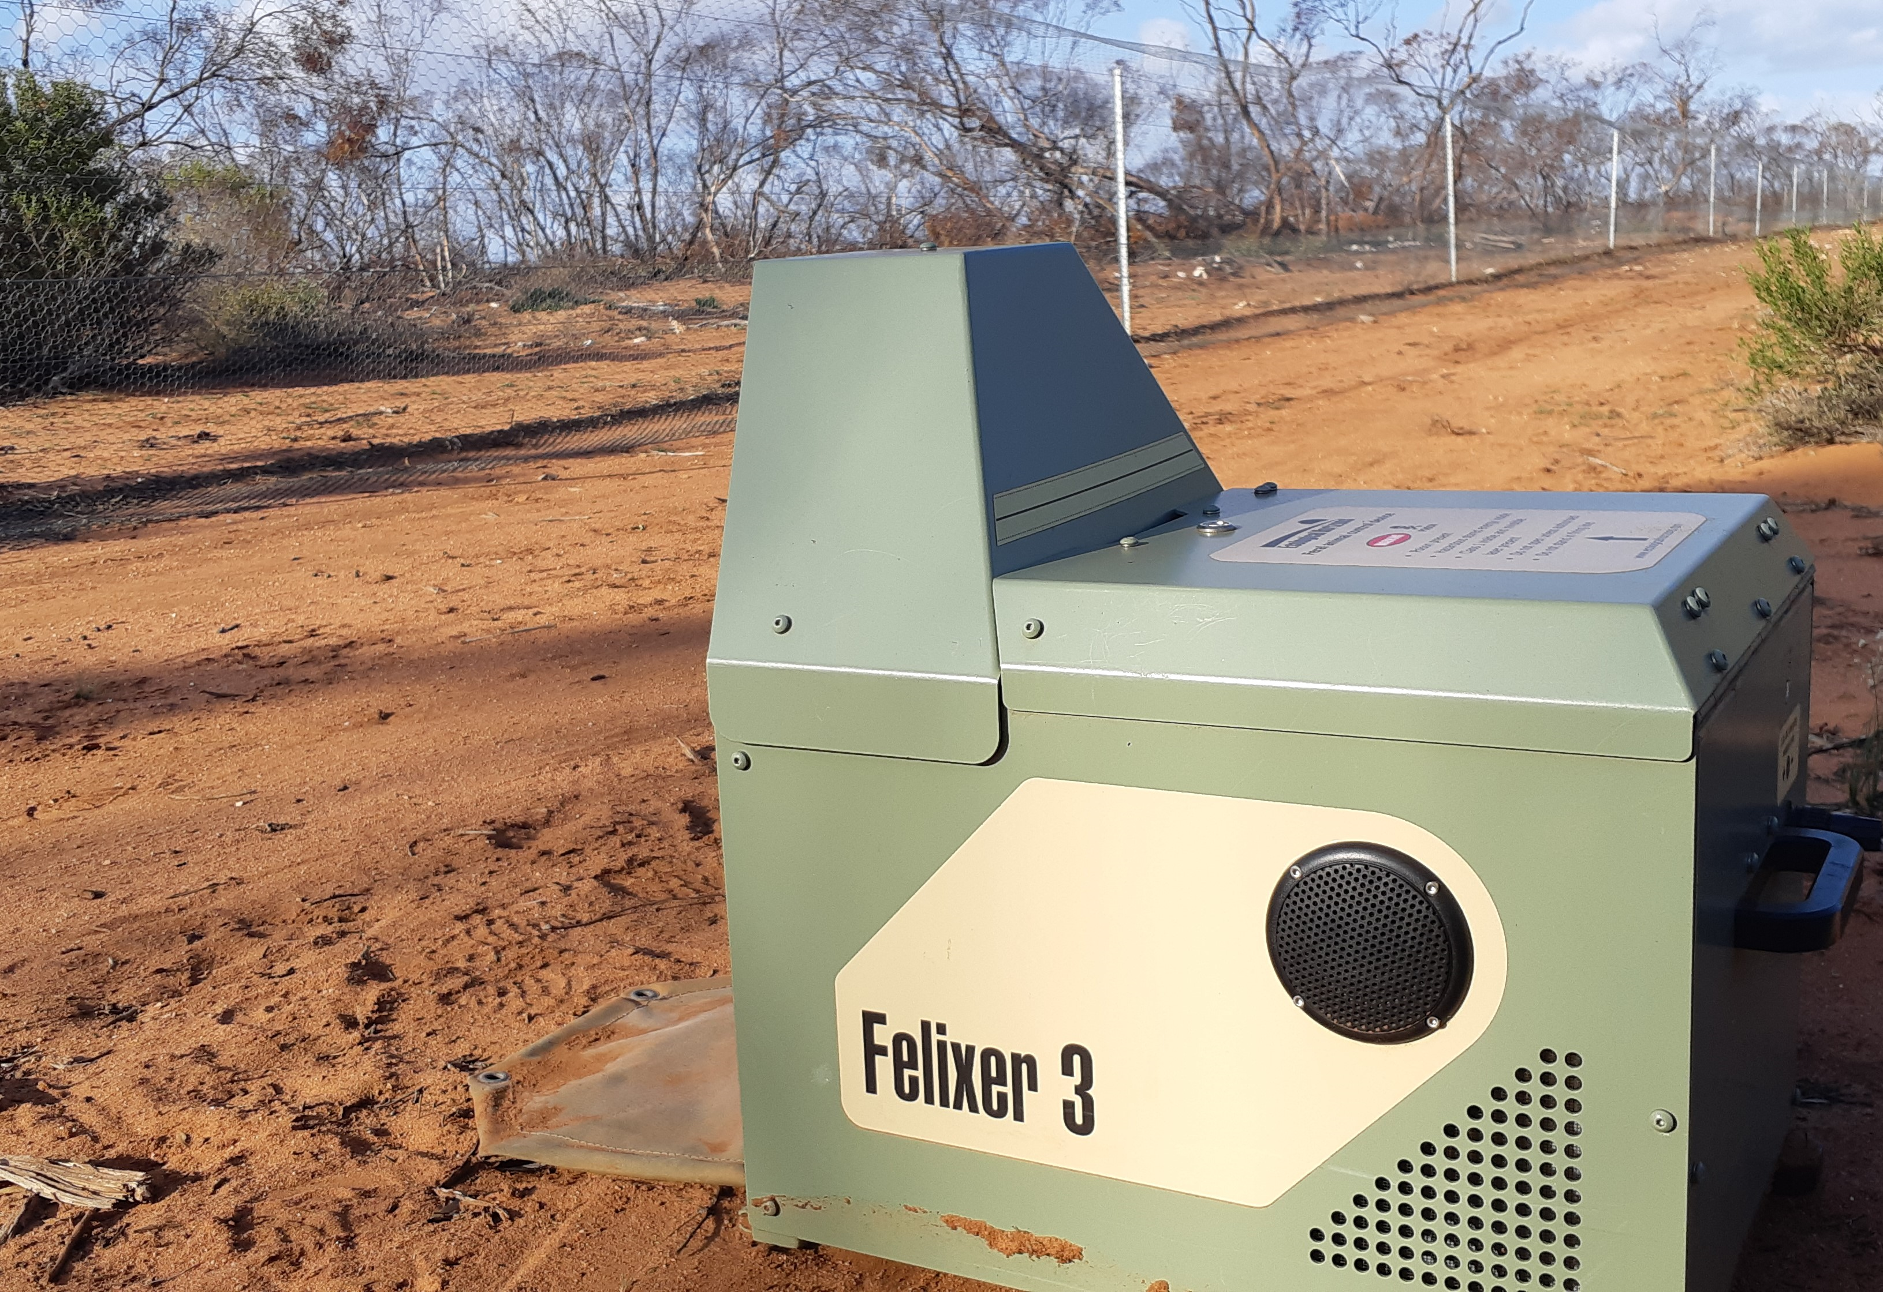

Slide 16
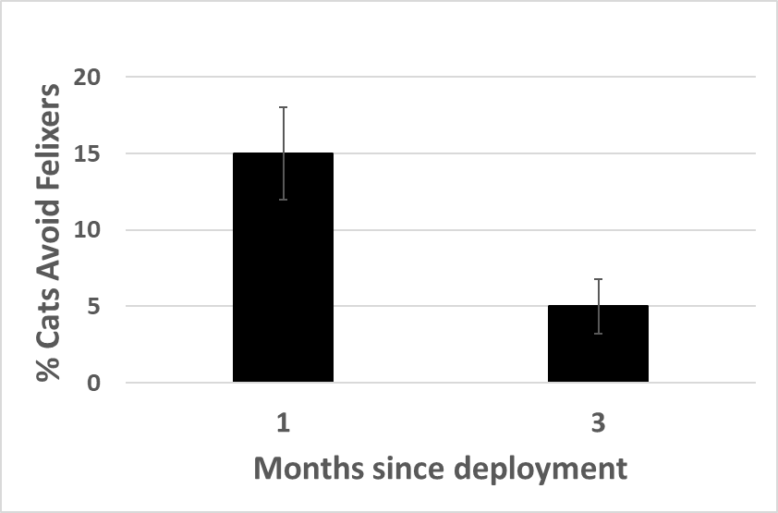
Some cats avoid Felixers initially
Neophobia declines through time
Concealment reduces neophobia
Ned L. Ryan-Schofield, John L. Read, Hugh W. McGregor, Todd J. McWhorter, Katherine E. Moseby

Slide 17
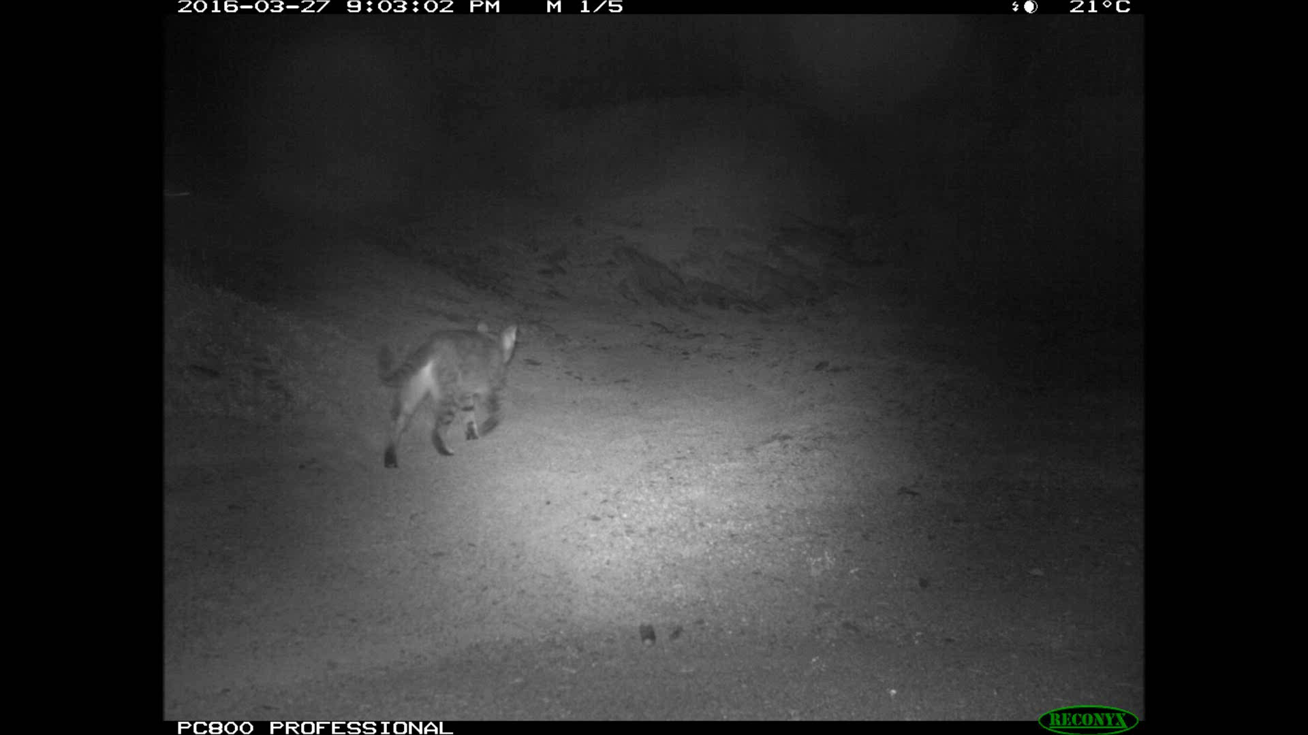

Slide 18
Ask Michael Johnston to see his enlightening/disturbing videos of cats ignoring or avoiding traps

Slide 19
Curiosity kills some cats
but
Wariness (or disinterest) saves others
Neophobia or avoidance is a challenge for all forms of feral and stray cat control

Slide 20
Curiosity kills the cat
but
Wariness (or disinterest) saves others
Neophobia or avoidance is a challenge for all forms of feral and stray cat control
Multiple tools and variability of deployment is optimal for sustained feral cat control

Slide 21

All cats are individuals (so are cat owners!)
“My cat doesn’t wander/hunt/spray”

Slide 22
All cats are individuals (so are cat owners!)
“My cat doesn’t wander/hunt/spray”
Many cats (pet, stray or feral) are very smart, they learn and resist management

Slide 23
All cats are individuals (so are cat owners!)
“My cat doesn’t wander/hunt/spray”
Many cats (pet, stray or feral) are very smart, they learn and resist management
Cats transition from pet to feral to pet
WAFCWG

Slide 24
All cats are individuals (so are cat owners!)
“My cat doesn’t wander/hunt/spray”
Many cats (pet, stray or feral) are very smart, they learn and resist management
Cats transition from pet to stray to feral & back
WAFCWG
X

Slide 25
Need to manage cats (feral, stray and pet) as individuals – not a numbers game or one size fits all
Therefore ideally we need to:
distinguish individual cats or predictive traits
develop/adapt management tools to target individuals and distinguish pets
Emerging technology and Community support are key

Slide 26
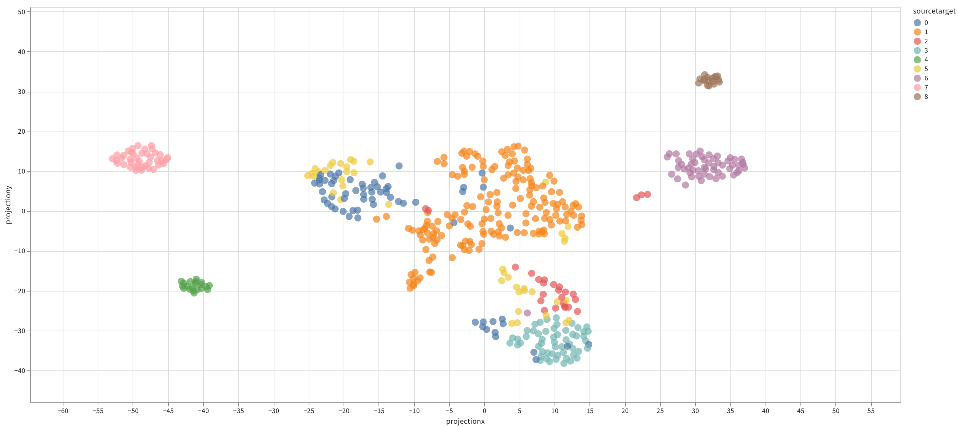
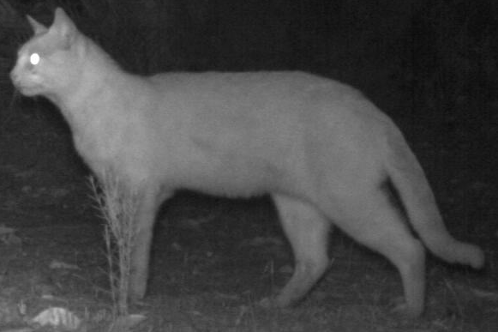
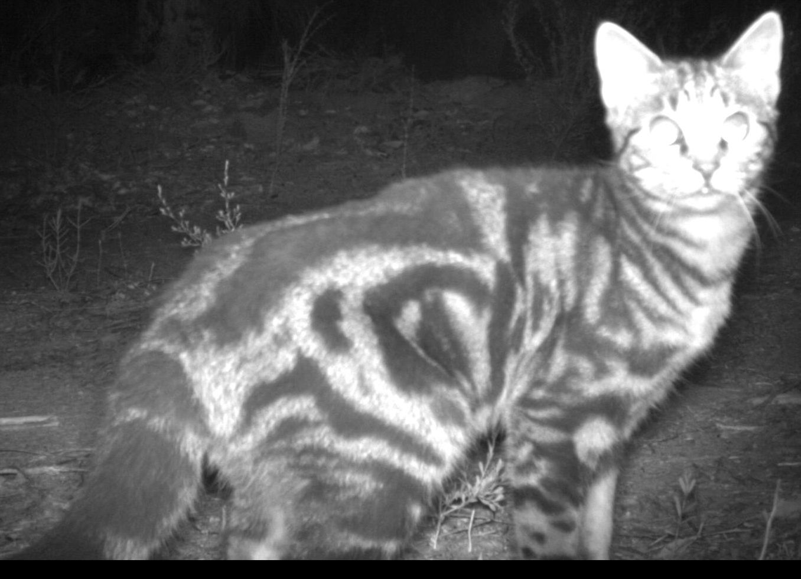
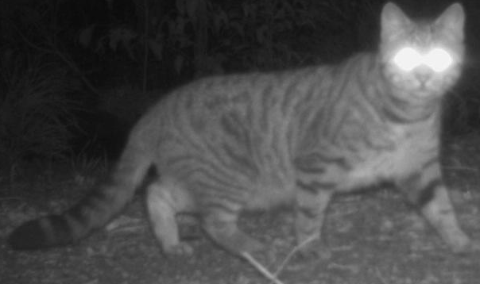
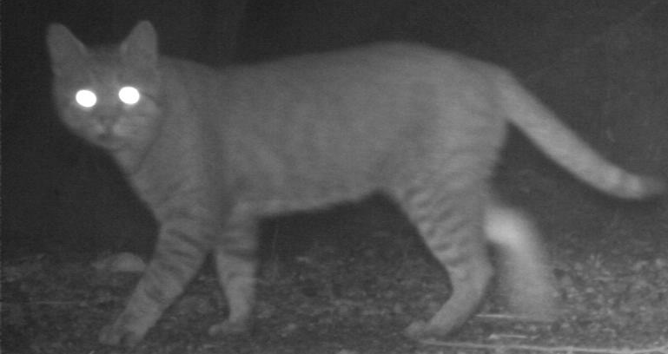
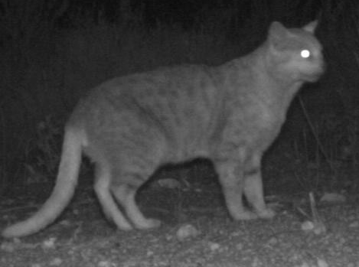
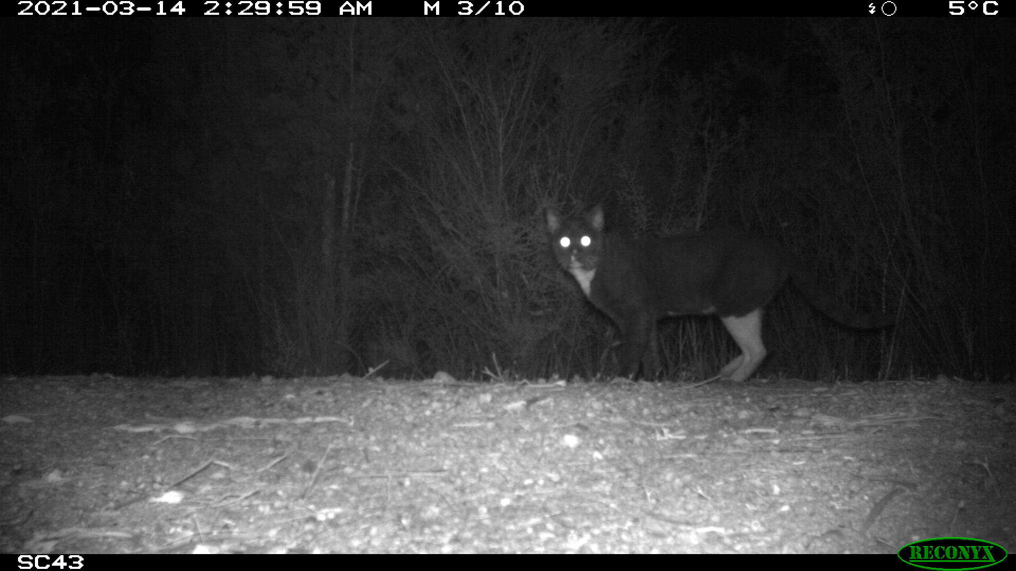
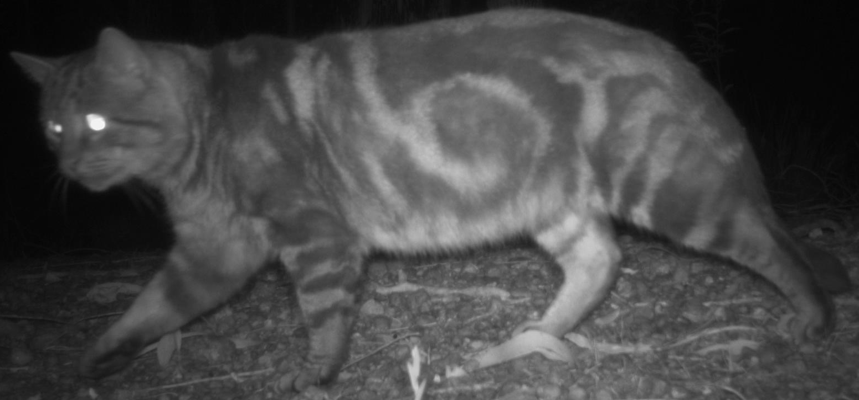
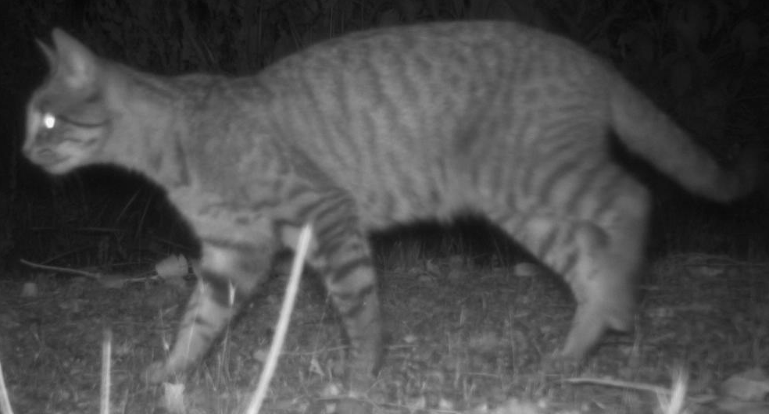
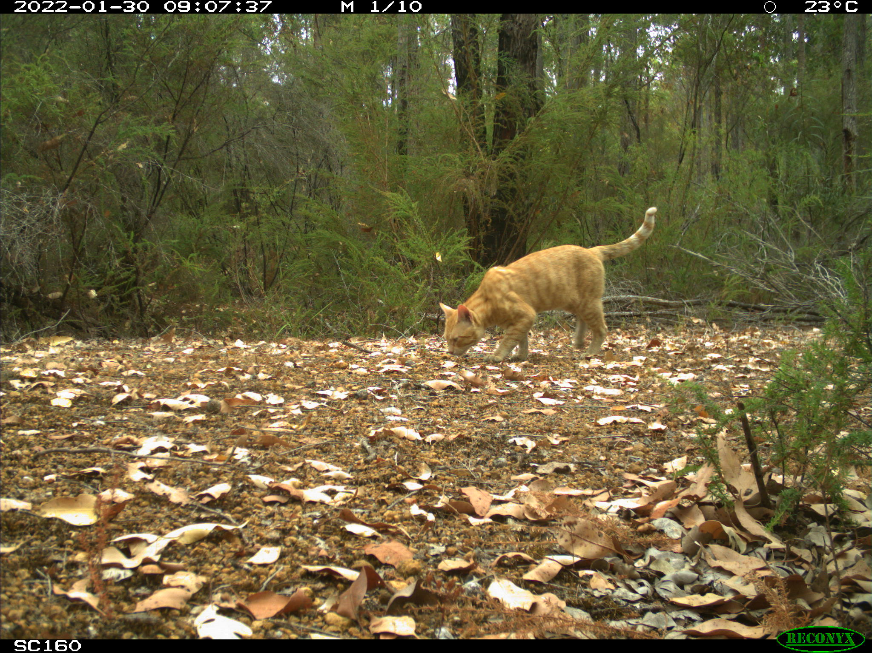
Machine Learning can identify cats
Target (8)
Snowy (7)
LM06 (5)
Eyebrows (1)
Pale tail(6)
Projection Y
Felix (2)
Circles (0)
LM05 (4)
Ginger (3)
Cat image data and visual IDs courtesy of DBCA (Marika Maxwell and Adrian Wayne)
Projection X
Lewis D’Antonio, Todd McWhorter, John Read, Stefan Podgorski and Ian Reid

Slide 27
Artificial intelligence (including Machine Learning) can distinguish:
Cats from wildlife
(Most) Individual feral cats by their patterns

Slide 28
Artificial intelligence (including Machine Learning) can distinguish:
Cats from wildlife
(Most) Individual feral cats by their patterns
But the future is even more exciting………

Slide 29
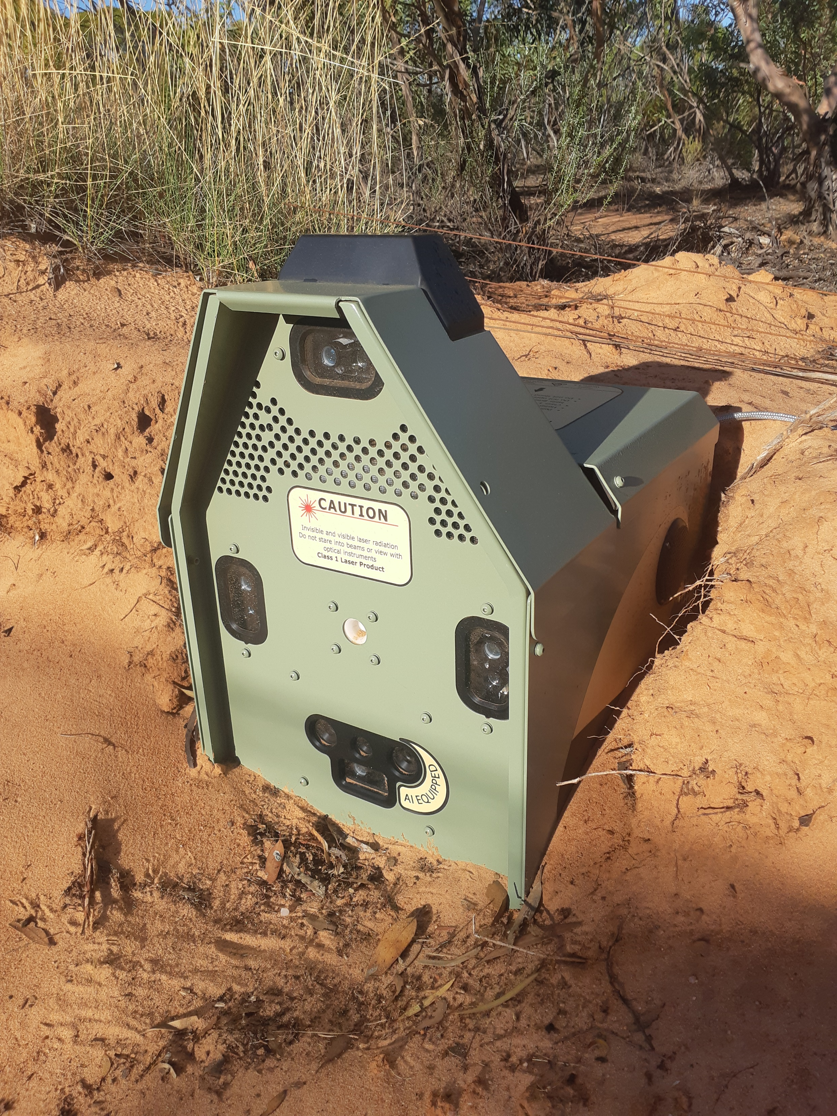
Bluetooth antenna and GPS
Felixer photo with ai and aerial cricled
EDGE AI camera 10 frames per second

Slide 30
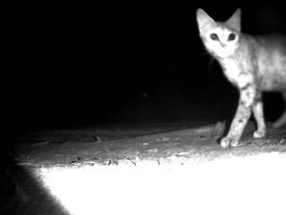
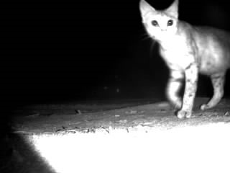
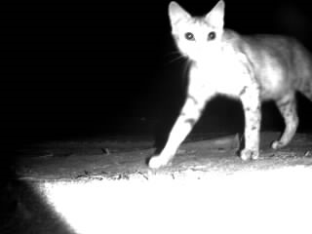
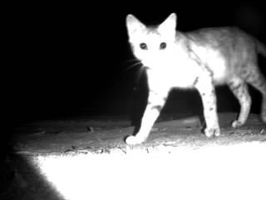
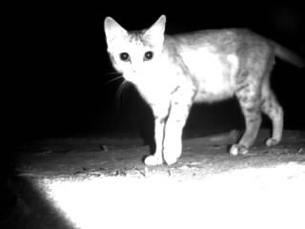

Slide 31
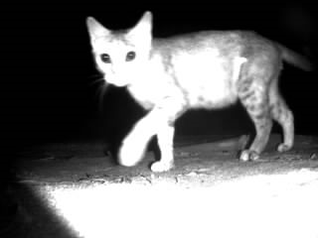
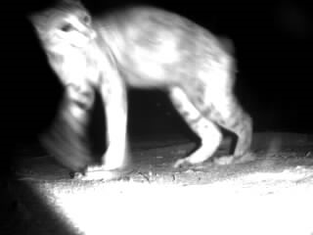
Frames per second provides:
more still images for AI (different angles)
enables gait to be used to distinguish individuals
Edge AI enables these identifications to trigger immediate management

Slide 32

24% of cats too fast or too angled to efficiently target with Felixers
0.5% False targeting is very low and within APVMA registration guidelines
Edge AI camera using multiple images improved targeting efficacy by 20% in first retraining

Slide 33
The ADIMA SafePet Solution
●Registered cats wear a council-issued
low cost, ultra-lightweight BLE tag
that is linked to microchip and
registration
●Council deploys base-stations at ‘cat free zones’ and
roving detectors (garbage trucks) used to detect nearby cats.
●Using ADIMA web-service Council can prove when registered cats stray without trying to trap.

Slide 34
The ADIMA SafePet Solution
●Registered cats wear a council-issued
low cost, ultra-lightweight BLE tag
that is linked to microchip and
registration
●Council deploys base-stations at ‘cat free zones’ and
roving detectors (garbage trucks) used to detect nearby cats.
●Using ADIMA web-service Council can prove when registered cats stray without trying to trap.
●Only councils and cat owners (via Bluetooth app) will
have access to private data on cat ownership and location
●Cat owners benefit through notifications (ultimately including health stats) about their cat and owners of lost cats can alert council to initiate additional searches.

Slide 35
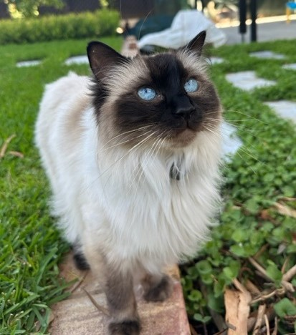
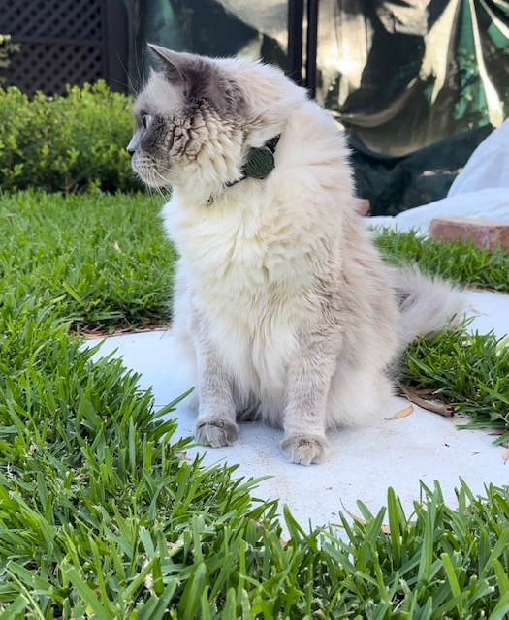

Slide 36
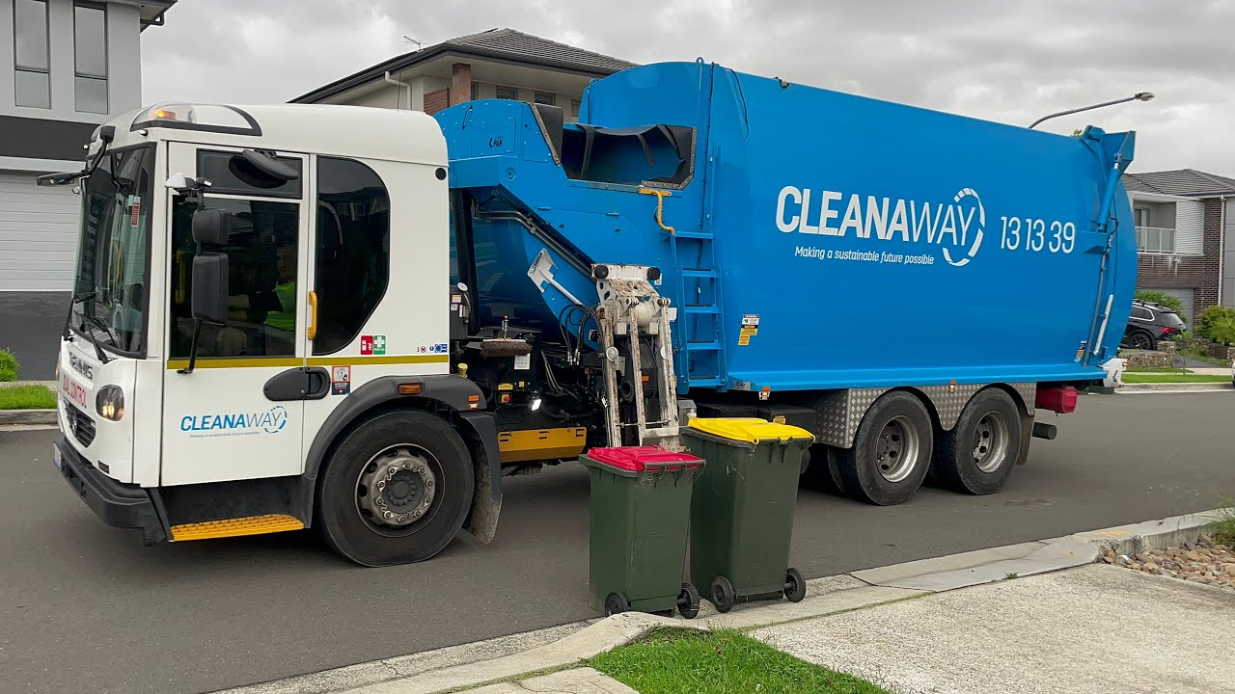
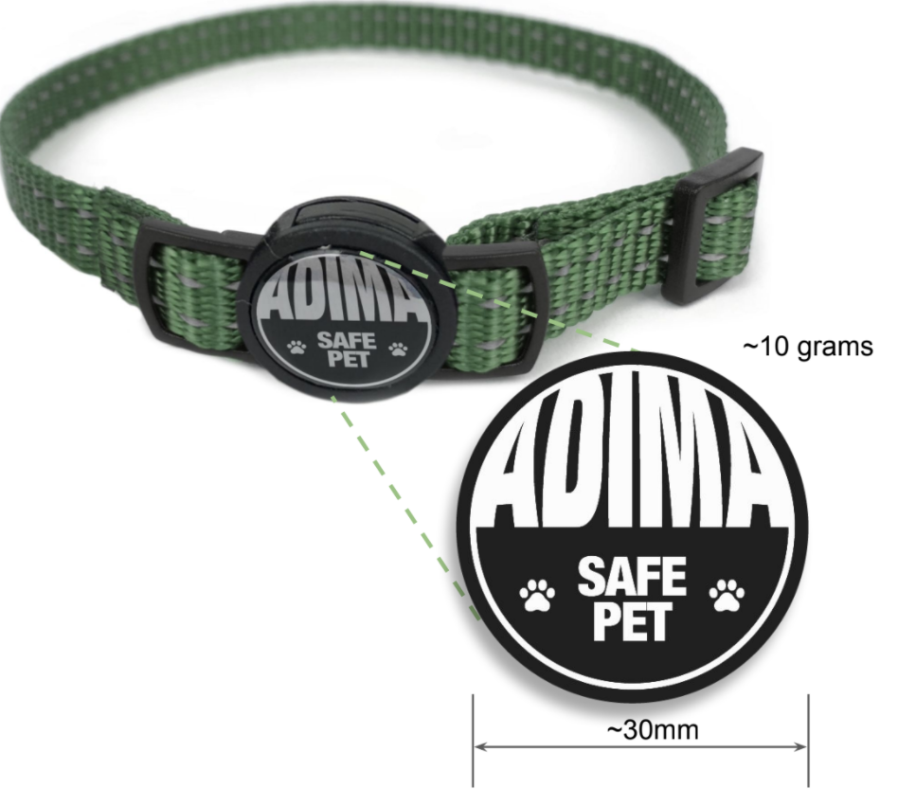
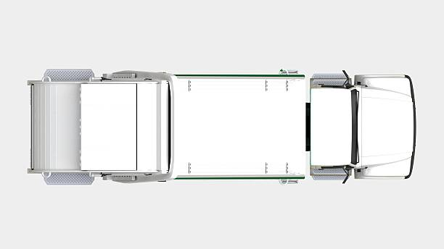
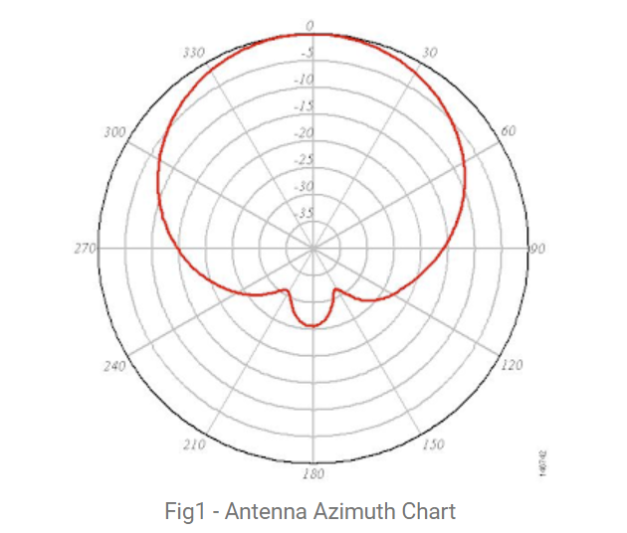
ADIMA-V1.0 Principle of Operation
Directional 2.4GHz directional antenna (~30-60 deg 3dB beam width) is mounted on ranger vehicles or garbage truck. This detects tags to the left side of the vehicle. This is to reduce the size of the detection zone as well as to detect tags reliably within most suburban blocks of land.

Slide 37
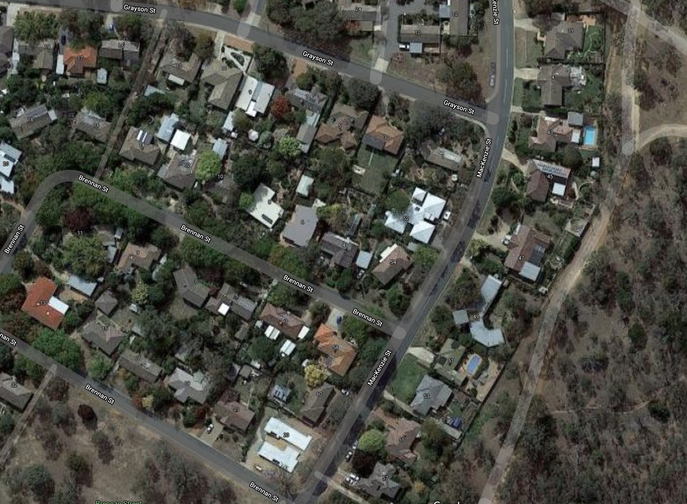
ADIMA-V1.0 Principle of Operation
Example showing stray pet detection
Pet’s registered address
Detection region, does not overlap
Base-station / vehicle location
Detection regions can be calculated using vehicle location, direction of travel, GPS fix accuracy, antenna pattern and received power.
Repeat detections from different vehicle locations within a short time period, can also be used to triangulate and reduce the region dimensions.
Detection accuracy may also (potentially) be improved by incorporating topography, vegetation and structure density data.
Lat -35.252324811946536
Lon 149.167518549268
Error 5m
Vel 4.72m/s
Bearing 28.4°
ADIMA ID 3567205
Rx -56dB
Batt 2.98V
Temp 38.1°
Concept illustration only to explain how algorithm may determine if any animal is stray (single detection).

Slide 38
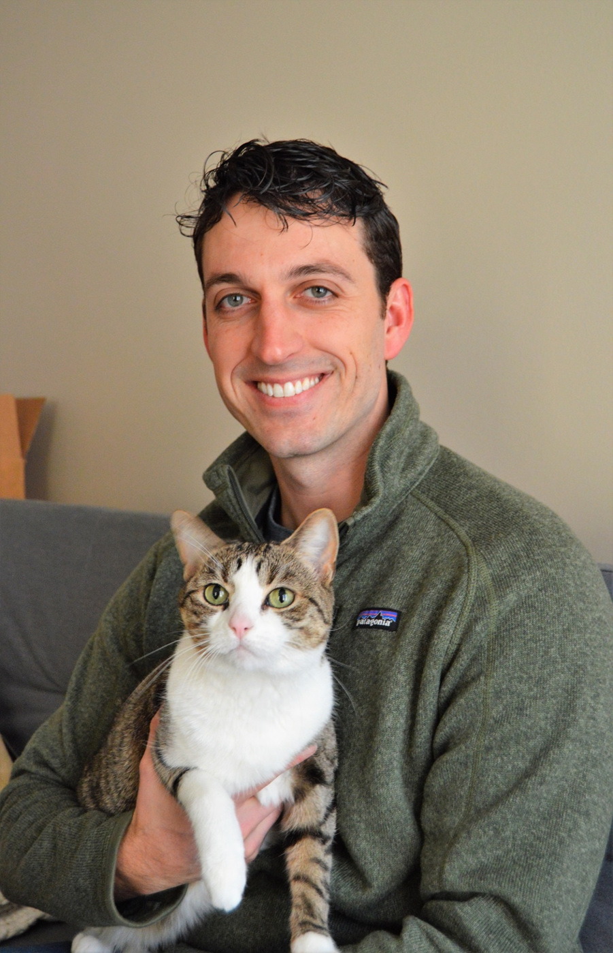
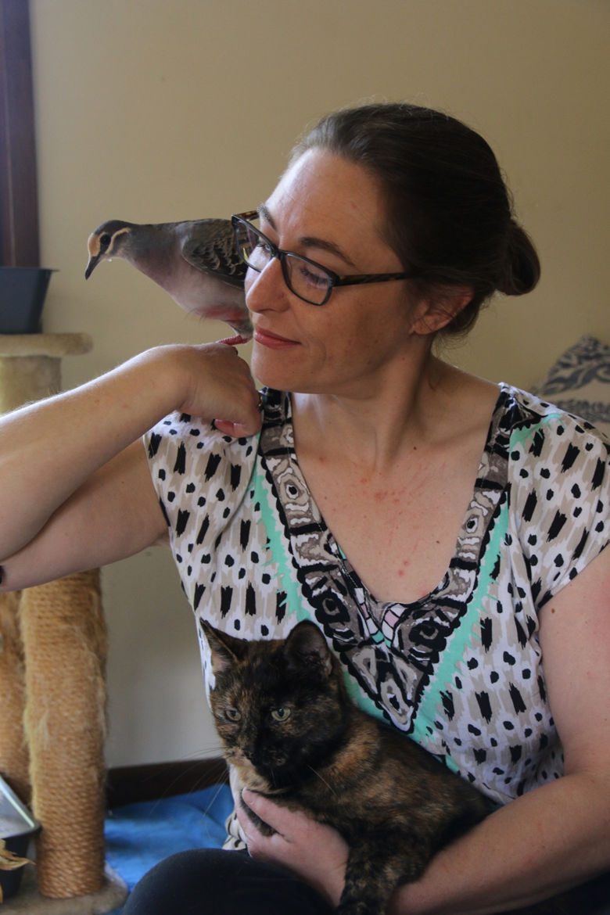
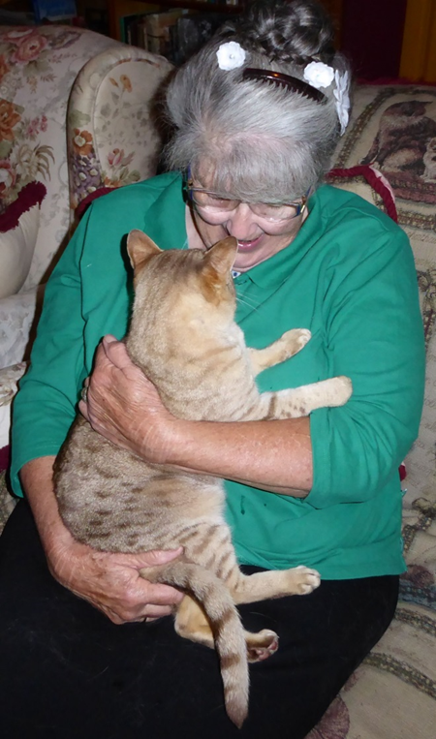
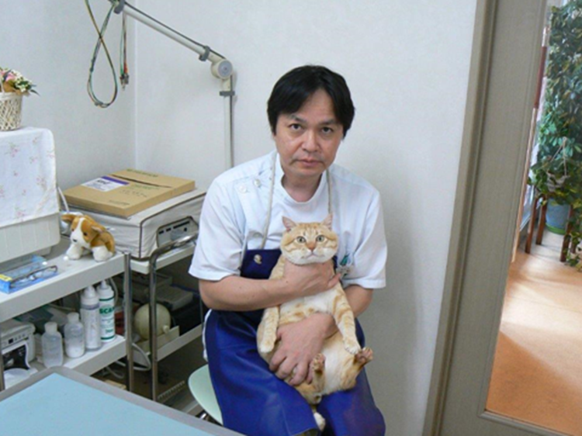

Cat carers want better management of owned and unowned cats too

Slide 39

Individual recognition enables differentiated management of cats
TARGET_PHOTO

Slide 40
Individual recognition enables differentiated management of cats
TARGET_PHOTO
80% confident no collar
40% confident not distinctive local pet
60% confident it is bandicoot killer
100% confident no rego tag

Slide 41

Individual recognition enables differentiated management of cats
TARGET_PHOTO
80% confident no collar
40% confident not distinctive local pet
60% confident it is bandicoot killer
100% confident no rego tag
TARGET_PHOTO_BLOCKED

Slide 42
Take home message
X
Take the ‘F’ out of WAFCWG!

Slide 43
Take home messages
Individual cats (pet, stray and feral) vary in appearance, behaviour, risk and response to management tools

Slide 44
Take home messages
Individual cats vary in appearance, behaviour, risk and response to management tools
Adaptive (including individualised) and diverse management required for eradication and optimal sustained control (because cats learn!)

Slide 45
Take home messages
Individual cats vary in appearance, behaviour, risk and response to management tools
Adaptive (including individualised) and diverse management required for eradication and optimal control
Pet cats can/should be distinguished from strays and ferals to enable management of unowned cats

Slide 46
Thankyou

Slide 47
Caveats
Conservation, animal welfare and human health benefits should be motivation and key deliverables of cat management, not dead cats.
Management of habitats (herbivores, fire) and key cat food (rabbits, rodents, refuse) are typically at least as important as removing cats.
Empowering responsible cat owner wishes (safety, welfare, aesthetics, management) needs to be key driver of policy and technology.

Slide 48


