Slide 2
We acknowledge and pay respect to the Whadjuk people of the Noongar Nation - the traditional owners of the country on which we gather today, as well as to all First Nations people and their country – the land on which we work and live.
We respectfully acknowledge their connection to native wildlife, waters, country and culture.

Slide 3
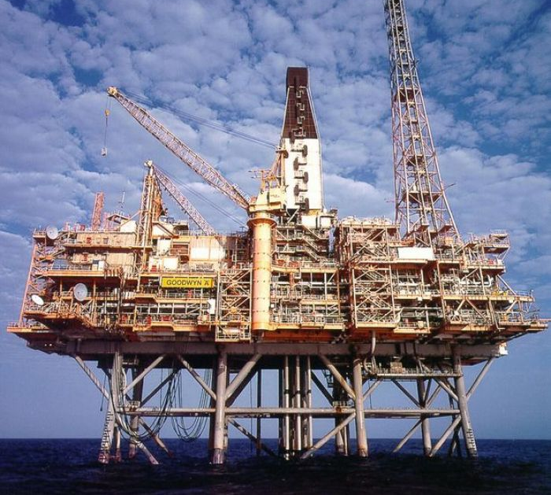
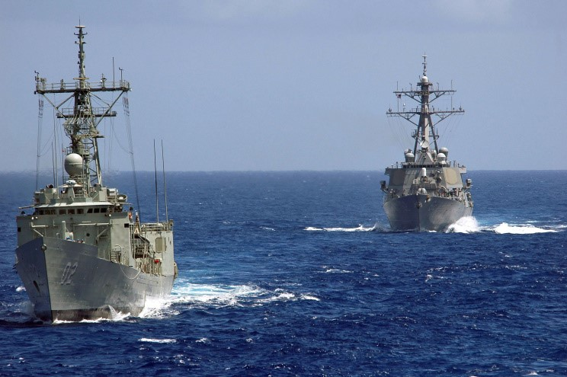
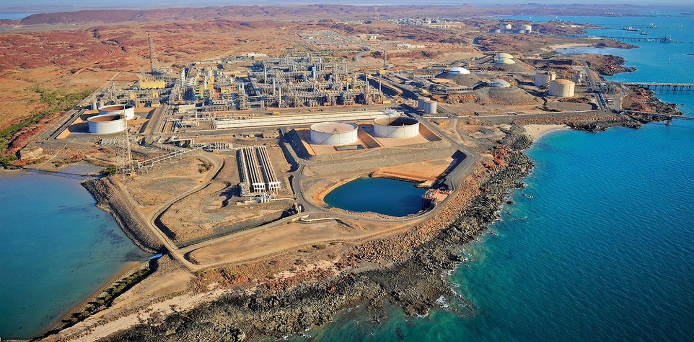
My natural habitat up to 2011 …

Slide 4
‘How dare you accuse cats of killing our wildlife. What proof do you have?’
AWC Facebook, c.2012
‘We should feed these feral cats …’
SBS Insight Program, c.2013
‘These cats are different to domestic cats’
AWC Facebook, c.2012

Slide 5
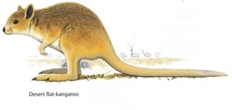
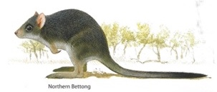
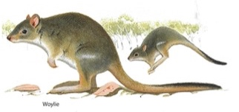
Wildlife continues to decline and go extinct
Number of species listed as threatened
under federal legislation
EXTINCT
ENDANGERED
ENDANGERED

Slide 7
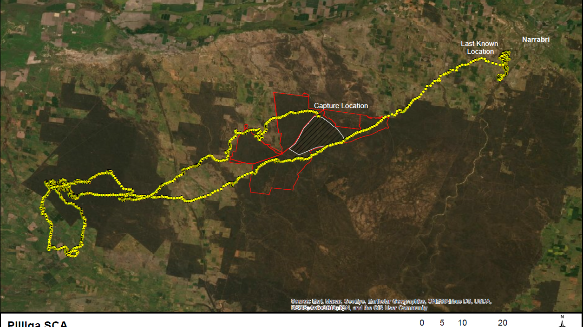

Slide 8
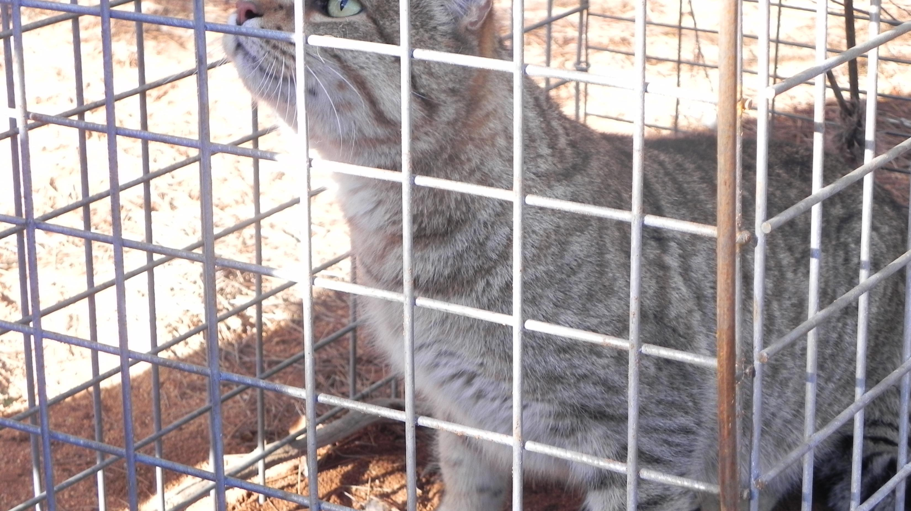
‘Bloody cats should be eliminated …’
AWC Facebook, c.2016 ‘Australia declares war on feral cats …’ Washington Post 2015

Slide 9
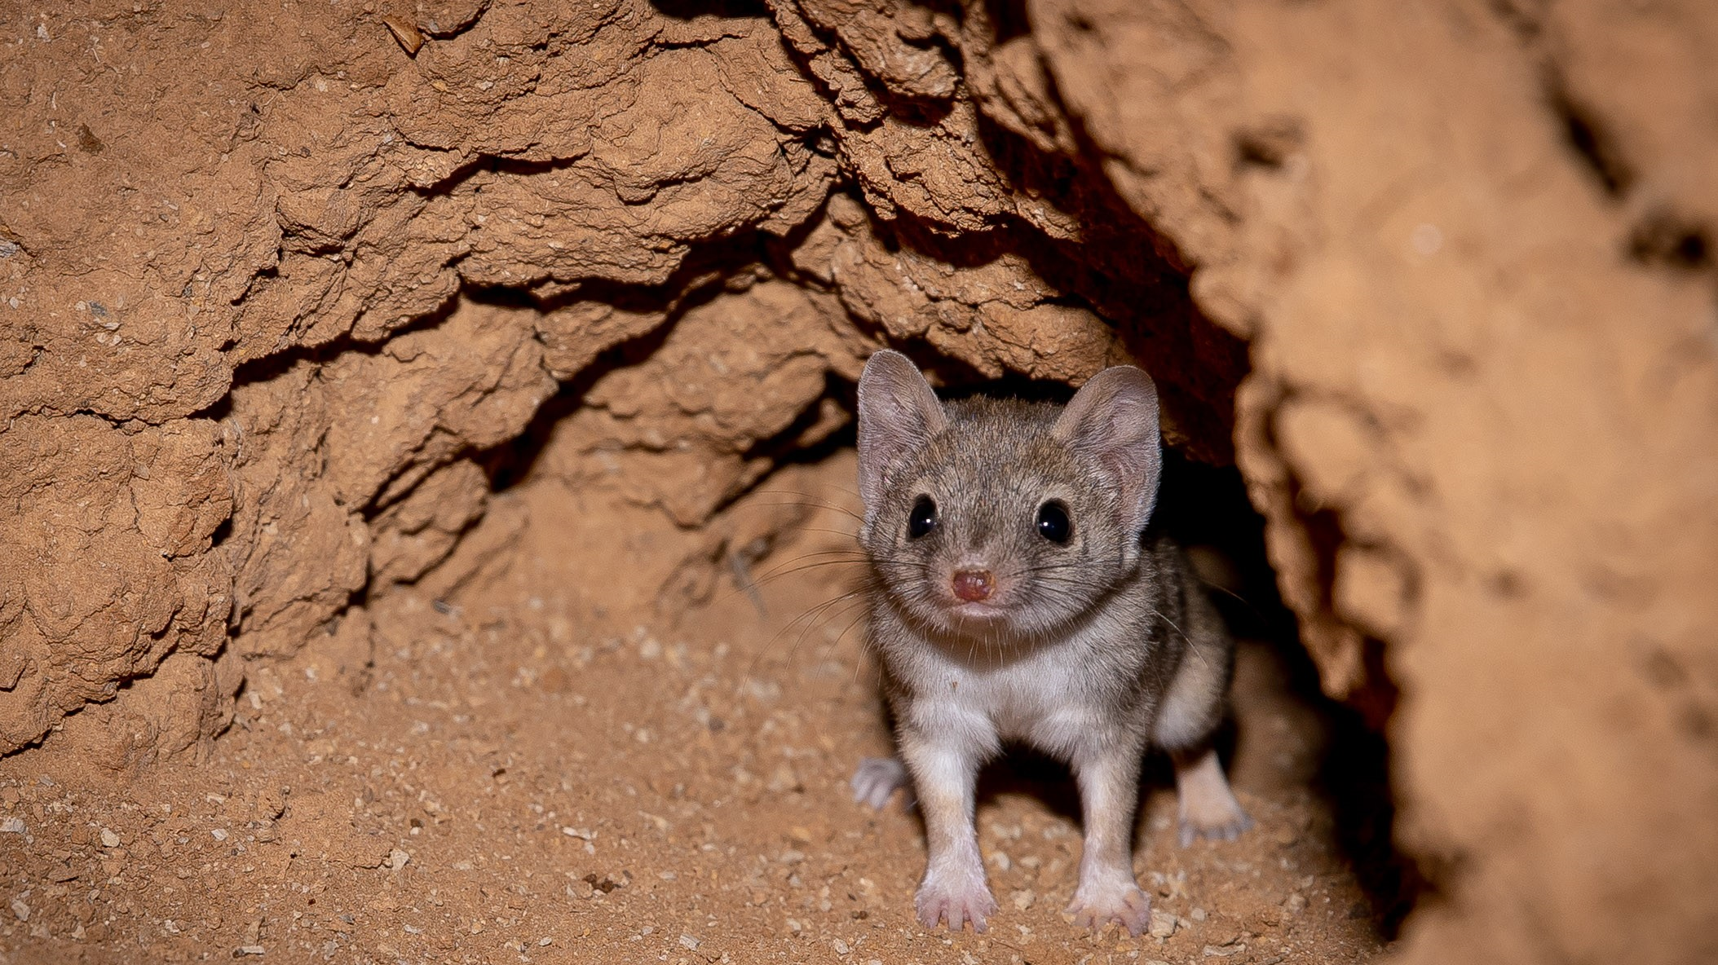
Choices

Slide 10
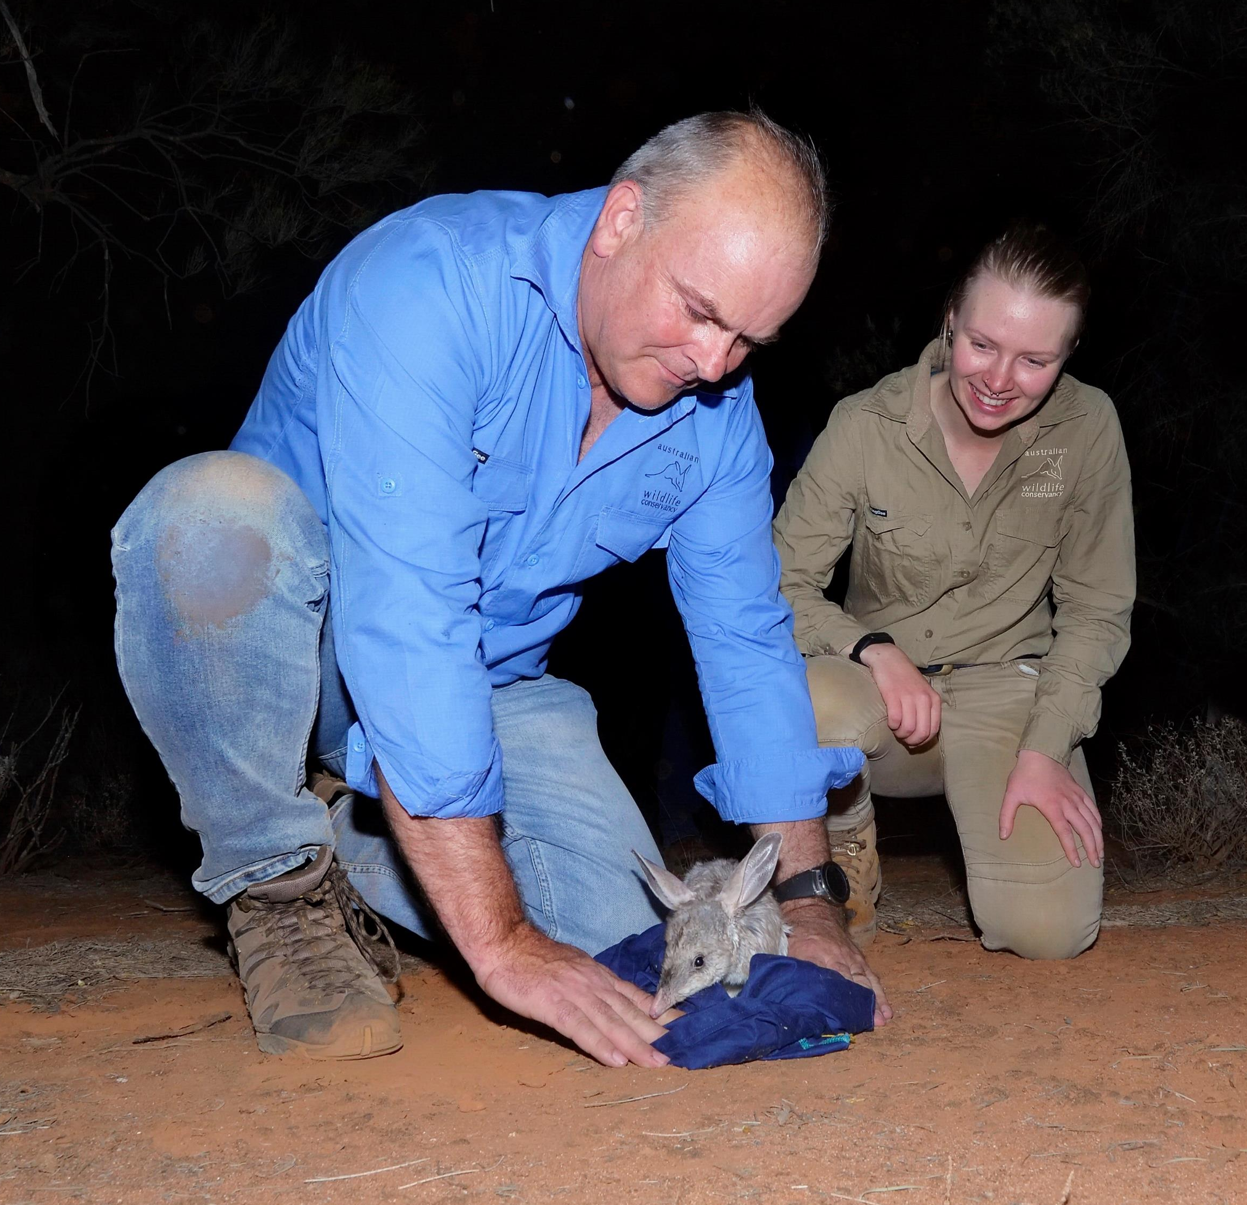
So, whilst this is good …

Slide 11
This is better ...

