Slide 1
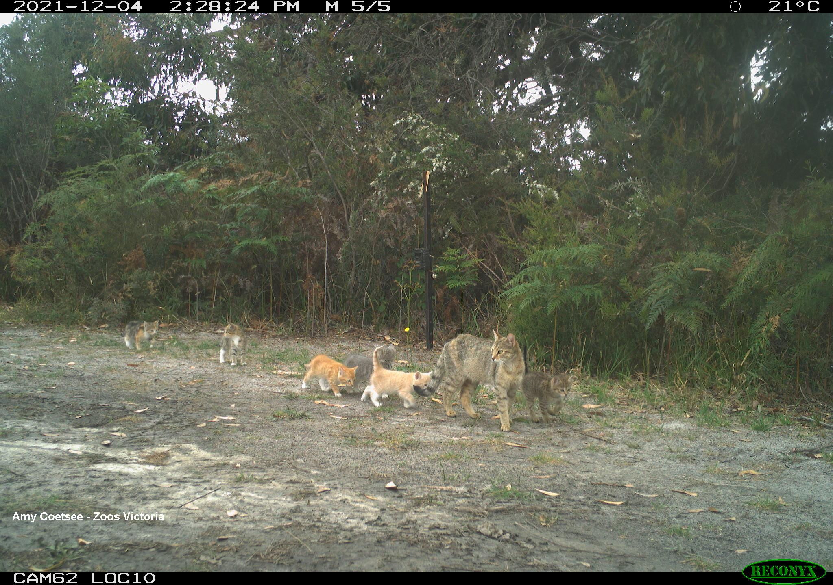
Setting the scene for failure:
Victorian feral cat legislation, social license dimensions and the French Island feral cat eradication project.
Michael Johnston
Zoos Victoria
Notes:
Good Afternoon All.
I acknowledge the Traditional Owners of the lands where we are meeting and also the Bunurong / Boonwerong people of the Kulin Nation who include French Island within their Traditional Territory. This presentation is intended to provide a brief overview of the Victorian situation as it applies to feral cats.

Slide 2
Notes:
The Victorian Government declared feral cats to be a pest species that must be controlled in July 2018.
Prior to this, control was undertaken using “seizure” powers under the Wildlife Act 1975. There was intensive work at some sites but many conservation sites didn’t bother.
The recent Declaration and access to the more effective tools is tied to specific land tenure, being only applicable to National Parks, some Crown land, Alpine resorts and PINP.
CLICK –
The Victorian Government recognizes that feral cats have a major impact on Victoria’s biodiversity and are one of the most significant threats to our native wildlife.

Slide 3
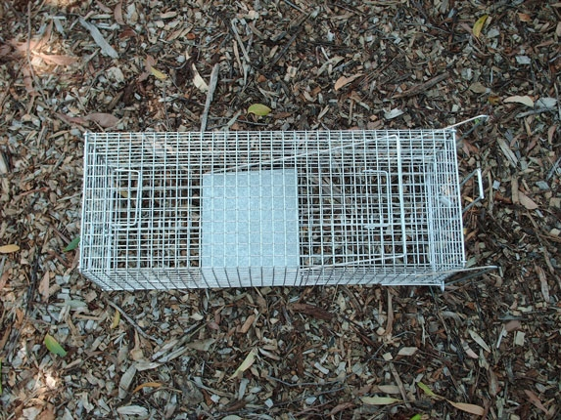
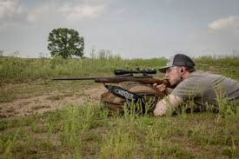
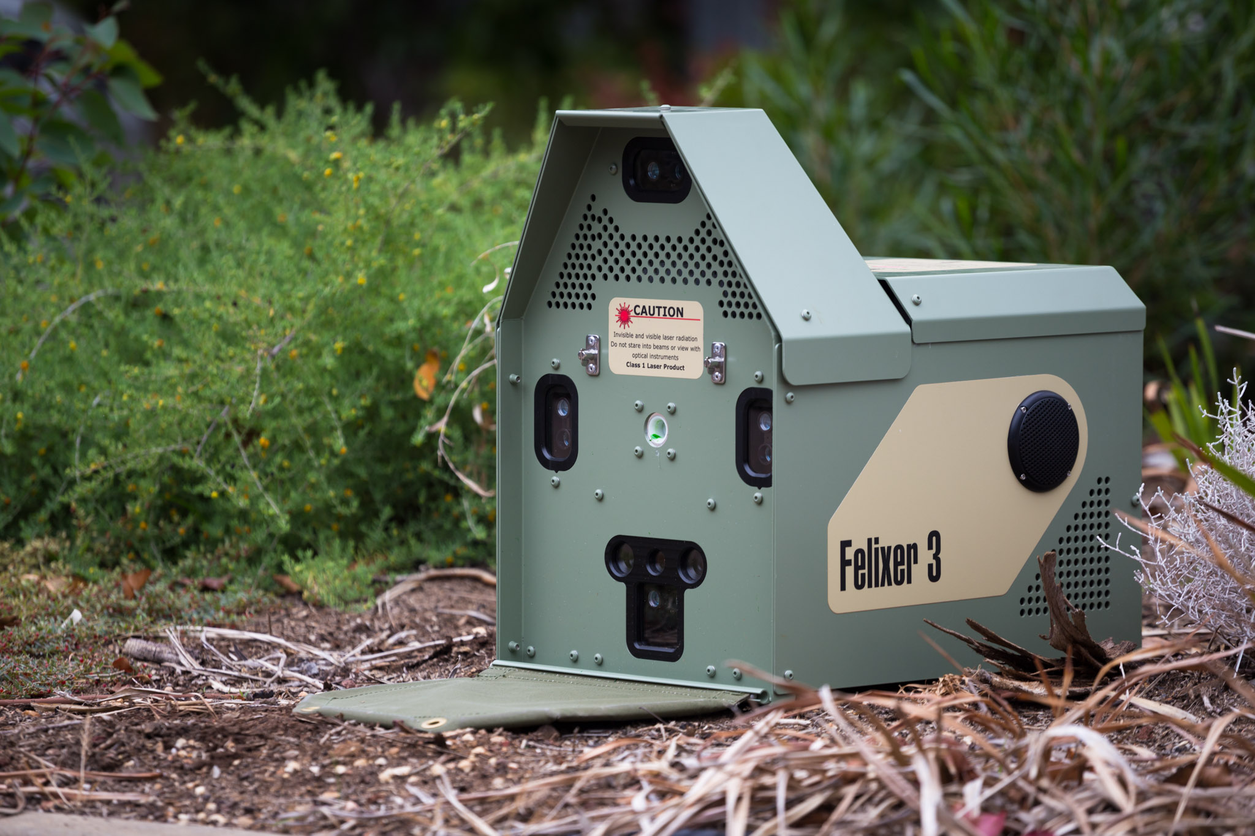
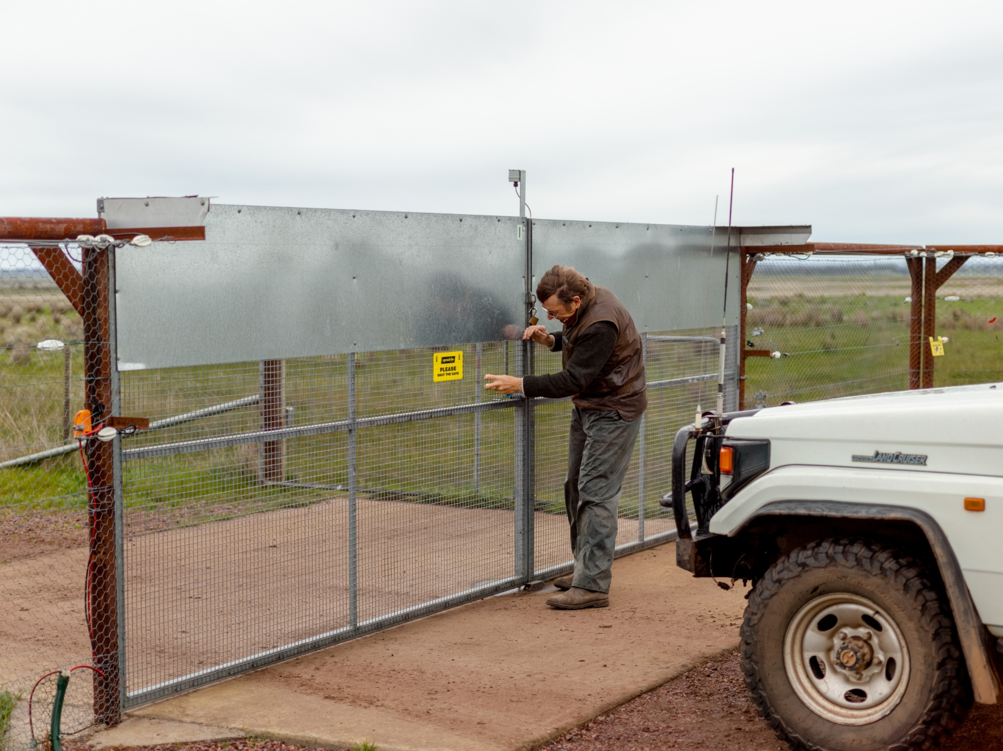
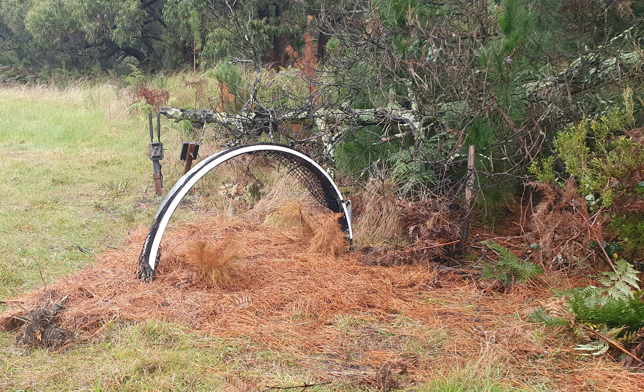
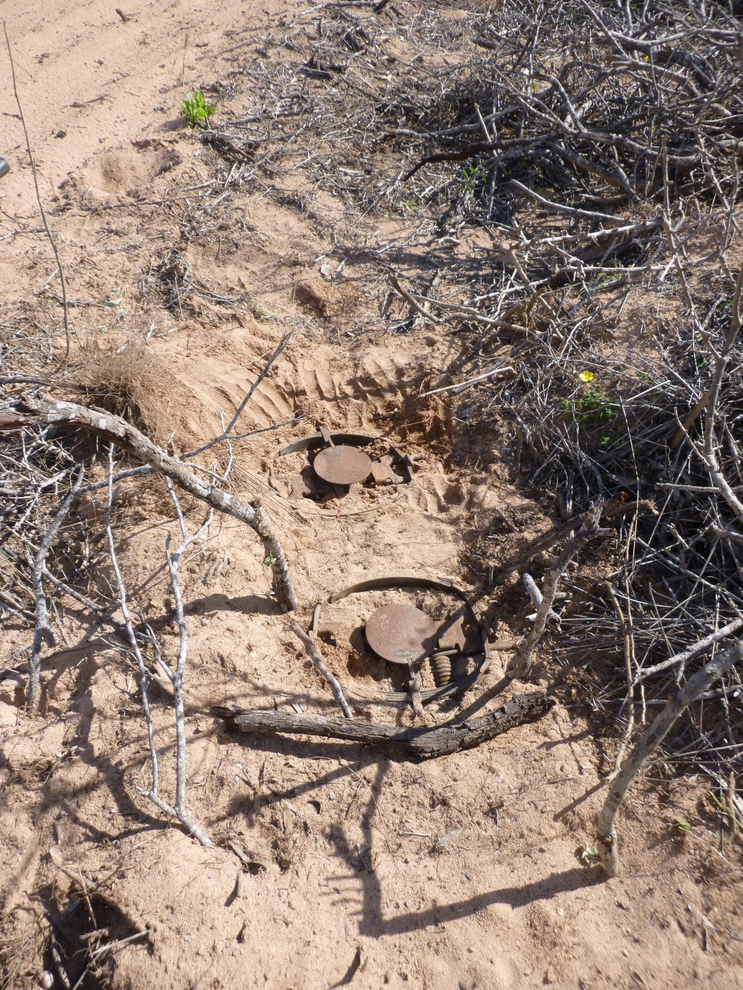
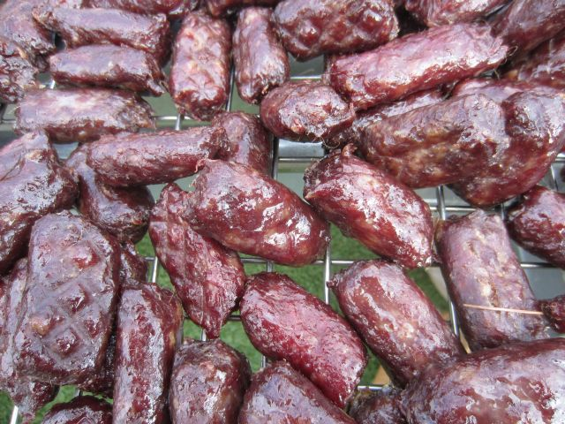
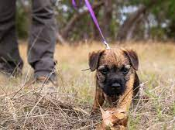
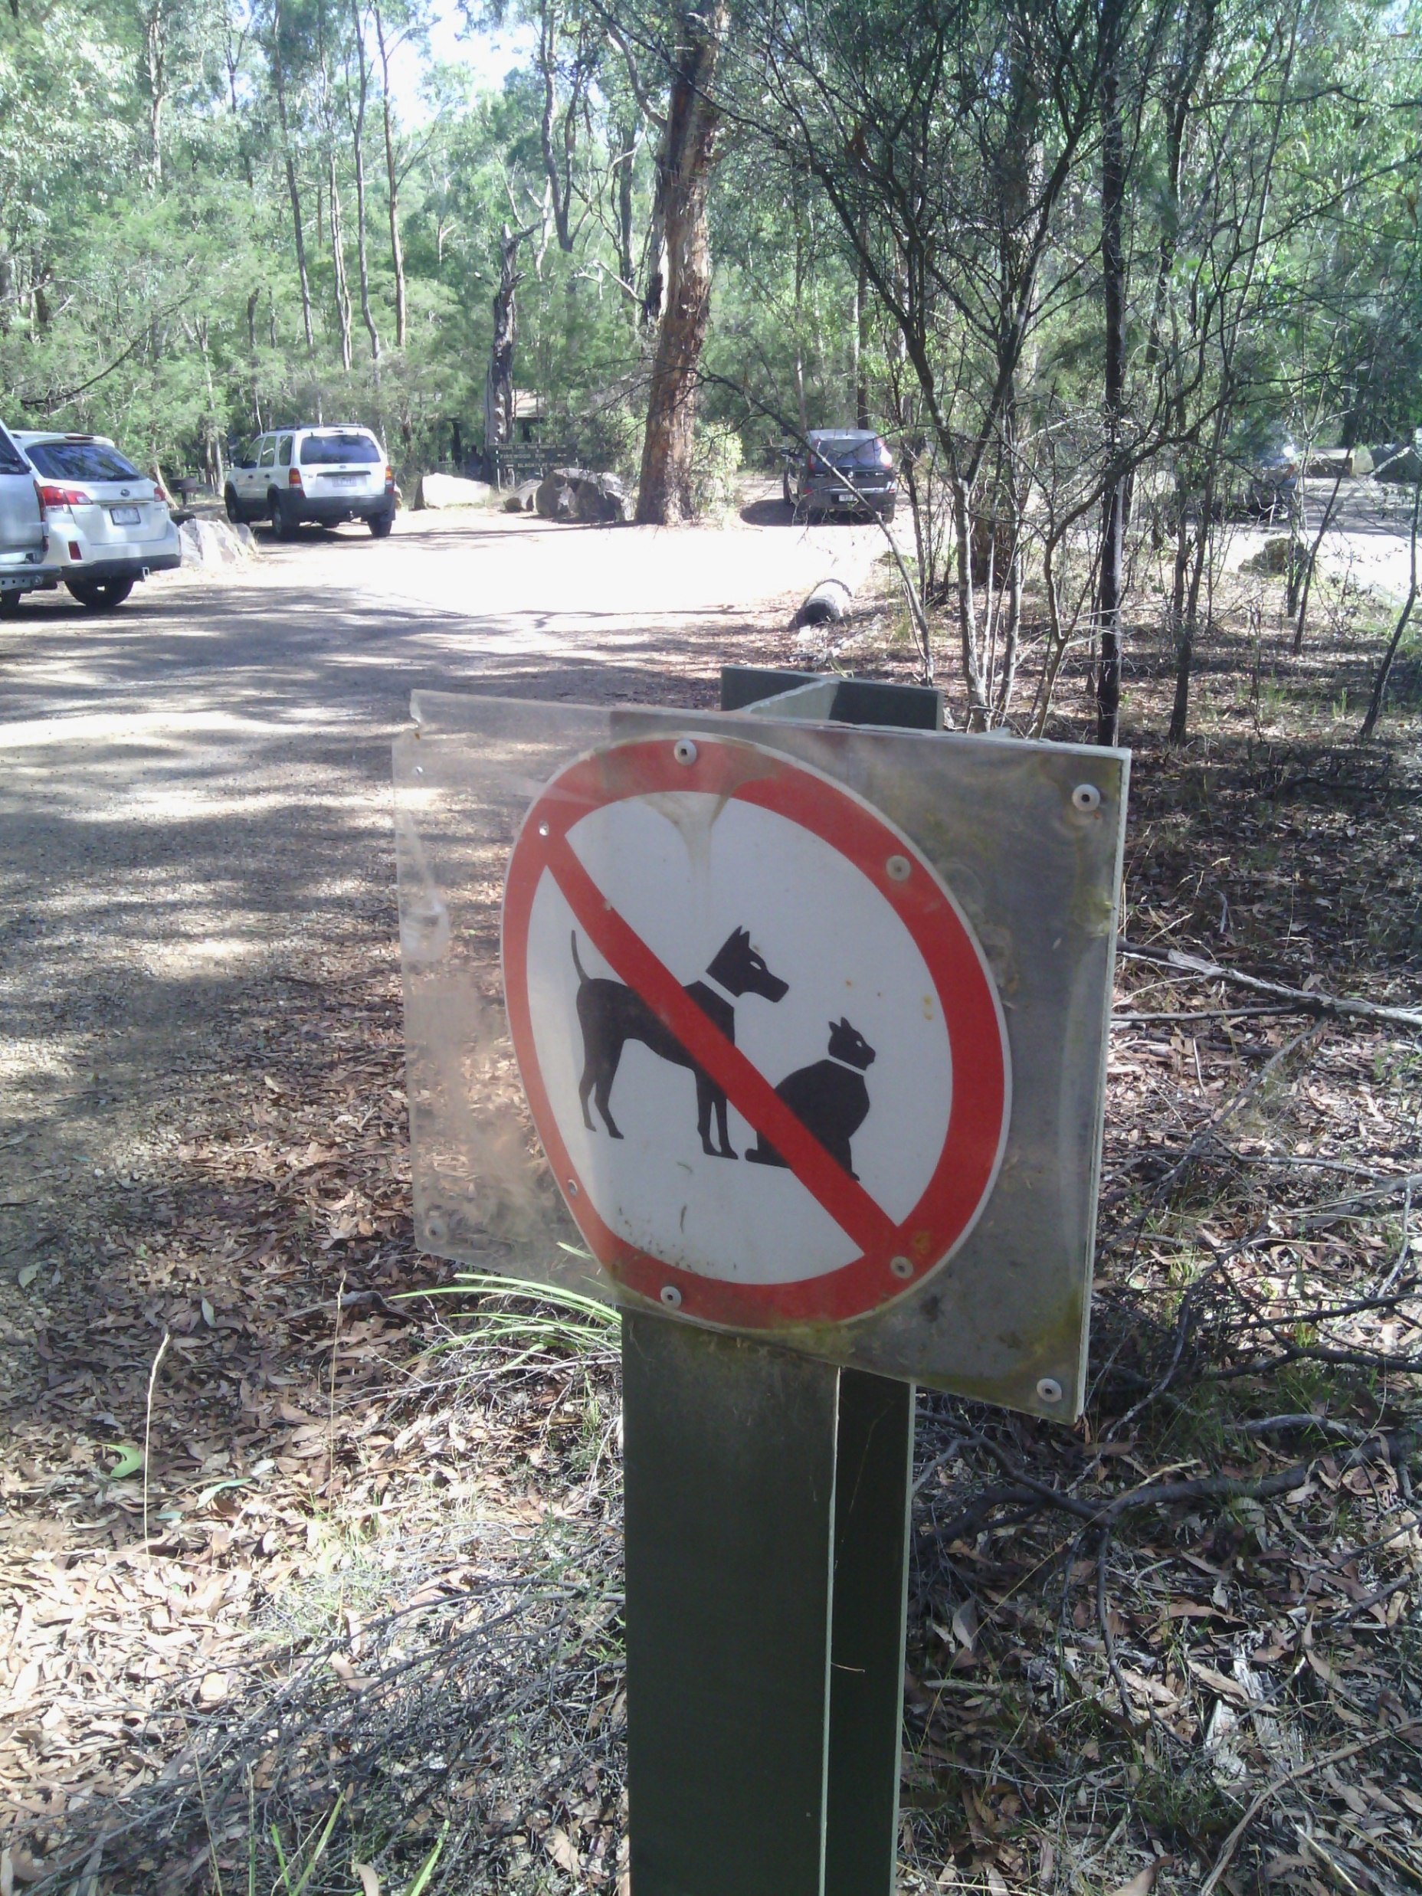
Johnston et al. (2020). When Cats turn bushranger: a case study of policy and planning a pest eradication. The Victorian Naturalist, 137(6), 228-239.
Notes:
This decision tree is my attempt to visualize access to tools available to Victorian land managers and was reviewed by key policy staff from relevant agencies before publication.
CLICK
Outside of the feral cat declaration areas – cage traps, authorised shooting, fencing and installation of signage can be used.
Within declaration areas, conservation land managers can also use ;
Detection / Bailing dogs – although there are few legitimate suppliers.
Curiosity Bait (PAPP) – is registered for use in Victoria but subject to time consuming risk assessment before each use. Despite the developmental work being largely undertaken on French Island, and two previous bait applications, it still took us months to get a permit for the 2022 baiting operation.
Hoop traps – are a prototype device that is obviously less invasive than other capture tools but policy specifies 4 hour trap inspections
LH traps – Only available to sites working towards eradication outcome – i.e. just French Island.
Felixer – can only used in Camera Only Mode as 1080 is not a supported pesticide for feral cats in Victoria.
The limitations on access to tools has undoubtedly reduced the efficacy and ecological outcomes achieved in Victoria’s feral cat management and threatened species recovery & translocation programs – Leadbeaters possum and EBB are primary examples. I’d argue that the care that goes into threatened species is not matched by State’s invasive species policies with a distinct gap between website promotions and operational delivery.

Slide 4
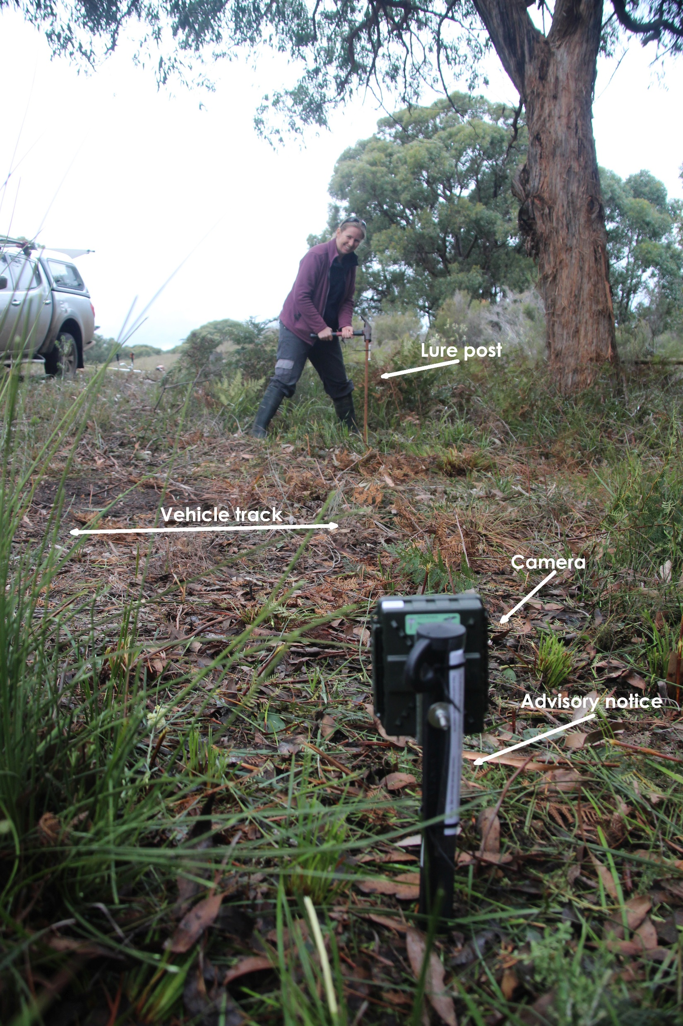
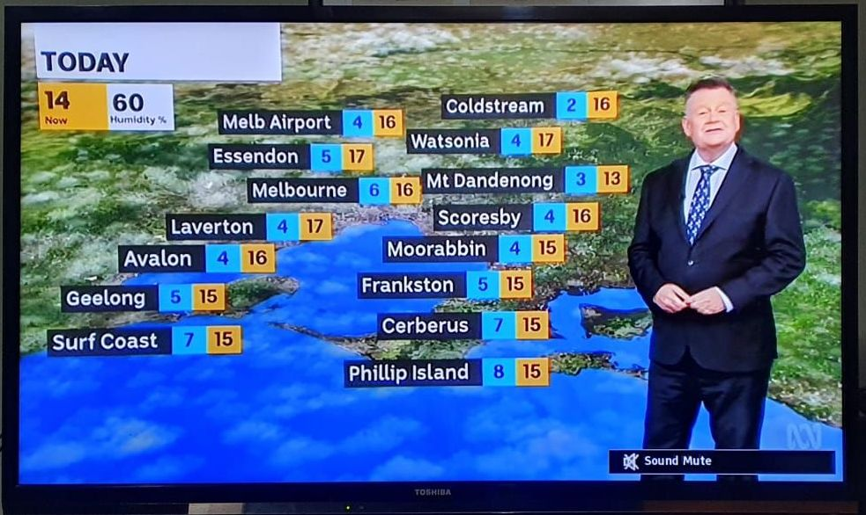
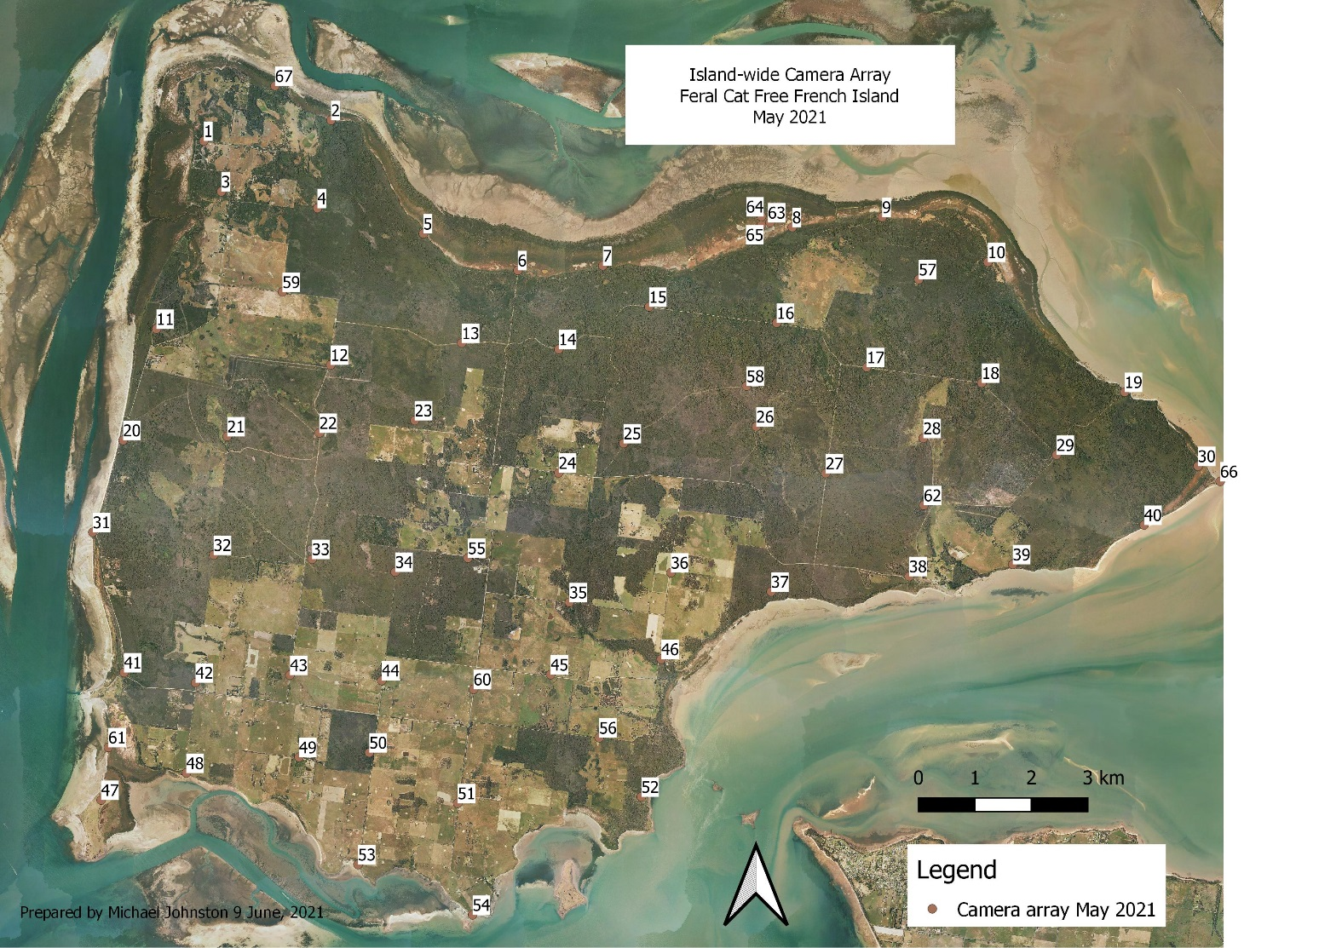
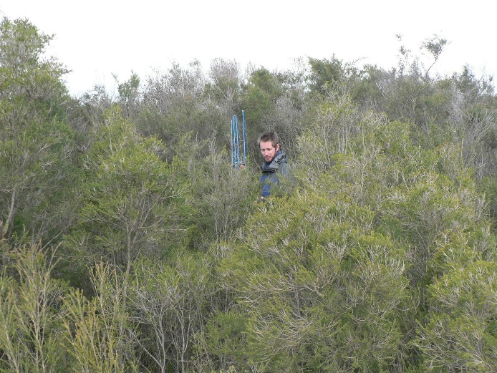
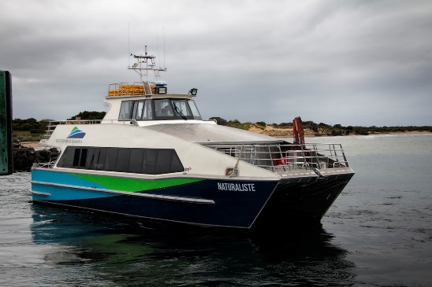
French Island
Notes:
Bringing us to French Island, the island is on the TV every night but likely that most people in Melbourne have never heard of it, let alone visited.
It is only 70 km SE Melb
170 sq km / 2021 census = 139 people
No local government - impacts domestic animal regulation
2/3 National Park / Freehold
Dense heath vegetation and extensive fringing saltmarsh
34 threatened fauna species.
Landcare installed a camera array 2018 that has operated continuously since

Slide 5
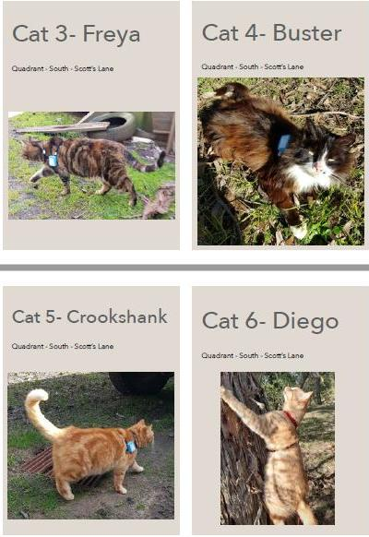
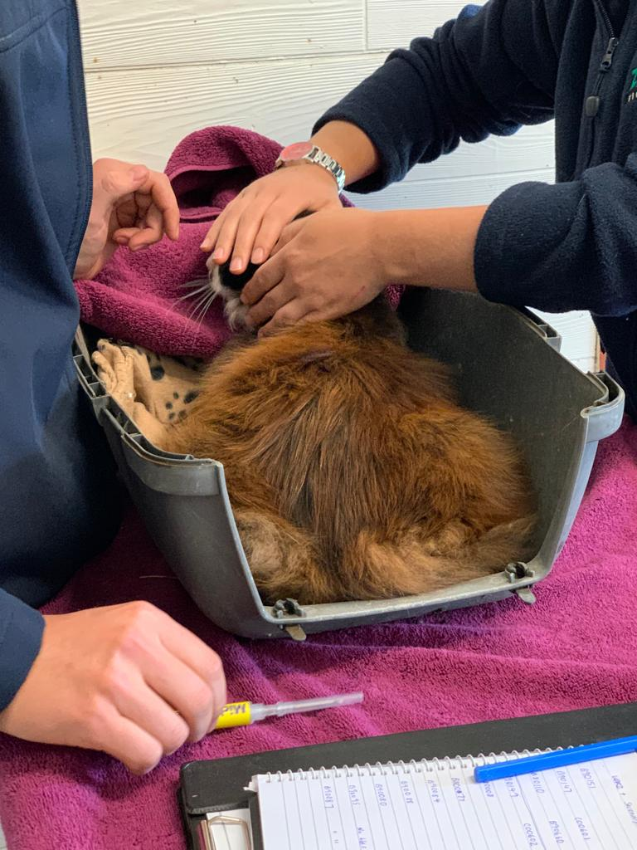
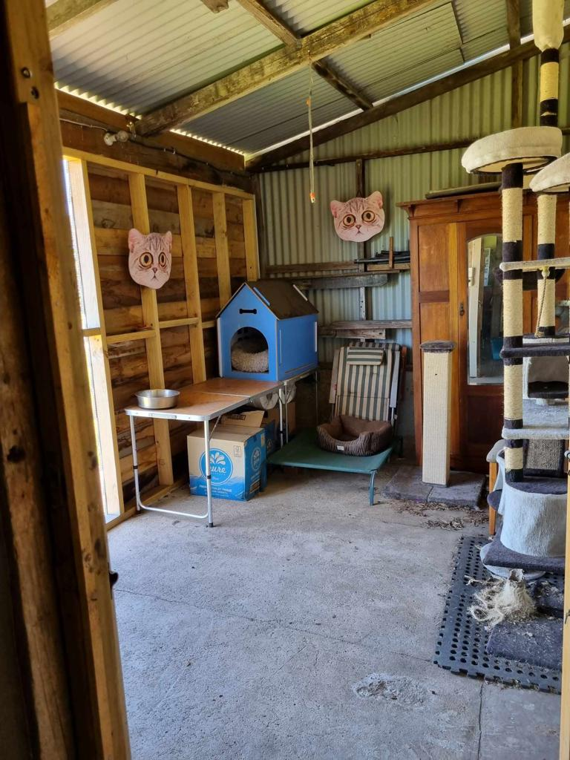
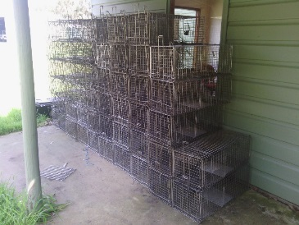
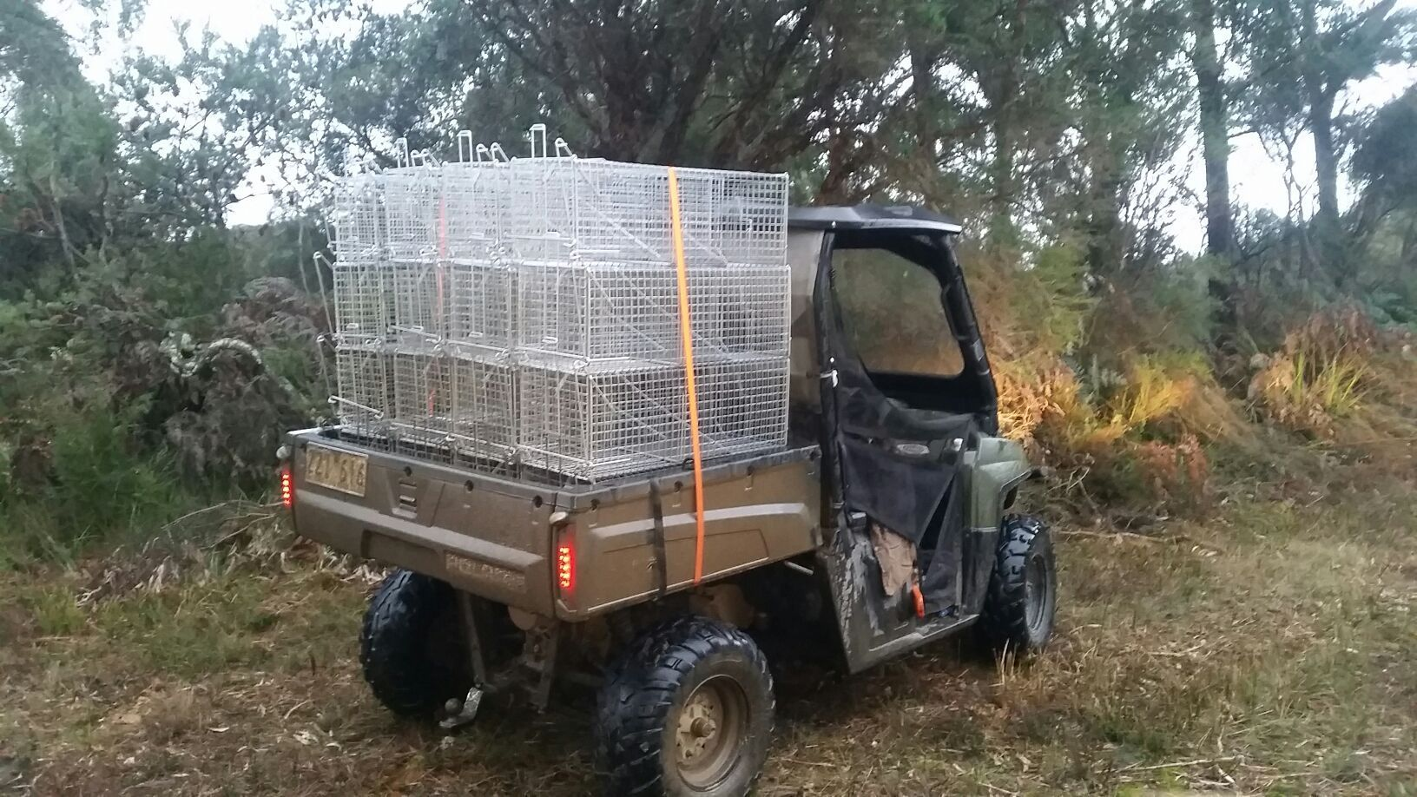
Population suppression (2010 – 2020)
Notes:
Parks started feral cat trapping 2010.
FILG started 2012.
80 -100 traps per night over 16 weeks using KFC as lure. 1200 cats removed.
CLICK Throughout that decade – Responsible Pet Ownership program. Sterilise, microchip and contain. (No ability to stop new cats from arriving)

Slide 6
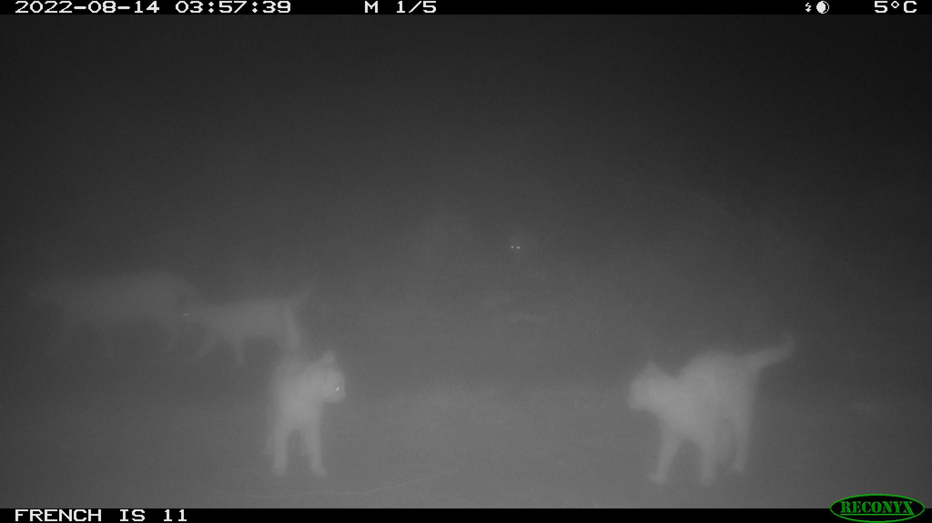
Eradication operation 284 days (2021 – 2022)
Notes:
The Eradication effort began in June 2021 after 3 years of regulatory change.
Baiting within the National Park provided the initial knockdown and followed up with follow-up LH and cage trapping across the island. Some shooting effort over summer.
The improvement in ability to remove feral cats is largely due to LH traps – well above the stagnating capture success with earlier cage trap-only effort.
On 22 July 2022, the Project Control Board stopped the use of LH traps due to concerns about the rate of capture of wildlife species. In my opinion, this was the end of eradication level effort – violated the established rules for eradication operations.
Trapping contractors left. My position was terminated.
CLICK 14th August – we got this photo.
Additional cage trap effort over two months resulted in the capture of 0 cats.
Thermal drone / shooting effort finally supported.

Slide 7
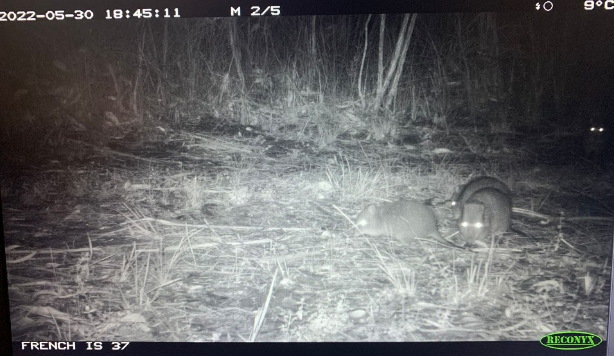
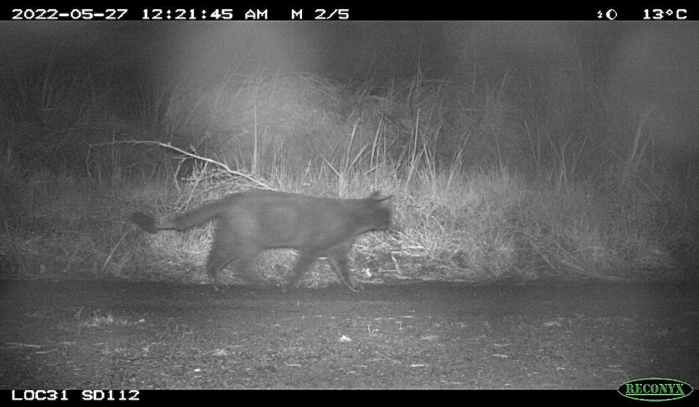
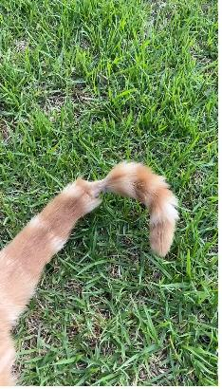
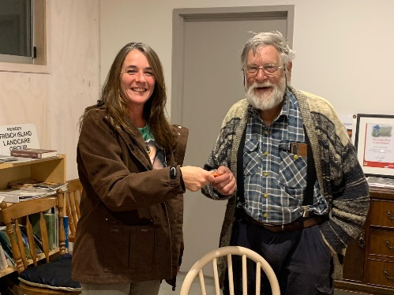
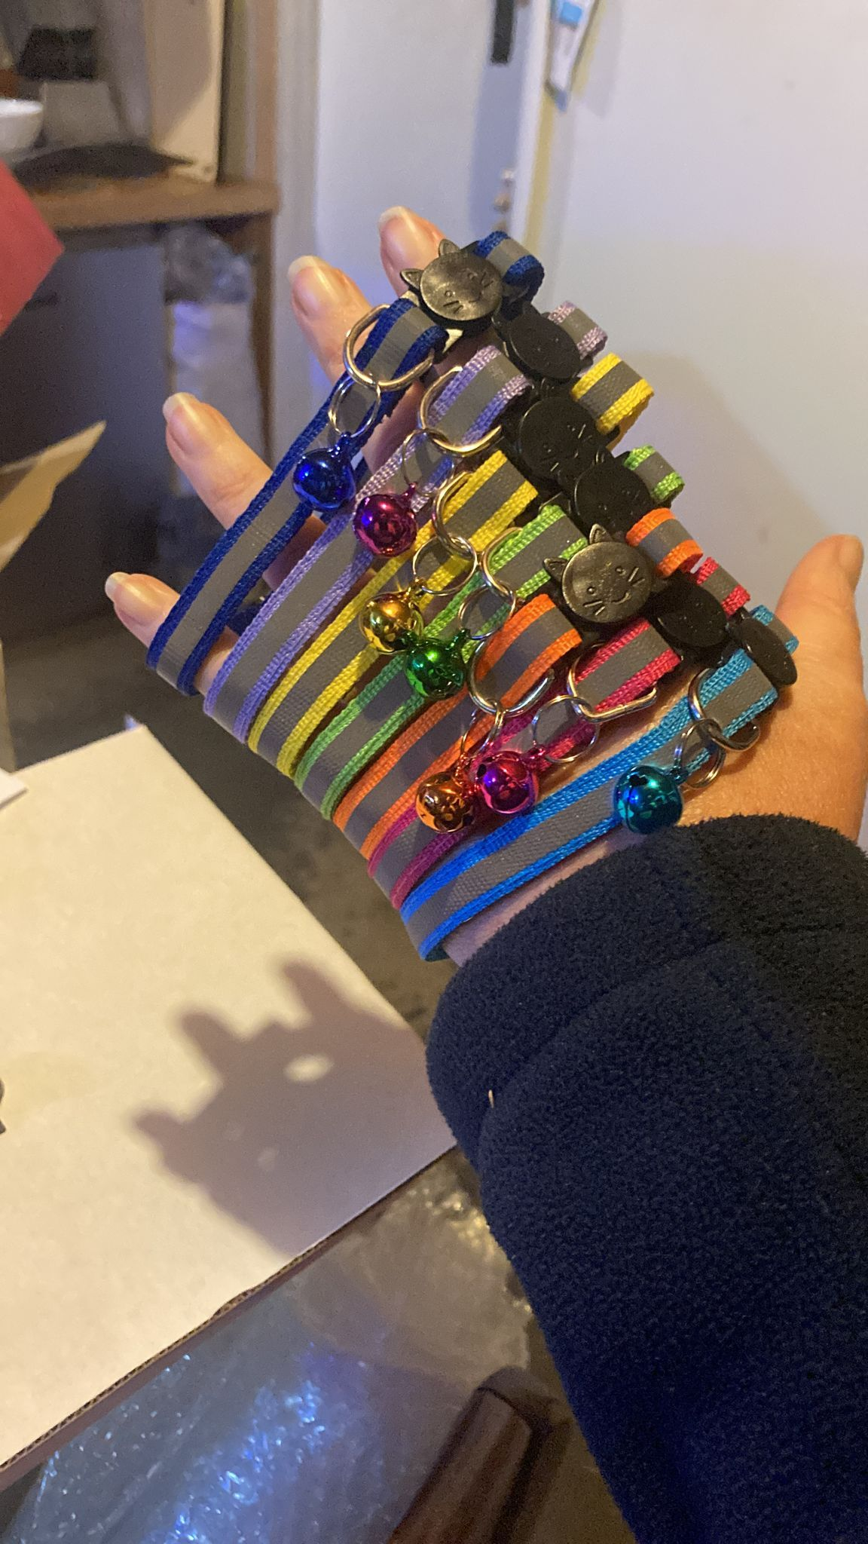
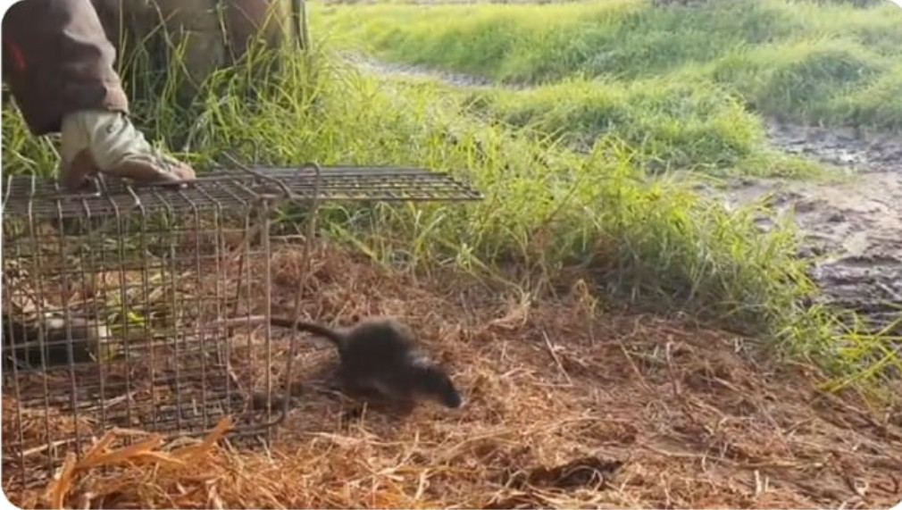
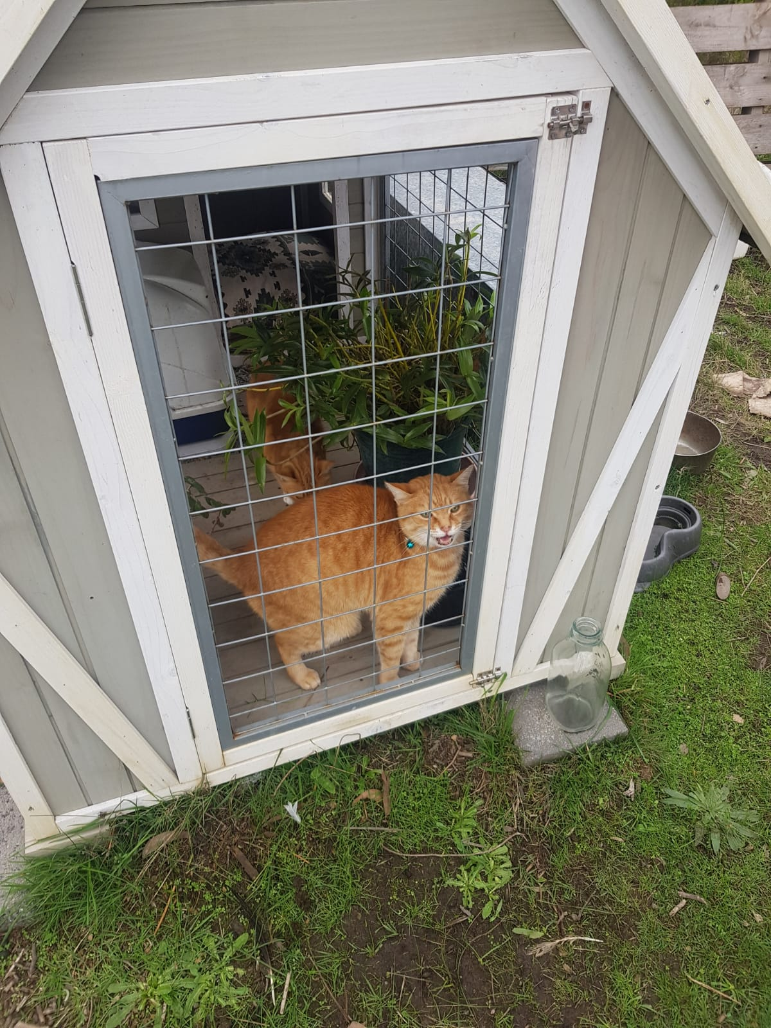
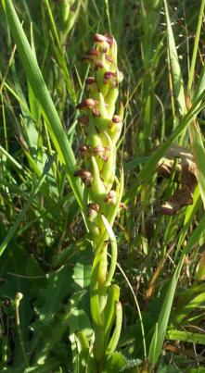
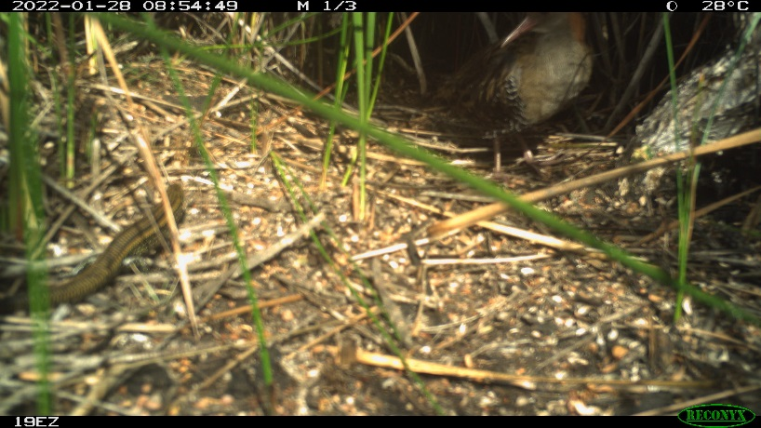
Success
Liz Znidersic
Notes:
Key wins from the project are;
the degree of community engagement and support for cat sterilisation, identification. >60% of private land was accessible to the project. All carrots, no sticks.
Biodiversity response – potoroo, Lewin’s Rail, rakali and much more – anecdotal reports of suppression of invasive plants linked to increased potoroo abundance.

Slide 8
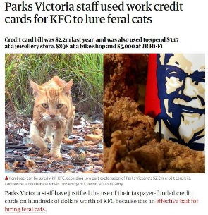
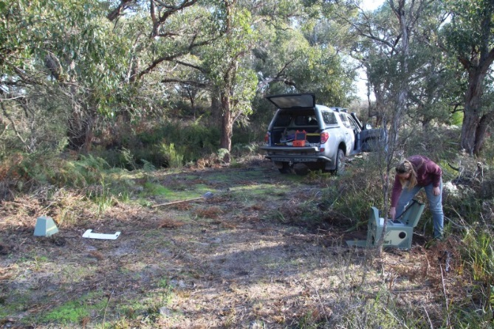
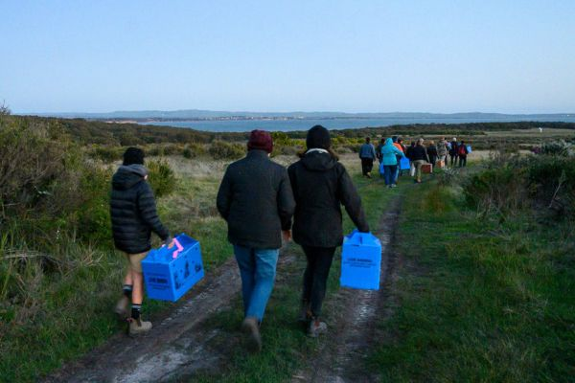
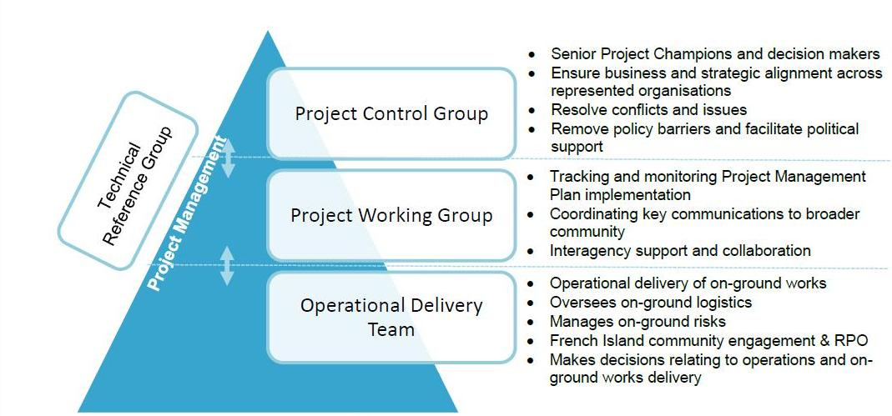
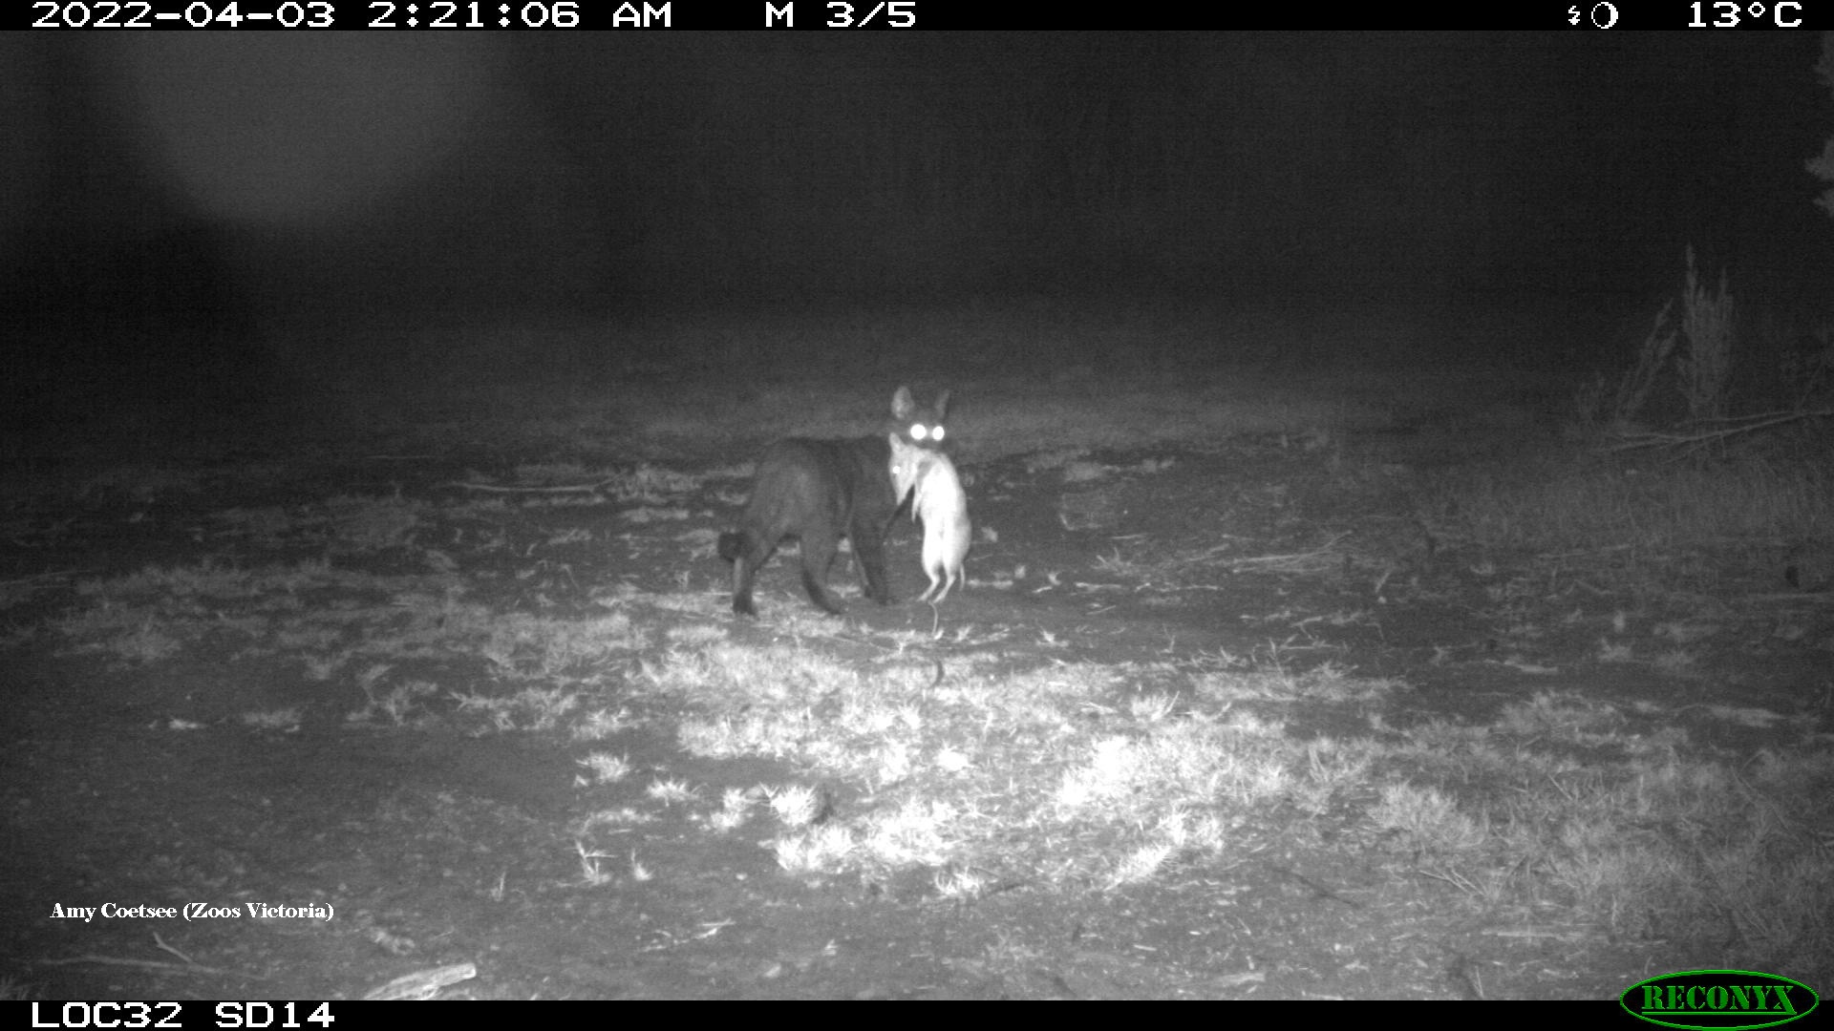
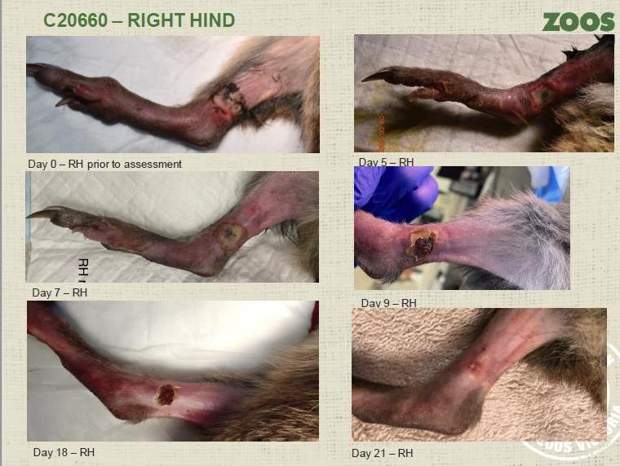
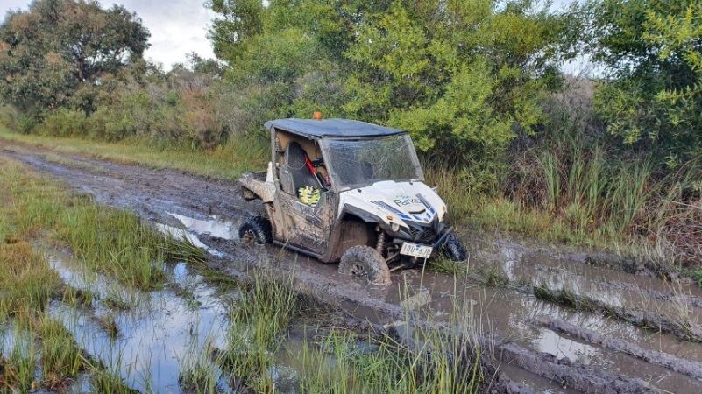
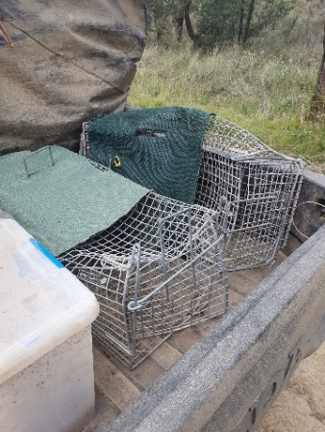
Challenges
Zoos Victoria
Notes:
Internal policies added unnecessary frustration and complication – illogical nuisances such as inability to purchase of cage trap lure and operation of drones in the park.
The release of Bandicoots ahead of the cat eradication confounded efficient cat removal in the release site.
Felixer – was used in 2019. Non-target hazard understood, no potoroos would be targeted. Not a silver bullet.
Local issues. Weather. Vandalism.
PCG – did they remove policy barriers? Were they excited about a successful outcome?
Technical reference group – highly experienced island restoration specialists provided expertise when requested. They were formerly advised about removal of LH traps 54 days after it happened. No contact since.
Potoroo captures. We tried various set designs to reduce capture. This species responded to favourable environmental conditions and reduction in predation pressure. People will have different attitudes to what is acceptable loss and would the population recover again once cats were eradicated.
There was likely <30 feral cats remaining at the end of July 2022. Pressure on the feral cat population was removed when the win was in sight.

Slide 9
Acknowledgements
Cat Team: Simon Pahor, Mark Geyle, Jack Trezise, Michelle Bass, Dave Caldwell, Rod Brindley, Ian Saunders, Roddy Sinclair, Hamish Sinclair, Brad Orszaczki, Brad Blake, Paddy Roth, Rose Ralston, Vaughn Thompson
Project support: French Island community, Julie Trezise, Linda Bowden, Corinne Mays, Andrew Morrison, Naomi Davis, Penny Fisher, Duncan Sutherland, Michael Towsey, Peter Voutier, Peter Wilcock, Tim Allen and local Parks Victoria staff.

