Slide 1
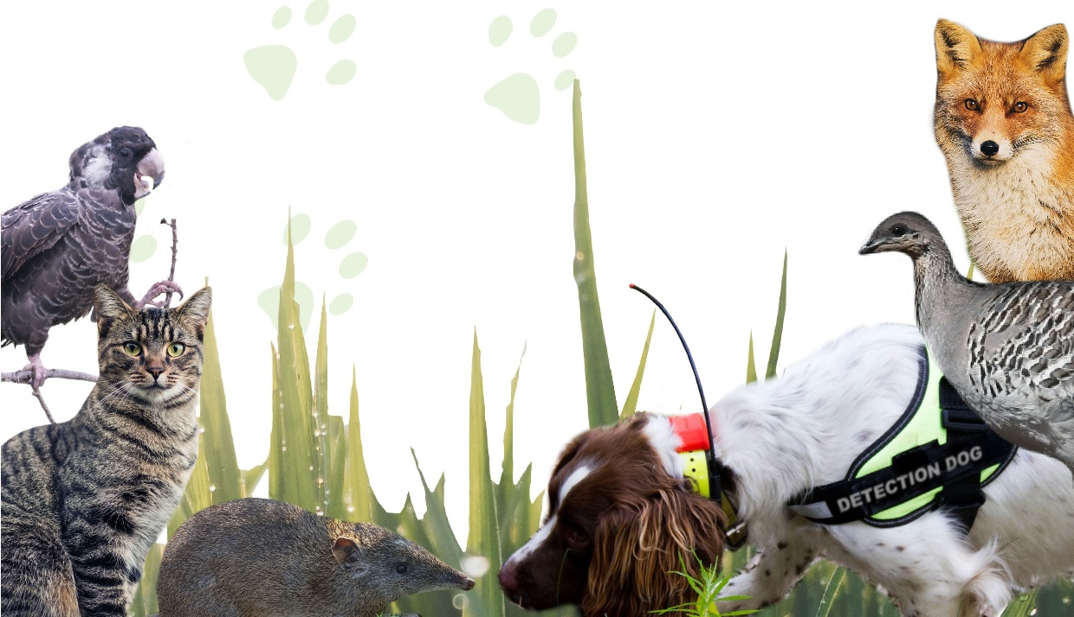
Using the data to better manage foxes in urban and peri-urban areas
Feral cat management and environmental approvals
Dr Graham Thompson
Dr Scott Thompson
Terrestrial Ecosystems

Slide 2
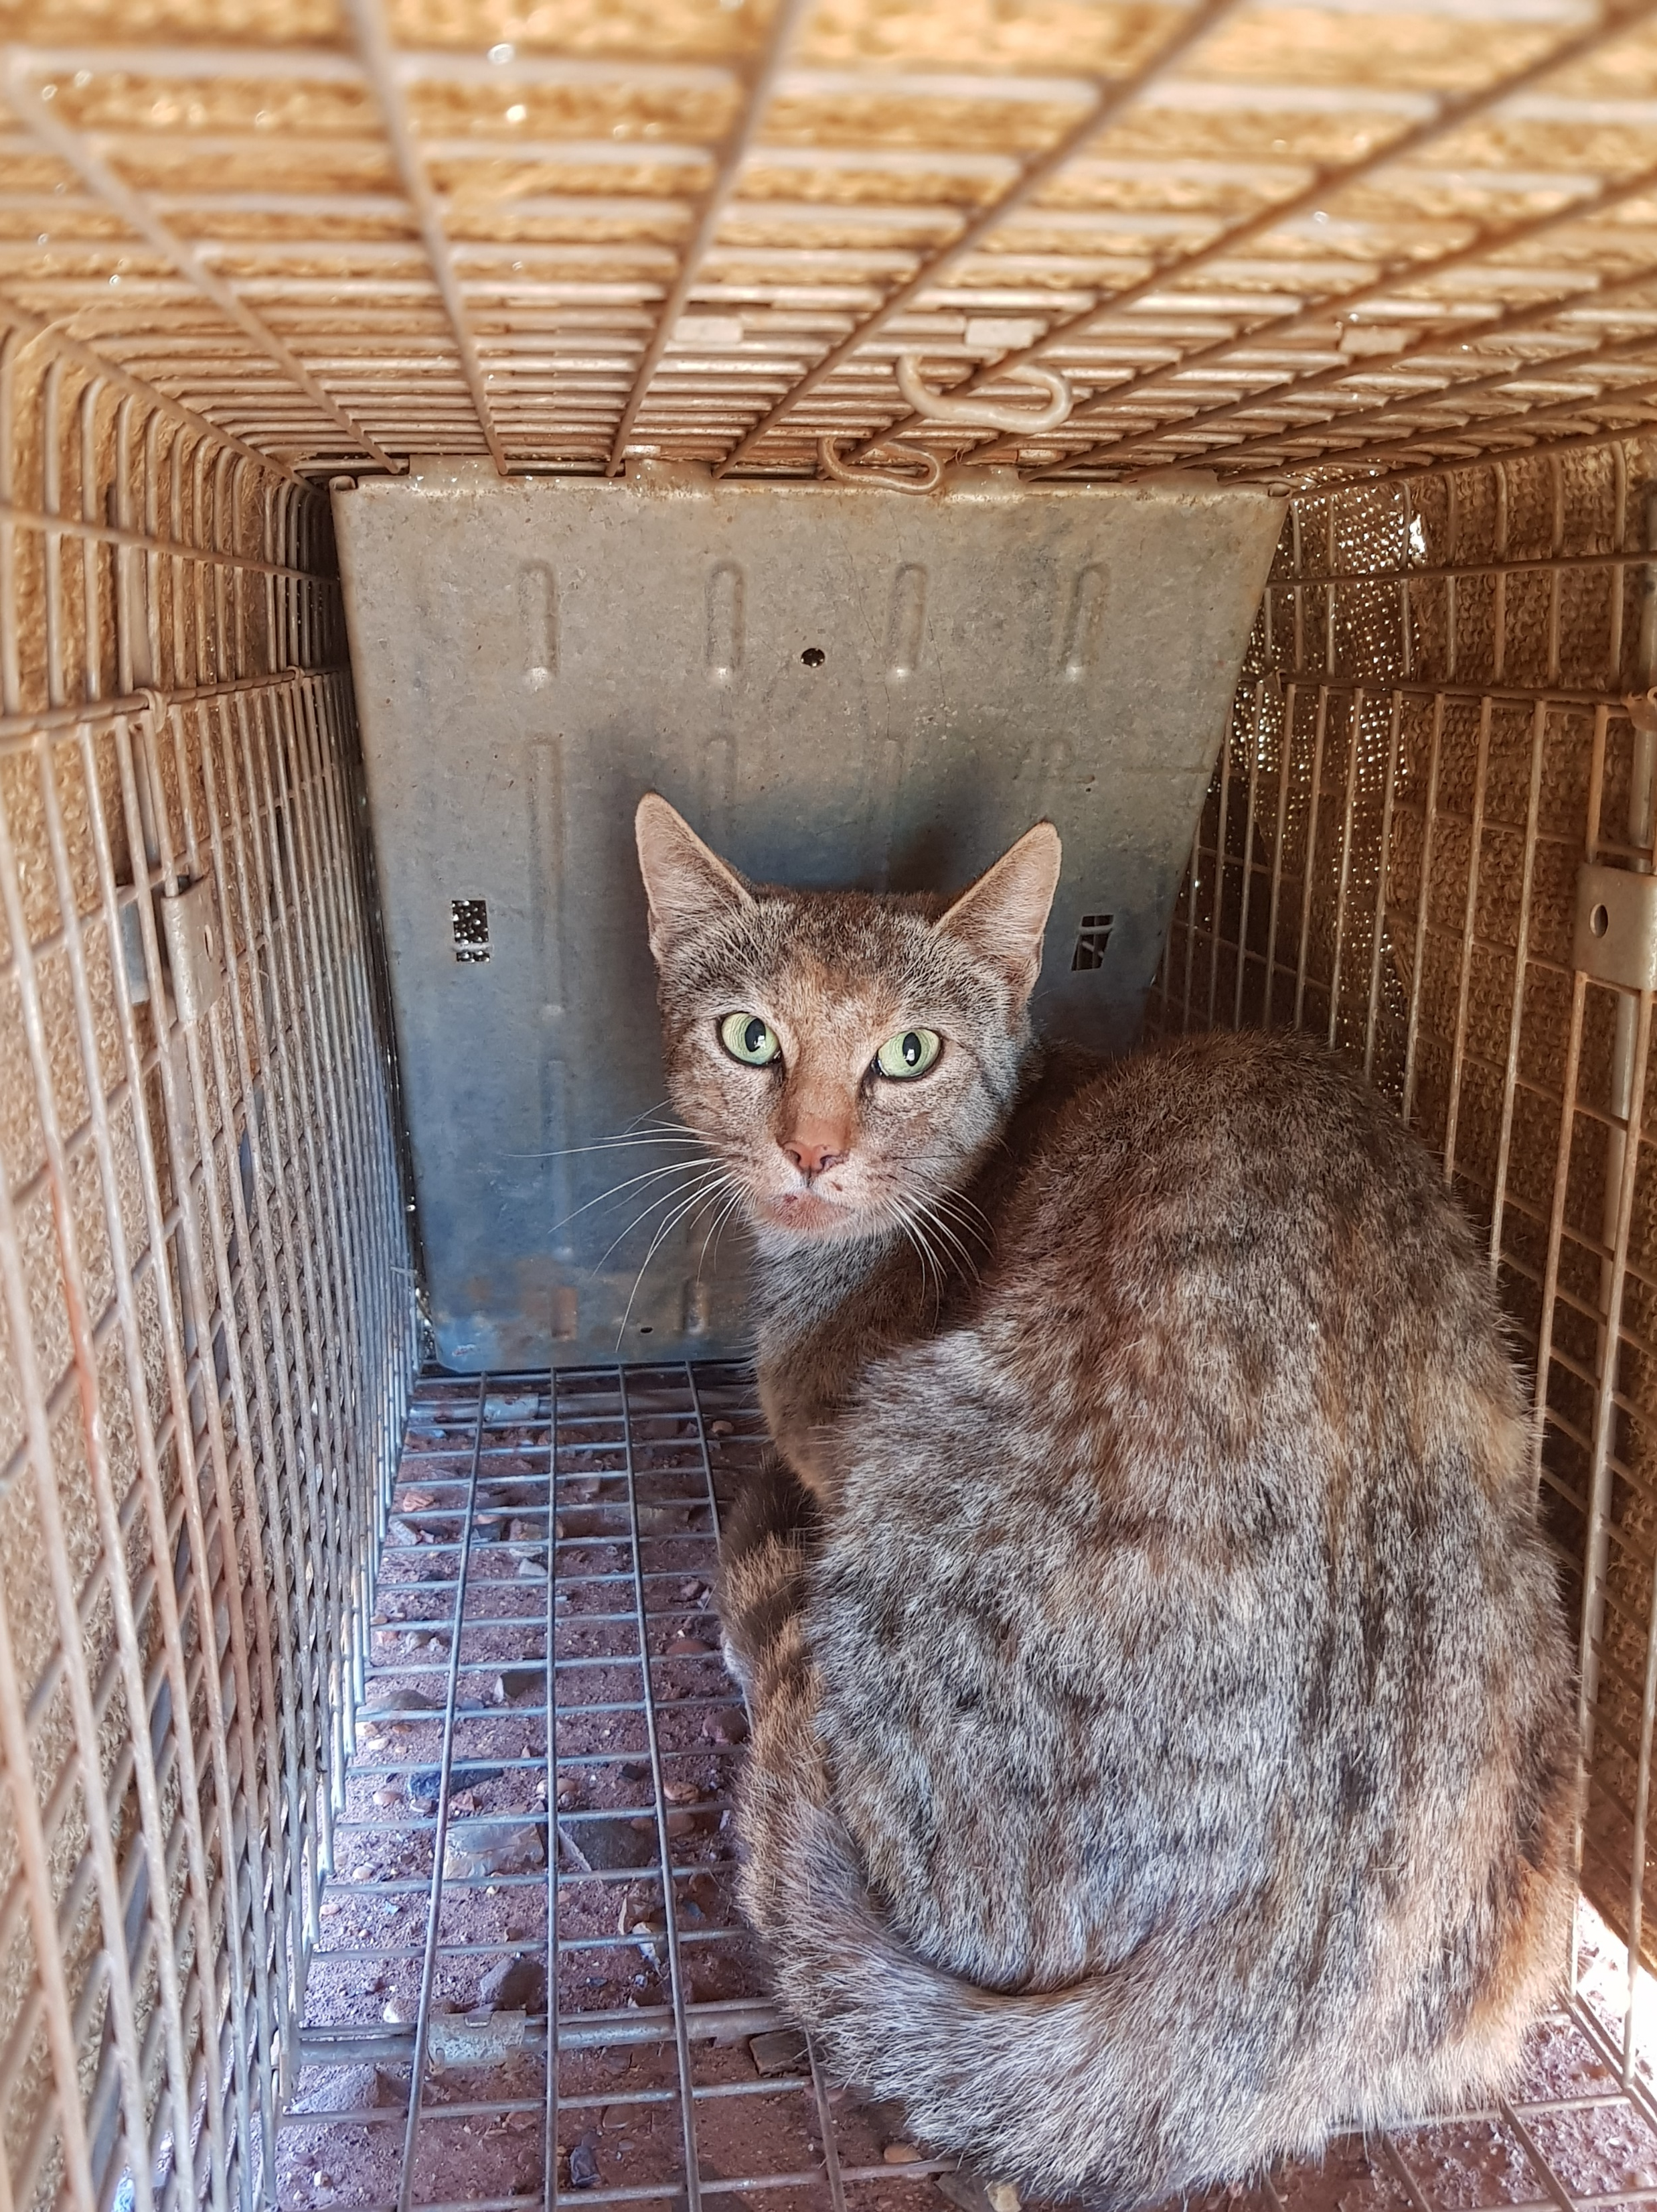
Outline
Feral cat management at all stages of mining:
EIA
Operations; and
Mine closure
Suggestions for going forward

Slide 3
Pre-approvals
Based on 0.27 cats/km² and a mean mining tenement size of 5.1km² (but many mines are on multiple tenements), there is approximately 1 cat/mining tenement
Cat diets include frogs (44/yr), mammals (393/yr), reptiles (225/yr) and birds (129/yr)
So, cats are impacting the native fauna before exploration and mining occurs
Mean 44 frogs consumed by each cat each year Woinarski et al. (2020) Predation by introduced cats Felis catus on Australian frogs: compilation of species records and estimation of numbers killed, Wildlife Research
Mean of 393 mammals consumed by each cat each year Murphy et al. (2019) Introduced cats (Felis catus) eating a continental fauna: The number of mammals killed in Australia, Biological Conservation
Mean of 225 reptiles consumed by each cat each year Woinarski et al. (2018) How many reptiles are killed by cats in Australia? Wildlife Research
Mean of 129 birds consumed by each cat each year Woinarski et al. (2017) How many birds are killed by cats in Australia?, Biological Conservation

Slide 4
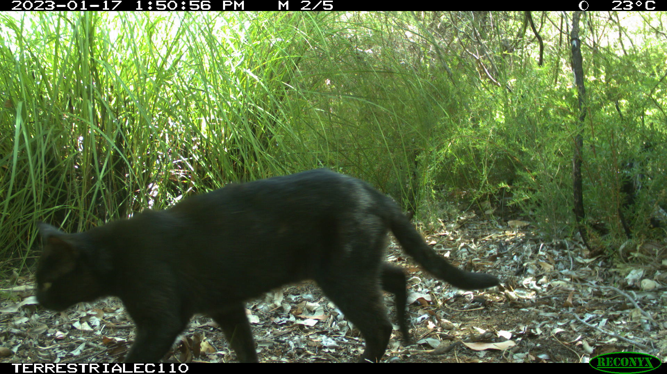
Pre-approvals surveys and assessments
Feral cats are rarely addressed:
In pre-approval surveys (i.e. sometimes recorded, but seldom a focus)
As a significant threatening process to vertebrate fauna
As requiring operational management as an approval condition
In fauna management plans

Slide 5
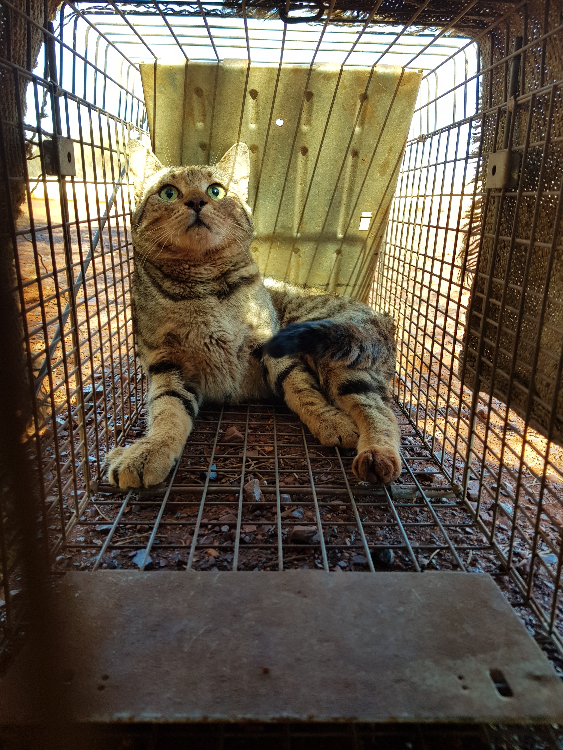
Mining operations
Mining locations | Cat # | Comment | Source
Plutonic | 8 | Cages and foot-hold traps, diet native mammals | Hamilton & Algar (2003)
Plutonic | 5 | Cages and foot-hold traps, diet native mammals | Hamilton & Algar (2004)
Granny Smith | 49 | Cages and foot-hold traps, diet native mammals | Onus, et al. (2011)
FQM Ravensthorpe | 6 | Foot-hold traps, native mammals, invertebrates and food scraps | APMS (2019)
Ravensthorpe | 21 | Cage traps, mammals | TE 2017
Higginsville | 4 | Cage traps, food scraps | TE 2021
Coolgardie | 2 | Cage traps, food scraps | TE 2021
Coolgardie | 11 | Cage traps, food scraps | TE 2021
South Kalgoorlie | 5 | Cage traps, food scraps | TE 2021
Pilbara | 4 | Cage trap, mammals and food scraps | TE 2022
Pilbara | 1 | Cage trap, mammals and food scraps | TE 2022
Pilbara | 3 | Cage trap, mammals and food scraps | TE 2022
Pilbara | 5 | Cage trap, mammals and food scraps | TE 2022
Pilbara | 5 | Cage trap, mammals and food scraps | TE 2022
Laverton | 4 | Cage trap, mammals and food scraps | TE 2022
Laverton | 1 | Cage trap, mammals and food scraps | TE 2022
Laverton | 2 | Cage trap, mammals and food scraps | TE 2022
Coolgardie | 4 | Cage traps, food scraps | TE 2022
Coolgardie | 5 | Cage traps, food scraps | TE 2022
Coolgardie | 4 | Cage traps, food scraps | TE 2022
Coolgardie | 8 | Cage traps, food scraps | TE 2022
Coolgardie | 1 | Cage traps, food scraps | TE 2022
Coolgardie | 16 | Cage traps, food scraps | TE2022
South Kalgoorlie | 5 | Cage traps, food scraps | TE2022
Cat abundance increases around infrastructure and waste management facilities
Mine site cats include putrescible material in their diet

Slide 6
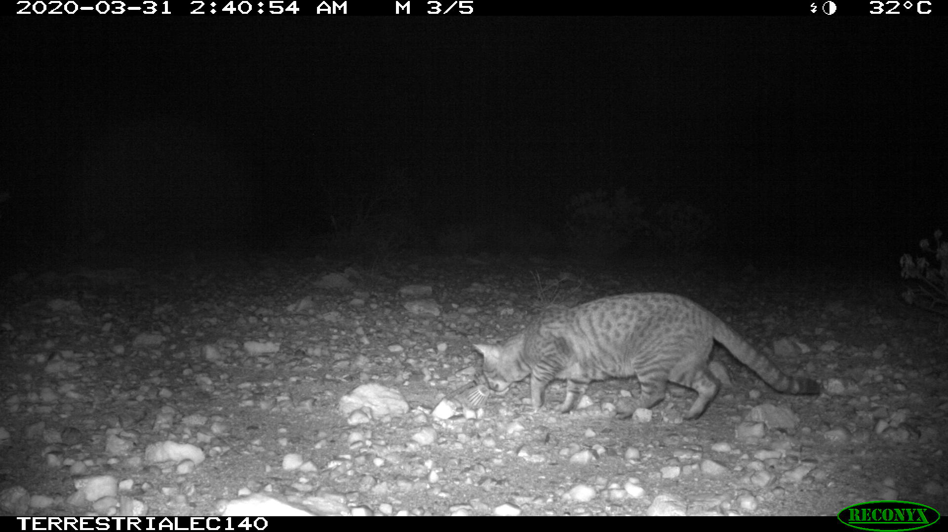
Mining operations
Few mine sites actively manage feral cats
Some sites don’t control cats because they ‘keep rat and mice numbers under control’

Slide 7
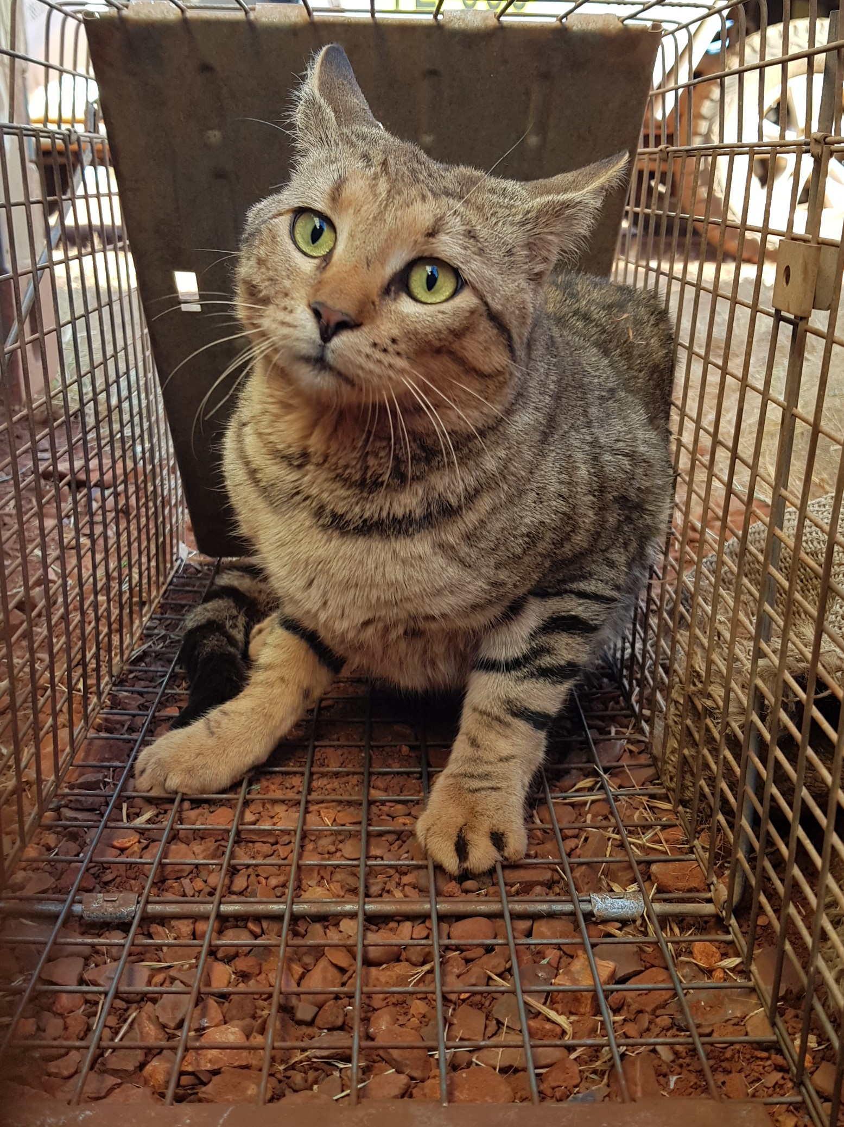
Mine closure
After mine closure, feral cats remain, possibly in higher densities
When a mine closes, food scraps and putrescible waste are no longer available, so ‘mine cats’ revert to predating on native animals

Slide 8
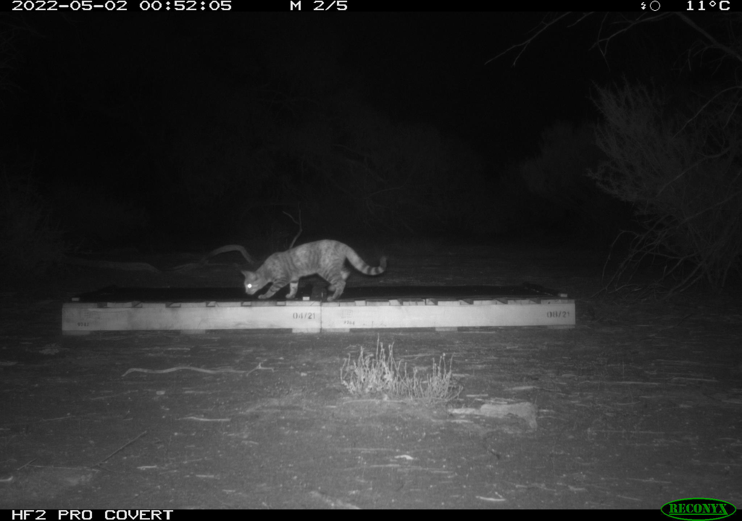
Mine closure
The issue of (and increased number of) feral cats is seldom addressed in mine closure plans
Simple ideas such as artificial shelters provide protection from predation in early stages of mine closure – see Tenaya Duncan’s presentation tomorrow
Photo from Tenaya Duncan

Slide 9
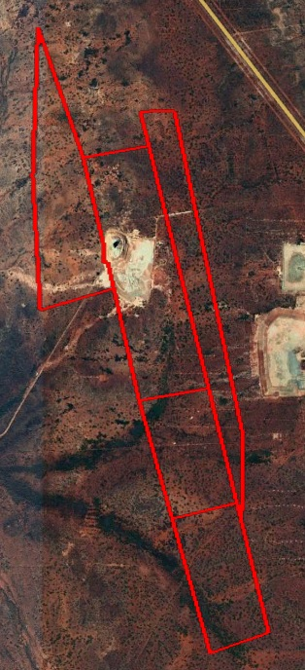
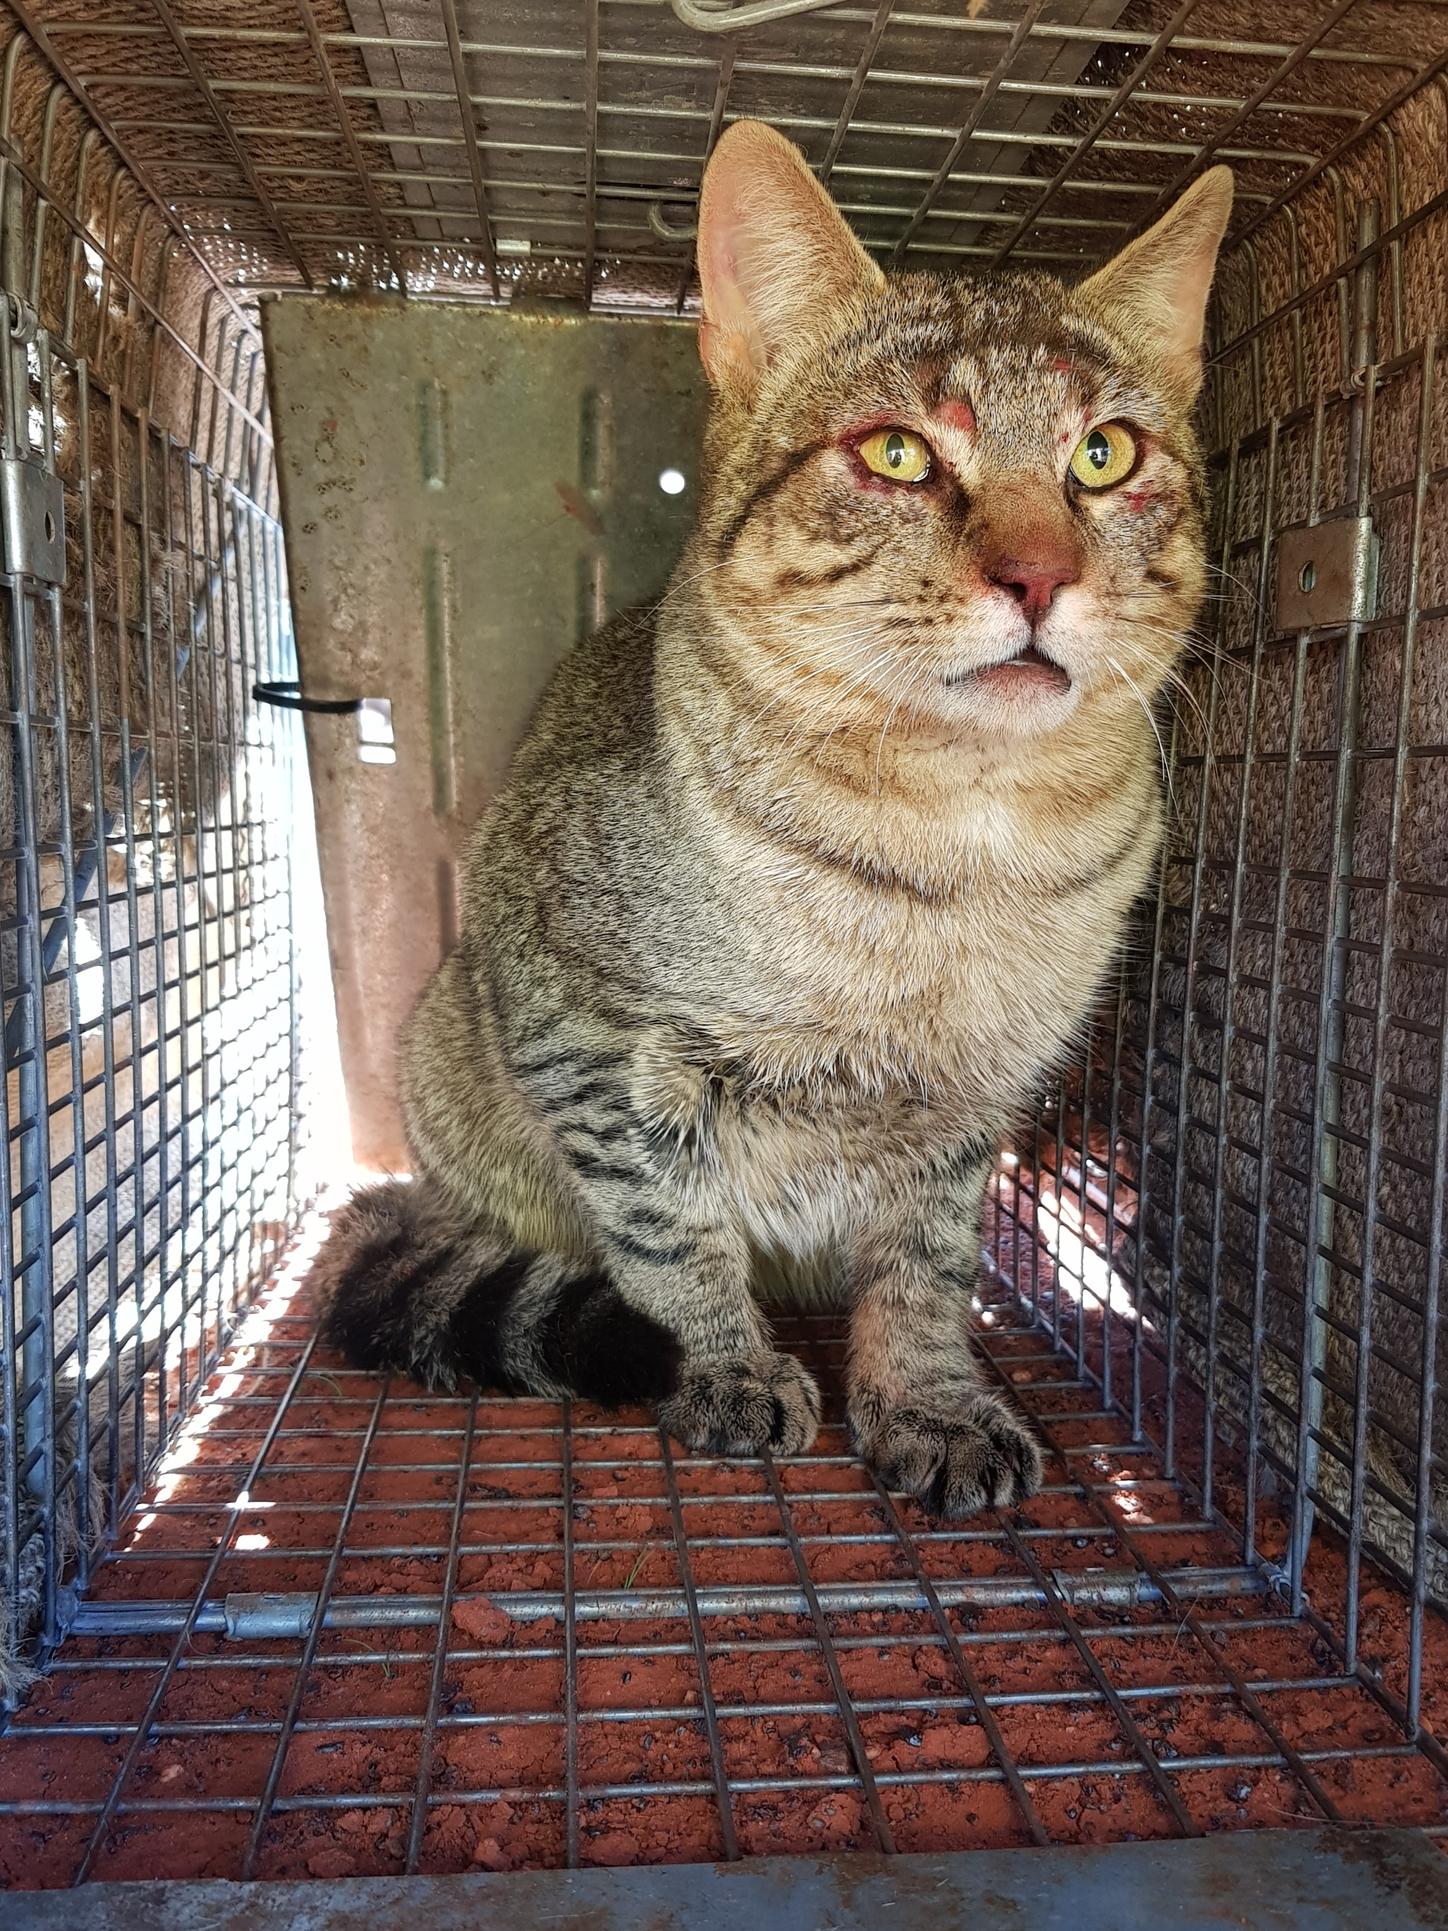
Mining cats
When considered over the life of the mine, it is possible that feral cats are having a greater impact, than the vegetation clearing and mining operations per se
There is a greater need to focus on feral cats in the EIA process, mining operations and post-mining closure

Slide 10
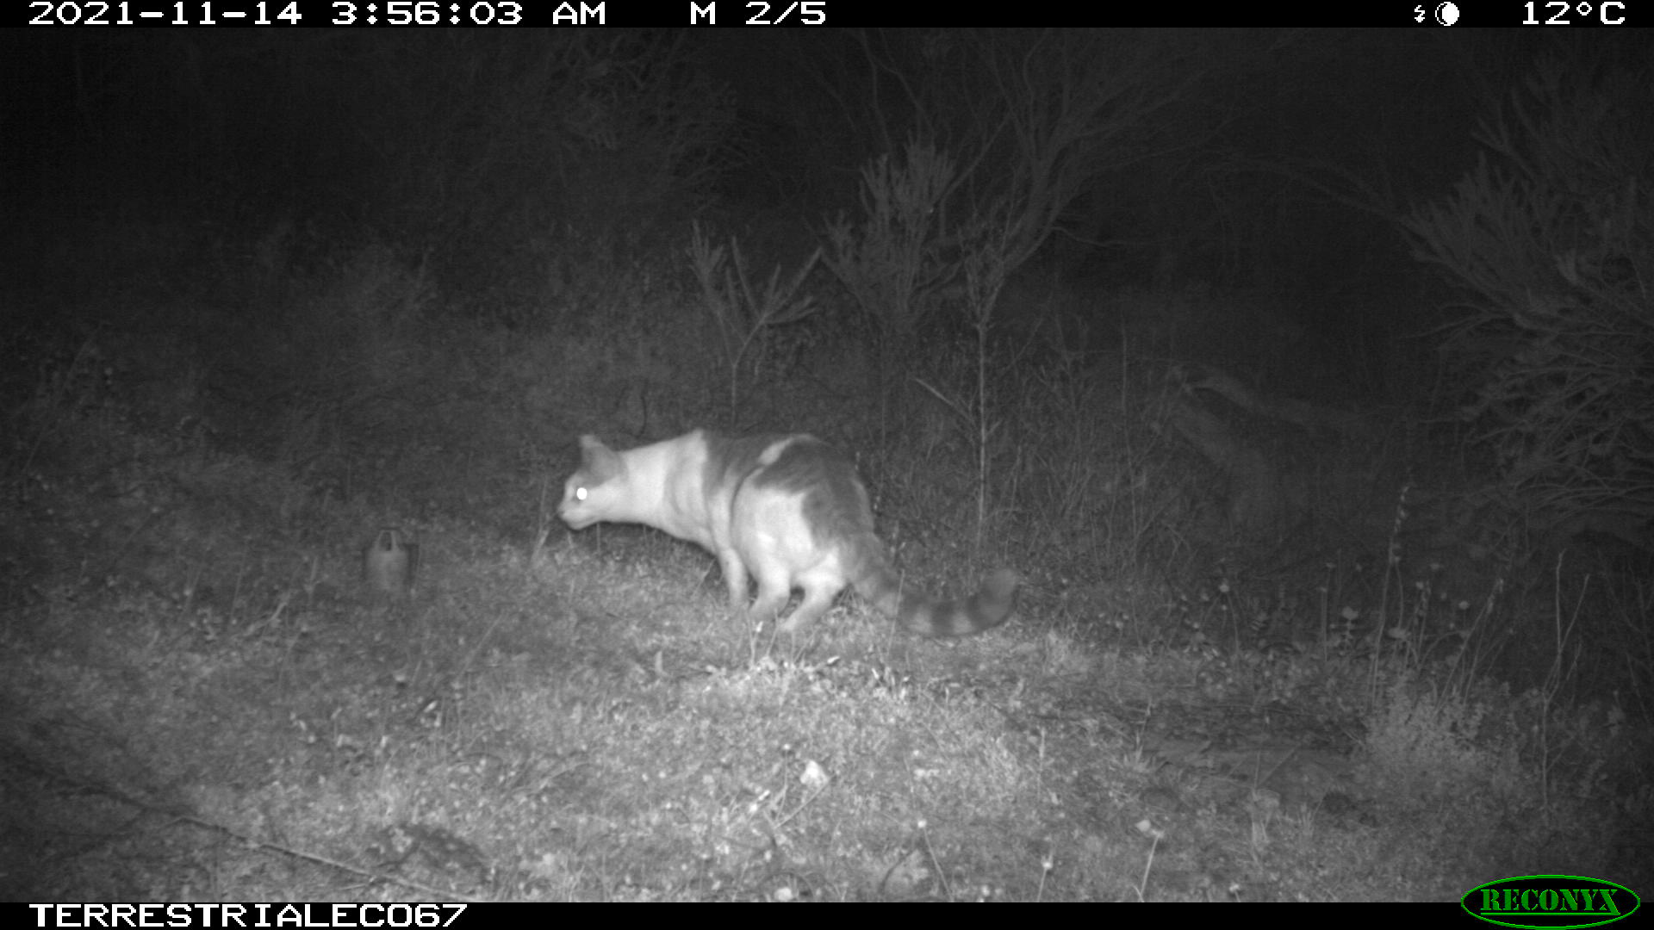
Going forward
Focus on feral predators and their threatening processes in EIA
Fauna surveys and reports, regulators assessment, approval conditions, management plans
Operational management should include a feral predator control
Mine closure plans need to include feral predator management and mitigation of threatening processes
Compliance reporting and checks to include an assessment of feral predator management (e.g. putrescible waste management, active management programs)

Slide 11
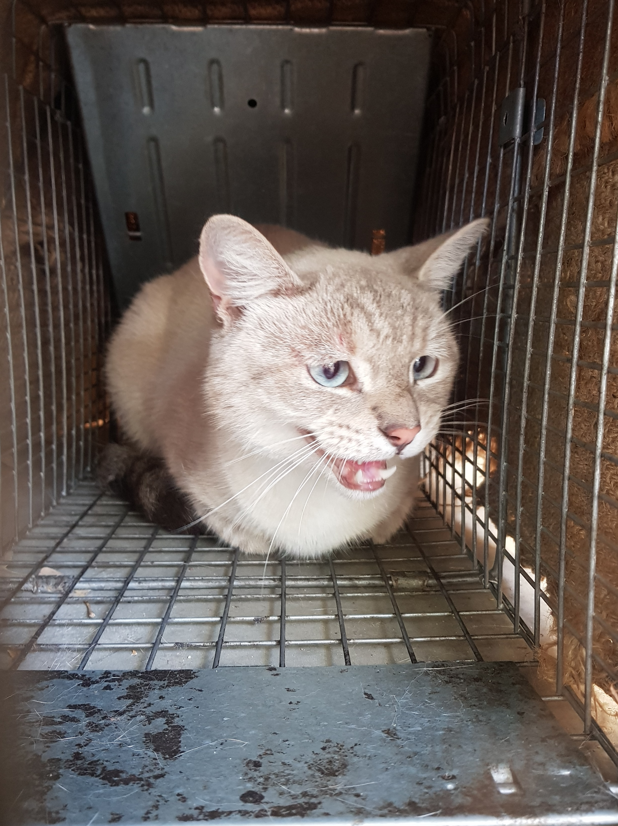
Cat management in mining needs to be addressed in a broader context
So, what might that look like?
Appointment of a senior government manager to facilitate operational feral cat management across mining, government and community agencies
Senior, because the person will be required to work across multiple government agencies and could experience significant push back
Person’s attributes – bold, courageous, focused, committed, collaborative

Slide 12
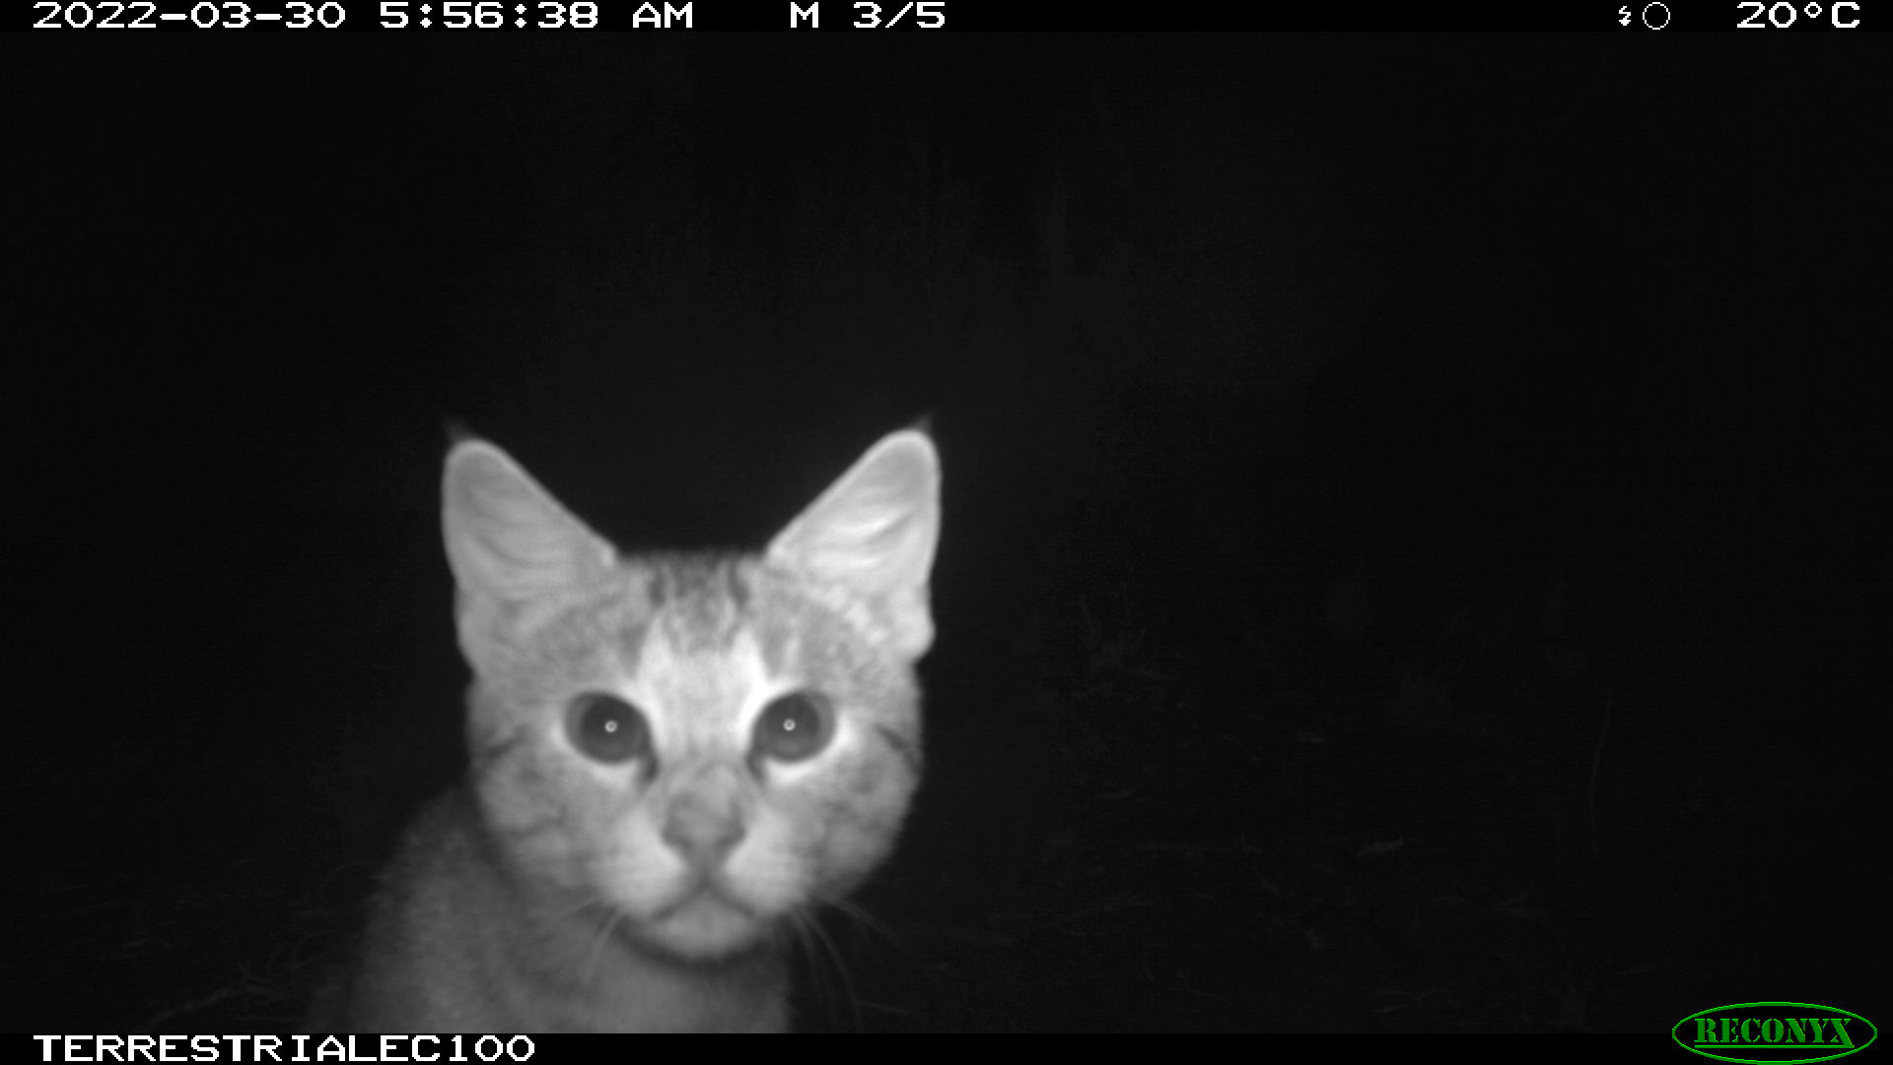
Manager’s coordination role and focus
Government agencies
EPA
DBCA
DPIRD
DWER
DMIRS
WaterCorp
Local government
DevelopmentWA
PTA
Community agencies
Land developers, managers and mining companies
Proponents
Consultants
RBGs
NRMs
Rural industry groups
University research programs
Development of community based program
Commercial agencies focussed on innovation and R&D
LPMTs

Slide 13
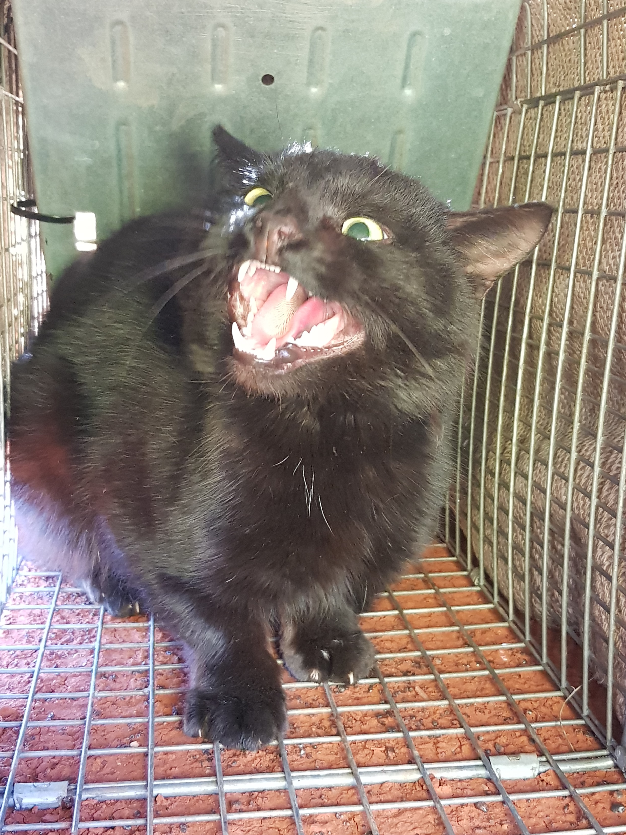
Manager’s focal tasks
Community engagement (- lots can be done – see predator free NZ by 2050)
Amendment of the Cat Act
Establish a monitoring program to measure the success of broad scale cat eradication programs
Effective and humane euthanasia strategies – mine sites, local government, community groups
Wildlife Animal Ethics Committee (WAEC) to assess LPMT’s applications to enable the use of foot-hold traps, as per DBCA’s use of these traps
Pilbara Environmental Offsets Fund (~ $90m)

