Slide 1
Pirrawarnku on warrarn
-Nyangumarta Ranger cat management journey
Notes:
Jacko
Welcome to

Slide 3
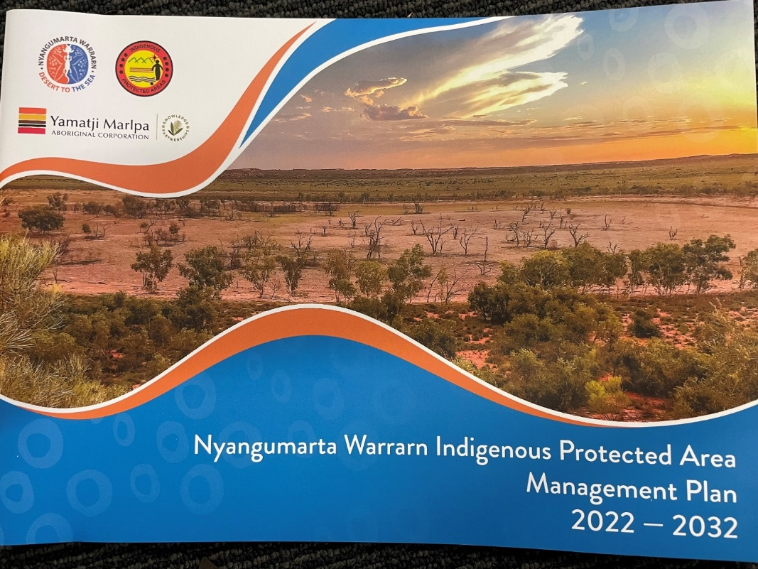
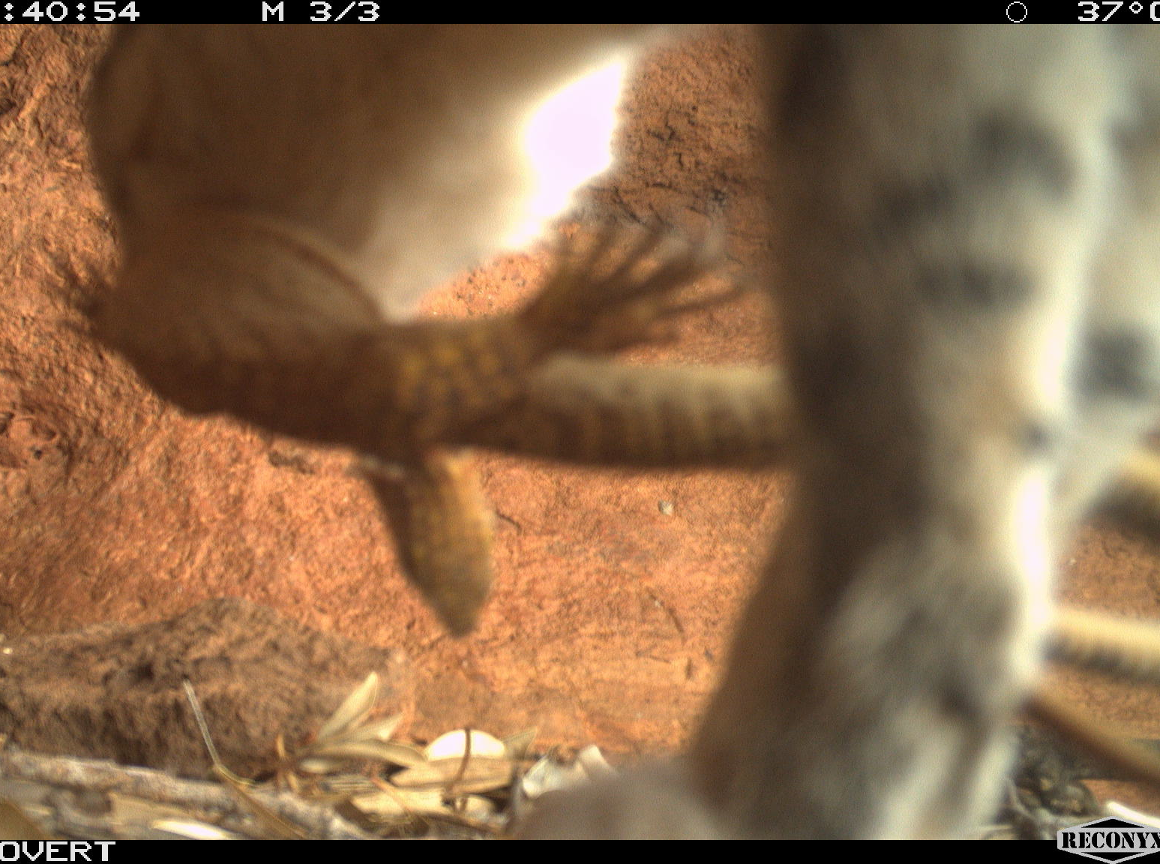
2009 Nyangumarta Warrarn native title awarded
2015 IPA declared and ranger team established.
Expanded to men and women's team with cultural advisors and elders ~ 40
Since first IPA management plan in 2015, feral animal control been a priority for Nyangumarta.
Concern for bilbies and other significant species.
Discovering new BFRW populations– known to be threatened by cats on Nyikina Mangala Country

Slide 4
Cat management
2 ha plot surveying → Cat tracks everywhere
Sensor camera surveys → Cats everywhere
Threatened species monitoring (bilby, black foot rock wallaby, northern quoll.)
Fire management
Cage trapping and spotlighting
Kiwirrkurra Ranger exchange (IDA) → Film Finalist at UNESCO Earth Futures Film Festival
Marrngumili Warrarn Muwarr Pirraja - Sharing Desert Stories on Vimeo
Fire and Biodiversity Project with Environs Kimberley to understand impact of different fire patterns on biodiversity
Felixer cat grooming traps

Slide 5
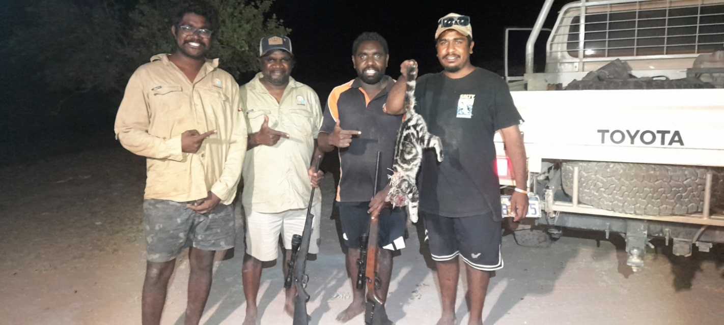
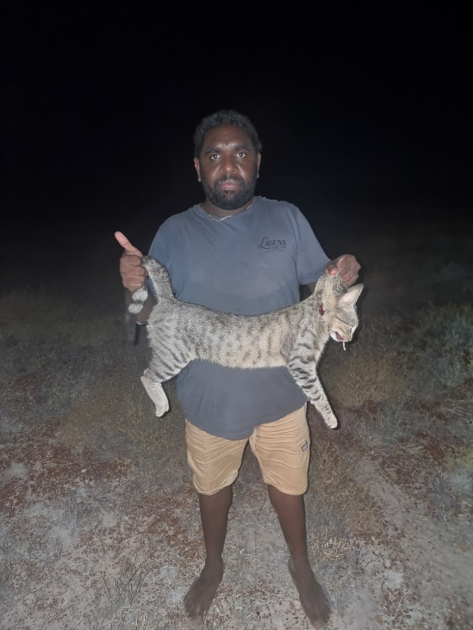
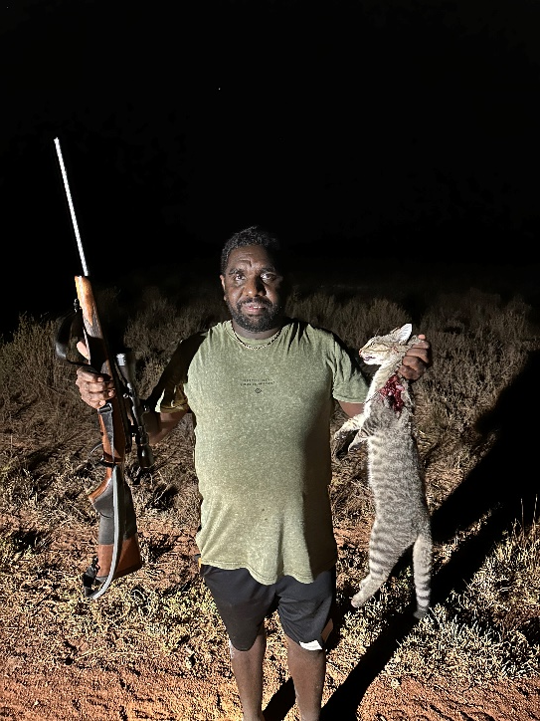
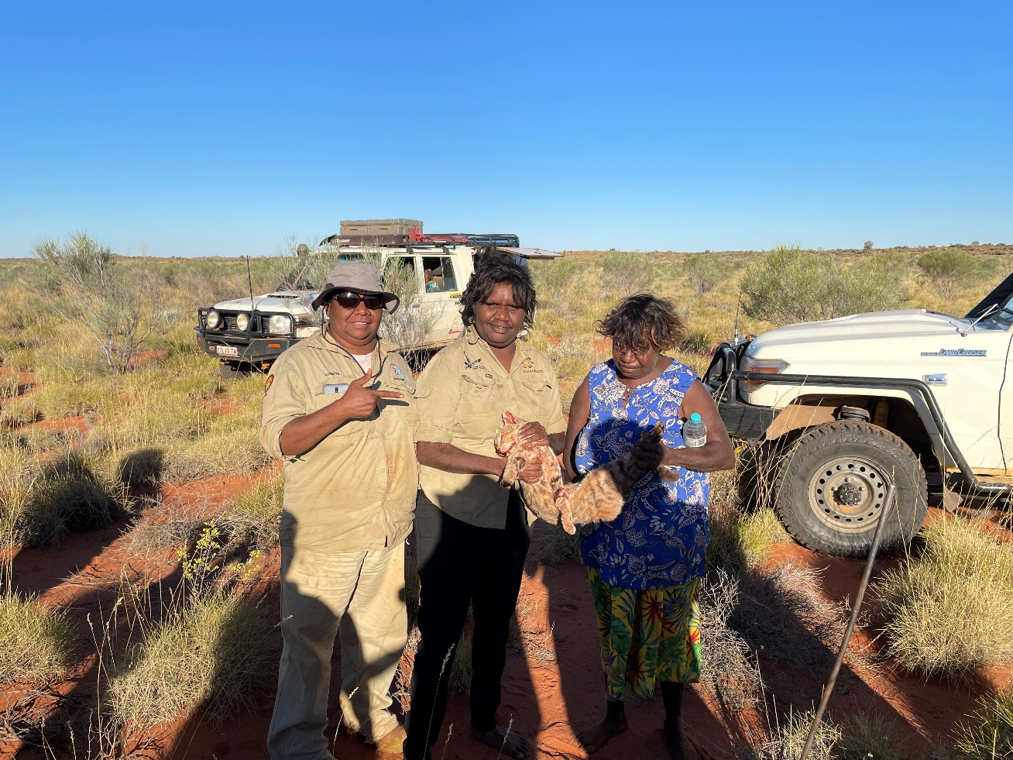
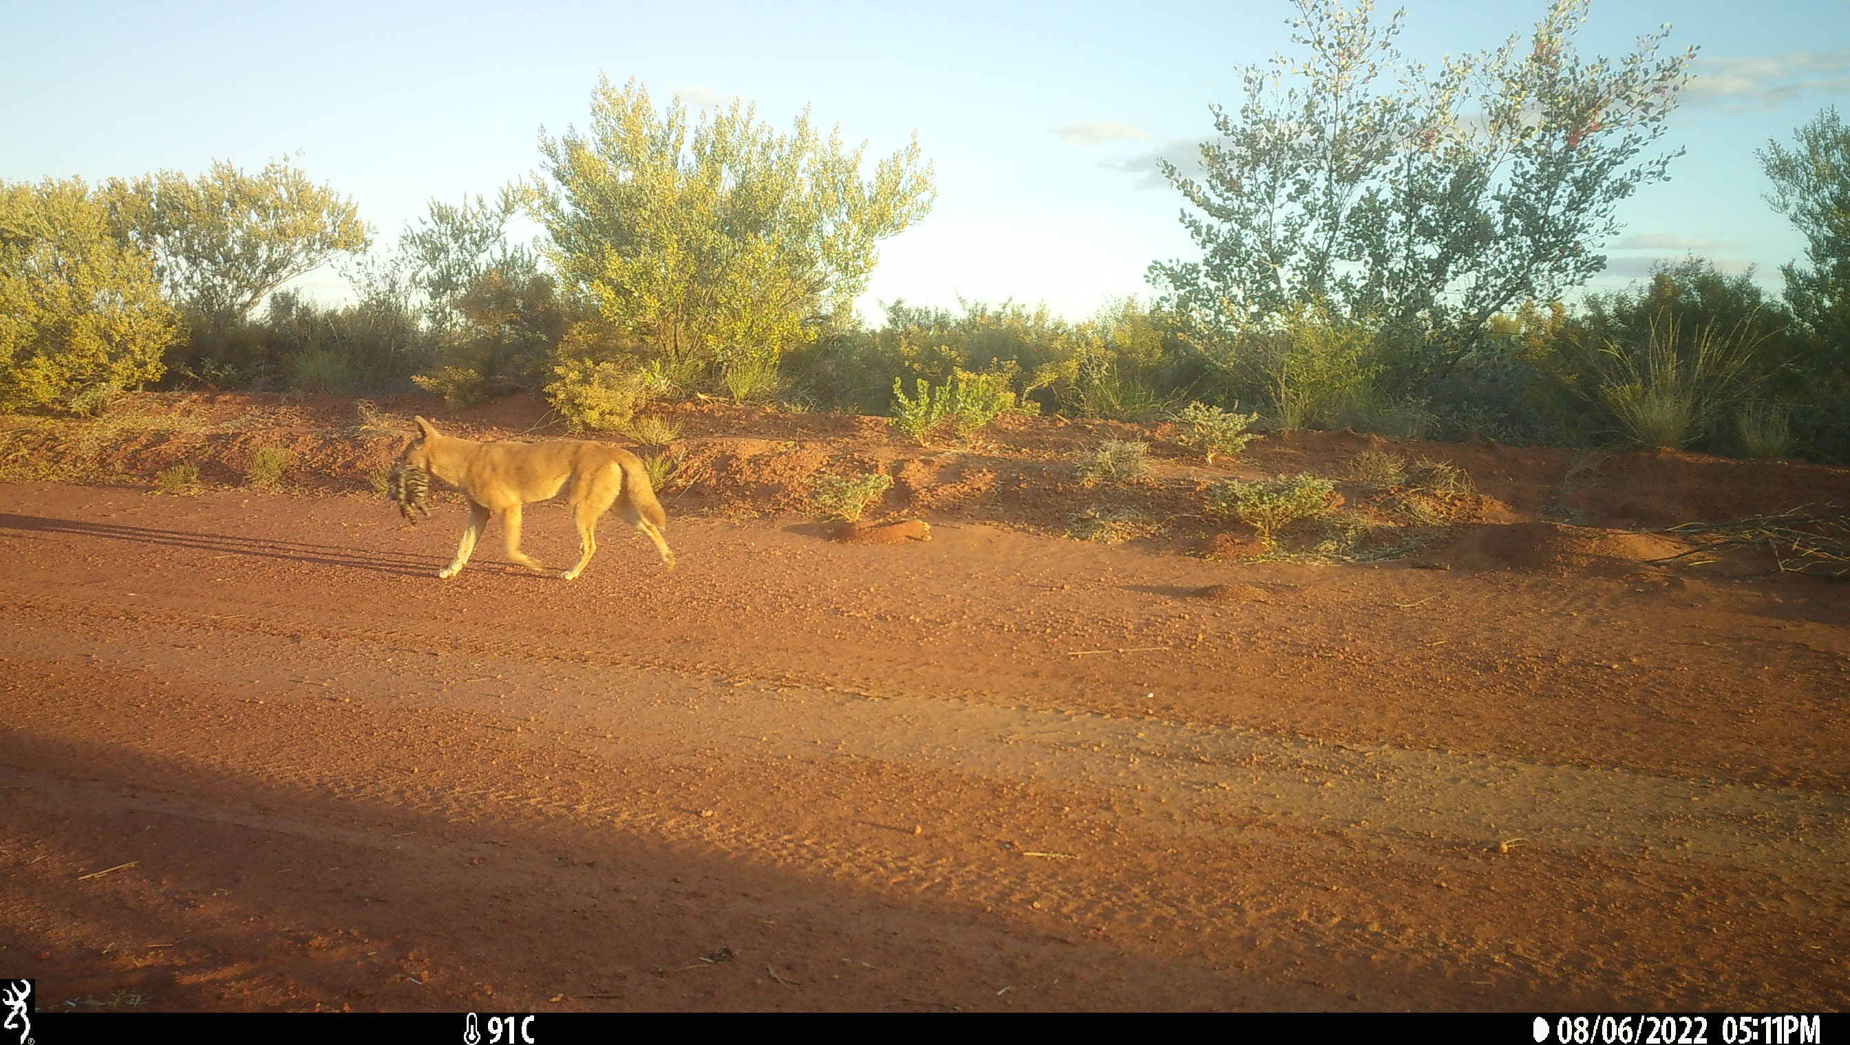
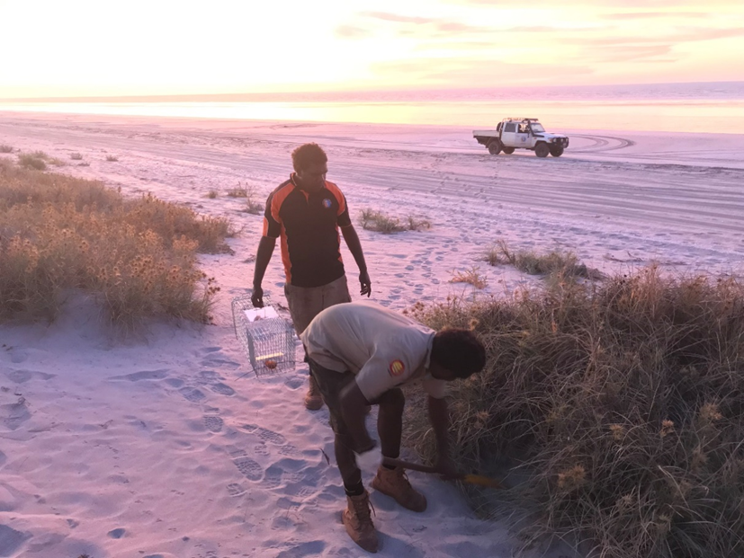

Slide 6
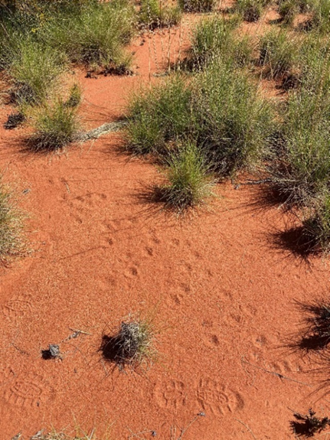
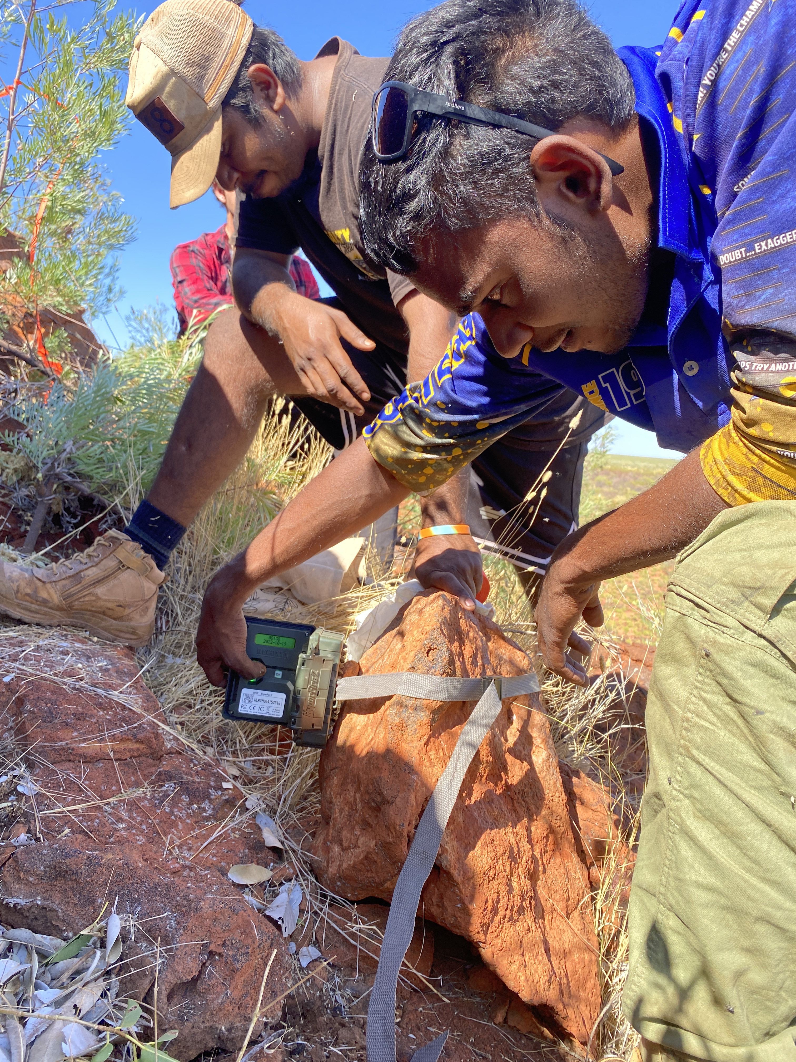
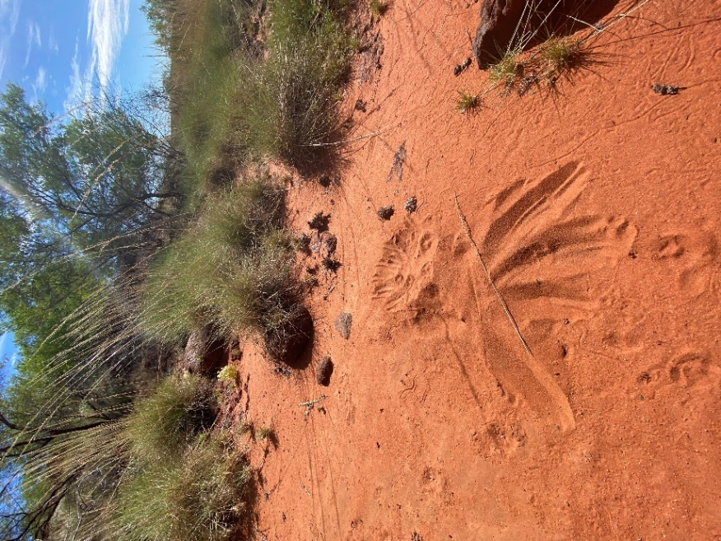
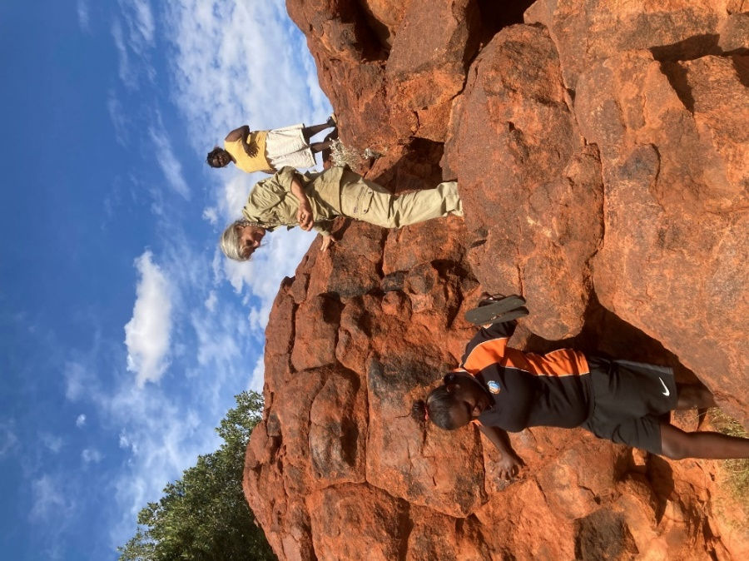
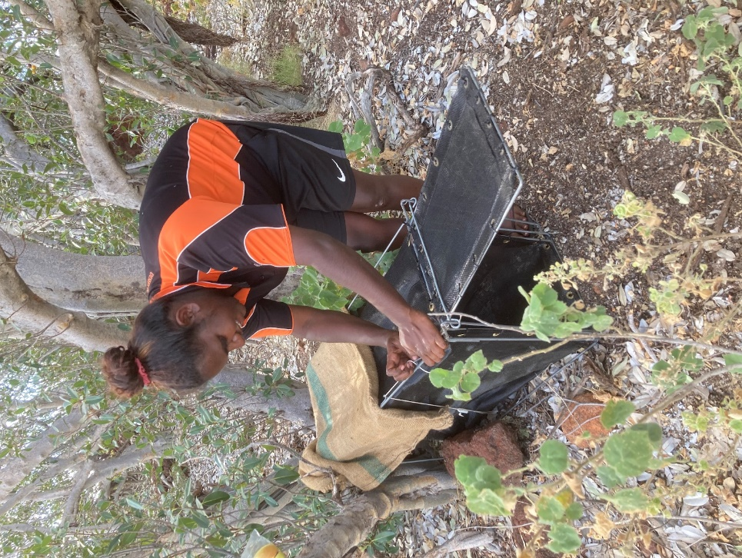
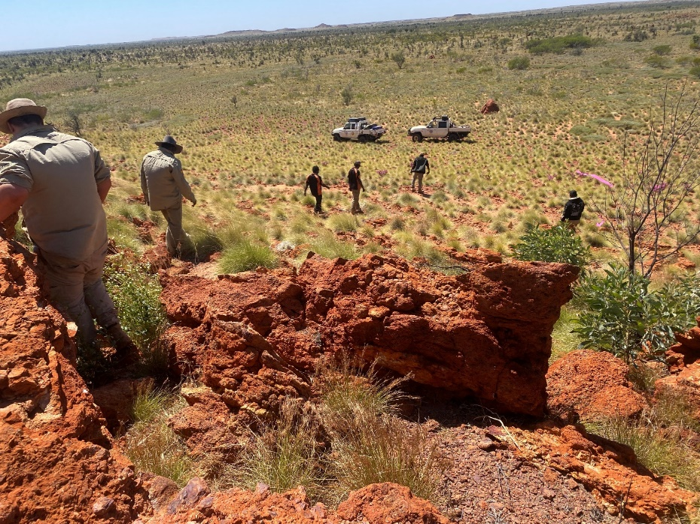
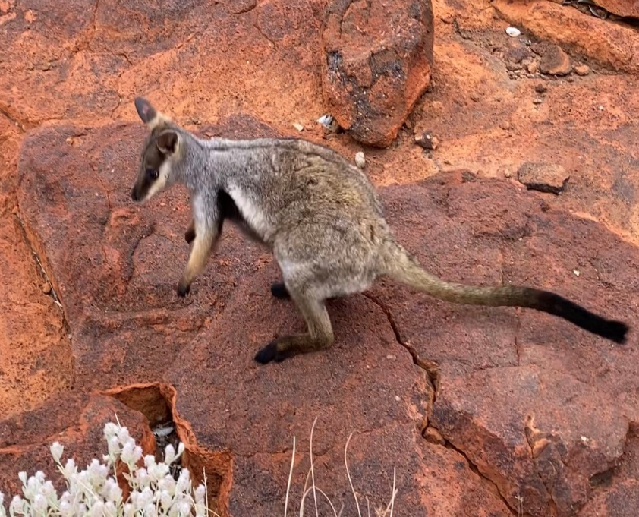
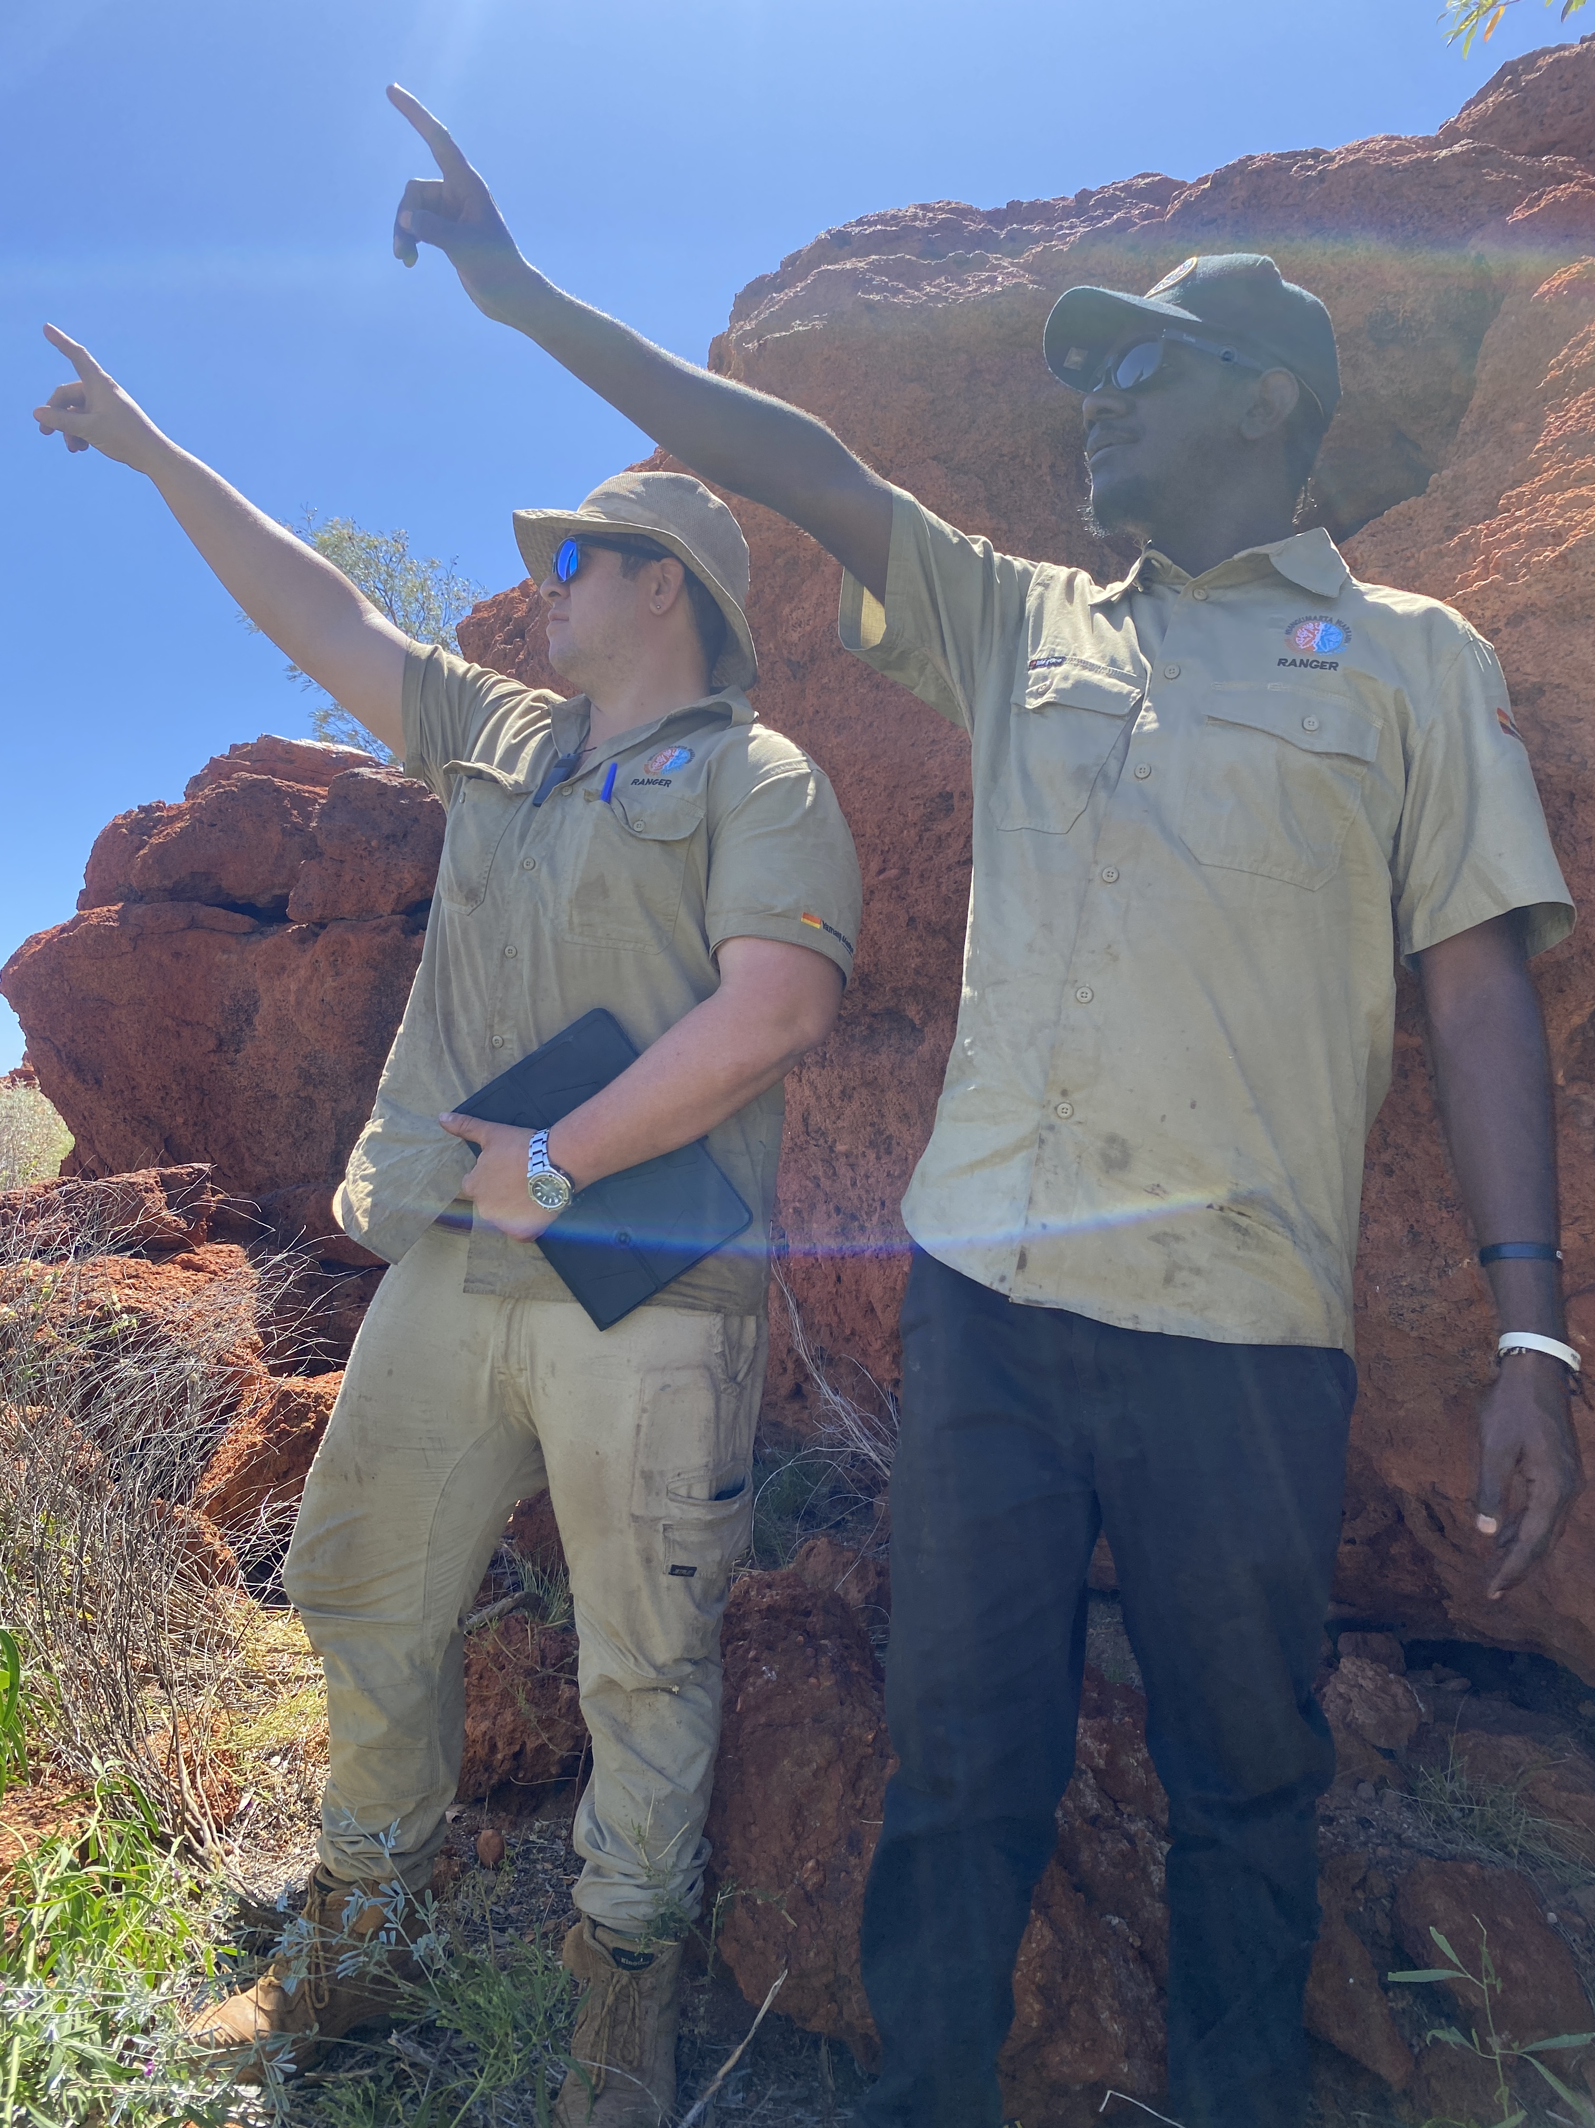

Slide 7
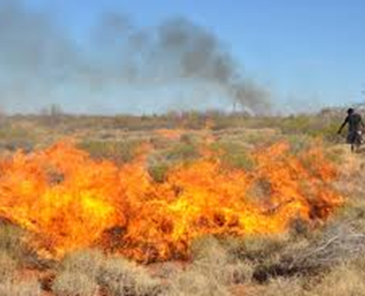
Fire Management
Burn Plans→ to protect different ages of spinifex and animal habitat
Burn right way
Fire Training
Fire Scar mapping
Biodiversity surveys to monitor and inform fire management

Slide 8
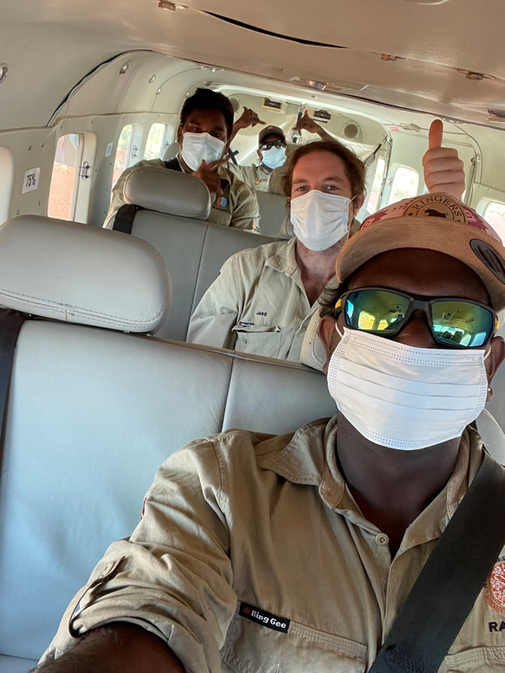
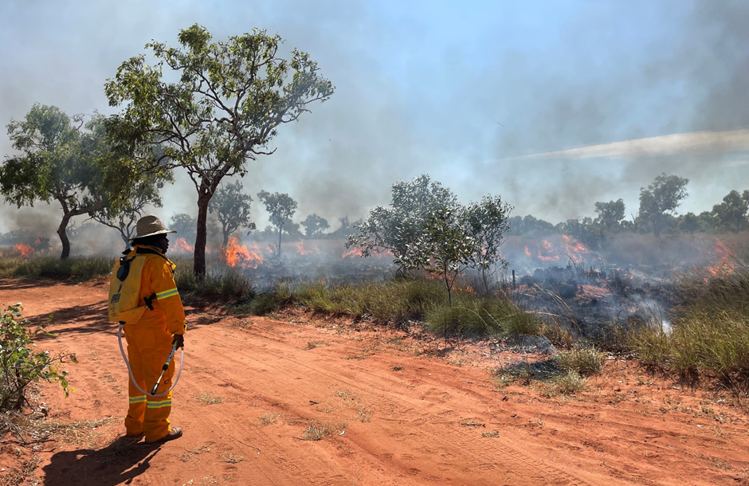
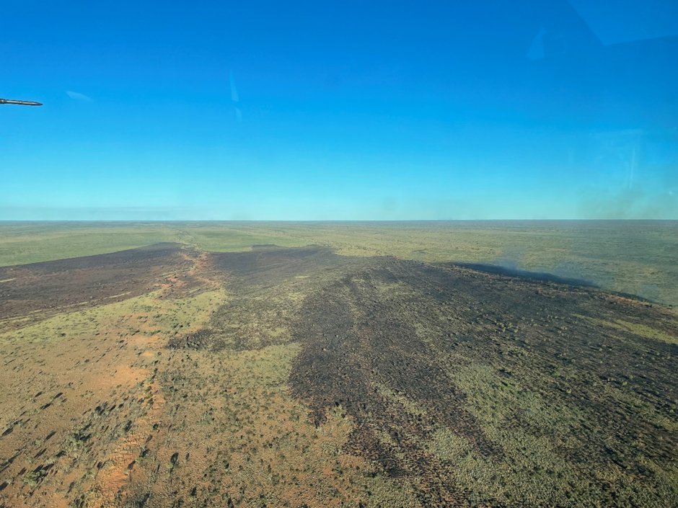
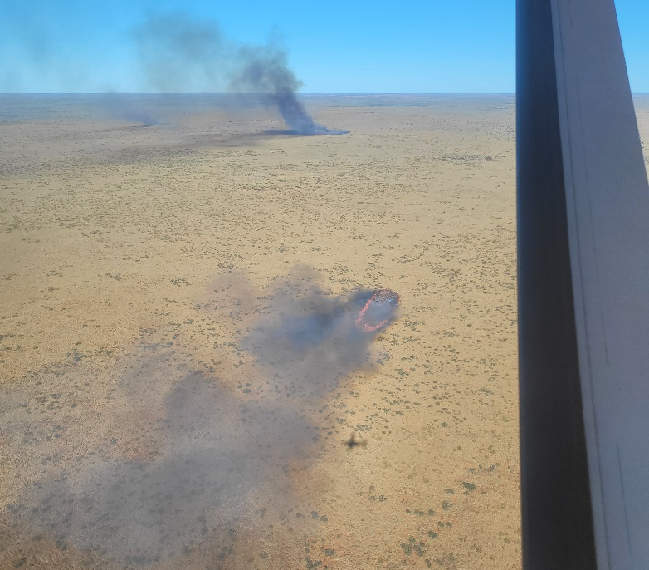
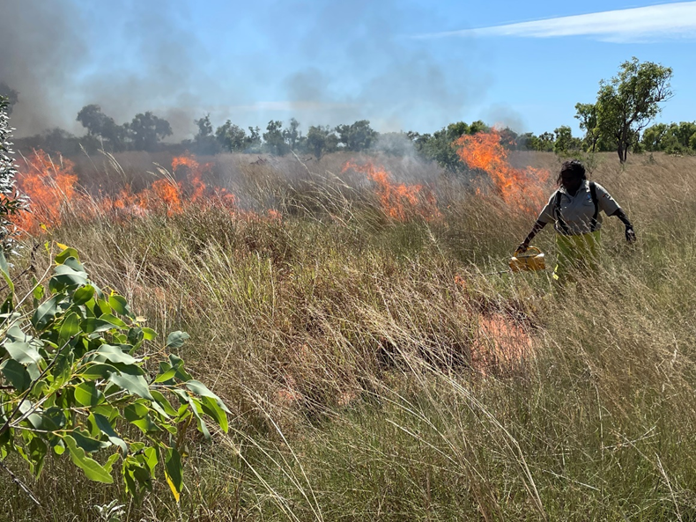
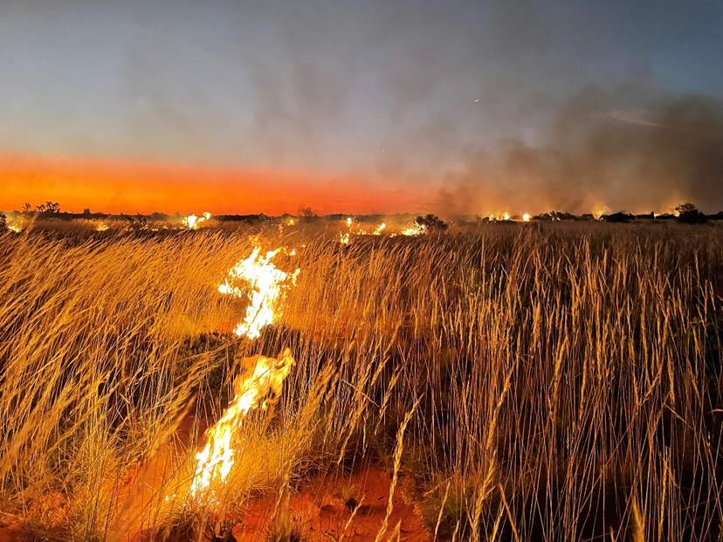

Slide 9
Feral Cat Mugshot ID
Creating a database of cats caught on camera.
Further camera trapping will identify whether cats in locality are changing.
Date | 14/06/2022
Time | 11:37:22 AM
Location | Rocky outcrop 2 FMG Track
Physical Condition | Very Good
Sex M/F | Male
Distinguishing Features | Ginger Tabby

Slide 10
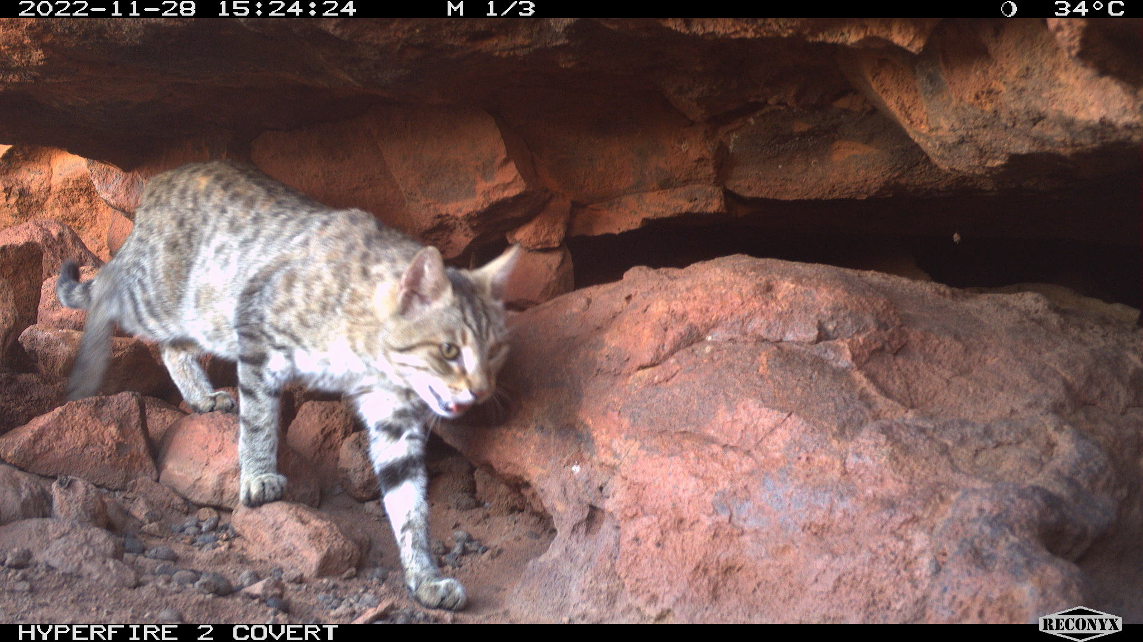
Felixer -Cat grooming Traps
Two Felixer for 15month lease
Two Felixer for 24 month lease
Threatened species project with EK on quolls, black-footed rock-wallabies and brush-tail possum → monitoring + management
Targeting key rocky outcrop habitat containing black-footed rock wallabies.
Assessing effectiveness of Felixers in managing cats visiting the outcrops.
Regular monitoring of cats and BFRW populations to be protected will take place.
Funding to continue to look for threatened species in the IPA.
Wanting to trial and find best options for cat management: also keen to try leg-hold trapping

Slide 11
Challenges
Methods which are easily available to us (cage trapping and shooting) found to not be effective on Nyangumarta desert country
Other methods (Felixers, leg-holds, baiting) require complicated licensing/permits, not easily accessible to Aboriginal rangers.
Felixers:
long and complicated process with little support and clarity
clear as mud in relation to signage
expensive
need to be leased instead of bought → tight timelines
How to get leg hold trapping permit/experience.

Slide 12
In the future it would be great to have:
More support and clarity from Government departments on possible management methods + licensing/permits
More support and info from Thylation on Felixer requirements and regulations (e.g. info sheet handed out to people who lease Felixers on what the requirements are for each state/ info on website)

Slide 13
Current Available methods
Shooting:
must be licenced and comply under the Firearms Act 1973, Animal Welfare Act 2002 and Biodiversity Conservation Act 2016; authorised persons may humanely destroy feral cats providing land owner permission is obtained.
Baiting:
Eradicat bait (1080) registered for use in Western Australia; Eradicat can only be used by Authorised Officers, Licensed Pesticide Management Technicians that comply under the Medicines and Poisons Act 2014.
Cage trapping:
cage trapping permitted for cat control (under permit) under the Animal Welfare Act 2002.
Leghold traps:
leghold traps are not permitted for cat control (unless under special exemption), considered inhumane devices under the Animal Welfare Act 2002.
Dogs:
the use of dogs is permitted ensuring compliance under the Animal Welfare Act 2002 and Dog Act 1976.
Felixer grooming trap:
no specific legislation preventing the use of Felixers; until broadscale registration is received, Felixers can only be operated with toxins if approved by the APVMA and State authorities.

Slide 14
Thankyou!!!! Any Questions?

