Slide 1
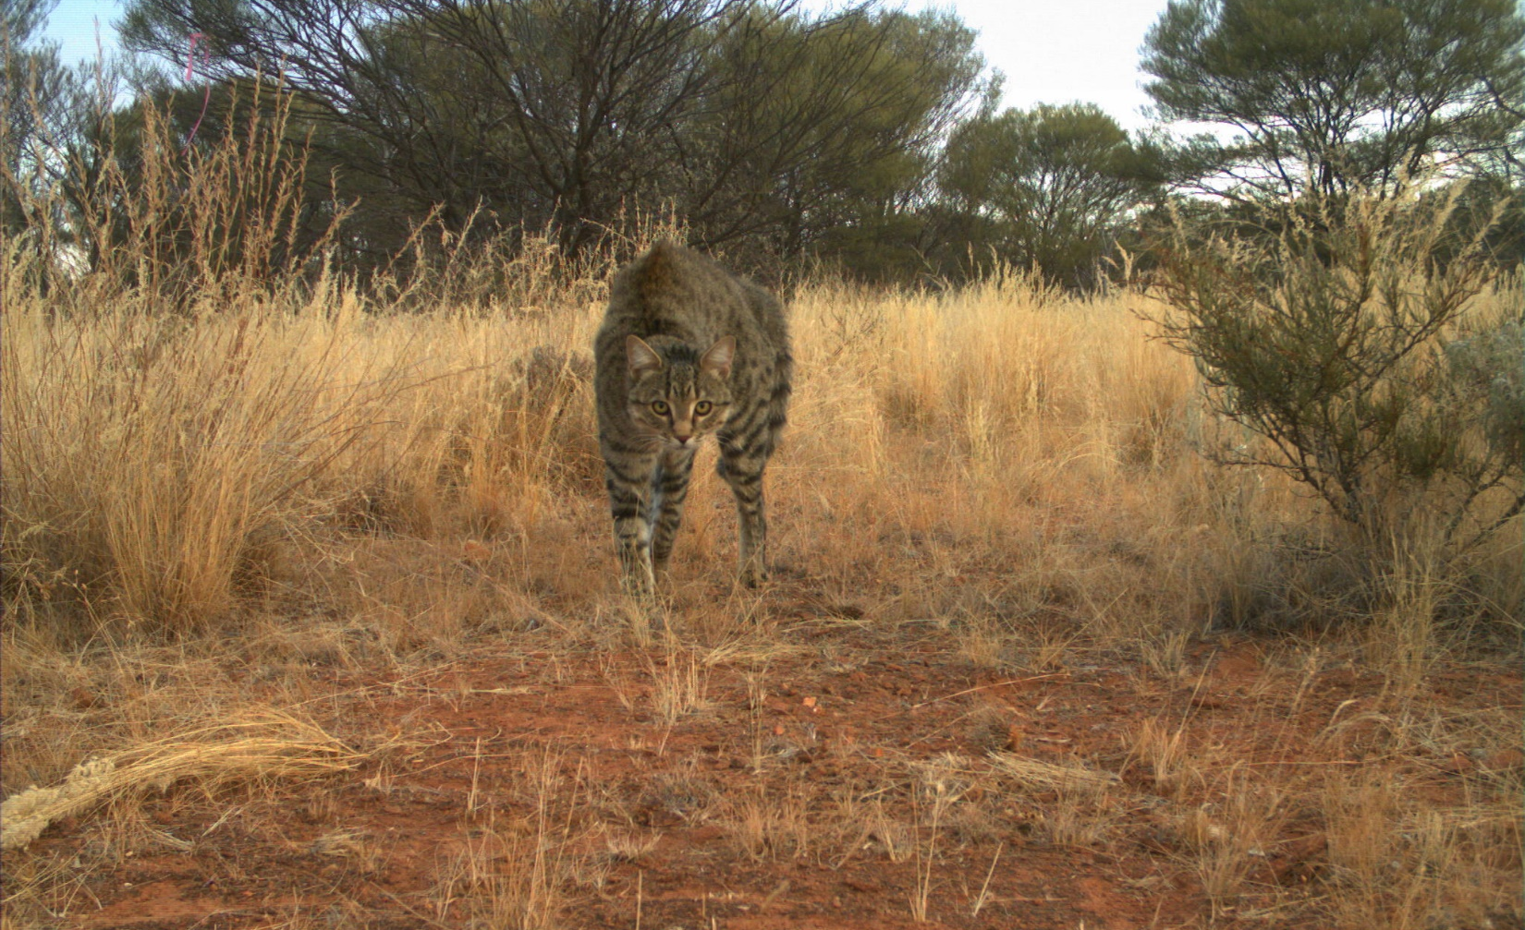
Counting cats in an arid landscape Cheryl Lohr, Dave Algar, Kristen Nilsson, Ashleigh Johnson, Neil Hamilton, Mike Onus
Notes:
As the Chair mentioned, my colleagues and I have a fairly long history of counting cats in the arid zone, particularly on Matuwa. We’ve used a few different methods over the years. Today I want to briefly introduce you to our 20 years of research ending on our latest somewhat disturbing findings.
All of our work has occurred on the Matuwa Indigenous Protected Area, in central Western Australia and I would like to acknowledge our collaborators, the traditional owners of the land, the Wiluna Martu People and Tarlka Matuwa Piarku Aboriginal Corporation.

Slide 2
Landscape scale
Notes:
Matuwa is huge, roughly 50km by 50km and roughly 1.5 hours drive from the nearest town of Wiluna. It was a cattle station until 2000. And now, as I mentioned is an Indigenous Protected Area.
The property has 2 IBRA Regions
Predominantly, spinifex sandplain in the SW and mulga woodland in the NE, with some breakaways, salt lakes, and calcrete exposures.
We’ve been using 2 main techniques for monitoring cats over the years – the track activity index (red and blue lines mark some of our transects) and camera traps in grid or spread out across the property as marked by the little camera icons.

Slide 3
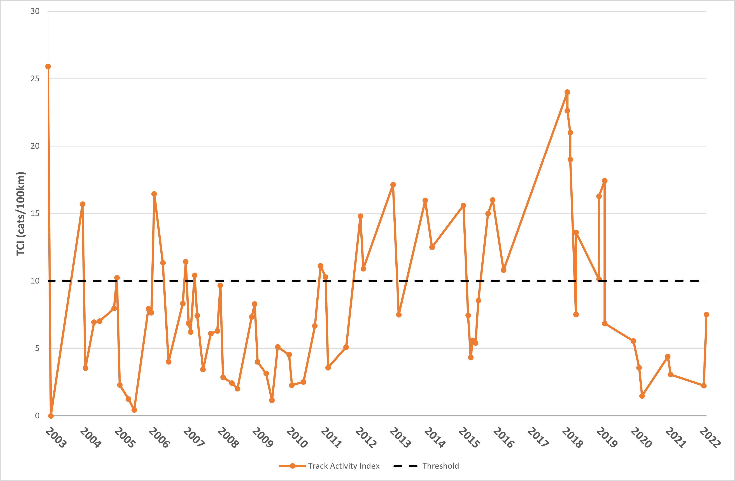
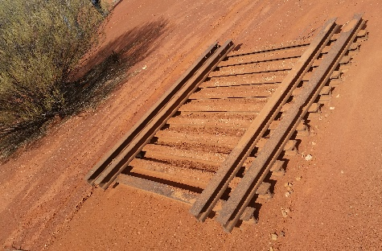
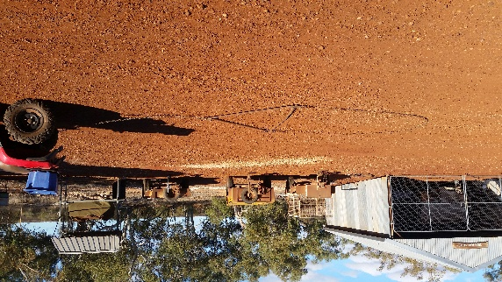
Track Activity Index
Notes:
What is the track activity index?
Well we use the pre-existing vehicle tracks, many of which are sandy and we look for cat tracks. We clear the tracks every day using heavy metal drag or and light chain drag, which you can see here behind a quad bike, to create a blank canvas. Then someone gets the job of slowly riding a quad bike along the track in the morning looking for cat tracks.
We make some assumptions about our data, primarily that any cat tracks that occur within 1km are the one cat meandering around the countryside.
Average the count of cat tracks across at least 4 days, assuming that not every cat will cross a road every day.
The TAI was all we had in the beginning and most of the data before 2015 was from the TAI.
Before we started cat management on Matuwa the team recorded 26 cats/ 100km of track.
We’ve been aiming to keep cat activity below this black line of 10 cats/100km, hoping this will provide sufficient predator control to allow the reintroduction of native species like bilbies onto the property.

Slide 4
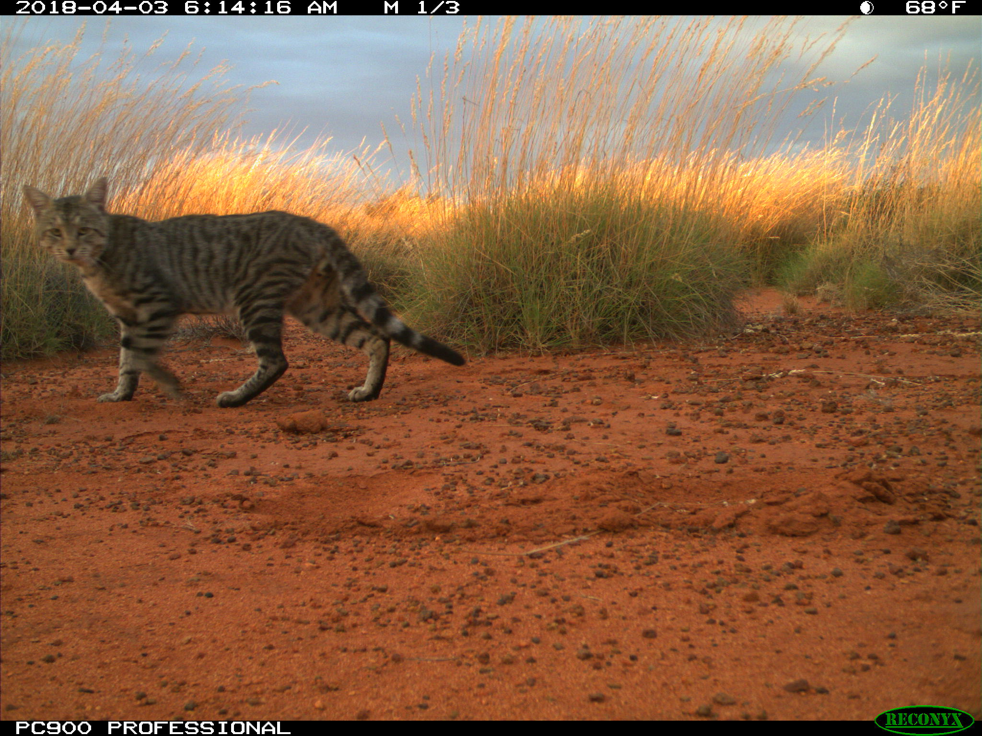
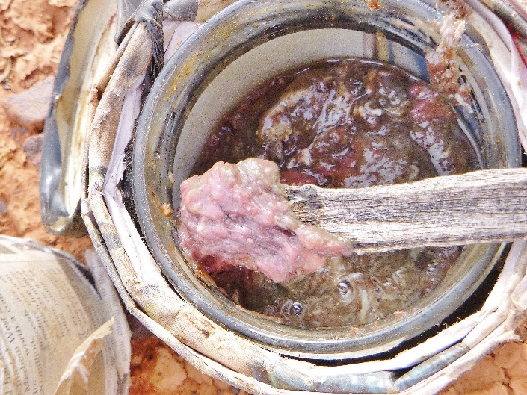
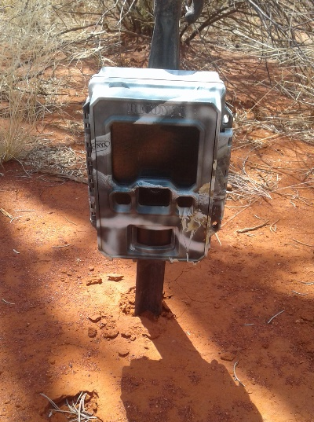
Camera-traps
Notes:
In more recent years we’ve een using camera-traps.
We have, however, continued to use the TAI as a second method of measuring cat activity because Matuwa is a site that is difficult to duplicate.
Kurrara Kurrara, another ex-cattle station to the north has different landsystems.
Jundee station to the west is a mining site with very different management history.
So we chose to use multiple methods of monitoring feral cats over time, using independent data sets to corroborate data trends over time.
We also work at a landscape scale, which means some monitoring sites are 50km apart and less prone to autocorrelation.
Our camera traps are usually lured and placed at least 30m from a road.

Slide 5
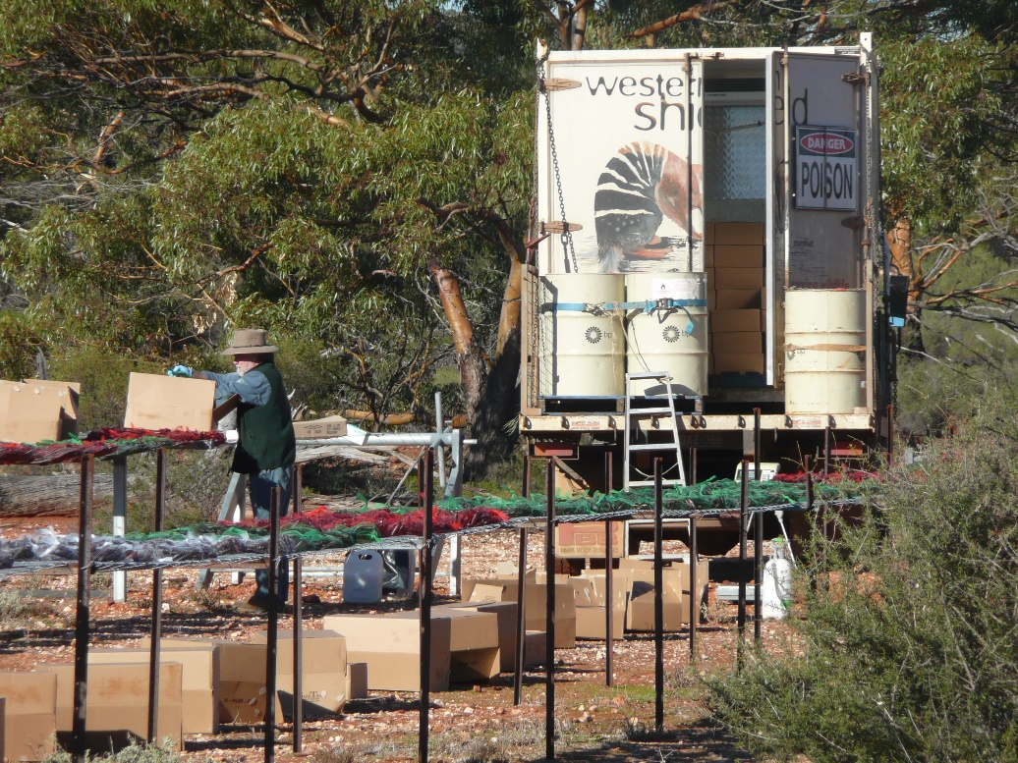
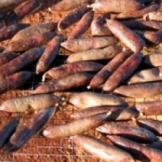
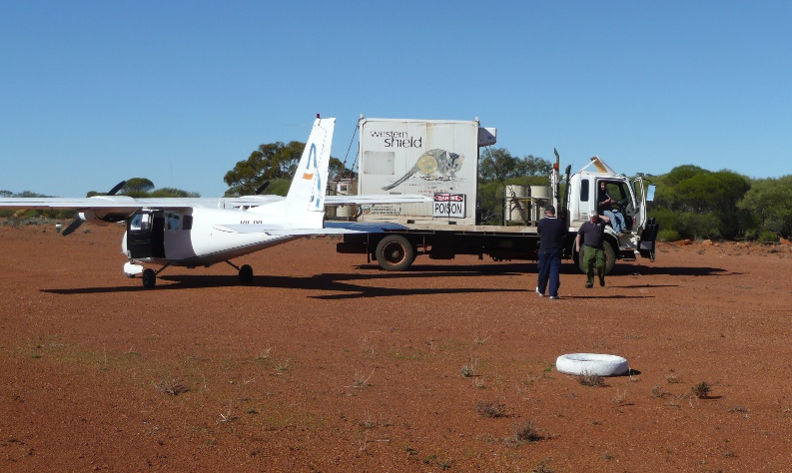
Eradicat
Notes:
Why try to count cats?
Because we want to know if our cat management techniques are working.
As many of you would know DBCA implements the Western Shield program, whereby we spread sausage baits that contain 1080 over the landscape via aircraft.
1080 is an unpleasant toxin, so it is important that we check to see if it is working, if we are achieving our conservation goals by spreading the bait.
We’ve been using these baits on Matuwa every year since 2003.

Slide 6
Is it working?
Notes:
Looking at our TAI data, which is the longest time series data we have – we were seeing some concerning trends.
Before management we started with 26 cats/100km.
That declined sharply when we first started using the bait. Then in 2012 cat numbers started to return. That sparked the new round of research we have been doing on feral cat management since 2018.

Slide 7
Aerial baiting v ground baiting
Notes:
First trial – aerial baiting v ground baiting
I won’t go into a lot of detail about each of these studies as it would take too long, but I’m more than happy to chat to folks after the presentations if you want more details.
We split Matuwa in half, aerial baited the east, and hand baited tracks in the west. Continued to use both TAI and cameras to monitor cat activity.
The blank area here is a buffer between our 2 treatments 5km wide and was not baited at all.
We found that while it was more expensive, aerial baiting was more effective in terms of the reduction in cat activity.
Both baiting applications worked best after leg-hold trapping had occurred.

Slide 8
Jump start
259 cats
Notes:
In fact, a few months of leg-hold trapping, which removed 259 cats from the property, seems to have jump started the system, with cat detection rates dropping well below our threshold in subsequent surveys…

Slide 9
Jump start
Notes:
and reduced the % of trapped cats that are adult males.
This is important because there is a difference between young inexperienced animals and older cats in terms of how effective they are as a hunter.
We’ve also hypothesized that the reason the Eradicat baiting didn’t appear to be working was because the cat population was biased towards older, experienced males that have less need, and hence less desire to scavenge. Lactating females, and inexperienced, hunters, however, might scavenge more and hence are more susceptible to the bait.
Remove the experienced males with some trapping and the baiting suddenly appears to be working again.

Slide 10
But then cats disappeared from the cameras
Notes:
Cat control is a long-term management action. So research continues. We were going to try and identify individual cats on the cameras and calculate a real estimate of abundance.
But the cats disappeared from the cameras.
Good thing we were still using the TAI – which confirmed cat activity is low but not gone.
Why did the TAI detect cats when cameras didn’t. Continuous survey of 100km of linear track ultimately covers 3 times the land area that 130 cameras can cover, for half the cost.

Slide 11
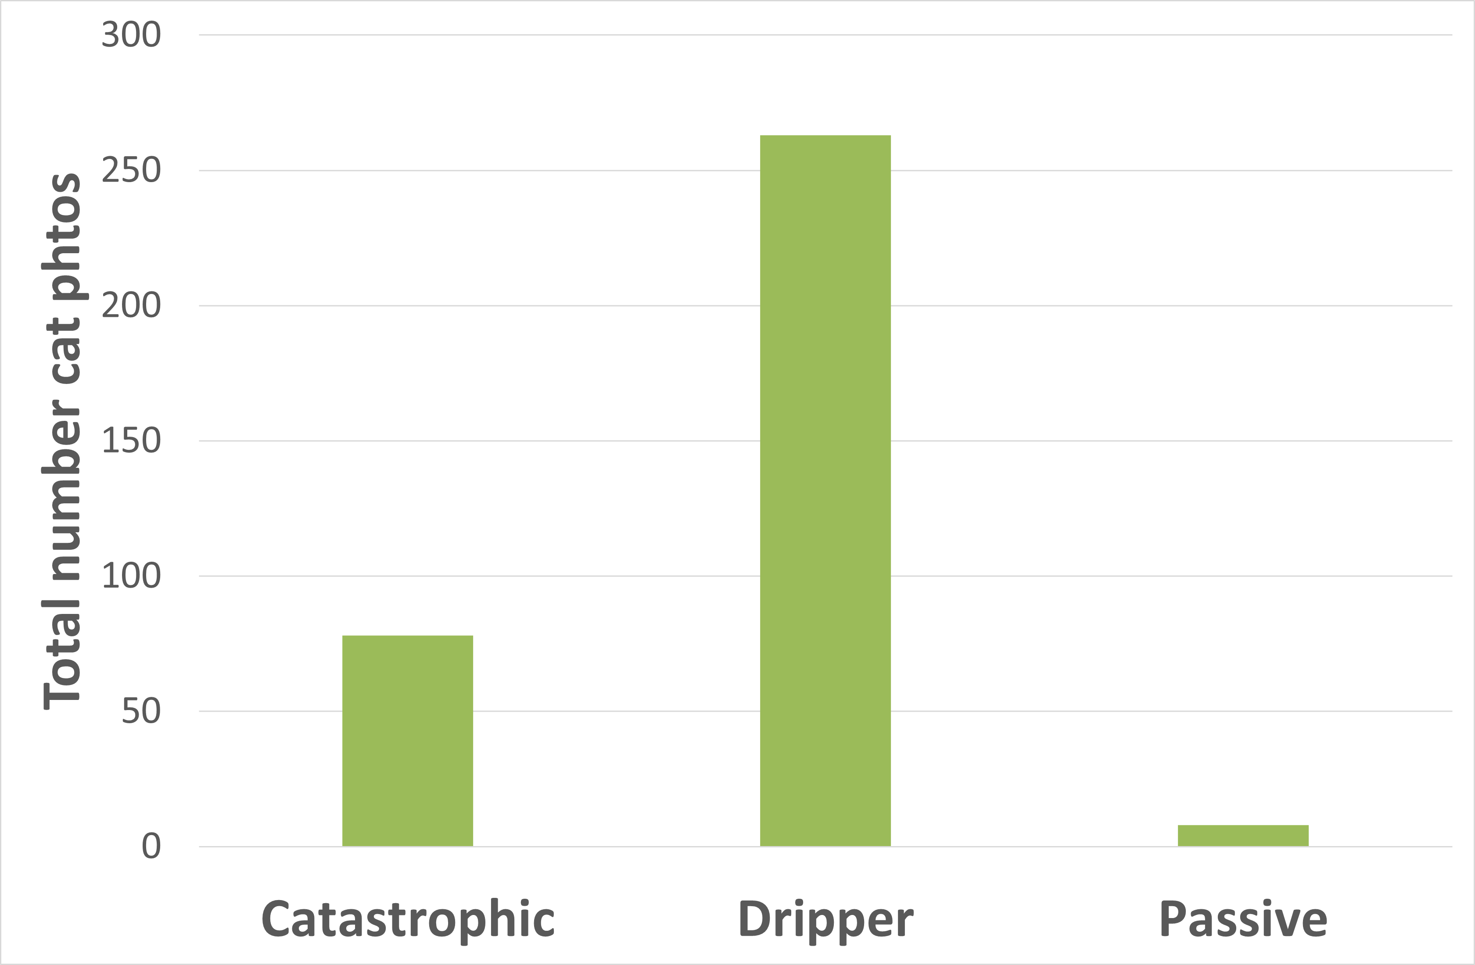
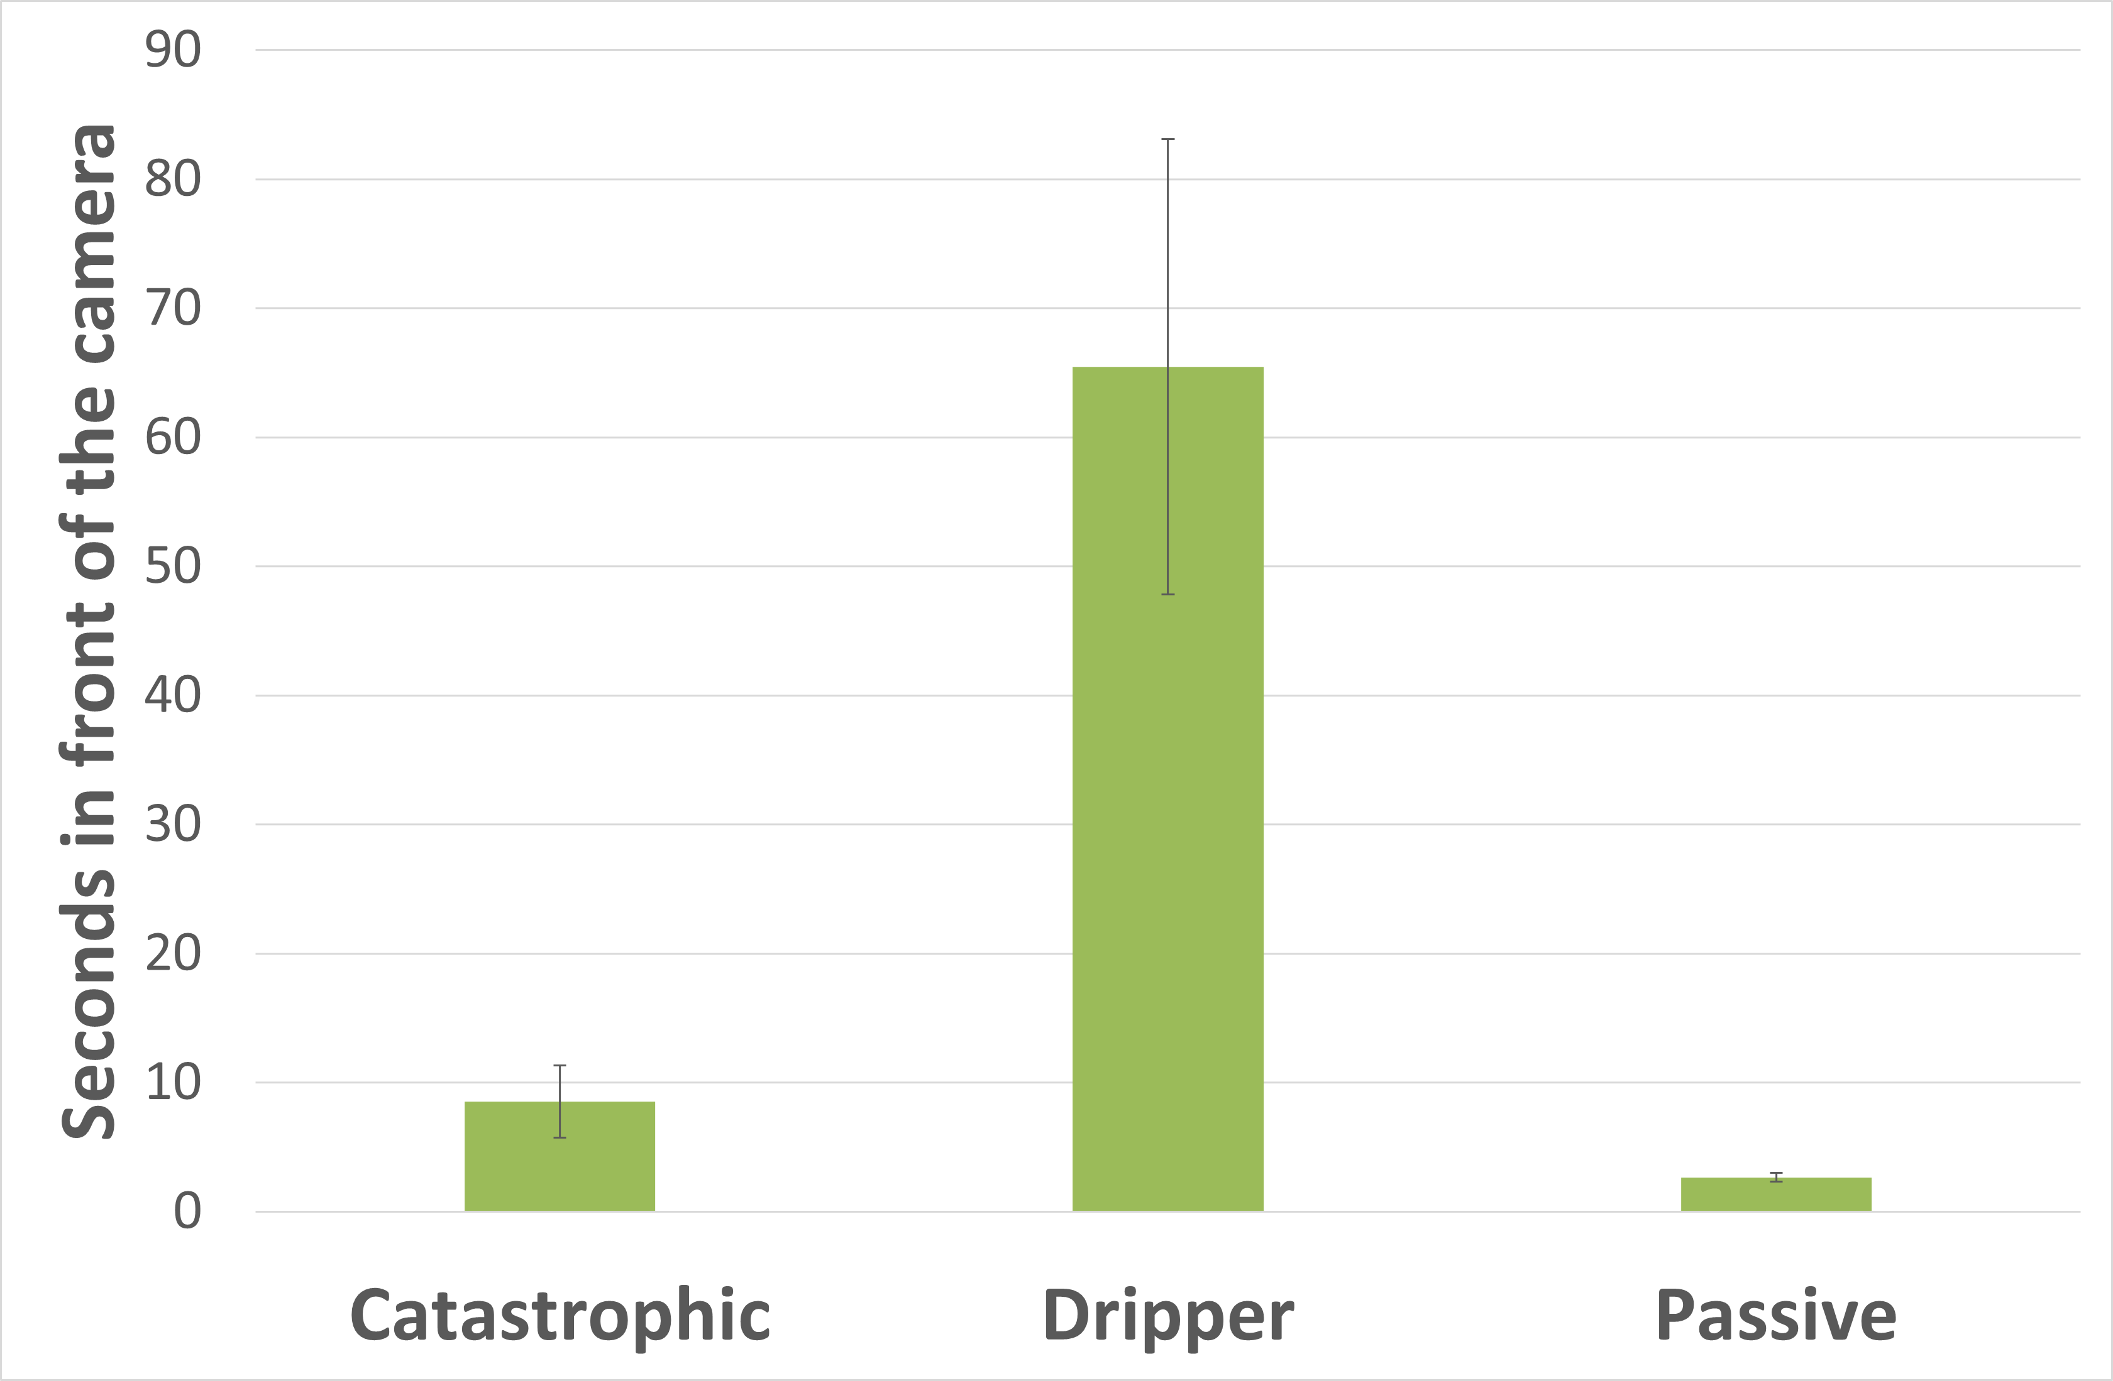
How do we improve camera detections?
Notes:
How do we improve camera detections of feral cats.
Folks would tell me to position the cameras so they face the road because cats like to walk along the road – but that increases the risk of autocorrelation between sample sites, and besides we have the TAI for that.
How do we improve camera detections for feral cats in the bush?
Trial different lures.
Between 12th of June and 9th of August 2022 we set 120 pairs of cameras
One camera at every site was lured with Catastrophic – which has been our standard lure in the past. Lovely stuff.
The other camera was either a passive camera with no lure, or we used a liquid lure that slowly dripped from these bags hanging above a stake. From trials here in Perth, it takes about 2 weeks for the drippers to completely empty – thought time depends on temperature of the bag.
What did we find?
Passive cameras detected 8 cats total in 2 months!
Catastrophic cameras found 78.
Drippers found 263.
Cats spent less 3 seconds in view of a passive camera, 9 in front of a Catastrophic camera, and 65 seconds at a Dripper.

Slide 12
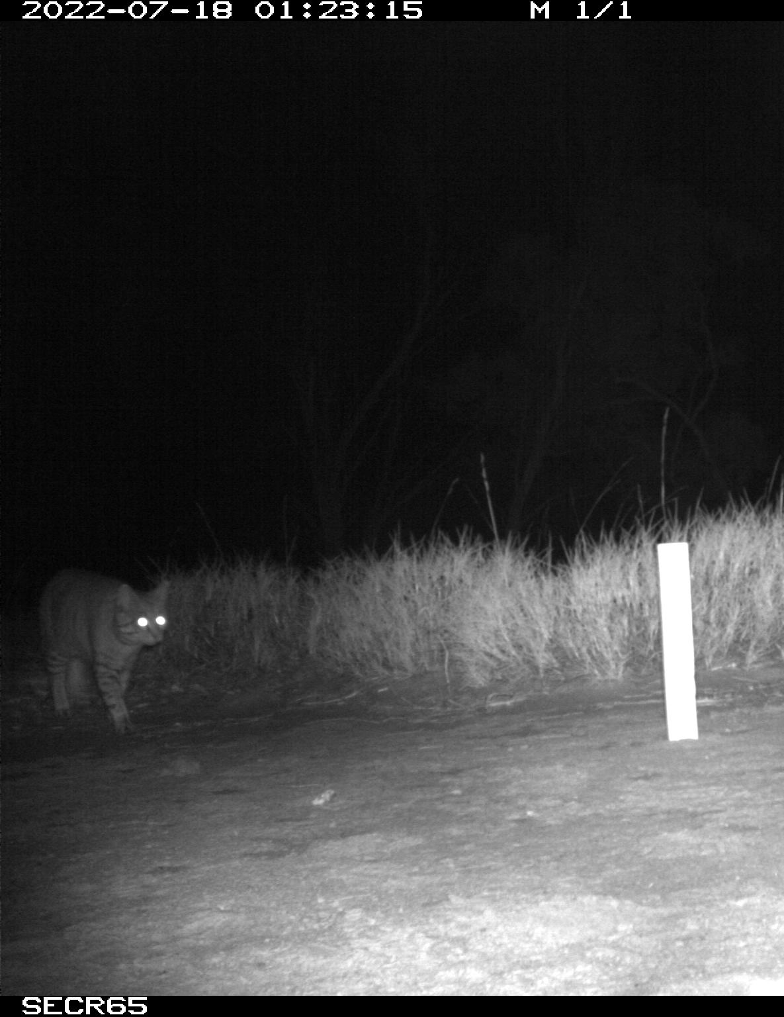
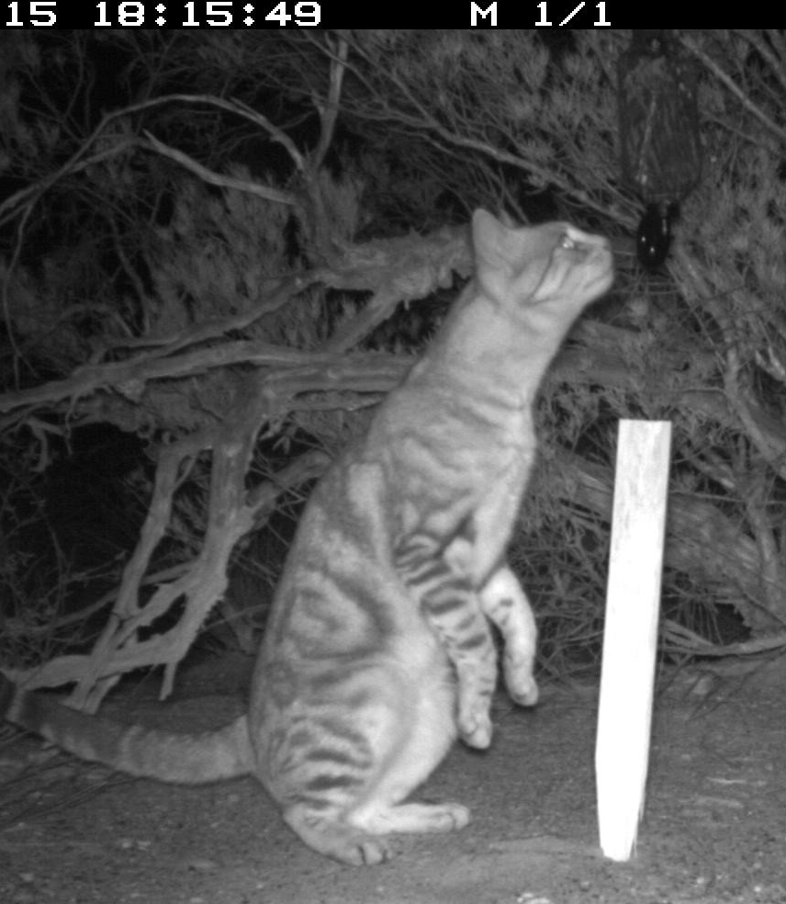
How do we improve camera detections?
Passive
Dripper
Notes:
The amount of time spent in front of the camera effects the quality of the photograph and how the cat behaves around the camera.
I couldn’t identify the individual in front of the passive camera, but I can get some great information on the coat pattern of the cat in front of the Dripper.

Slide 13
How do we improve camera detections?
Notes:
We’ve done a lot of work on Matuwa monitoring cats over the years.
We’ve made management decisions based on data that we are getting from cameras lured with Catastrophic plus the TAI
We’ve recorded wide fluctuations in cat numbers and our TAI has stayed below our threshold for a few years now.
So I want to leave you with a question
Would our data have the same trends in it if we used Drippers as our standard lure instead of Catastrophic? How many cats would you see on your site if you switched to the Drippers? How could that effect your conclusions?

Slide 14
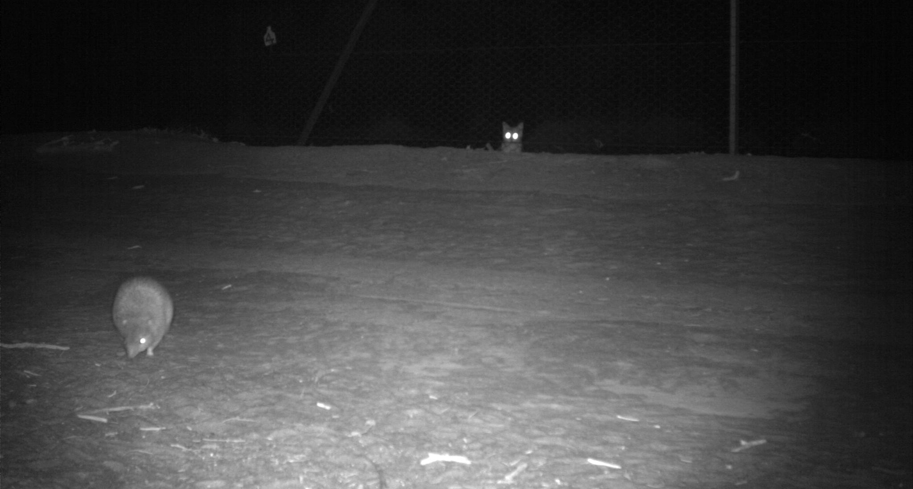
Thank you

