Slide 1

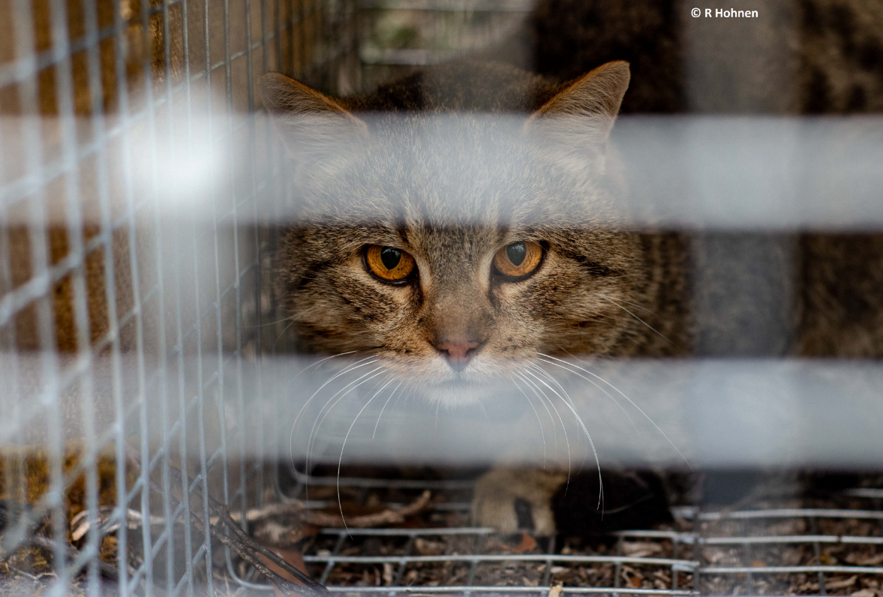



Kangaroo Island Feral Cat Eradication Program
James Smith
Josh Mulvaney Nathan Lennane Cheryl-Ann Monks Emily Reynolds Bronwyn Fancourt Denny Murphy

Slide 2
How much do feral cats kill?
Reptiles
Birds
Mammals
466,000,000 per year
272,000,000 per year
99% native
815,000,000 per year
56% native
Woinarski et al. (2019) Wildlife Research
Woinarski et al. (2019) Biological Conservation
Murphy et al. (2019) Biological Conservation

Slide 3
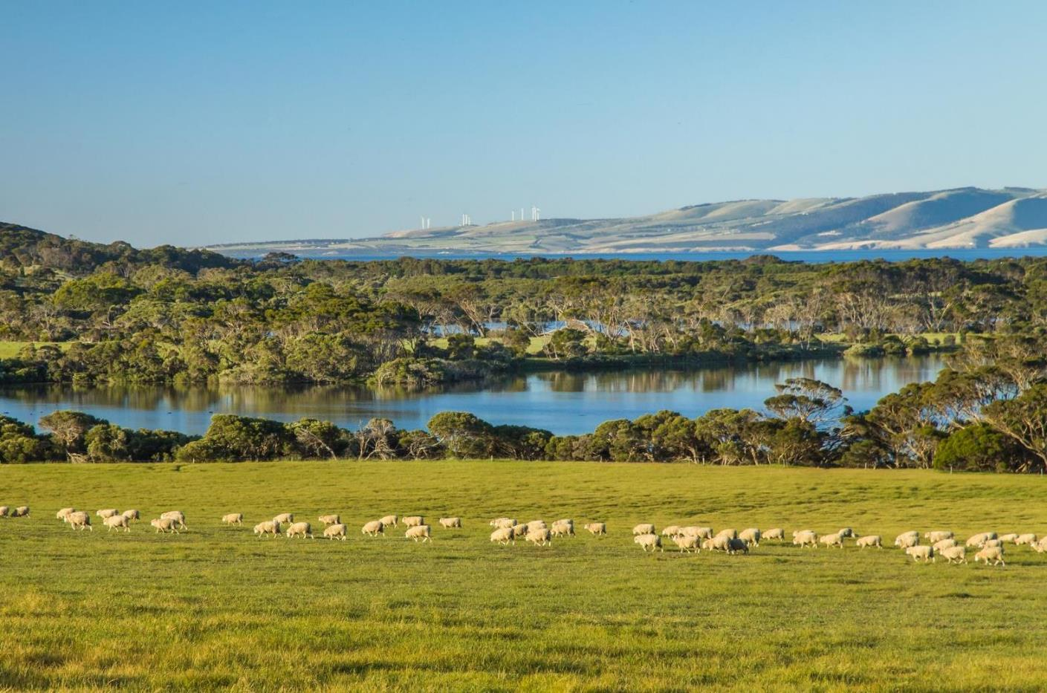
Feral cats spread diseases to wildlife and livestock
89% of feral cats on Kangaroo Island carry the Toxoplasmosa gondii parasite
Toxoplasmosis is fatal to many native animals
Toxoplasmosis can have severe impacts on human health
Costs KI farmers between $10 – 20m annually

Slide 4
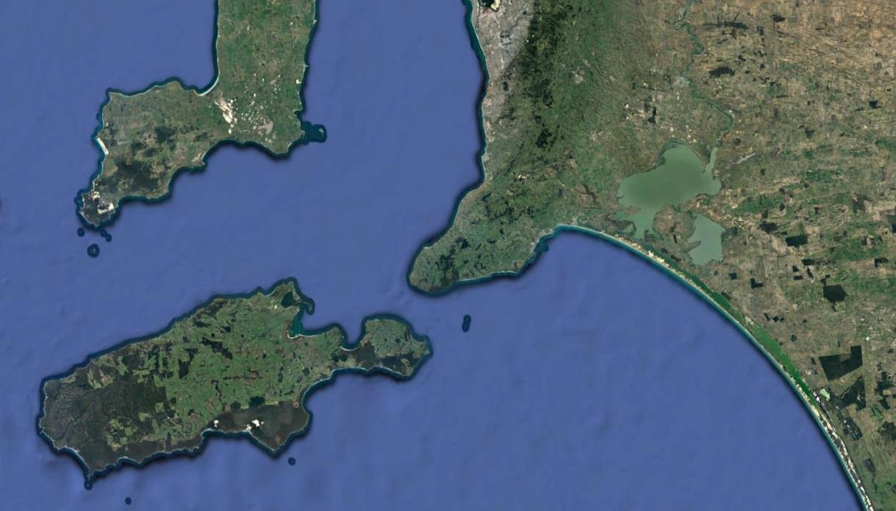

Why are KI impacts so much higher?
Feral cat densities 10 x higher
Notes:
No foxes or wild dogs – many more cats to fill that niche, our feral cats are our foxes and dogs
Reduce cat densities not an option – just equal mainland densities
Cool, humid conditions
KI = double whammy

Slide 5
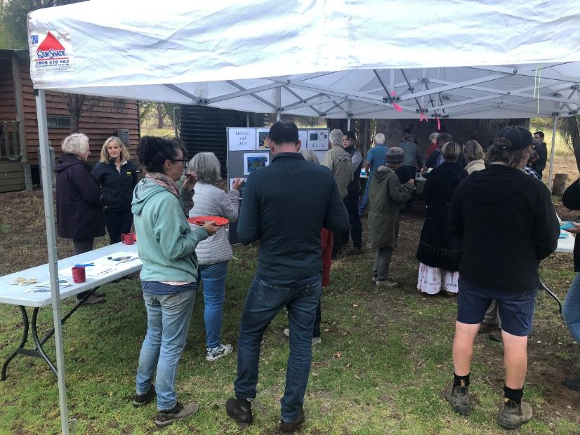
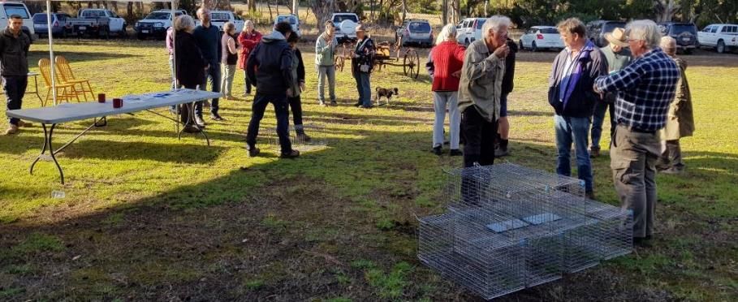
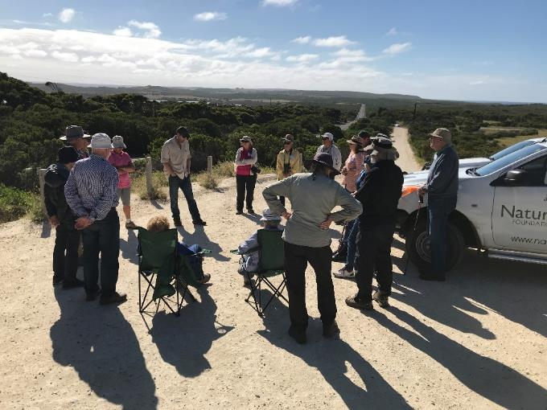
Unprecedented landholder support
Widespread community support (99.2%)
All sectors of the community see its importance
Community have been actively involved for over a decade
Notes:
Farmers can’t legally destroy cats captured within 1 km of their house, so they appreciate our efforts
Environmental and farmers

Slide 6
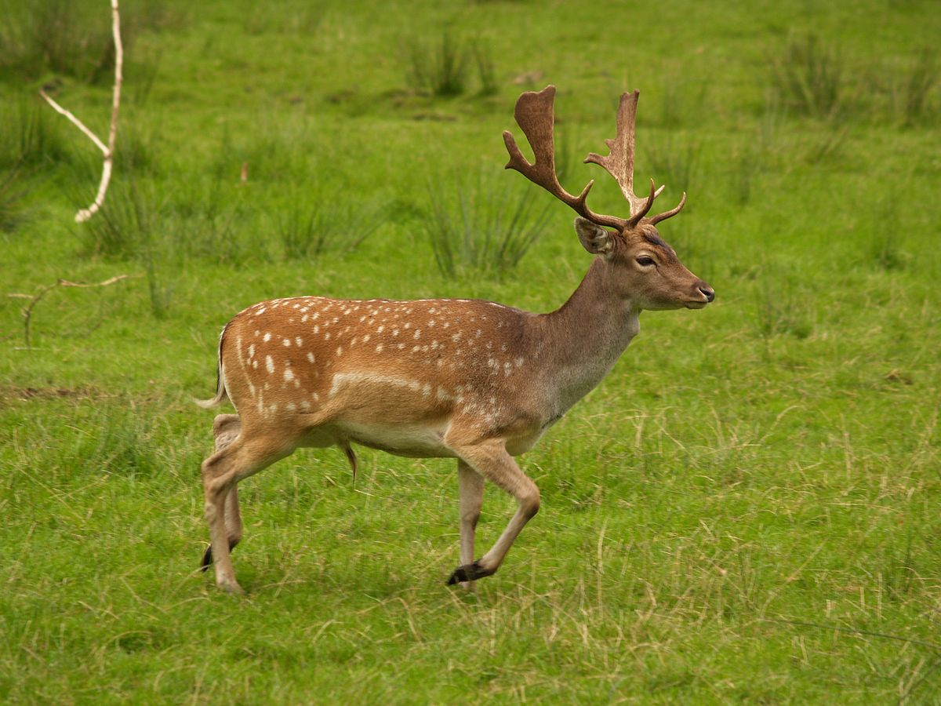
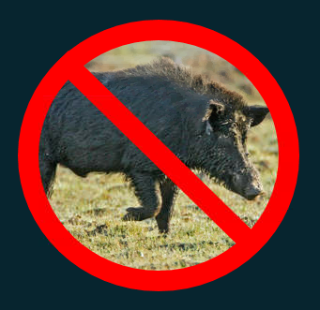
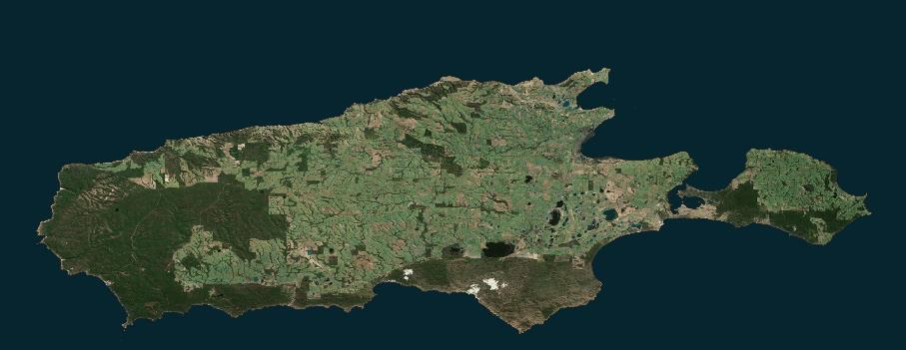
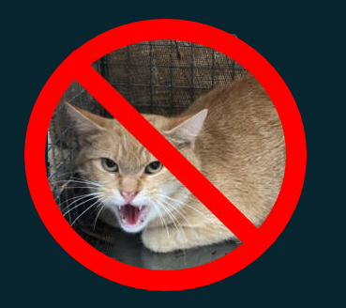
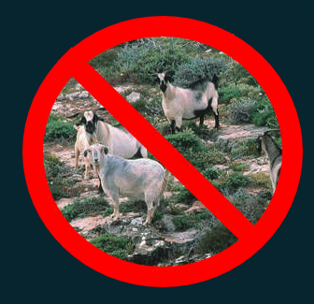

Proven track record with eradications
Notes:
KILB eradication staff working on the PIRSA feral pig eradication to help them
Feral cats are the last remaining invasive mammal

Slide 7
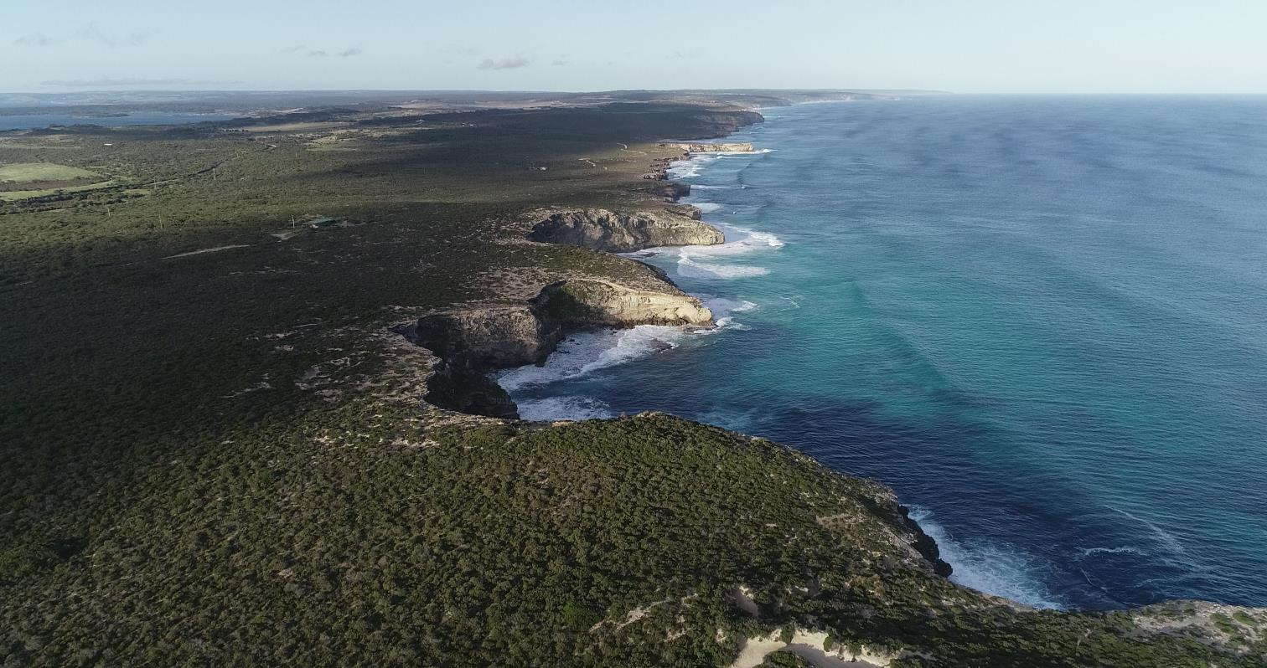
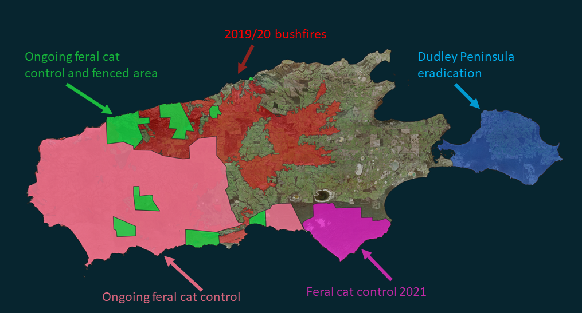




Towards whole of island eradication

Slide 8

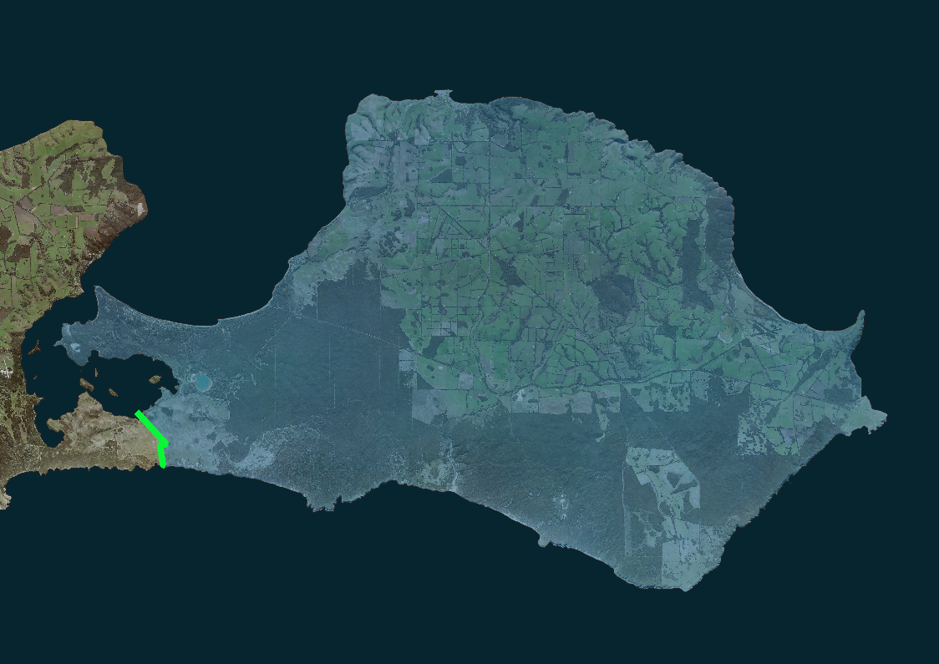
Dudley Peninsula feral cat eradication
Dudley Peninsula
384 km²
Predator proof fence

Slide 9
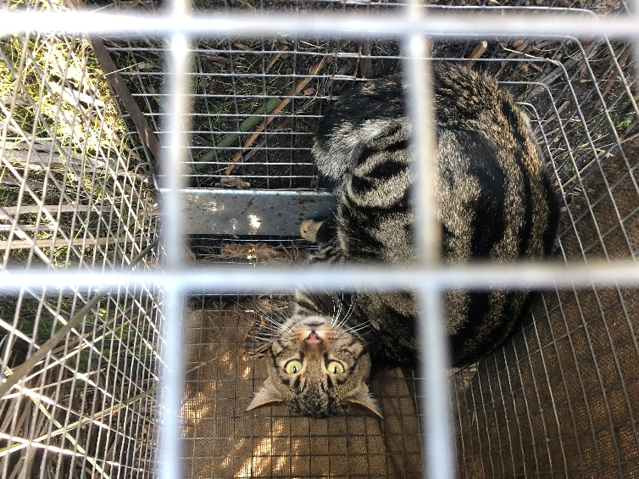
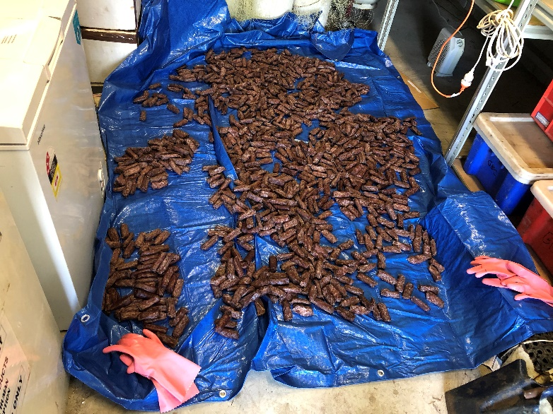
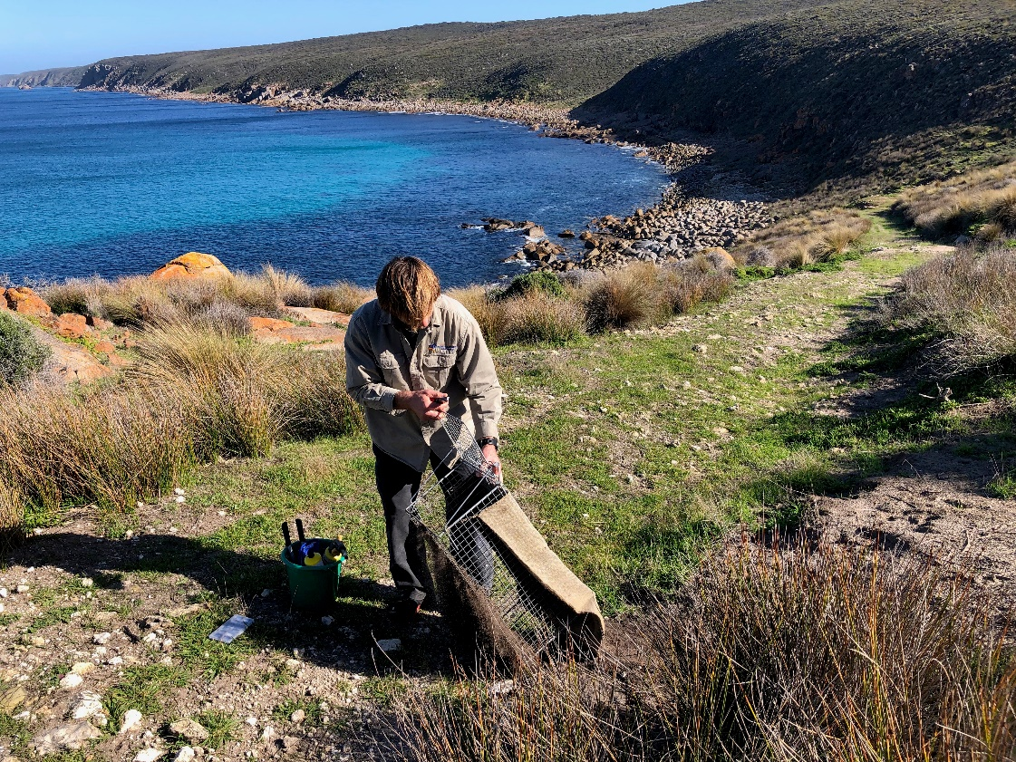
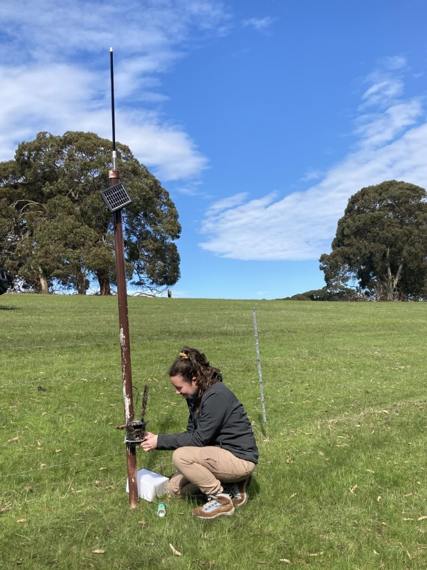
Whole suite of control tools
Eradication
Cage trapping
Foothold trapping
Baiting with Curiosity®
Felixer Grooming traps
Thermal Shooting
Detector dogs
Monitoring
Remote cameras
Landholder reports
Thermal survey
Detector dogs
New Technologies
Notes:
Toxo vaccine – ongoing cost + doesn’t fix sarco
Eradicate – a PERMANENT solution
Big island
Starting with DP

Slide 10
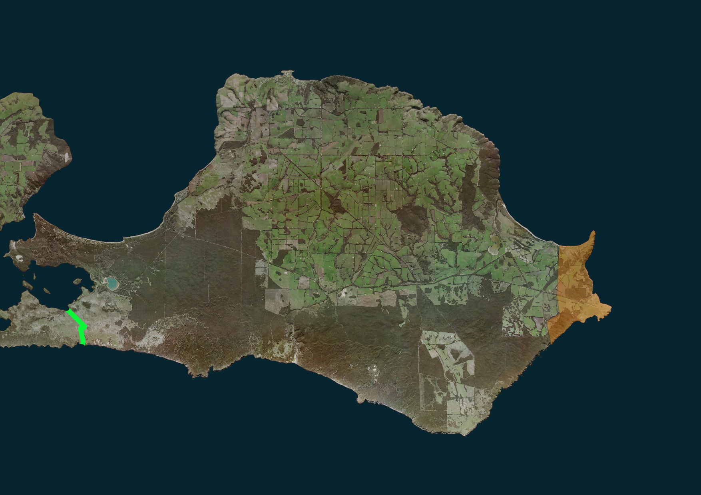
Rolling eradication front
No large scale knockdown tool
Area too large
Too many sheepdogs
(can’t bait)
May 2020
Initial eradication begins

Slide 11
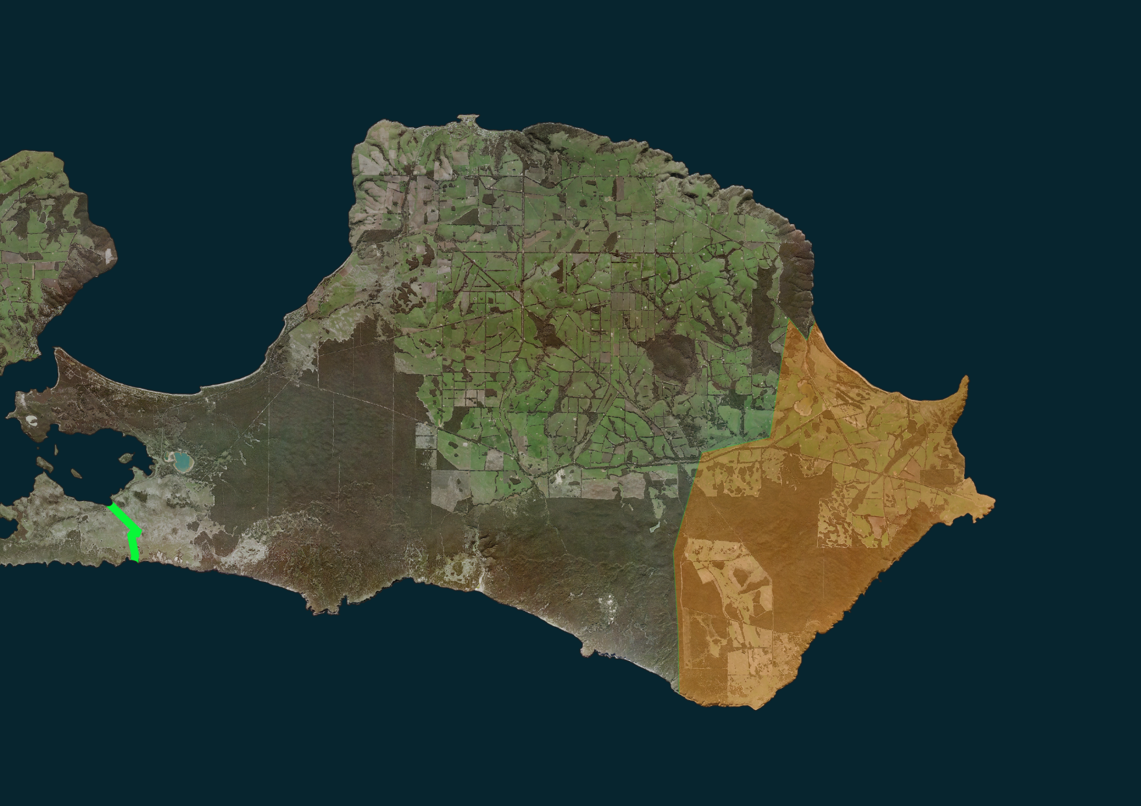

Slide 12
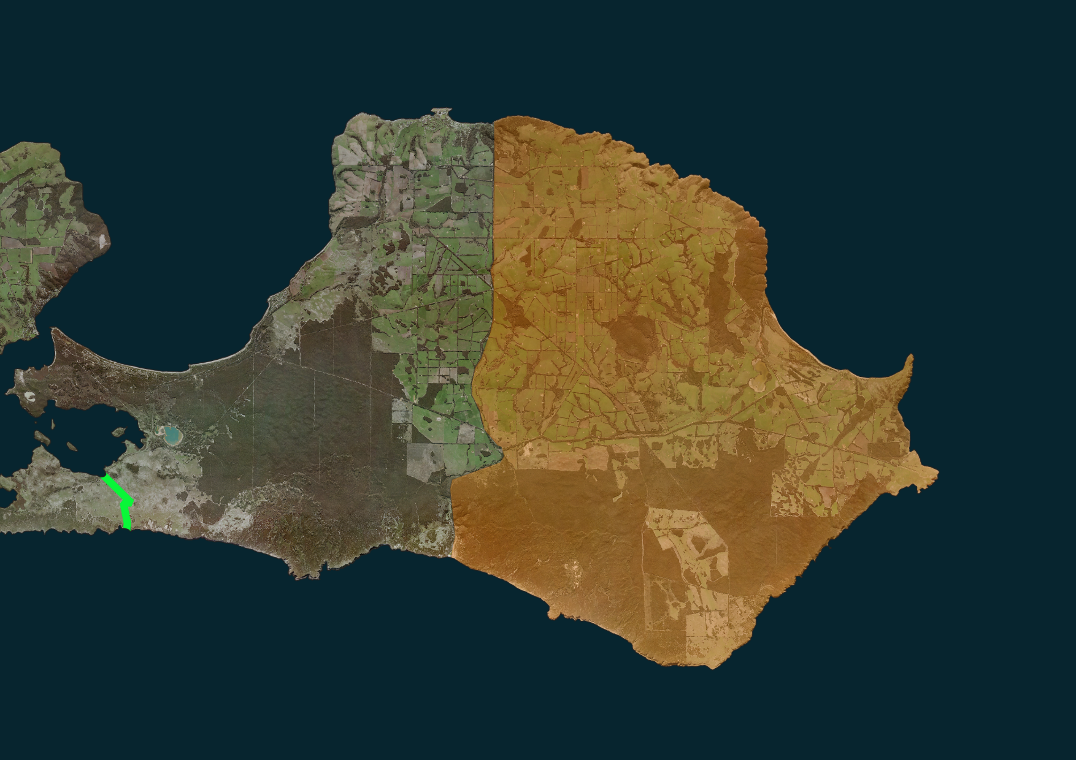
Large area for monitoring “behind us”

Slide 13
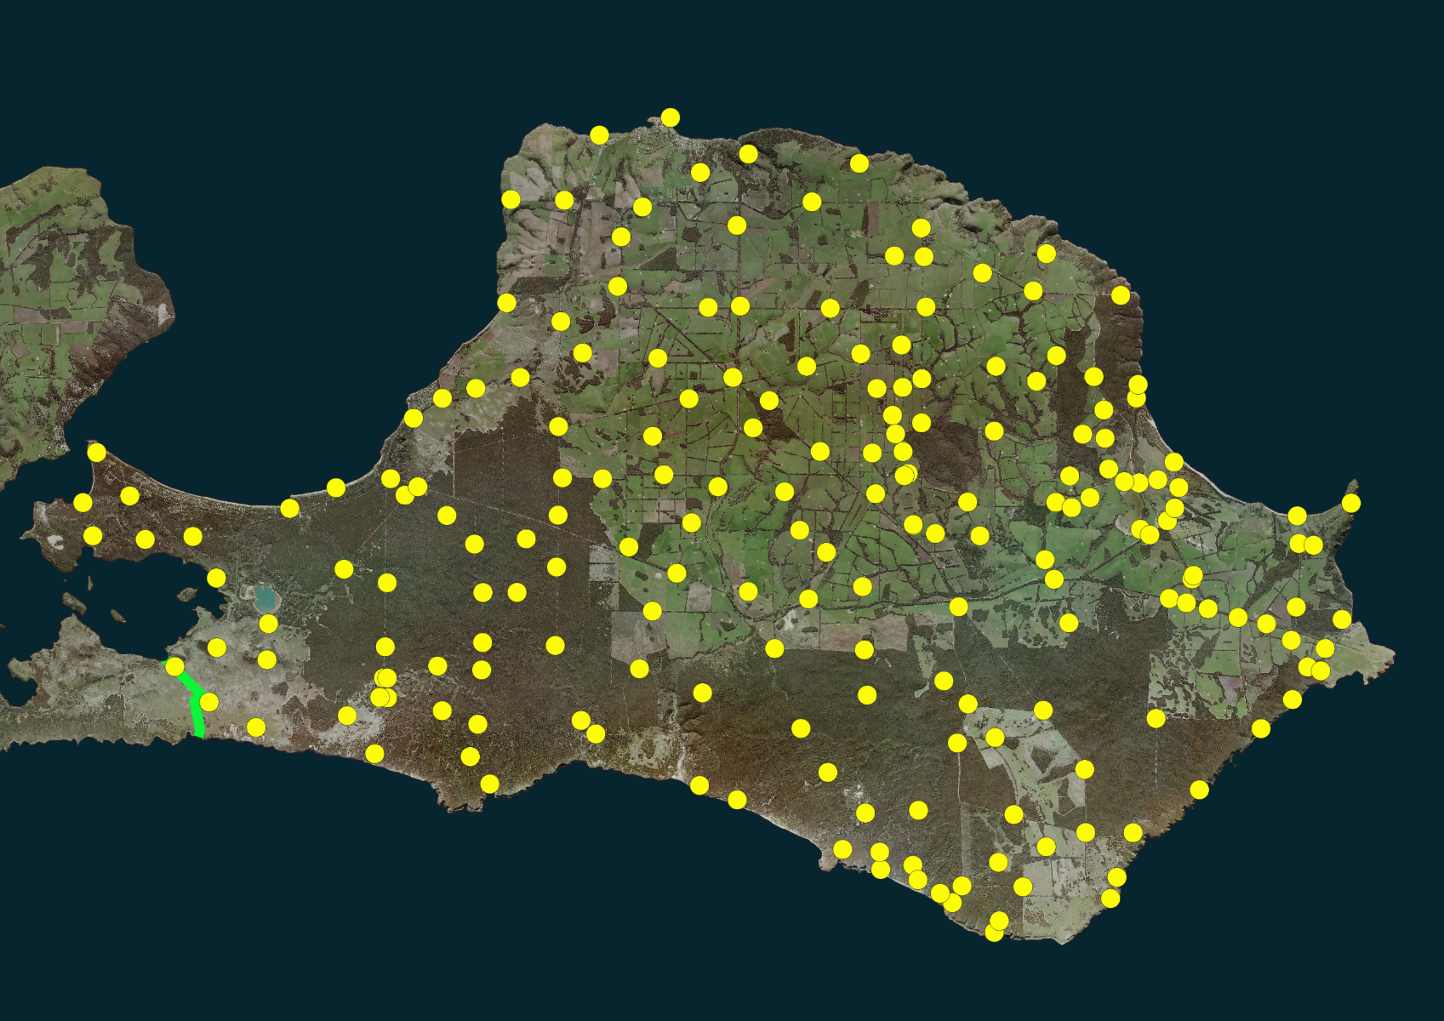
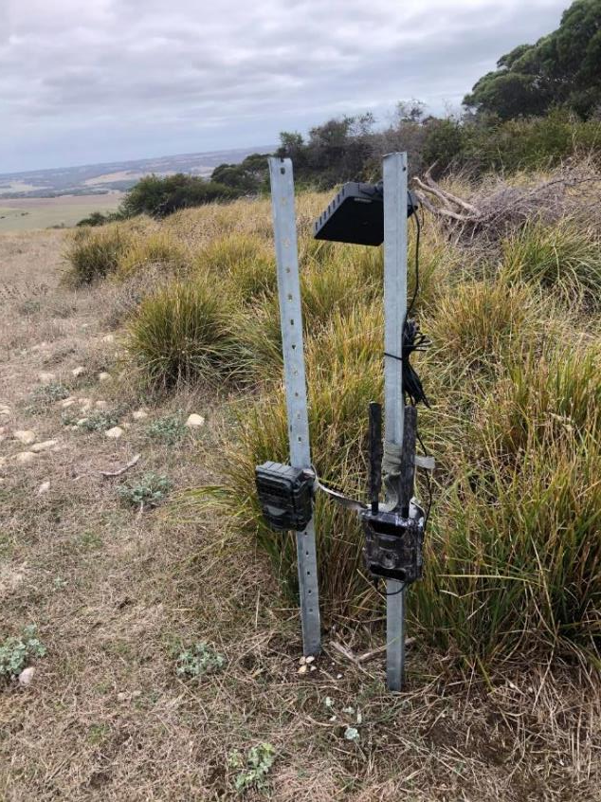
4G camera network- coupled with AI

Slide 14
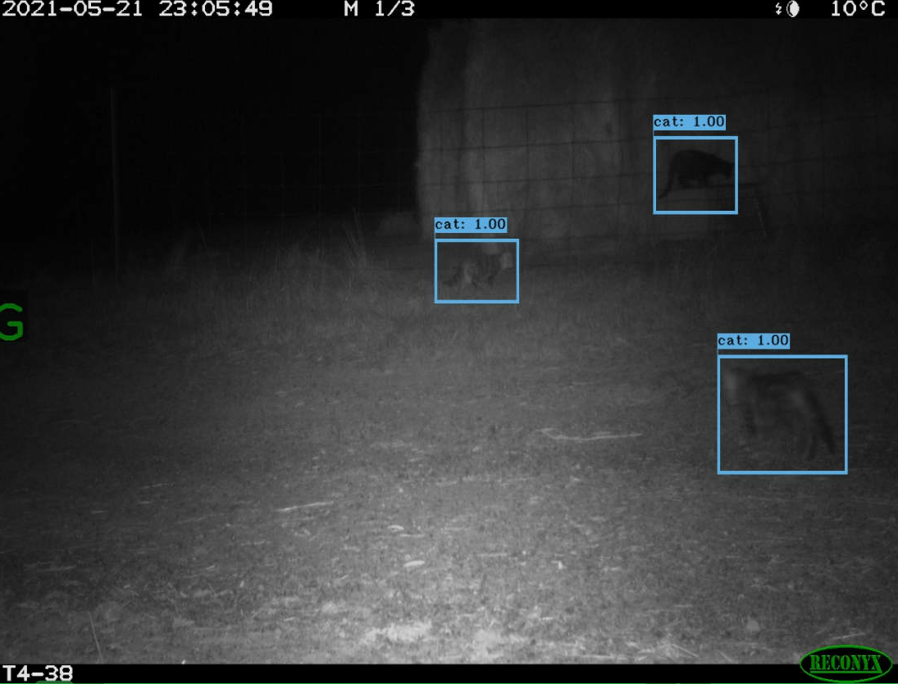
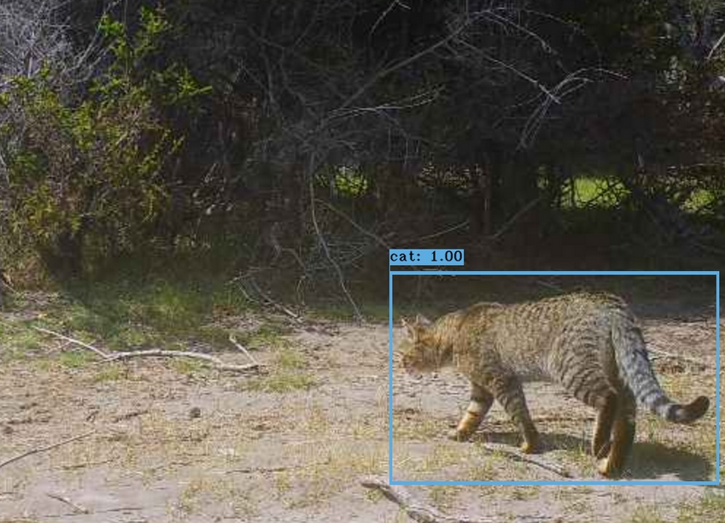
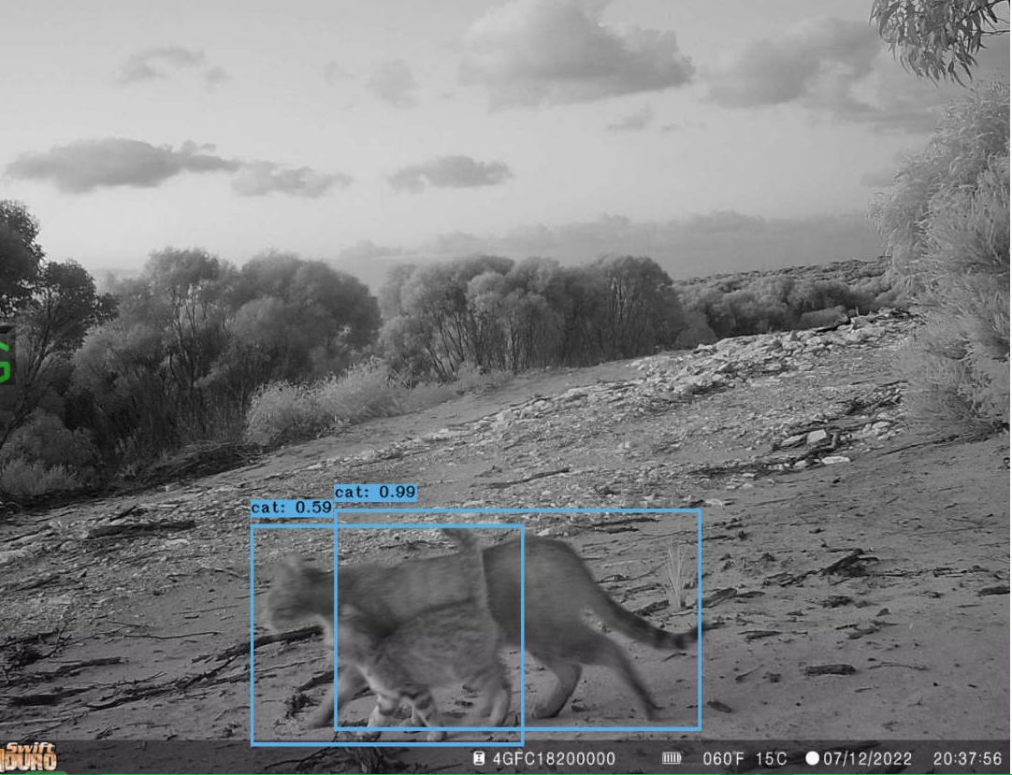
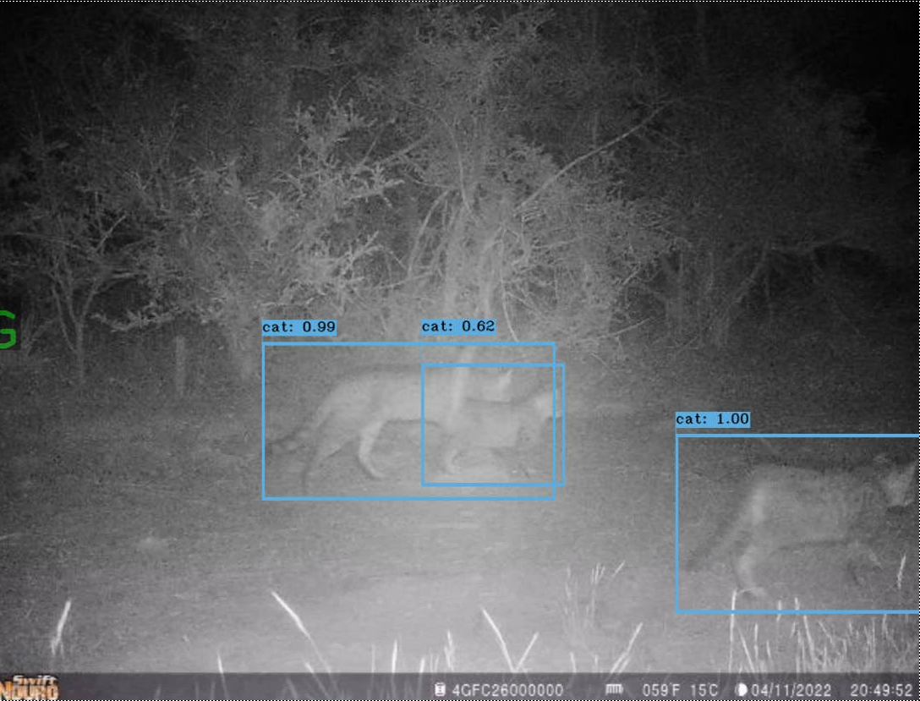
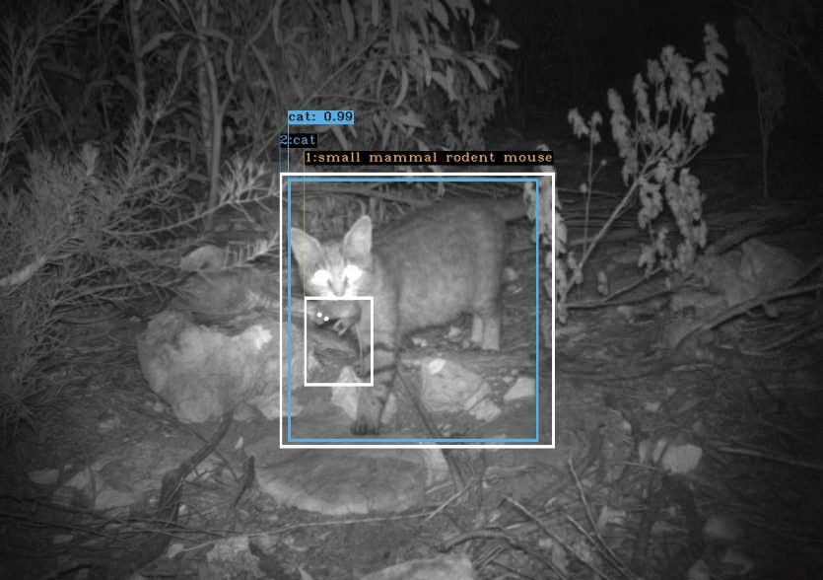
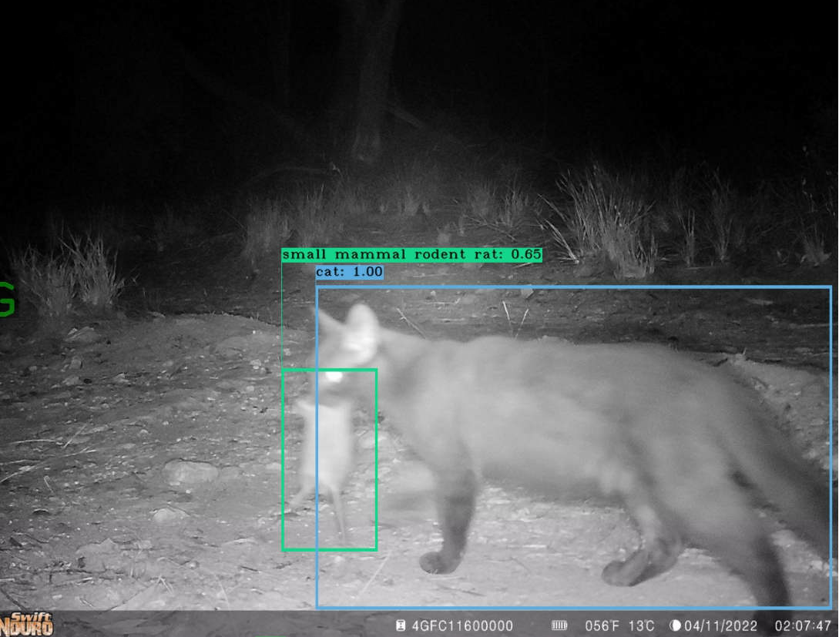
Notes:
Connected to evorta AI algorithm

Slide 15
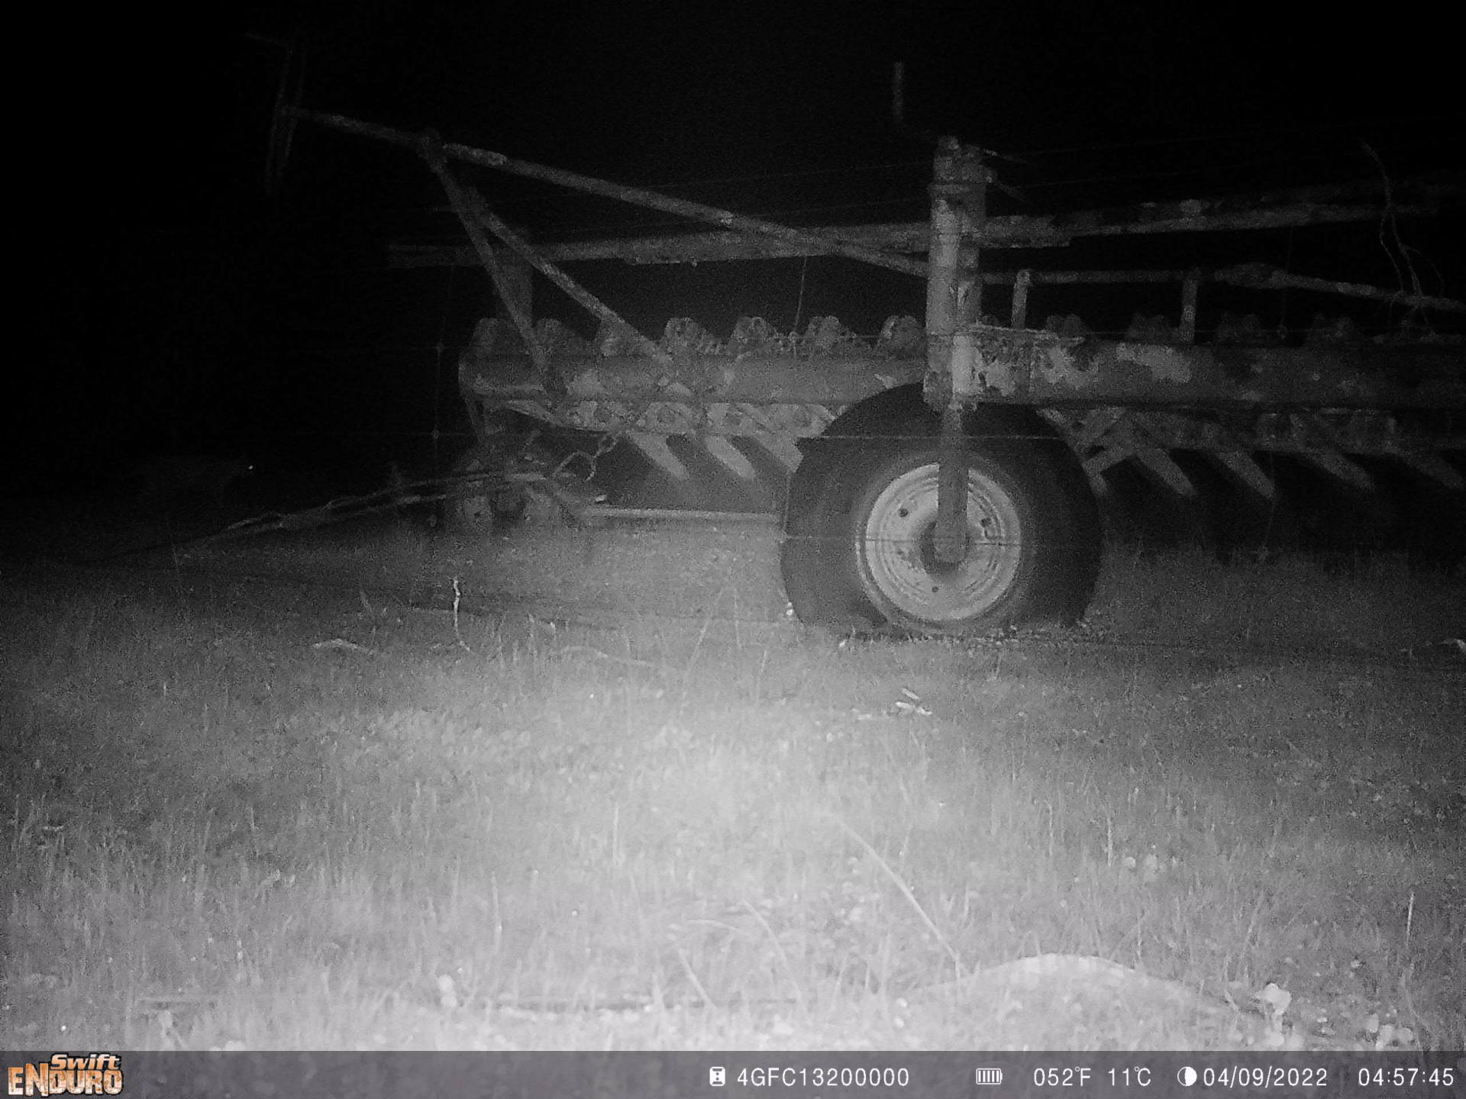

Slide 16
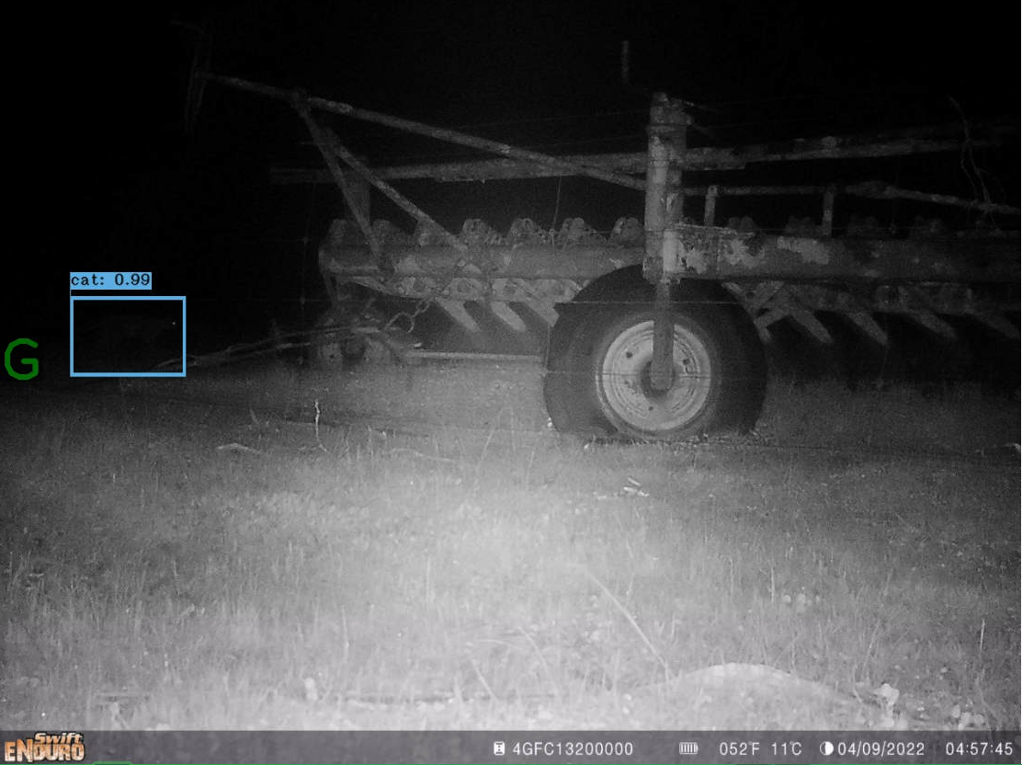

Slide 17
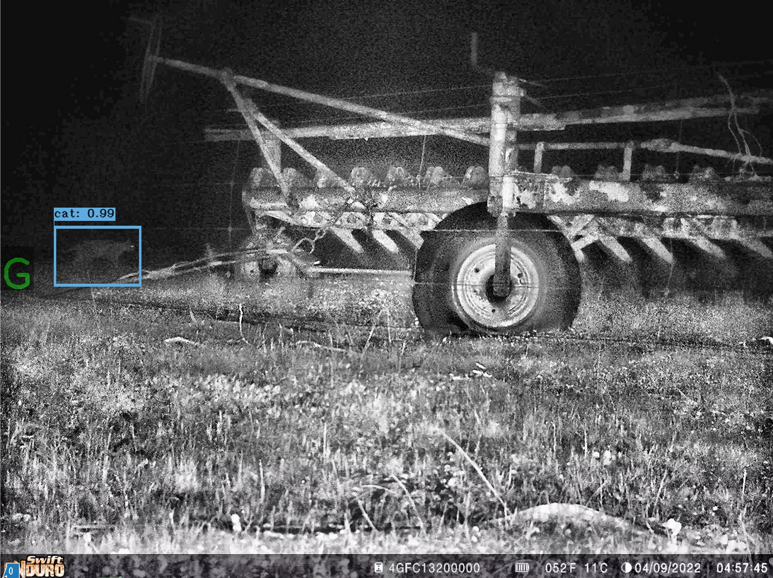

Slide 18
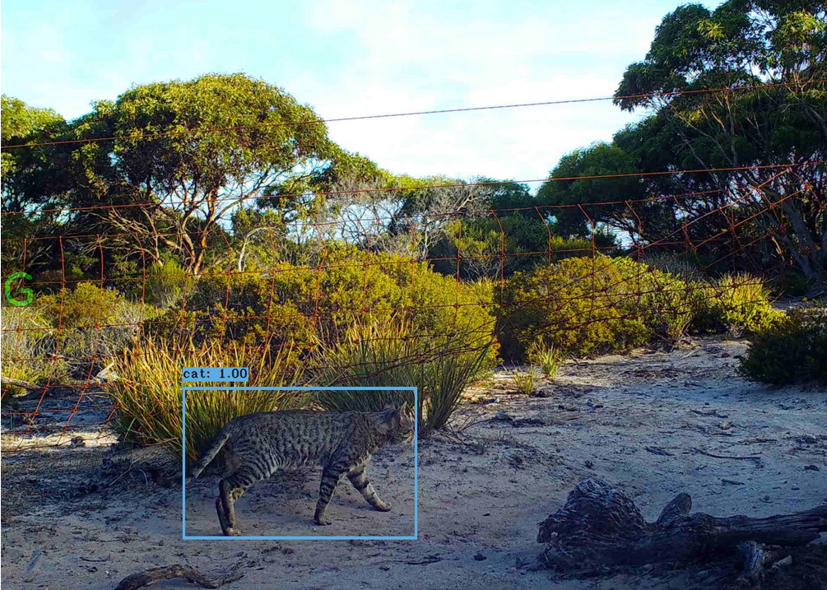
Faster and better than humans at classifying animals
Saves 88.8% of staff time
Saves ~14 tonnes of CO₂ per vehicle annually
All at no extra cost now deployed
(ms in preparation)

Slide 19
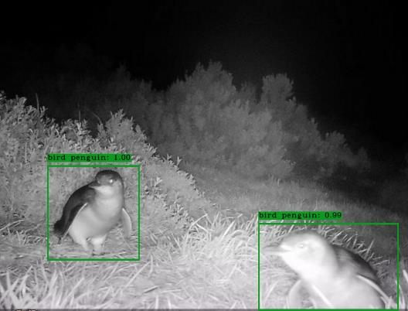
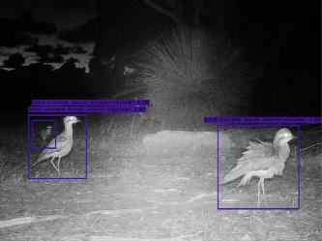
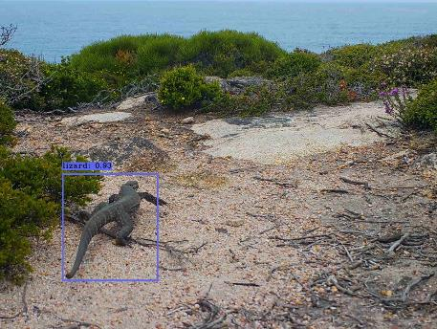
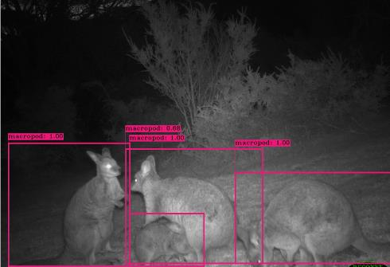
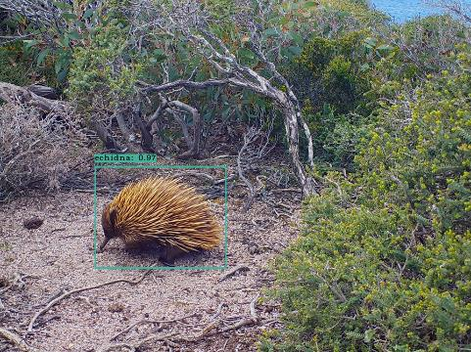
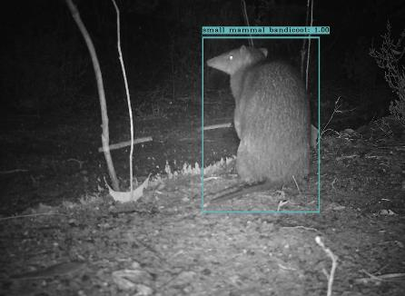
Little penguin
Bush stone-curlew
Rosenbergs goanna
Tamar Wallaby
KI echidna
Southern brown bandicoot
Notes:
Also trained to identify lots of native animals
Allows us to monitor response of threatened species to feral cat removal
Feral pig eradication program have now followed our lead and using it (where 4G)

Slide 20
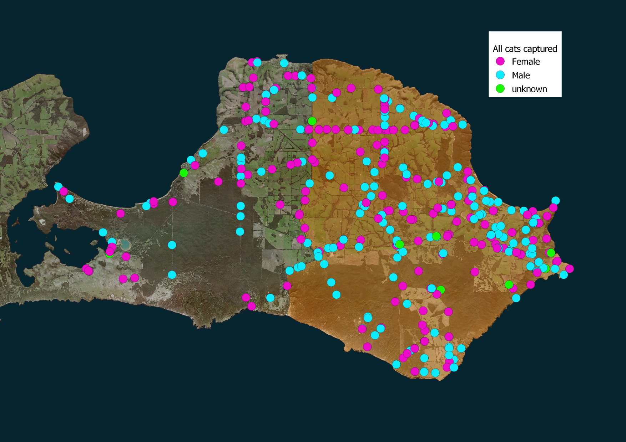
Only around 10 cats in the orange zone (200 km²)
Over 670 feral cats trapped and removed
Hundreds more baited

Slide 21

Moving forward: June 2024
Bulk of eradication work complete

Slide 22
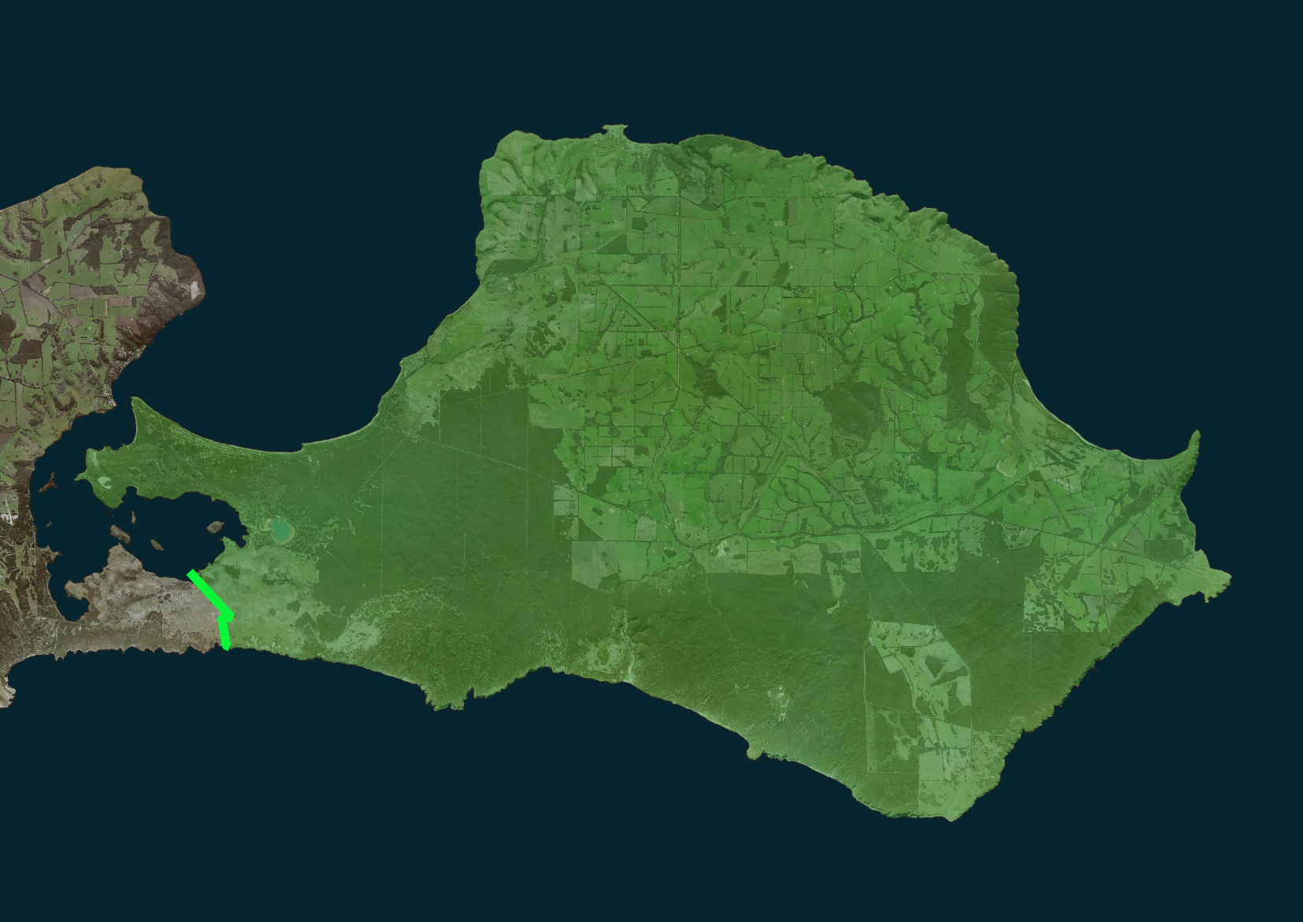
Moving forward: June 2025
12 months of monitoring
Eradication declared

Slide 23
Towards whole of island eradication

Slide 24
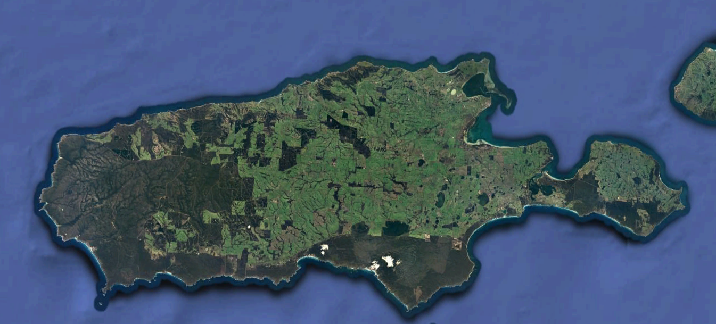
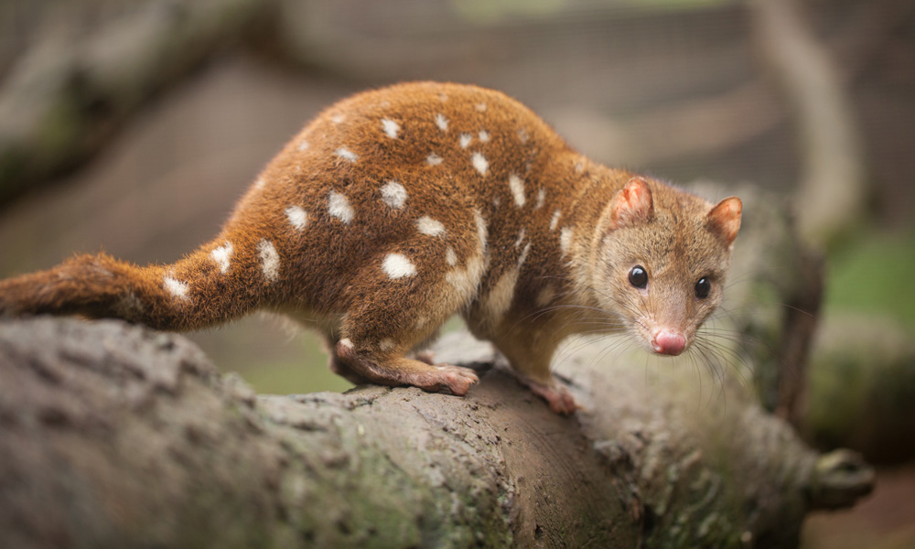
Once free of feral cats
The possibilities are endless!
© WWF

Slide 25


Slide 26


















Thanks to all our supporters and collaborators

