Slide 1
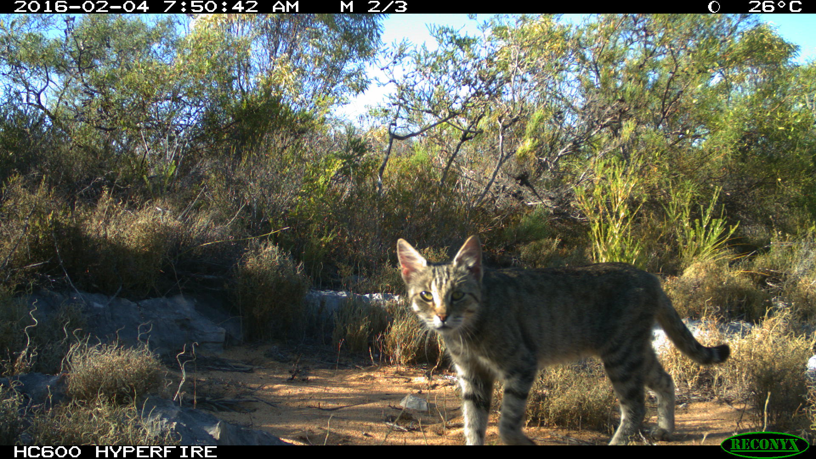
Feral cat management in complex management areas
A comparison of toxic baits for feral cat and fox control in southwest Western Australia: An Adaptive Management experiment testing the effectiveness of cat management in complex management areas.
Daniel C. Gwinn^{1,2}, Michelle Drew³
¹ Biometrics Research, Fremantle, WA.
² Ooid Scientific, North Lake, WA.
³ Ecosystem Health Branch, Department of Parks and Wildlife, Kensington, WA.

Slide 2
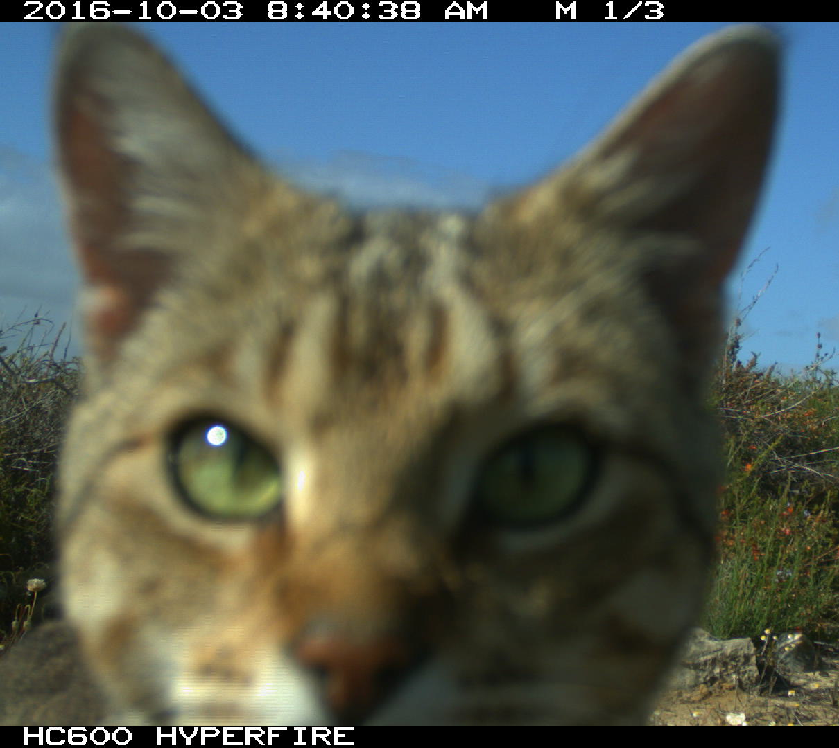
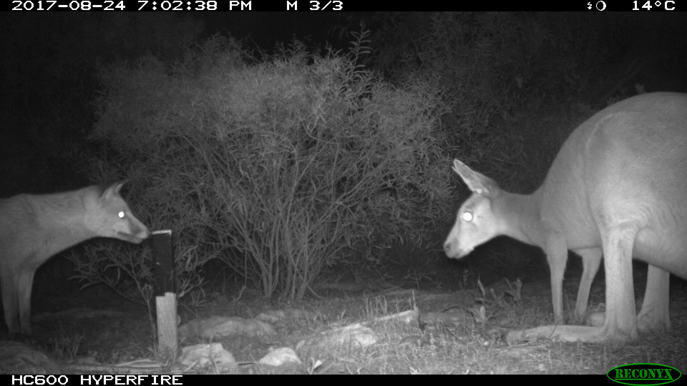
Background
Feral cats and European red fox — damaging invasive species
Extinction of 30 Australian mammals and threatened the existence of a further 125 mammal species
Eradicat® toxic (1080) meat bait develop to target feral cats
Effective in reducing cat activity in some environments (e.g. Algar et al 2010, 2011, Doherty and Algar 2015).
Yet to be fully tested in wetter biomes
We tested the efficacy of integrating Eradicat® and Probait (fox bait) at a complex site on the northern sandplains of Western Australia.
Notes:
Feral cats and the European red fox are arguably two of the most damaging invasive species in Australia.
Both species have been implicated in the extinction of 30 Australian mammals and continue to threaten the existence of a further 125 mammal species.
Eradicat®, is a meat based toxic (1080) bait that was developed specifically to target feral cats.
And this management tool has been shown to be effective in reducing cat activity in arid Western Australia (Algar et al 2010, 2011, Doherty and Algar 2015).
However, its success is not always consistent (Moseby at al 2011) and the capacity of the bait to work effectively in wetter, temperate biomes is still subject to operational trials.
In this study we tested the efficacy of integrating Eradicat within an existing fox baiting program at a relatively complex area on the northern sandplains of WA using an adaptive management experiment.

Slide 3
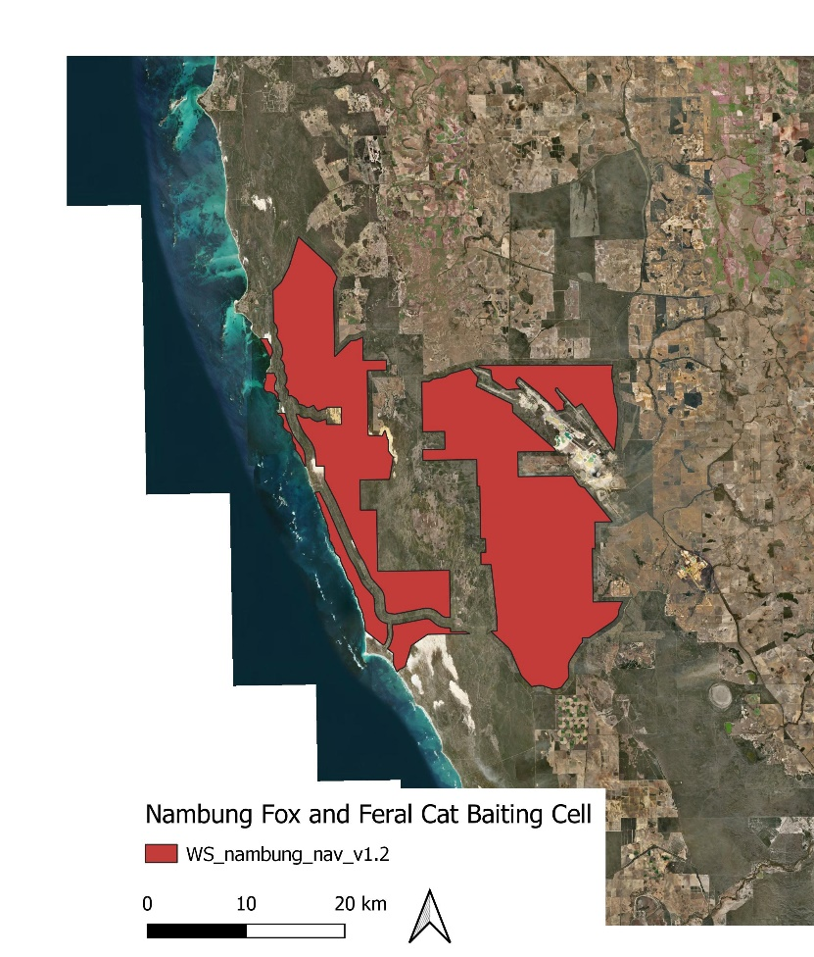
Study area
Nambung National Park and Southern Beekeepers Reserve
Complex boundary
Highly modified landscape
Fox baited twice per annum 2014-2016
Between 2016 and 2018, a single Eradicat bait/ annum was added to the existing fox baiting prescription
700 km²
All baiting ceased in 2018
Notes:
Nambung National Park and associated reserves are located near Cervantes Western Australia.
The current management area has a complex boundary, with high edge-to-core ratio with a large capacity for immigration of species from surrounding areas
And is largely surrounded by cleared /highly modified properties
Nambung NP also has high visitor rates, preventing baiting of the entire reserve area.
The red area on the map constitutes approximately 700 square km and was baited with two deployments of fox bait per year from 2014.
From 2016 the fox prescription was adjusted to include an annual Eradicat bait for three years.

Slide 4
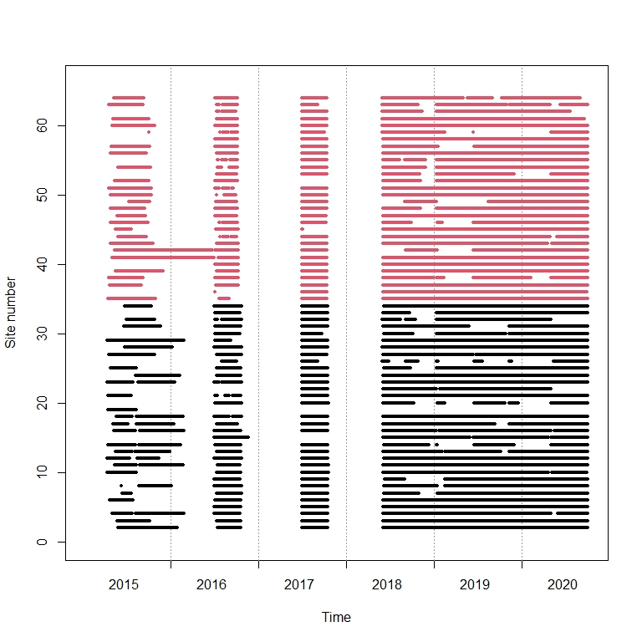
Methods
Adaptive management experiment
Contrast in the data to improve resolution
Developed novel spatiotemporal dynamic occupancy model
“What is the effect of baiting on predator activity and how does this effect attenuate with time since the bait deployment?”
Inclusion of baiting attenuation allowed us to identify the length of time baiting was effective.
Camera monitoring (BACI)
Notes:
Because past attempts to evaluate baiting effects have been hit and miss, we changed our approach in this project in two key ways.
First, we implemented an adaptive management experiment by altering our baiting regime using a reverse approach — as such all baiting ceased in late 2018.
This aimed to create contrast in the data and improve the resolution of our analysis.
Secondly, we developed a novel spatiotemporal dynamic occupancy model.
This allowed us to account for density-dependent influences on cat activity levels that can mask the potential effects of baiting on cats
And how baiting effects attenuate with time
This allowed the model to better describe the period of baiting effectiveness and account for any lags that will likely be important for determining optimal baiting frequency
Monitoring was implemented using cameras within the baited area and a nearby non-baited control area to establish a Before-After-Control-Impact design

Slide 5
Modelled bait impacts
Cat activity reduced by < 20% (50 days after baiting)
100 days post baiting this impact was negligible
Foxes 94 – 99% reduction, 50 days post baiting
100 days later this effect was reduced to 20%
The impact was dependent upon the starting activity levels
At sites with high starting activity (ca. 0.9) — the reduction in activity was predicted to be less
Extremely large confidence intervals for models involving feral cats, this reflects the rarity of detecting cats on camera
Notes:
Modelling identified that cat activity was reduced by less than 20% up to 50 days post Eradicat baiting and by day 100, the reduction was no longer detectable
In comparison there was 94 - 99% reduction in foxes 50 days after Eradicat baiting, but this effect was quickly reduced to less than 20% 100 days after the bait drop
Modelling identified that the total impact was dependent upon the starting activity levels
With reductions in activity levels predicted to be less at sites with high starting activity (ca. 0.9)
Extremely large confidence intervals for cats reflected the rarity of detecting cats on camera (2966 cat detections over 5 years, compared to over 24 000 for foxes in the same time frame).

Slide 6
Recovery rate/ bait attenuation
Days
Notes:
Figures above show the modelled recovery response of both feral cats and foxes after reducing activity to 0.01 in the absence of additional management
Both foxes and feral cats had the capacity to recover from baiting within four months,
Potentially because of the high level of immigration to the site facilitated by the high perimeter-to-area ratio and the small scale of the baiting area within a highly modified landscape
Clearly identified the need to have regular ongoing management, rather than singular management events

Slide 7
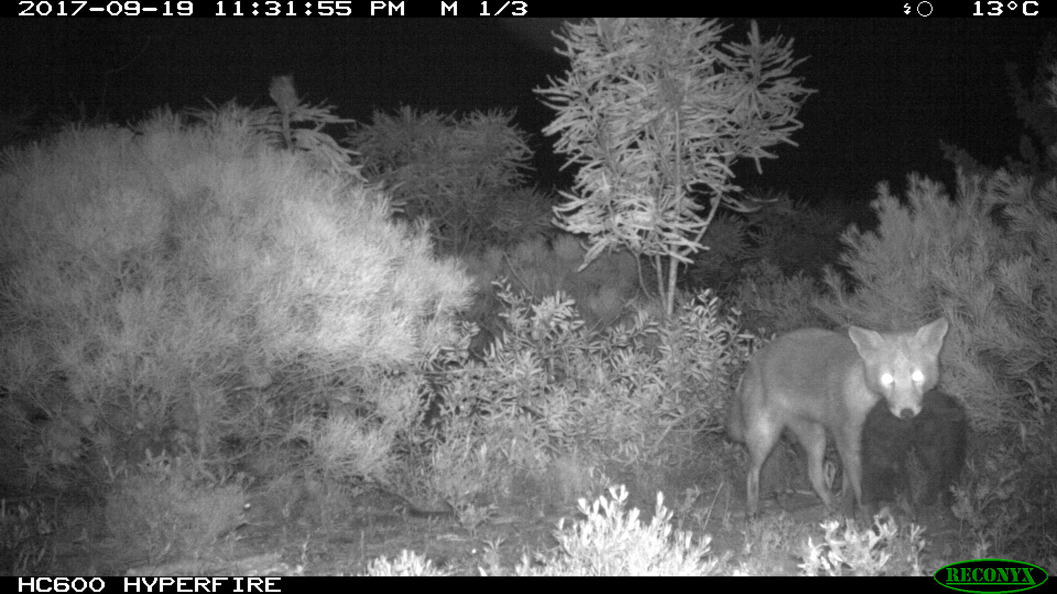
Conclusions
Subheader
Notes:
Our model predicted that the maximum potential reductions in cat activity would likely not exceed about 25% at this site
Compensatory mechanisms, such as migration from the broader landscape quickly masked the impact of the baiting, resulting in the total feral cat activity not changing substantially over time
Other behavioural changes may have also contributed to the minimal change in activity post baiting.
Given the massive reduction in foxes immediately post baiting it is possible a change in cat behaviour may have potentially increased their detectability, counteracting any impacts from feral cat baiting
There was evidence of foxes predating cats at Nambung suggesting cats may actively avoid foxes at this site.
Although Eradicat has been shown to be very effective, at some locations, in some years, the impact of baiting on feral cats is not always consistent and likely strongly influenced by local conditions prior to and at the time of baiting and the frequency of other cat management strategies.
Recent evidence from other sites that have implemented an integrated approach to cat management, incorporating cat removal through trapping or shooting programs and are consistently baited for feral cats using both aerial and ground baiting have shown promising results, evidenced by strong native species response. (e.g. Cape Range and Kalbarri — BFRW, chuditch, Dryandra)
This suggests that there needs to be a more wholistic approach to feral cat management with the implementation of multiple cat management approaches rather than a single annual event.

