Slide 1
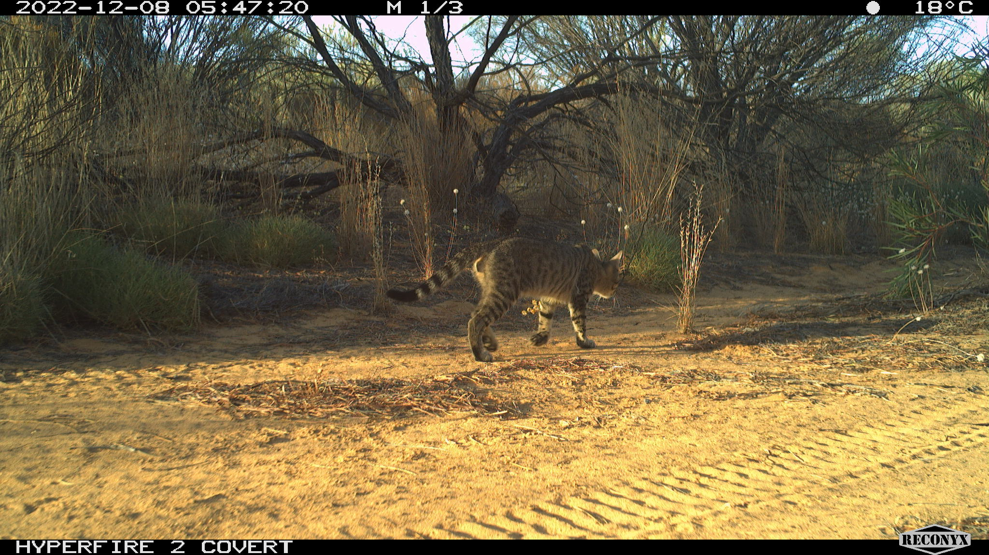
TO CATCH A CAT — DEVELOPING A SMART TRAP FOR FERAL CATS
Trish Fleming, Dave Algar, Helen Blackie, Kenji Irie, Melissa Thomas t.fleming@murdoch.edu.au

Slide 2
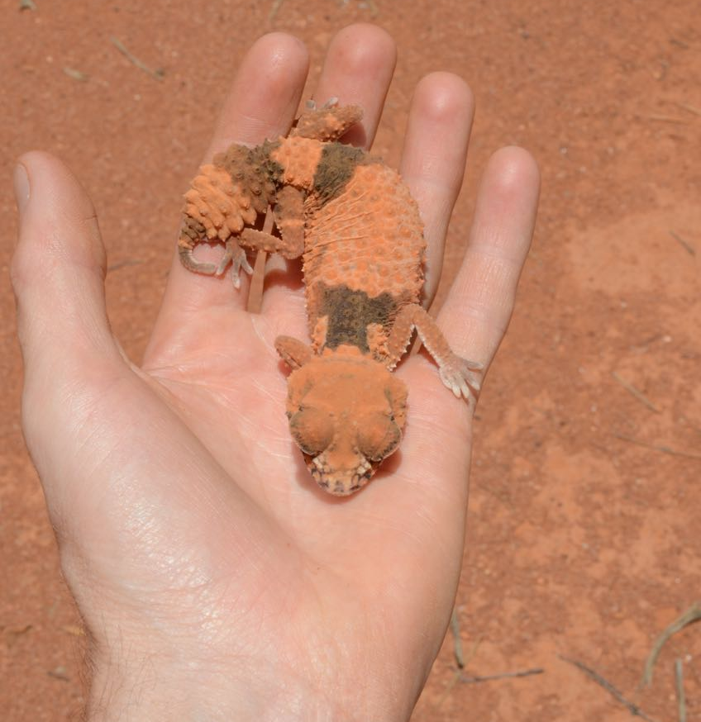
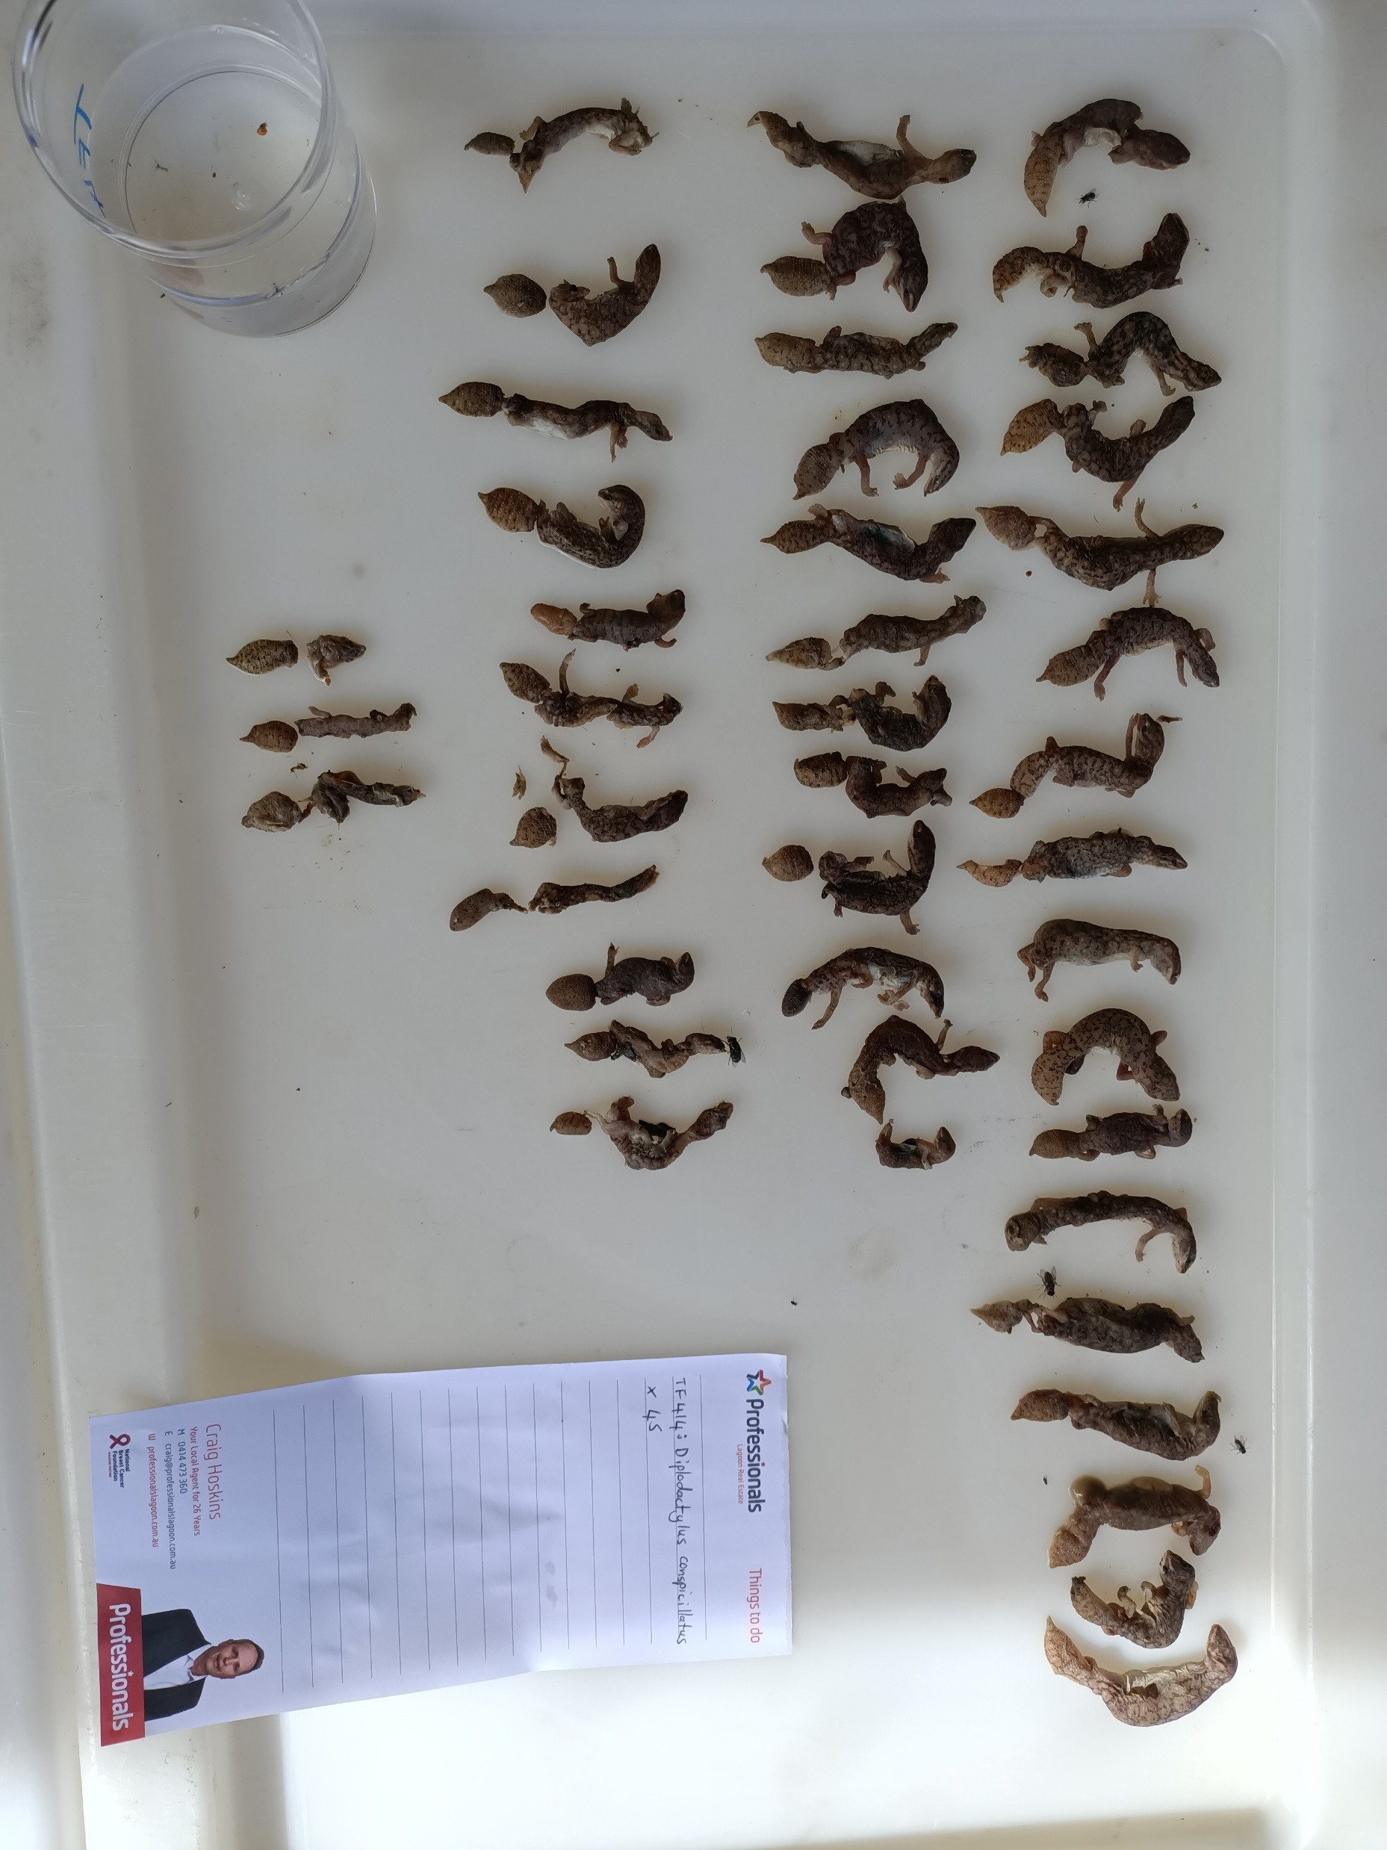
Our past — Our present — Our future?
Contents of 1 feral cat’s stomach
Acknowledgement of Country Murdoch University is situated on the lands of the Whadjuk and Binjareb Noongar people and this boodjar (country) has been a place of learning for thousands of years. We pay our respect to their enduring and dynamic culture and the leadership of the Noongar elders past and present.

Slide 3
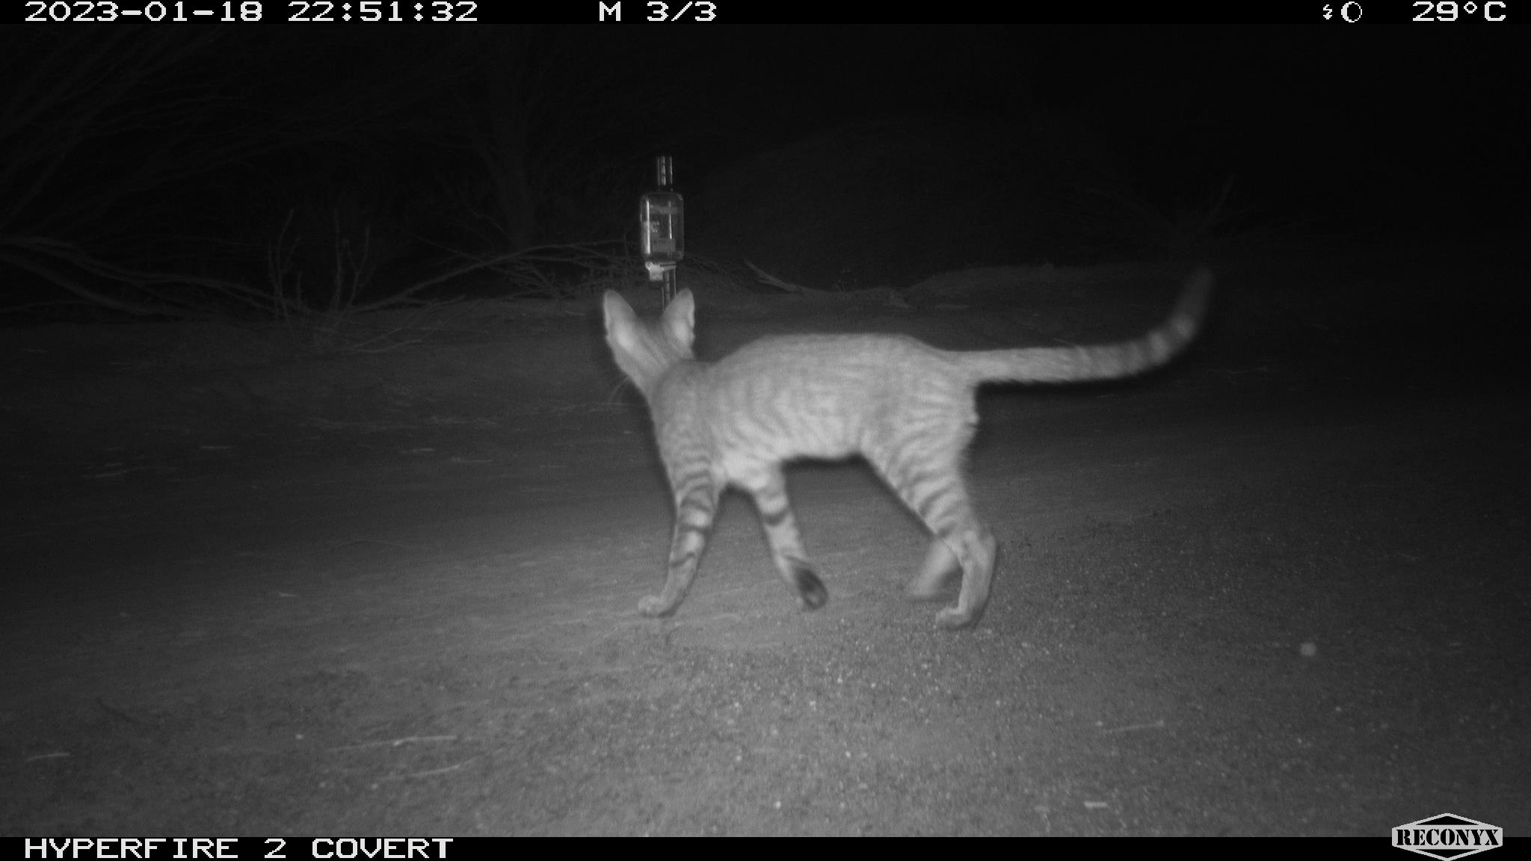
Cat control
We need a range of cat control tools
To deal with different ‘personalities’
Lethal and non-lethal
Including humane tools that do not rely on toxins

Slide 4
Smart cat trap
Smart traps that
On-board automatic species identification fast enough to trigger a trap mechanism
Can be programmed to release the animal within a fixed timeframe if access is problematic
Are self-resetting
Can communicate when activated
Are affordable and can therefore be deployed at scale

Slide 5
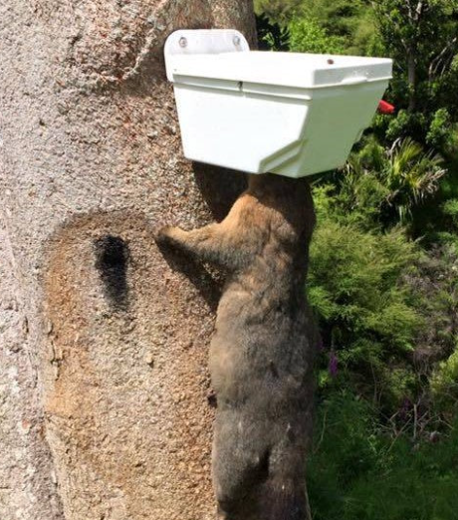
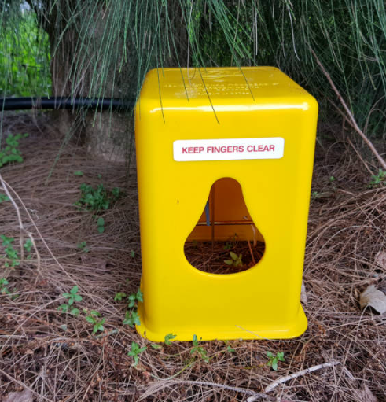
Smart cat trap
NZ has a range of commercially available traps that are capable of trapping cats too
Using smart technology, rat, stoat and possum trap trials in New Zealand ^{[1]} have achieved NZ NAWAC Class A kills ^{[2]}
Translating this to cats
1. Be able to identify a cat
2. Differentiate from Australian non-targets
3. Attractive edible lure
Connovation Trapinator $42.00 NZD
Timms Possum Trap
$57.00 NZD
National Animal Welfare Advisory Committee (NAWAC)
[1] https://predatorfreenz.org/research/high-tech-solutions/
[2] Blackie et al. 2022 How and why we're using AI for pest control and surveillance. AWMS conference Napier, New Zealand

Slide 6
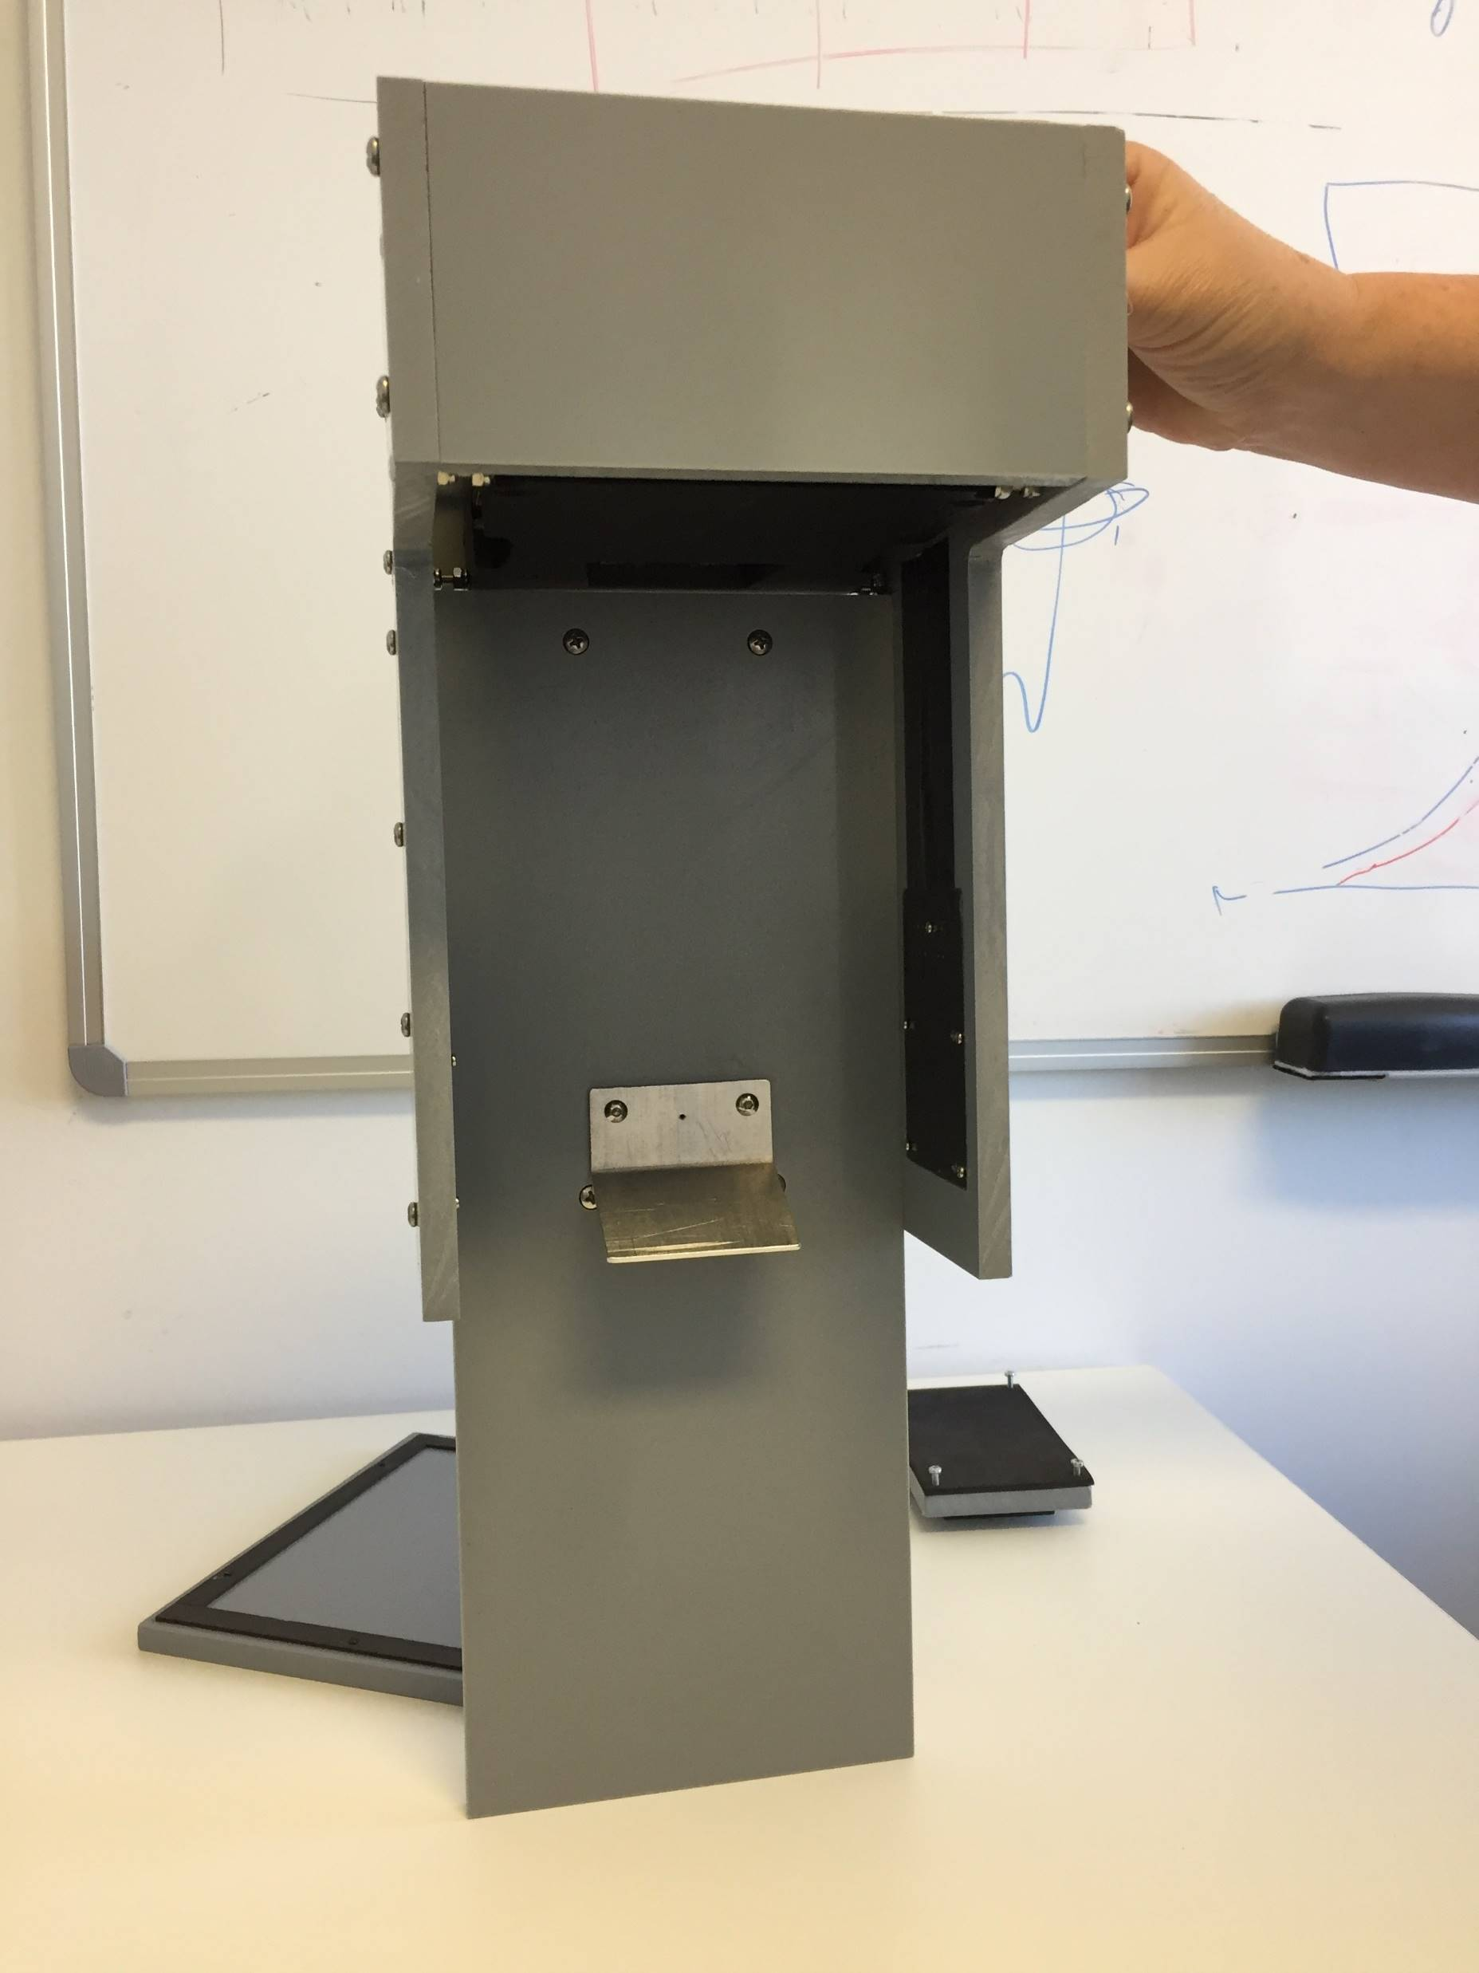
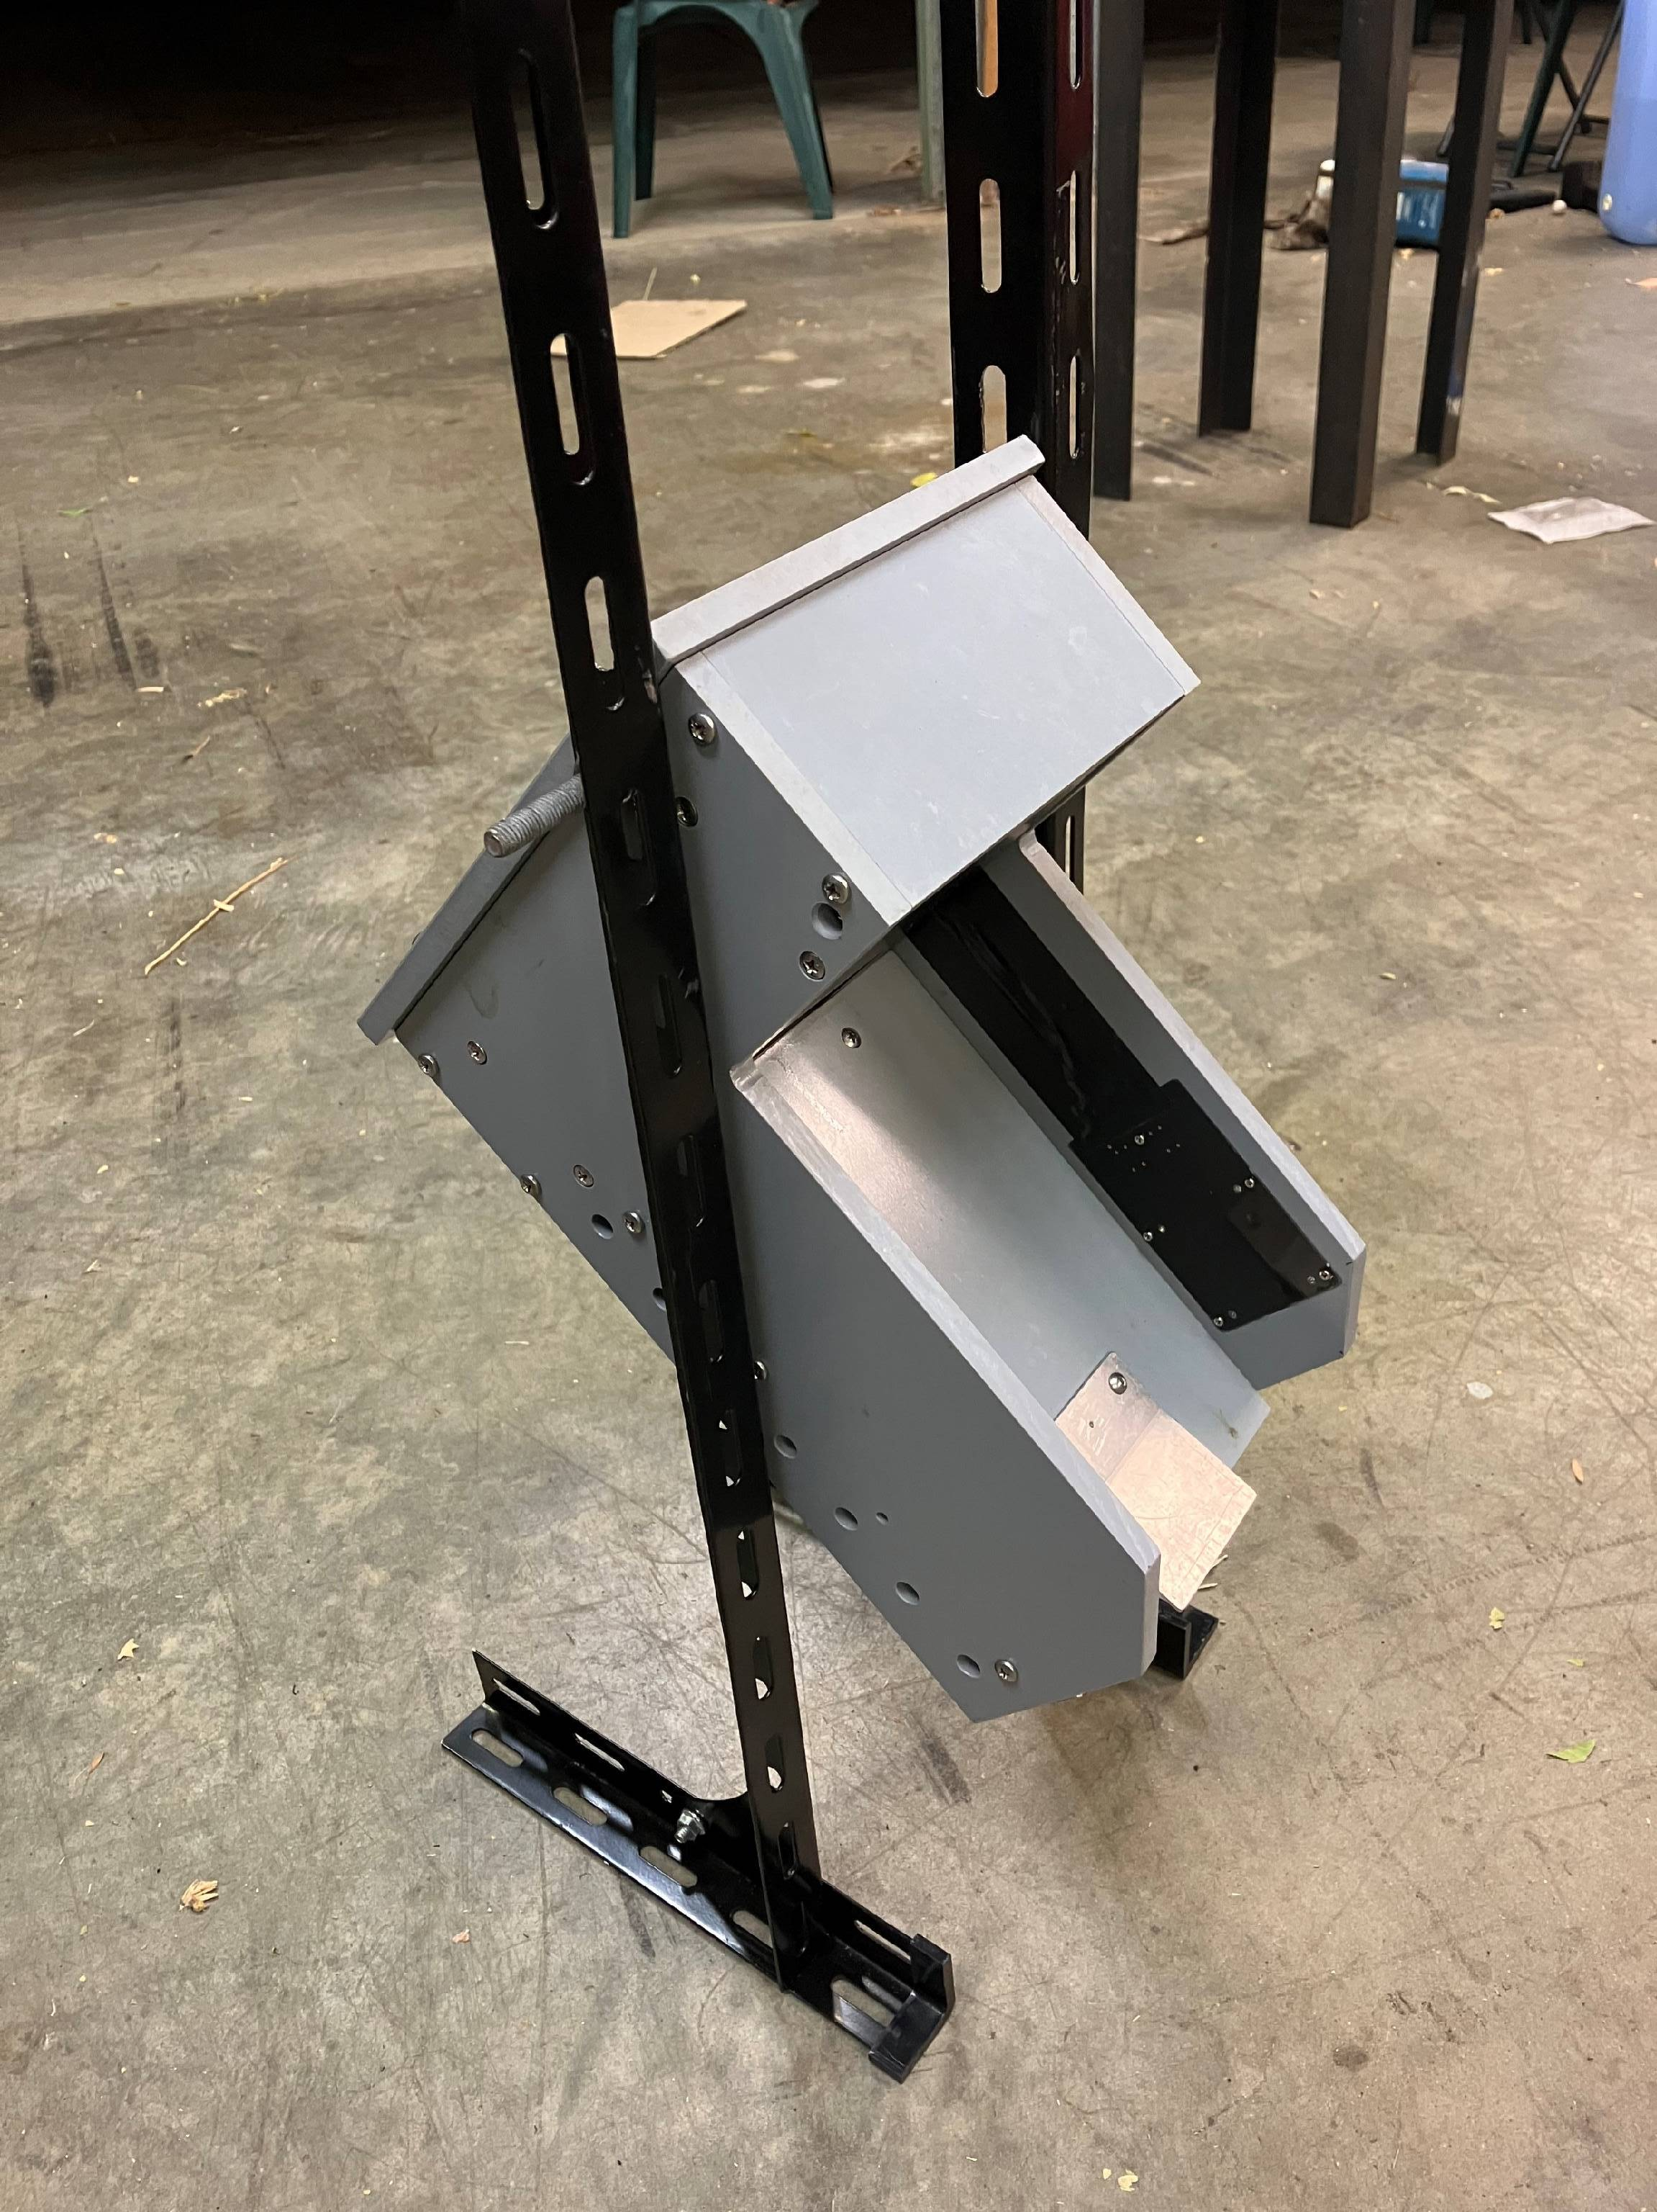
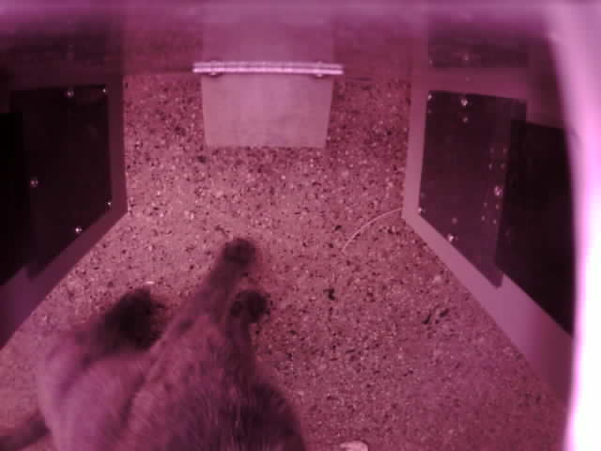
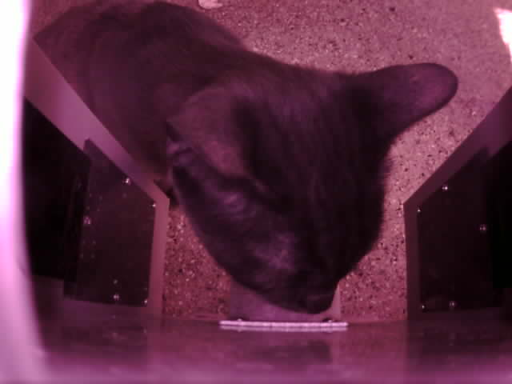
… a future smart cat trap
Lure plate

Slide 7
1. Be able to identify a cat

Slide 8
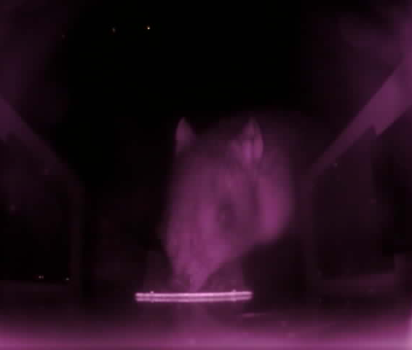
2. Differentiate from non-targets

Slide 9
3. Attractive edible lure
Many lures lose their appeal after a short period of time
Animals become habituated to the presence of ‘novel’ objects such as tinsel and feathers (visual lures)
Olfactory cues suggesting presence of another animal can fade over time
Long-life, edible lures provide positive reinforcement

Slide 10
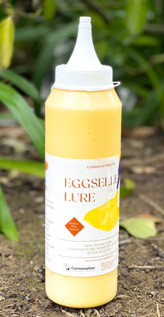
3. Attractive edible lure – PEN TRIALS
Individual cat

Slide 11
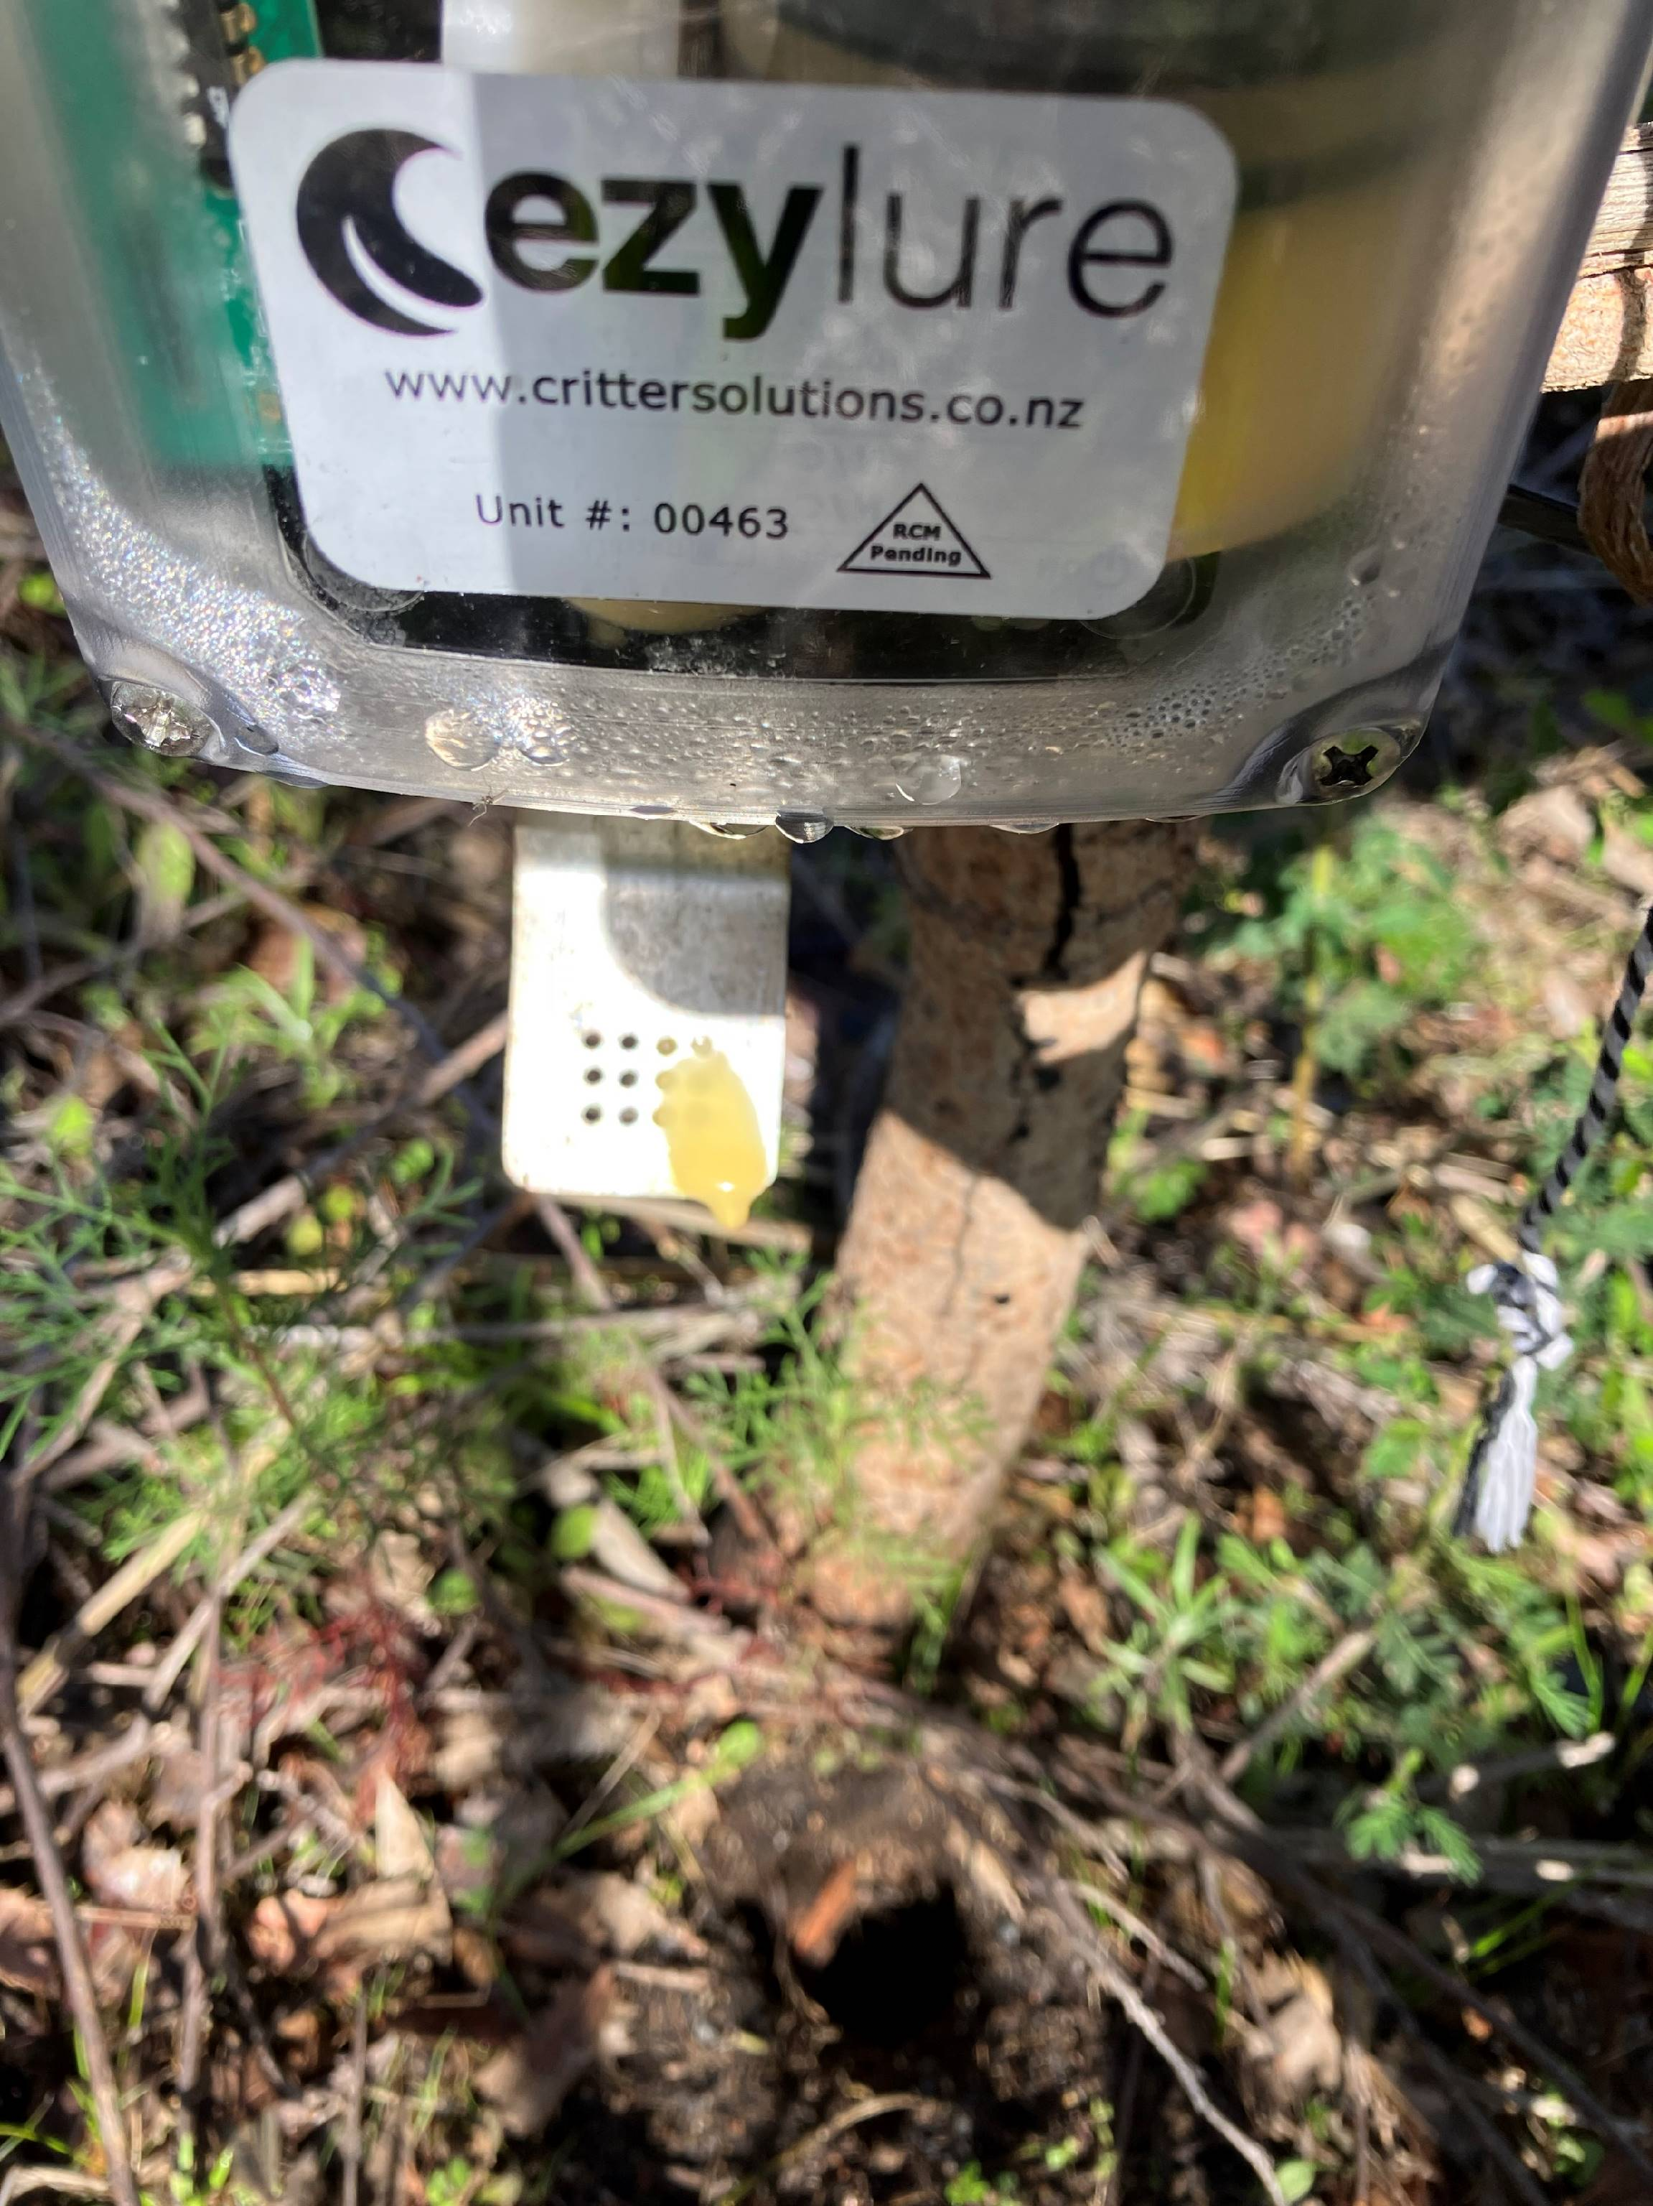
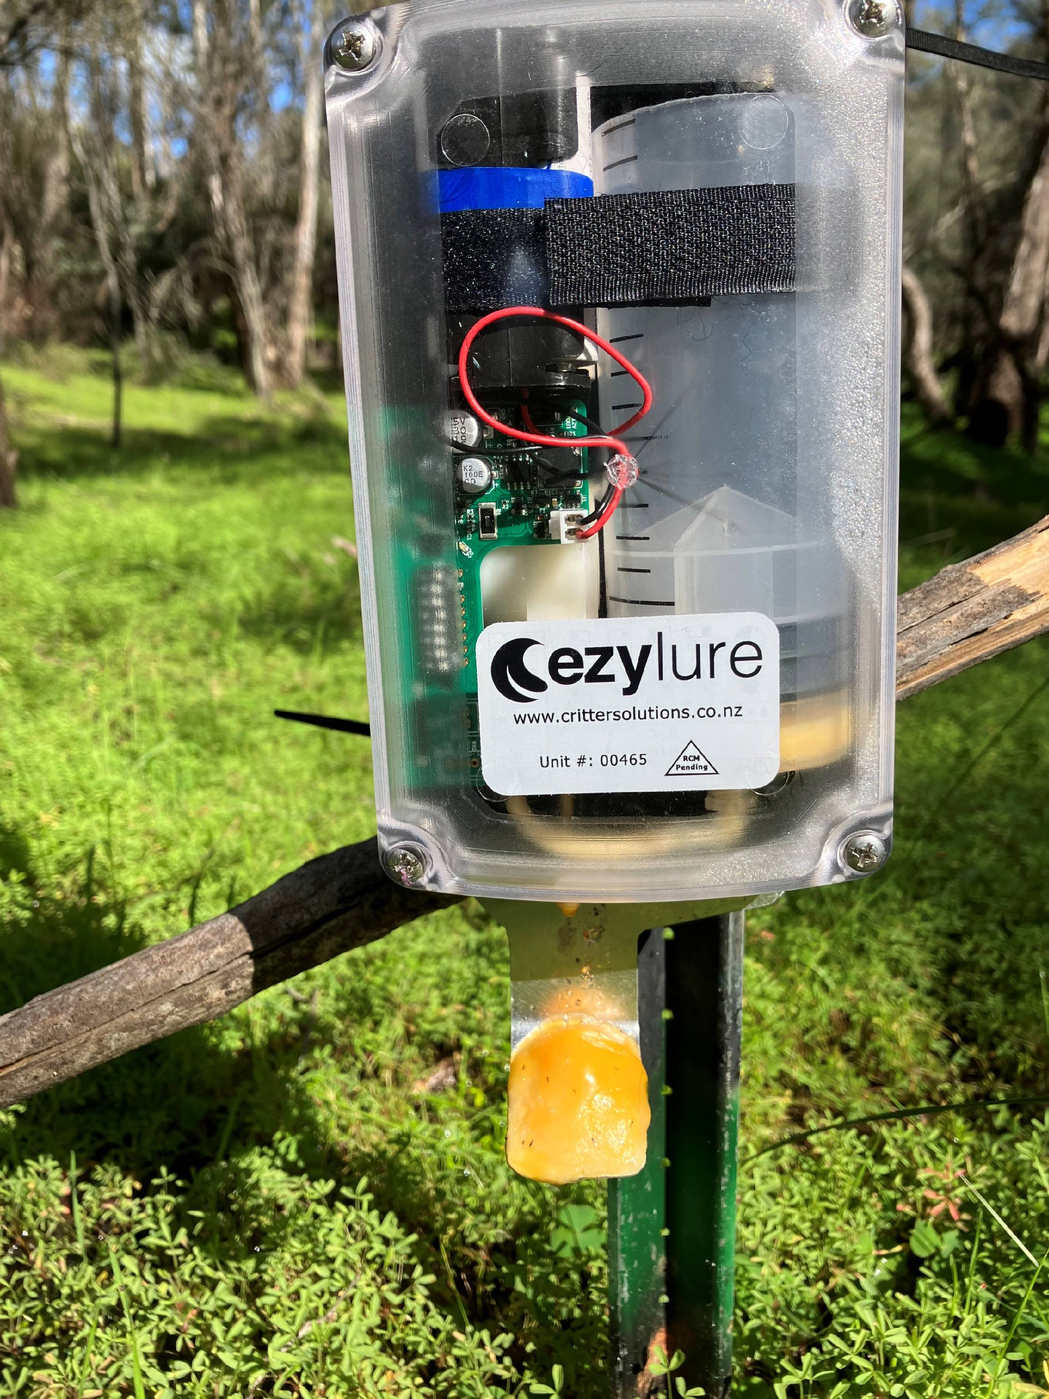
3. Attractive edible lure – FIELD TRIALS
Walyunga National Park, WA
Connovation Eggsellent edible lure in Ezylure automatic dispensers (0.75ml twice a day)
30 pairs of camera traps (one ~3m from the lure and one unlured)
50 days
Only a single lure dispenser showed an accumulation of lure

Slide 12
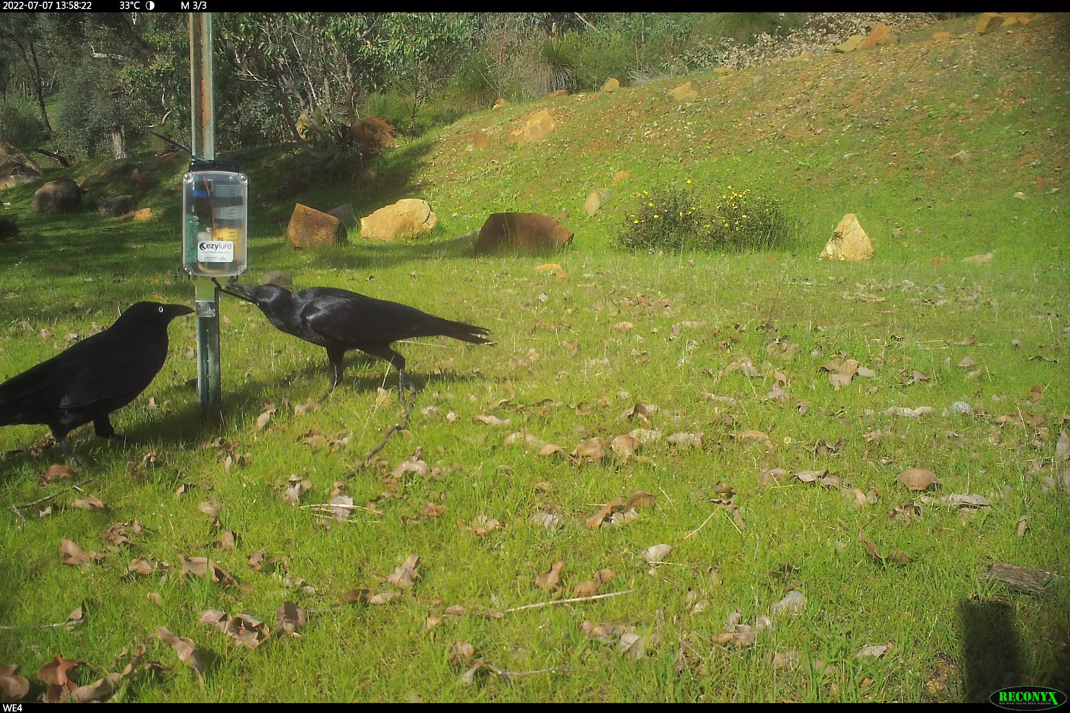
Australian ravens
Independent records

Slide 13
WA had a plague of house mouse in 2022
W11L

Slide 14
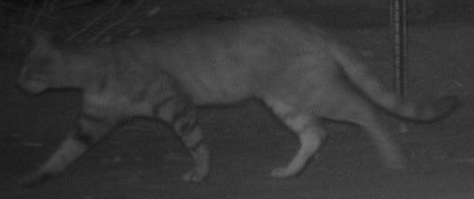
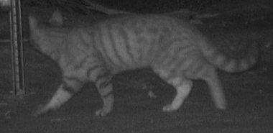
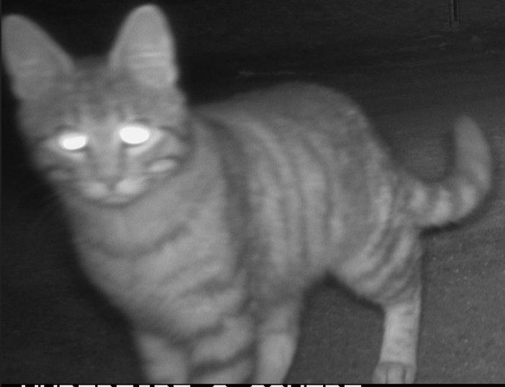
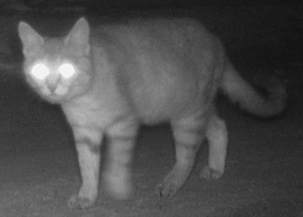
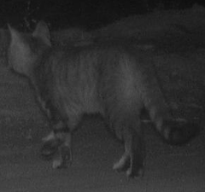
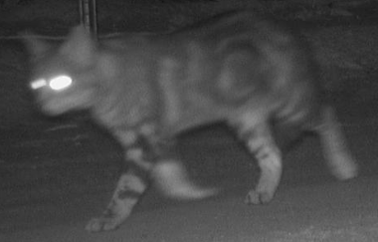
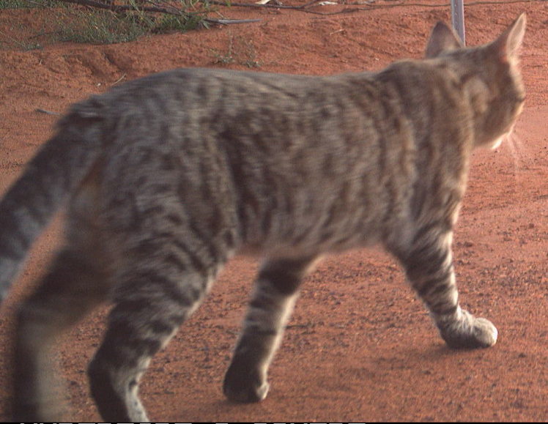
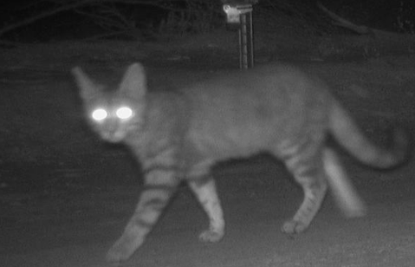
3. Attractive edible lure – FIELD TRIALS
Southern Rangelands, WA
Connovation Eggsellent edible lure in Ezylure automatic dispensers (0.75ml twice a day)
30 pairs of camera traps (one ~5m from the lure and one unlured)
5 months

Slide 15
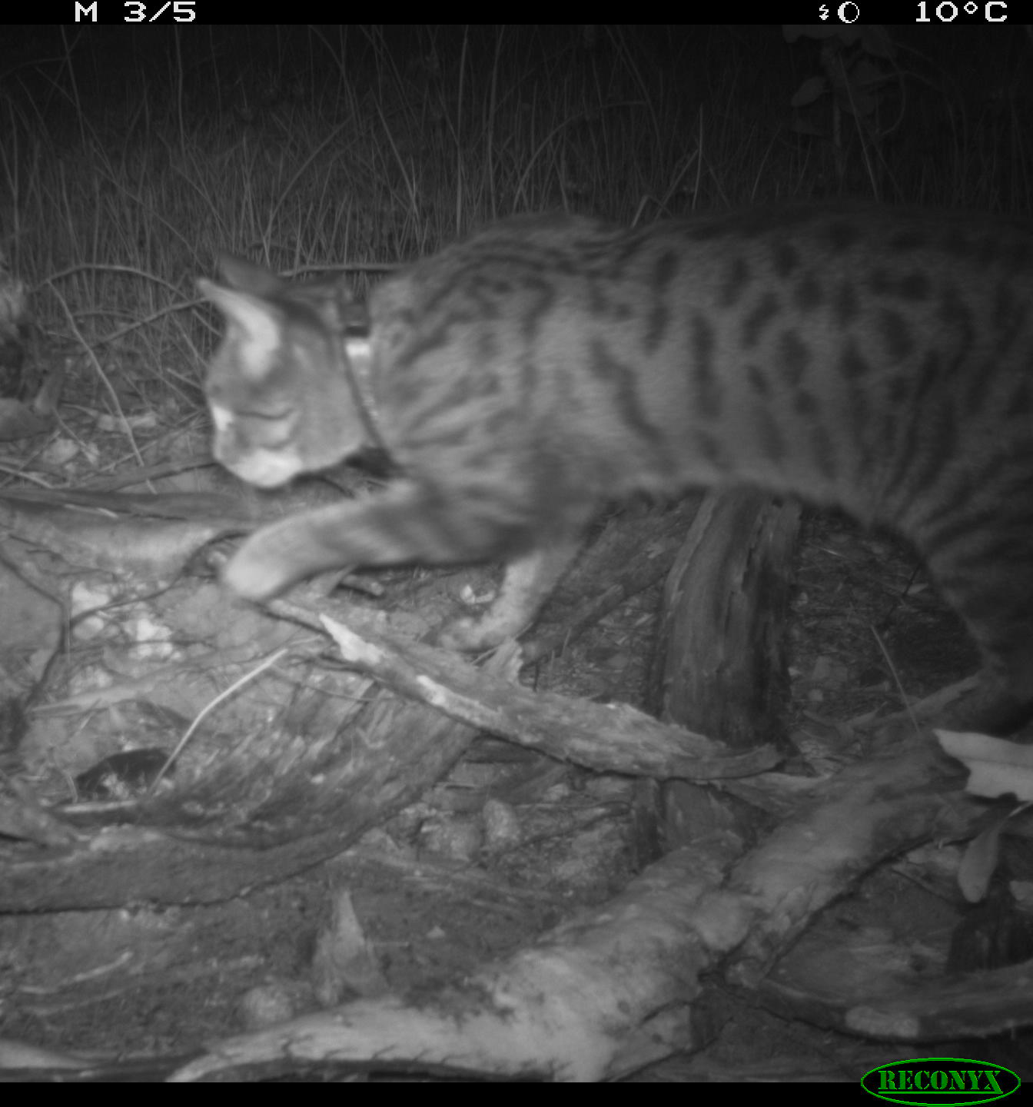
Cats

Slide 16
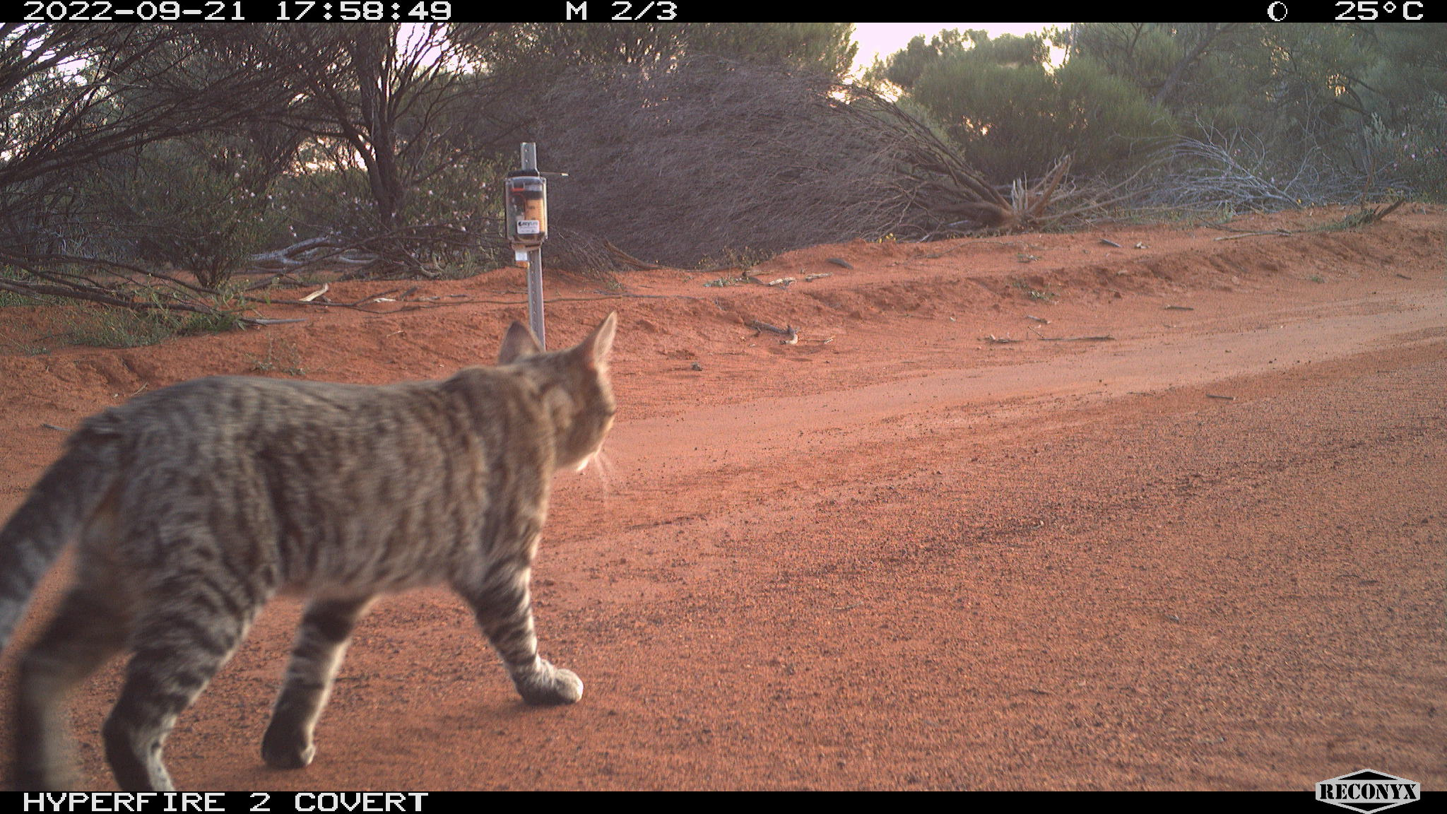
Smart trap development
Smart camera that discriminates between cats and native species
☑ Cat image collection
Non-target species image collection:
☑ WA (collecting)
◻ Other states
□ Additional data training
◻ Field testing smart cameras
Trapping mechanism build and test

Slide 17
Cats
W7L

Slide 18
3. Attractive edible lure – FIELD TRIALS

