Slide 1
The importance of flexibility and persistence in feral cat management
February 2023
Amanda Bourne, Phil Scully, Raquel Parker, Clint McGee, Bryony Palmer, Georgina Anderson, Georgia Volck, Phoebe Dickins, Poppy Walker, Sophia Callander

Slide 2
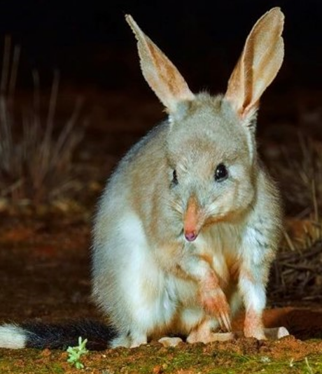
AWC’s Mission
The effective conservation of all Australian animal species and the habitats in which they live.
Supported by:

Slide 3
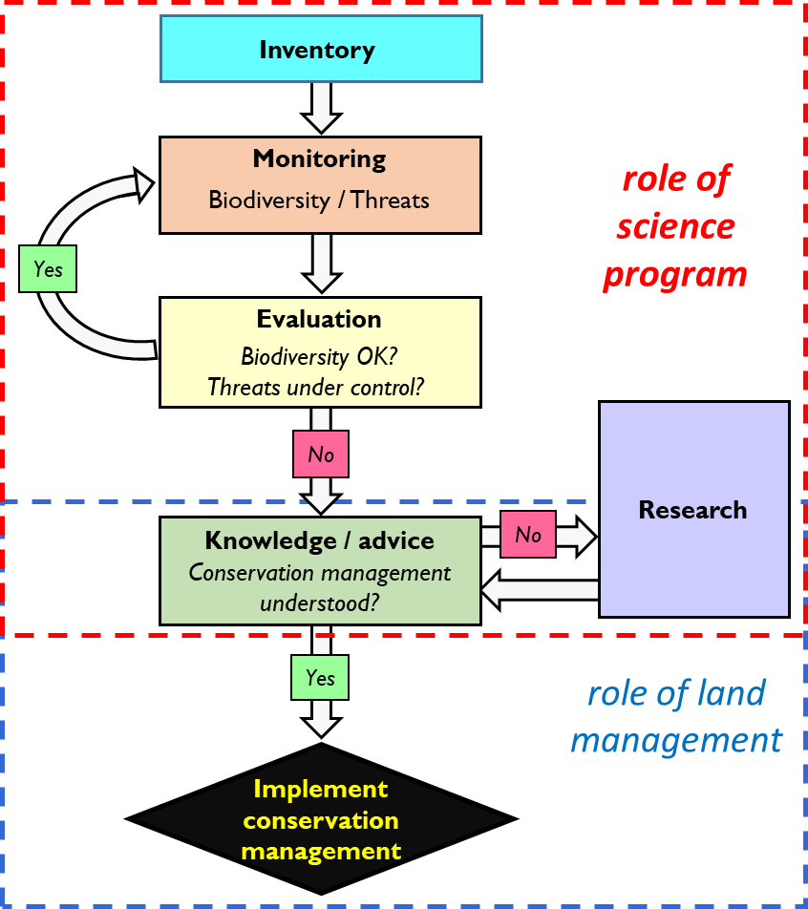
AWC’s Conservation Program
Collect and analyse ecological data on AWC properties
Monitor impact and inform adaptive management
Develop and implement conservation strategies
Work closely with land managers to manage threats
Focus on threatened and iconic species, particularly mammals
Threat management is a large part of the conservation program at AWC – includes feral animals, weeds, climate change and fire

Slide 4
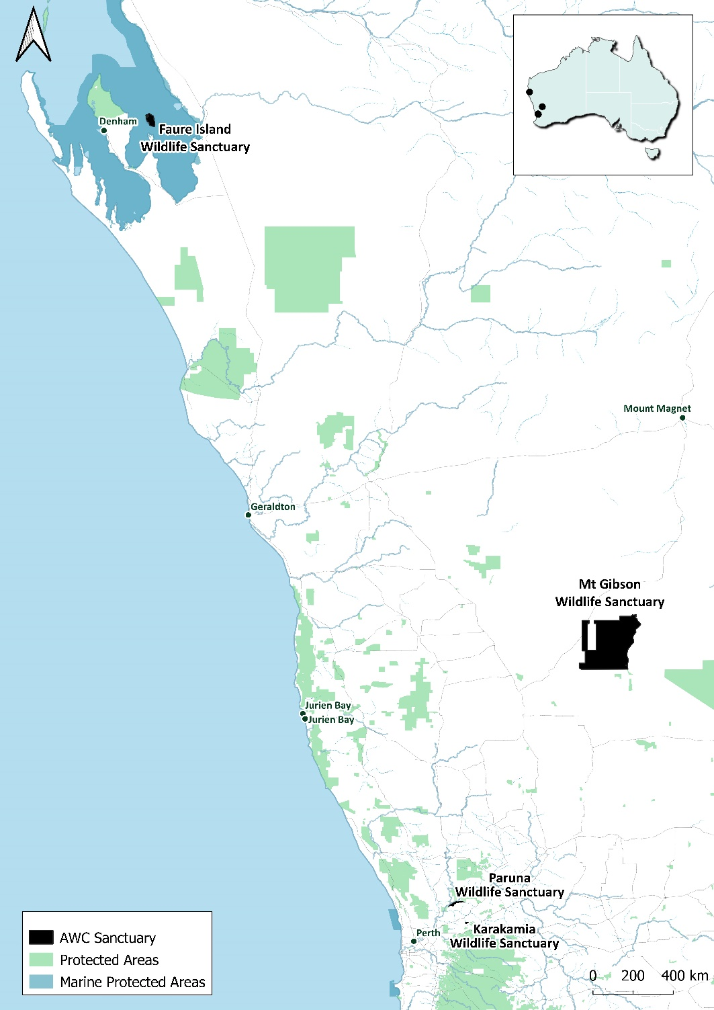
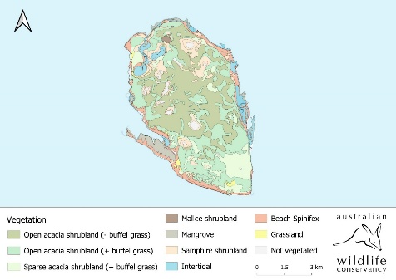
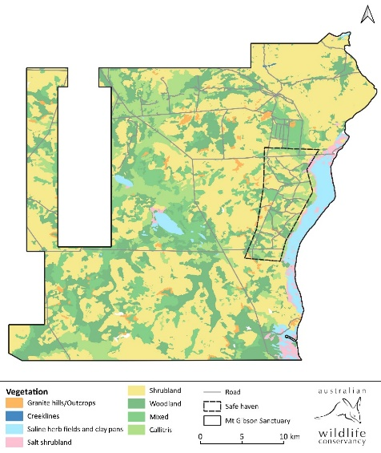
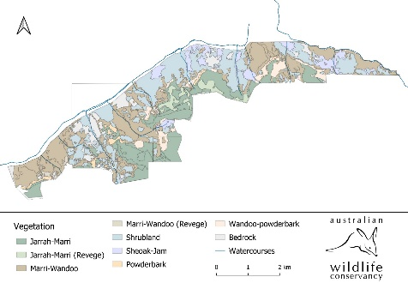
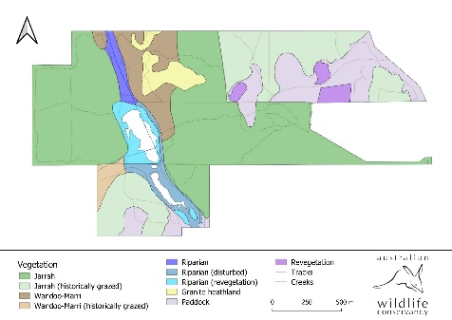
AWC’s South West Region
Faure Island: 4,554 ha
Mt Gibson: 131,812 ha
Paruna: 1,912 ha
Karakamia: 268 ha

Slide 5
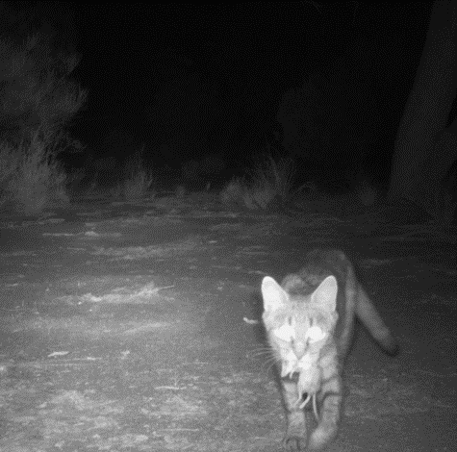
Feral Cat Management in AWC’s South West region
Feral-predator free exclosures
Aerial and ground-based Eradicat baiting
Targeted trapping
Camera trap monitoring

Slide 6
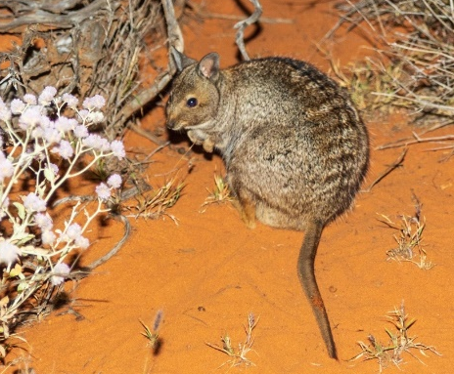
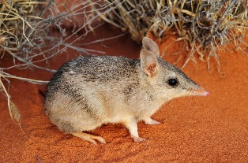
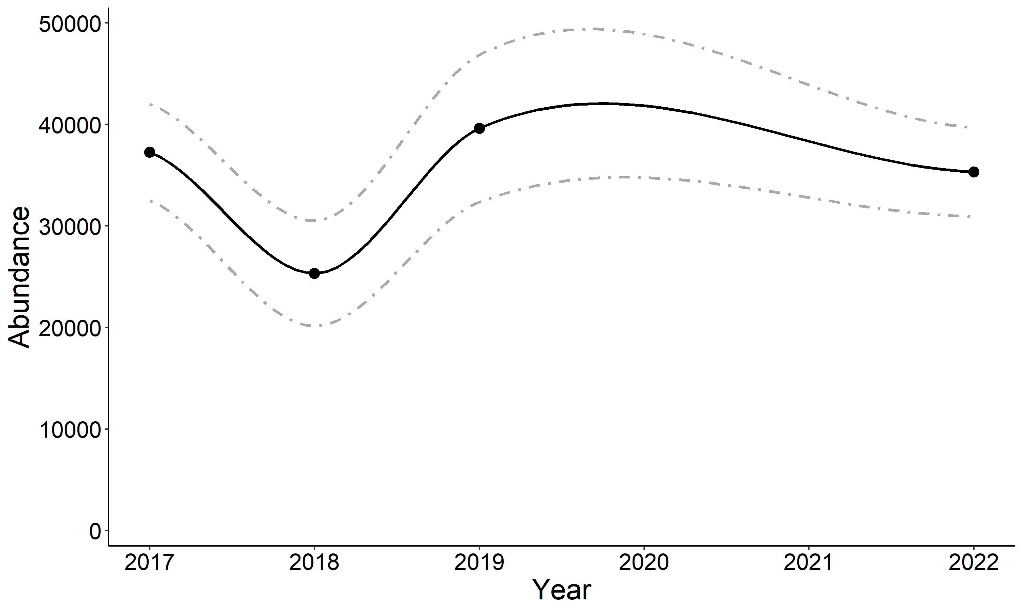
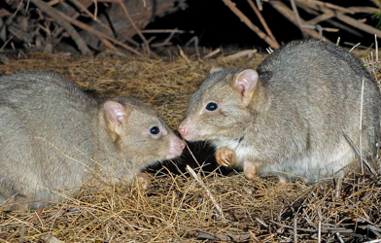
Faure Island
Cats were eradicated in 2001*
Four reintroduced mammals
100 % Occupancy
93 % Occupancy
27 % Occupancy
*Algar et al. 2010.

Slide 7
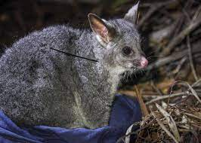
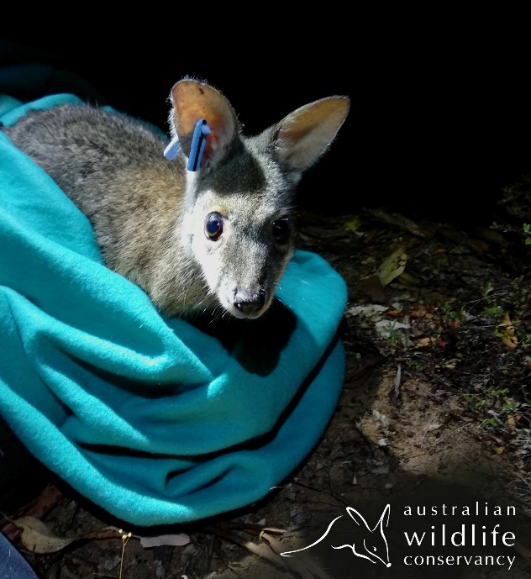
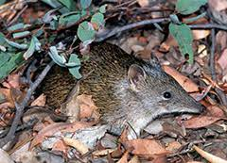
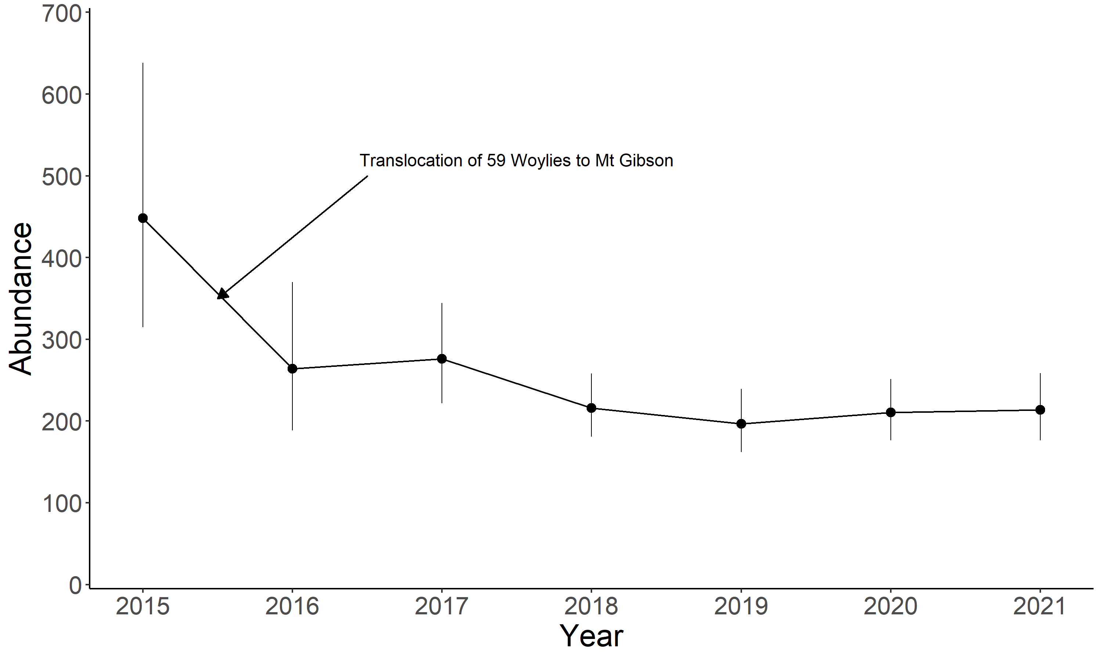
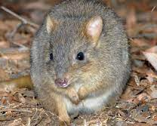
Karakamia
Cats were eradicated in 1994
Four reintroduced mammals
~197 individuals
~205 individuals
~170 individuals

Slide 8
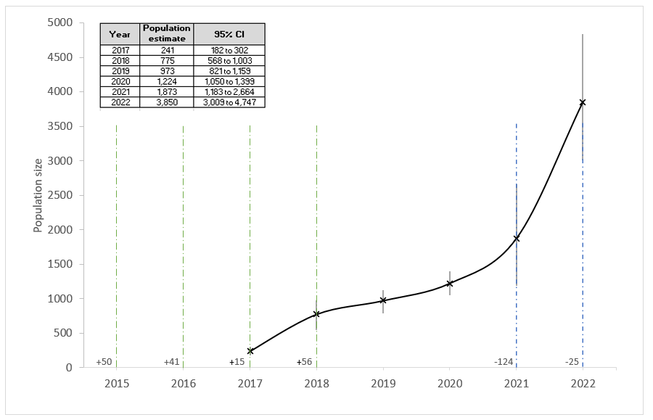
Mt Gibson
7,832 ha fenced exclosure
Cats were eradicated in
2015
Eight reintroduced
mammals

Slide 9
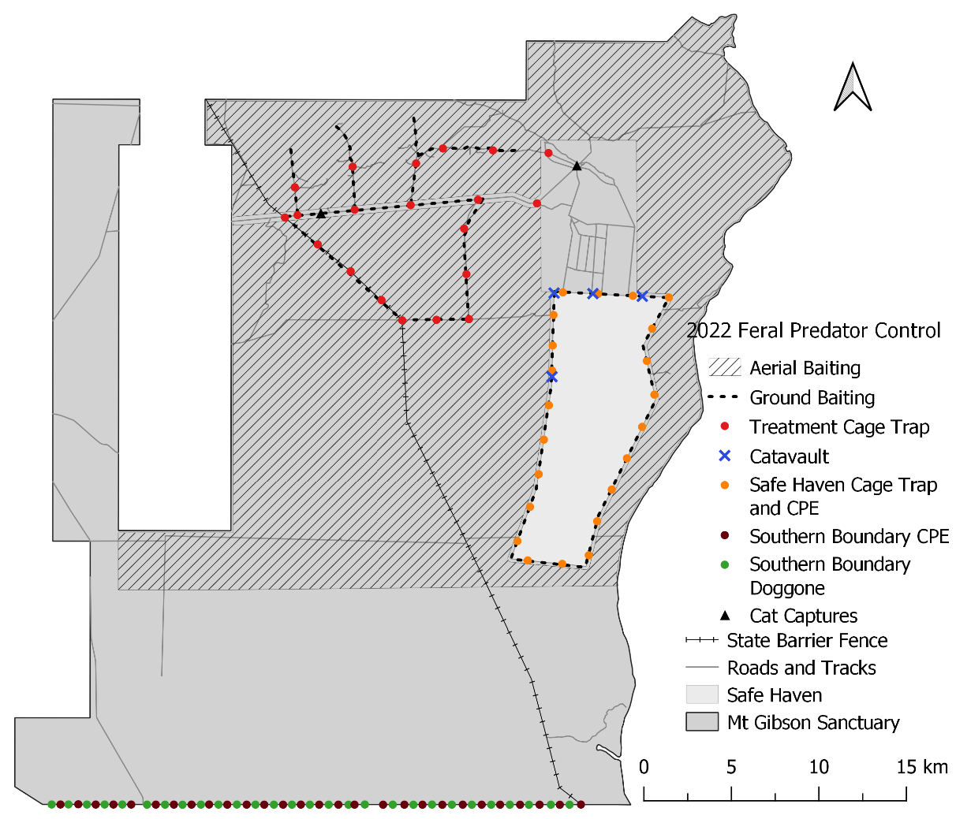
Mt Gibson outside the fence
Cats are present (~5 detections per day)
One intentionally reintroduced mammal
Eradicat baiting program
Camera array to identify cat activity hotspots
Targeted trapping in hotspots

Slide 10
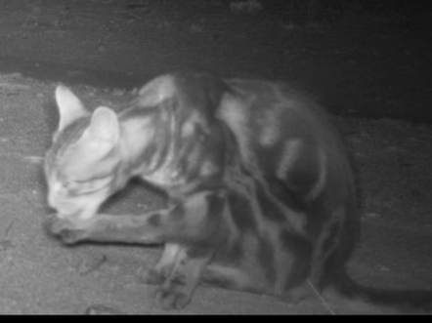
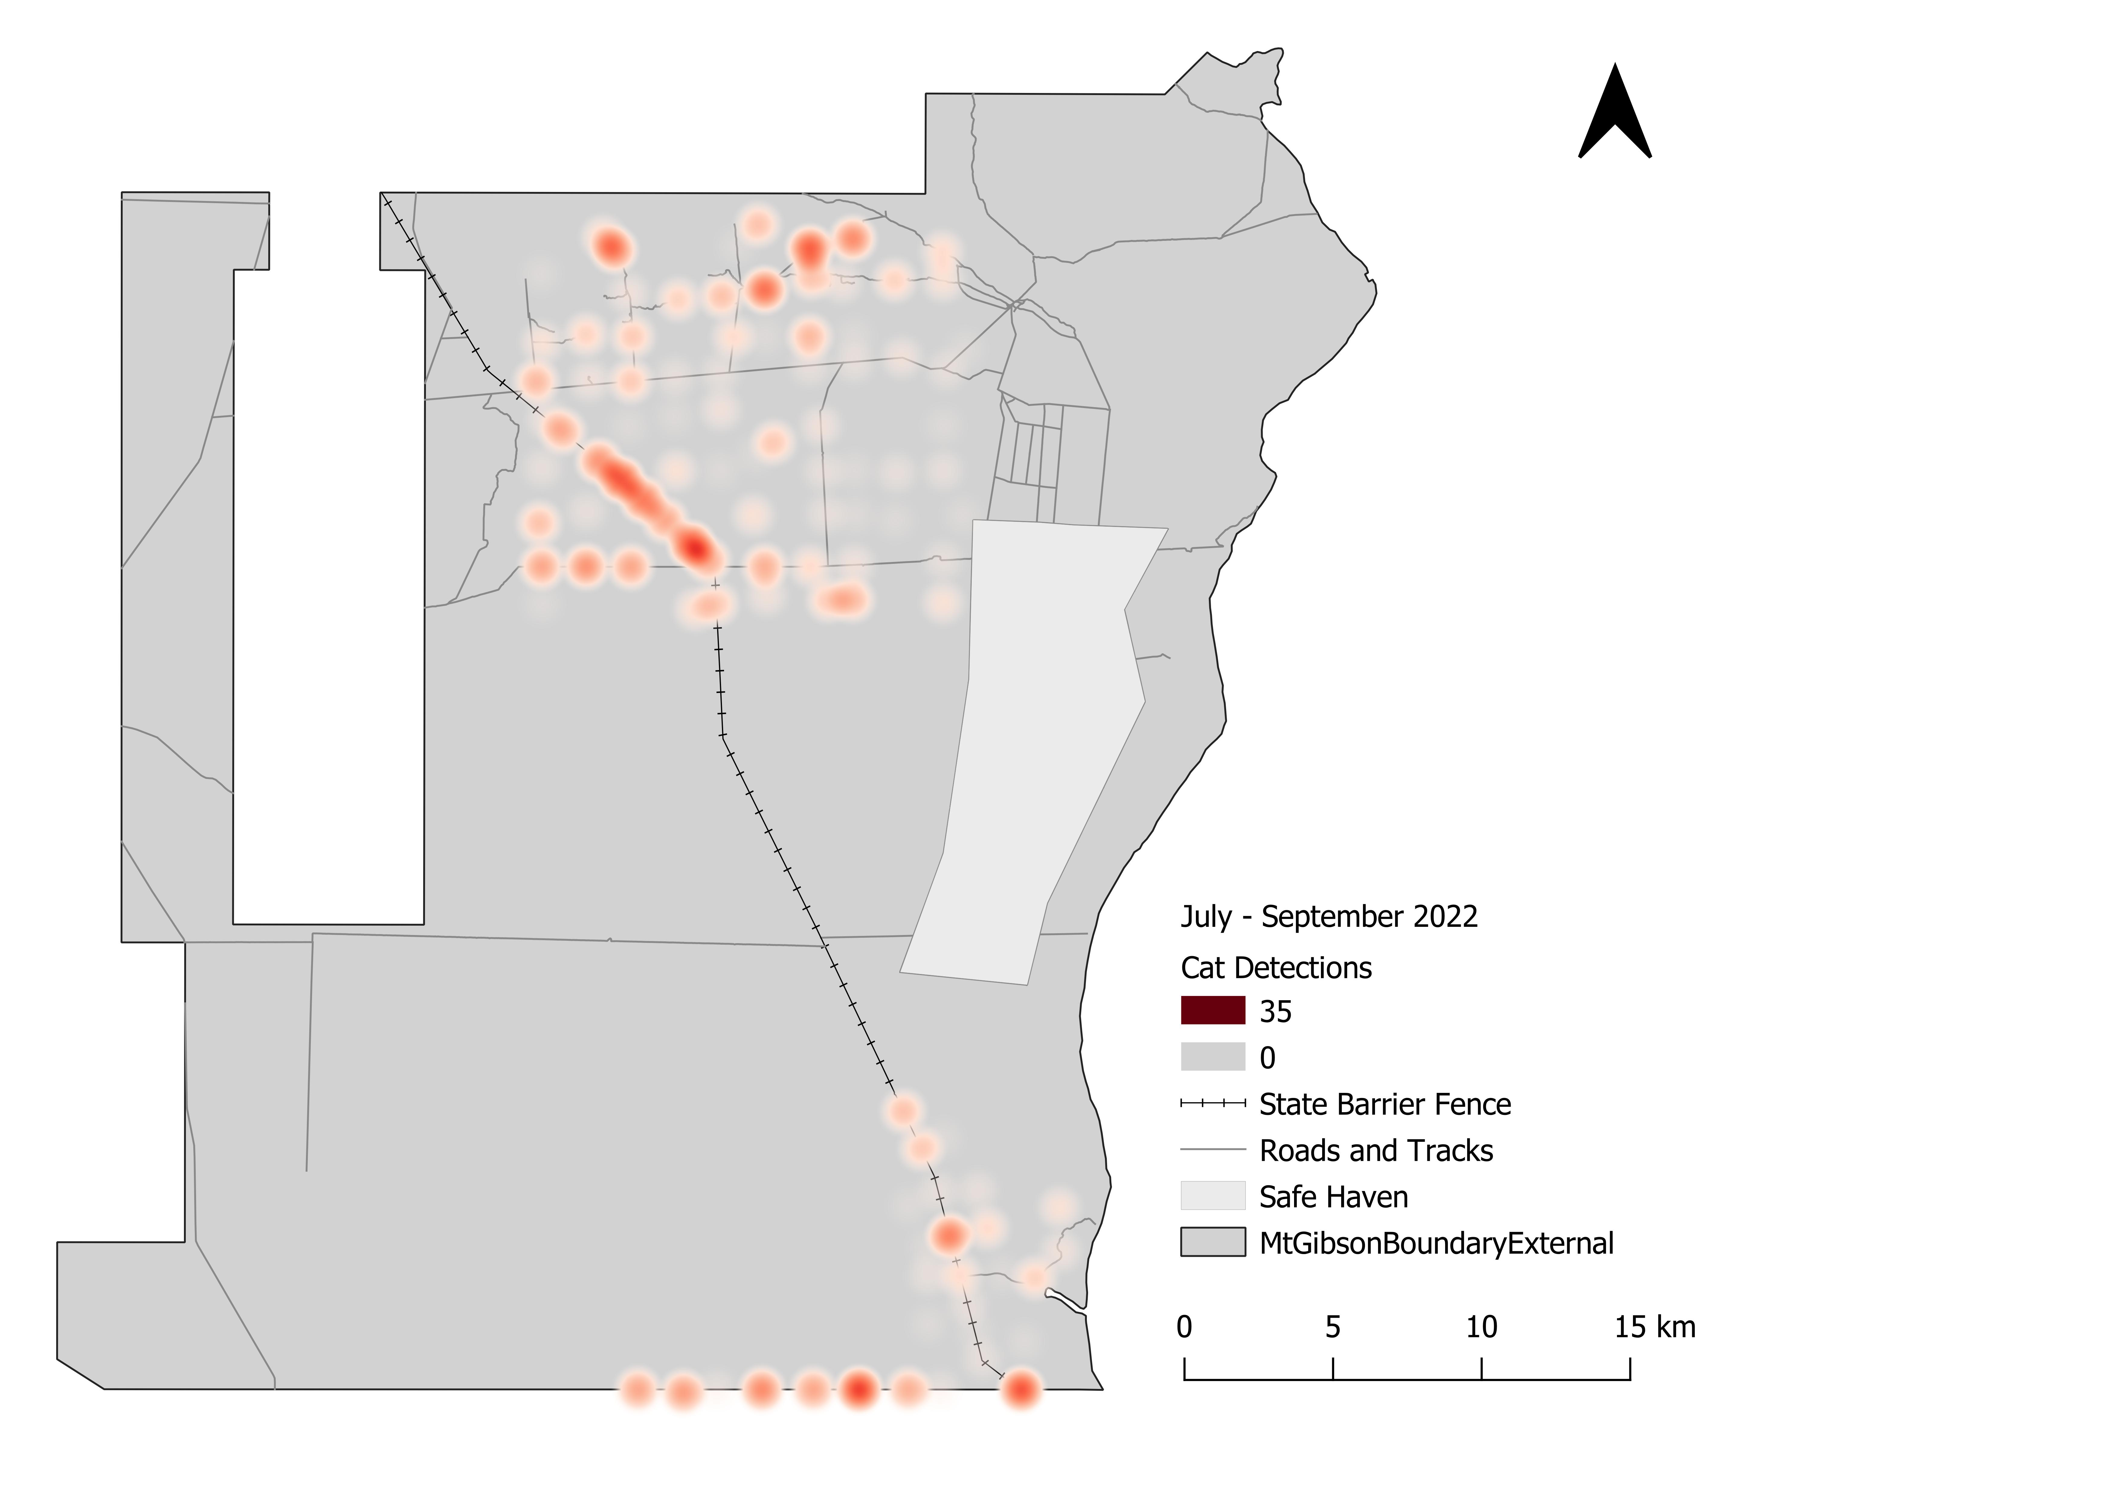
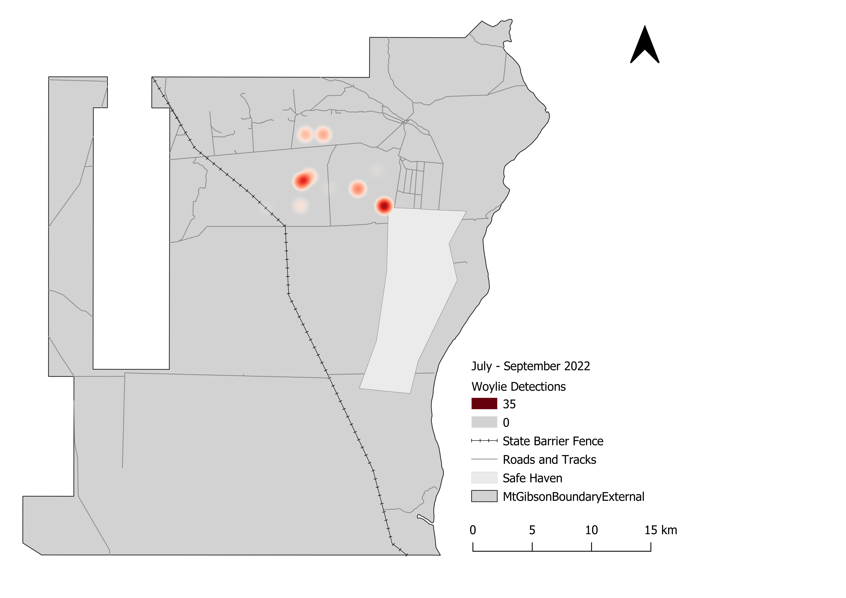
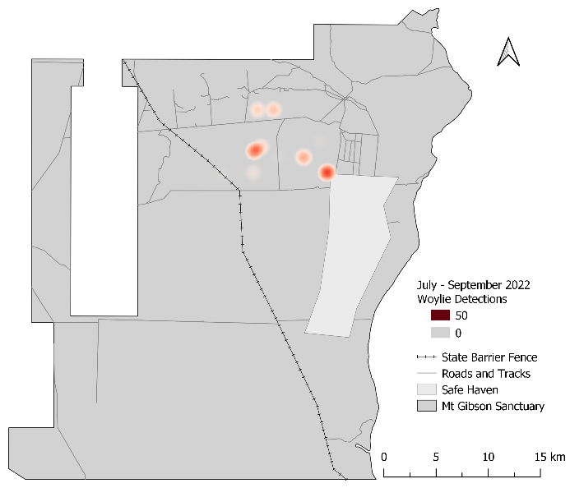
Mt Gibson outside the fence

Slide 11
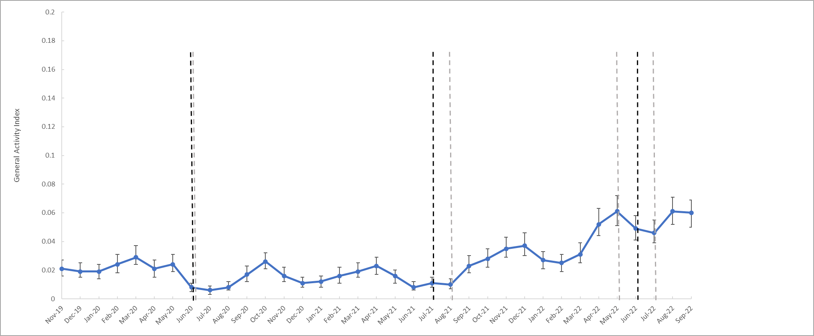
Mt Gibson outside the fence

Slide 12
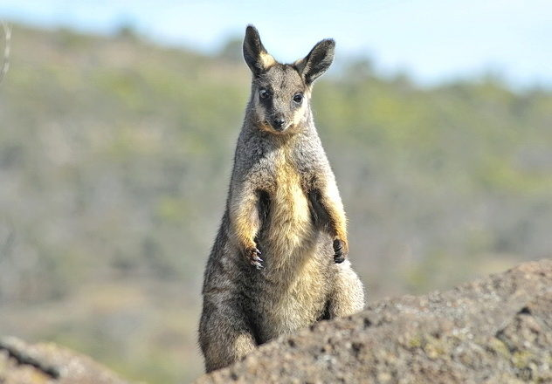
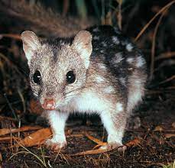
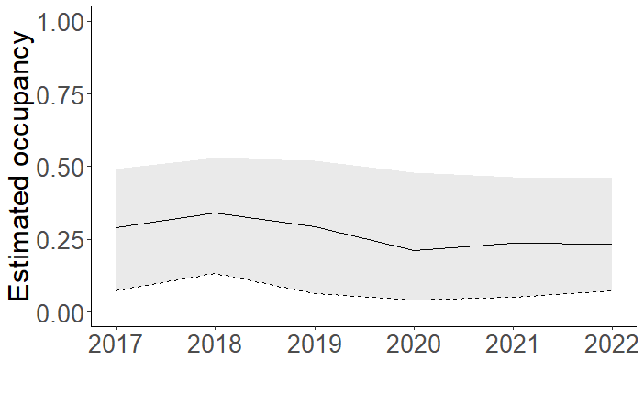
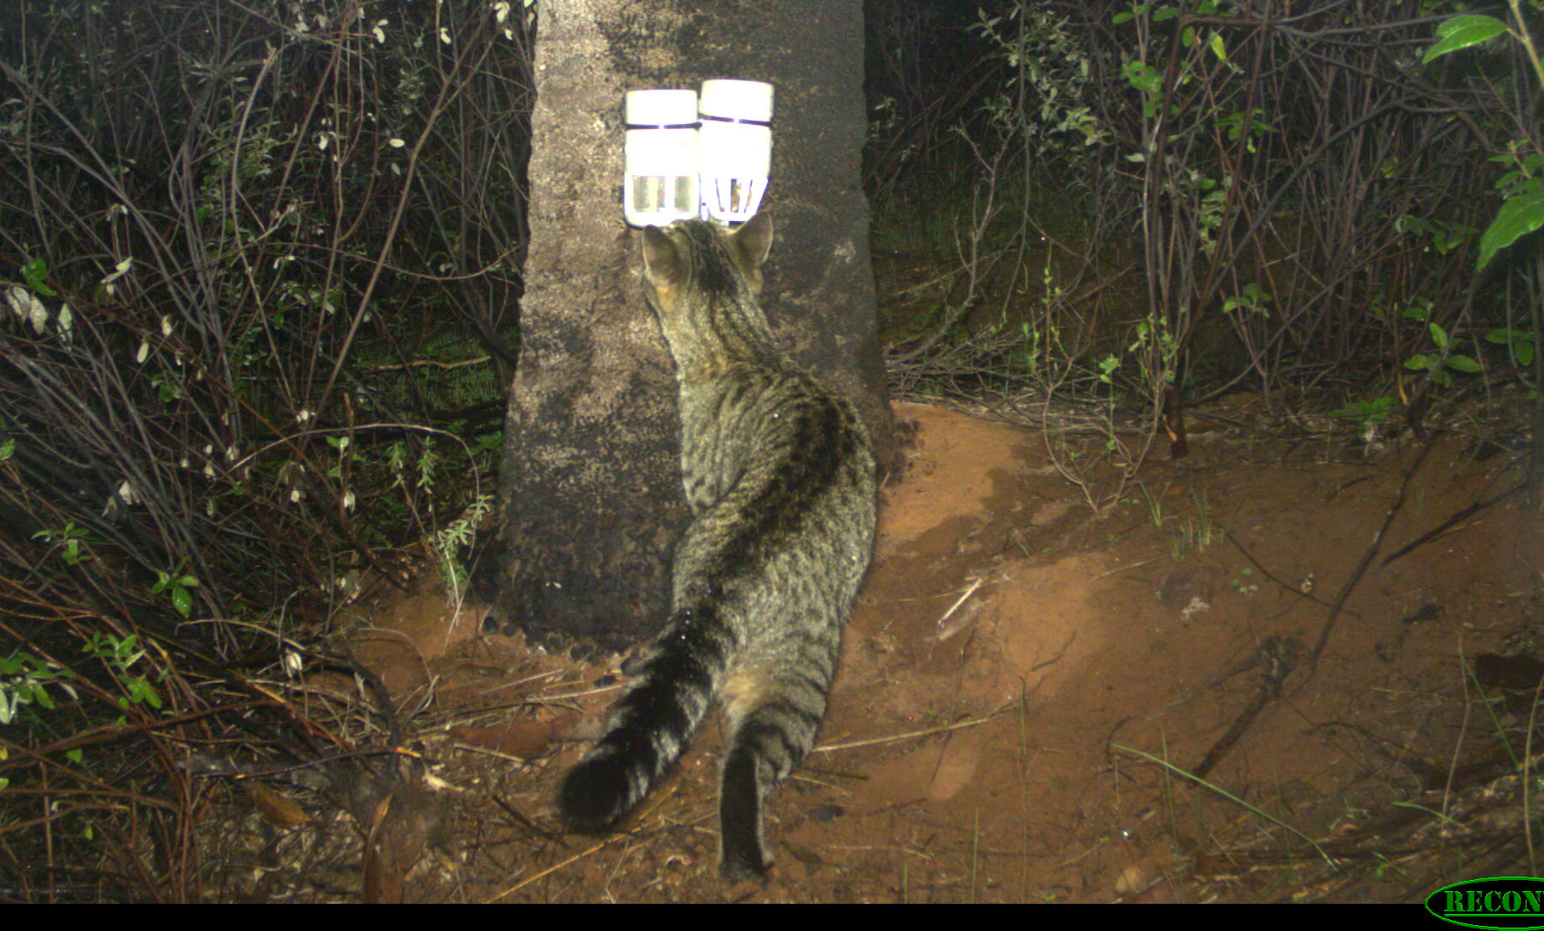
Paruna
Cats are present (8% occupancy)
Two threatened mammals
Camera array to identify cat activity hotspots
Targeted trapping and shooting in hotspots
Four cats euthanised in 2022
<5 individuals
3 % Occupancy

Slide 13
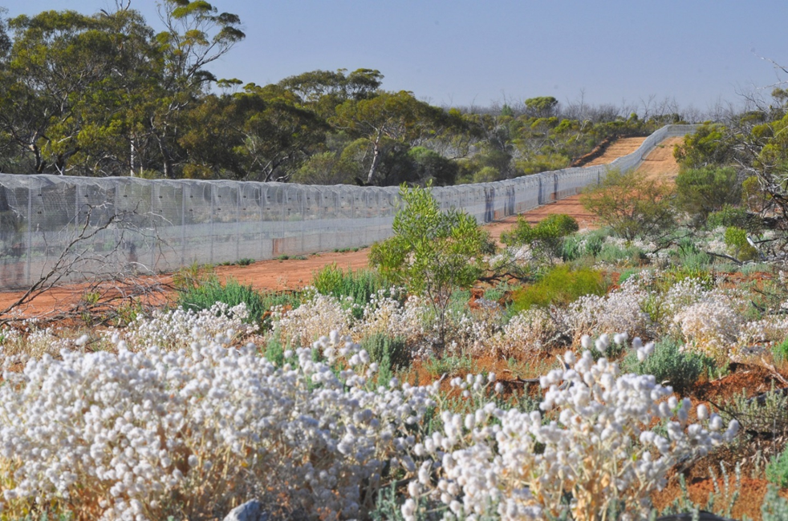
Feral Predator Management
Fast recovery of native wildlife when cats are completely removed
Different approaches for different places
Adaptive & responsive
Constant monitoring and management
Pragmatic about what can be achieved
Are there tolerable thresholds? What native mammal densities are desired?

Slide 14
Thank you
Please contact us or check out the Annual Ecohealth Reports online for more information
Dr Amanda Bourne
Regional Ecologist South West
E: amanda.bourne@australianwildlife.org
M: 0472 711 333
Dr Sophia Callander
Senior Wildlife Ecologist South West
E: sophia.Callander@australianwildlife.org
M: 0459 324 812
Phil Scully
Regional Operations Manager South West
E: phil.scully@australianwildlife.org
T: 08 9572 3853

Slide 15
AWC Colour Palette
Primary Colours:
 | Navy RGB: 21, 31, 45 |  | Green RGB: 36, 157, 116 |  | Stone Grey RGB: 117, 117, 117
Secondary Colours:
 | Pink Cockatoo RGB: 246, 114, 128 |  | Sky RGB: 68, 142, 246 |  | Terracotta RGB: 171, 53, 31
 | Rock RGB: 99, 65, 76 |  | Yellow RGB: 255, 218, 14 |  | Sand RGB: 193, 134,83
 | Light Grey RGB: 244, 244, 244

