Slide 1
Managing predator impacts for resilient landscapes
Guy Ballard^{1,2}, Andrew Claridge^{1,2}, Annalie Dorph¹, Amy Edwards^{1,3} and Jaime Heiniger^{1,3}
1 School of Environmental and Rural Science, University of New England, NSW, 2351, Australia
2 Vertebrate Pest Research Unit, NSW Department of Primary Industries, Orange, NSW, 2800, Australia
3 NSW National Parks and Wildlife Service, Parramatta, NSW, 2124, Australia
Email: gballar3@une.edu.au

Slide 2
Acknowledgement of Country
We thank the Noongar people for hosting us on their lands and acknowledge the many Traditional Owners we work with across Australia, and their continuing connection to and stewardship of land, sea and community.
All members of our research team pay our respects to Traditional Owners, their cultures and to their Ancestors and Elders.
Our Indigenous research partnerships are a valued and respected component of National Environmental Science Program research, as well as those of the NSW State Government and the University of New England.

Slide 3
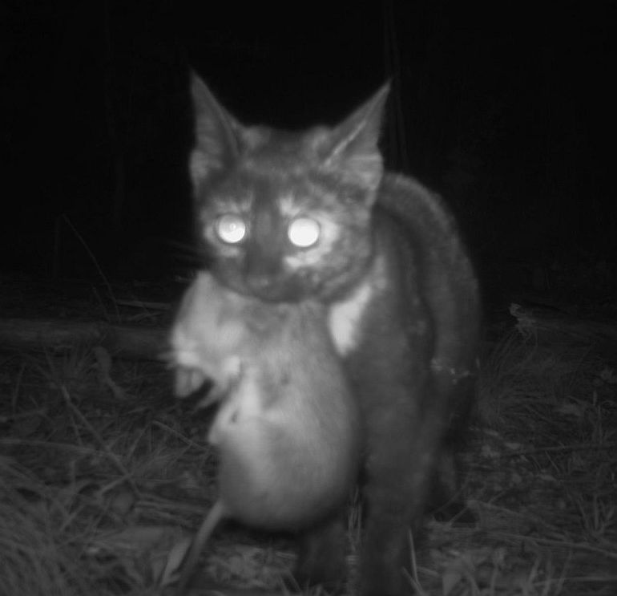
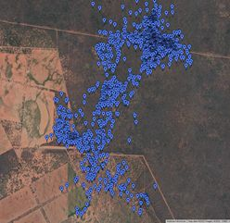
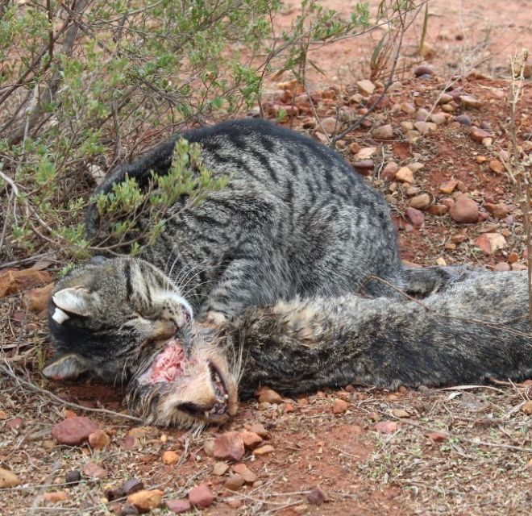
Predators have multiple roles
Predators provide ecosystem services by:
Hunting – may have multi-level consequences
Moving – transports organisms / propagules
Dying – provides food / resources for other organisms
Humans see some services as positive, others as negative.
Land managers want to maximise the ‘good’ and minimise the ‘bad’

Slide 4
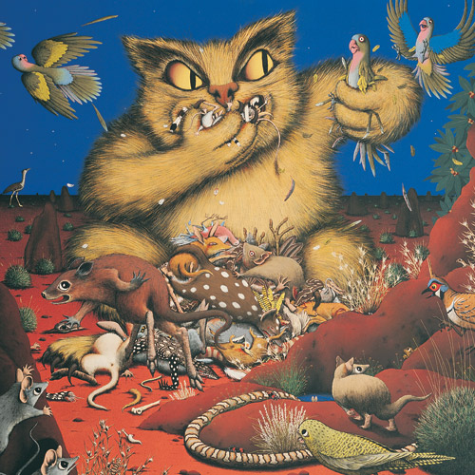
Feral cats pose a massive problem
Feral cats are:
Hunting – preying unsustainably on endemic fauna
Moving – harmful parasites / disease through our landscapes, impacting endemic fauna, livestock, pets and people
Dying – They do provide food / resources for other predators but as a population are more than coping with this pressure.
‘That feral cat’, Kaye Kessing 1990

Slide 5
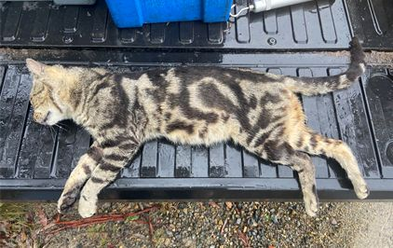
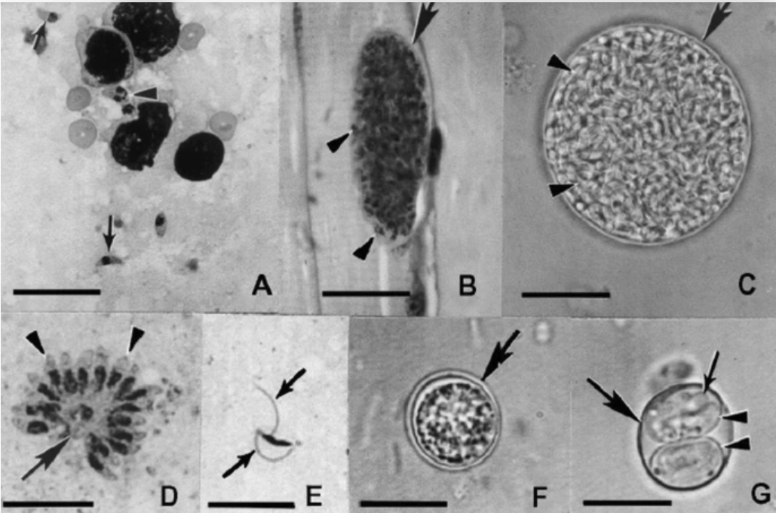
Australian predator management
We tend to worry first about minimising harm:
Stopping harmful effects of predation
Limiting spread of disease
Alleviating competition with endemics (e.g. quolls!)
With feral cats we have become ‘desperate’;
National Key Threatening Process listing
National Feral Cat Taskforce
New lessons re impacts on people, wildlife, livestock and pets
Dead feral cat, Image: G. Ballard
Toxoplasma gondii, Montoya & Contopoulos-Ioannidis (2021)

Slide 6
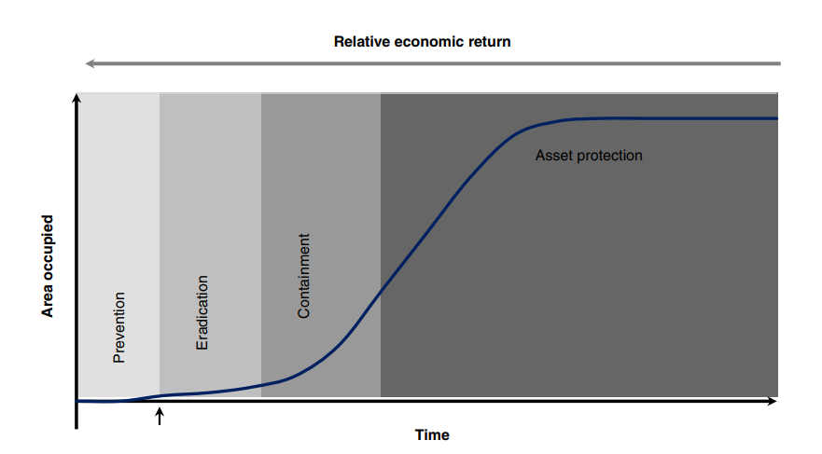
Expected cost
Fleming, Ballard, Reid and Tracey 2017

Slide 7
(Re) creating resilient landscapes
We want landscapes to withstand, or rapidly recover from, damaging events and processes
Local asset protection won’t provide landscapes resilient to feral cat impacts
We need to suppress feral cats effectively at relatively large scales AND undertake complimentary actions to promote resilience
Instead, we tend to take a simple approach:
1. Cats are ‘bad’ for wildlife
2. Let’s kill as many cats as we can!
3. Negative impacts will probably* decrease
All reinforced by an optimistic social norm: ‘we are doing something!’
* we often cannot guarantee negative impacts will decrease!

Slide 8
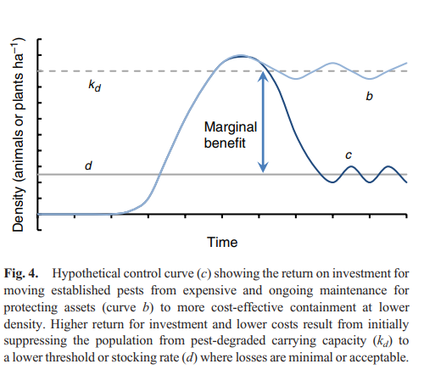
Fleming, Ballard, Reid and Tracey 2017

Slide 9
Coordination
Feral cat control (at useful scales) in open landscapes
Fenced areas to protect at-risk fauna
Effective domestic cat management
Reliable monitoring
Advanced technologies (esp. control and monitoring)
Science
Public support

Slide 10
Developing effective feral cat management strategies (NSW)
6 year project (2019 – 2025)
Operating in 3 ecoregions of New South Wales
Northern temperate forests/woodlands, 4 x 20,000 ha sites (2 treatment, 2 ‘business as usual’)
Southern coastal forests, 3 sites (1 treatment, 2 ‘business as usual’)
Central semi-arid mallee, 3 sites (1 treatment, 2 ‘business as usual’)
Trying to:
measure the impact of various tools / strategies on feral cats and other fauna
Improve the way we monitor and control feral cats

Slide 11
Effective strategies for feral cat control
How do we get densities low and keep them there?
Cost-effective feral cat monitoring
Reduced effort associated with effective monitoring
Stabilise / recover threatened fauna
Reduce risks from: Disease, Predation, Competition
Land managers trained in ‘best practice’
Key lessons shared to grow community of practice

Slide 12
Playing ‘catch up’ re baiting cats
2020
Baseline
2021
Winter baiting
2022
Wild dog baits
2024
Eradicat ???
2023
Fox baits

Slide 13
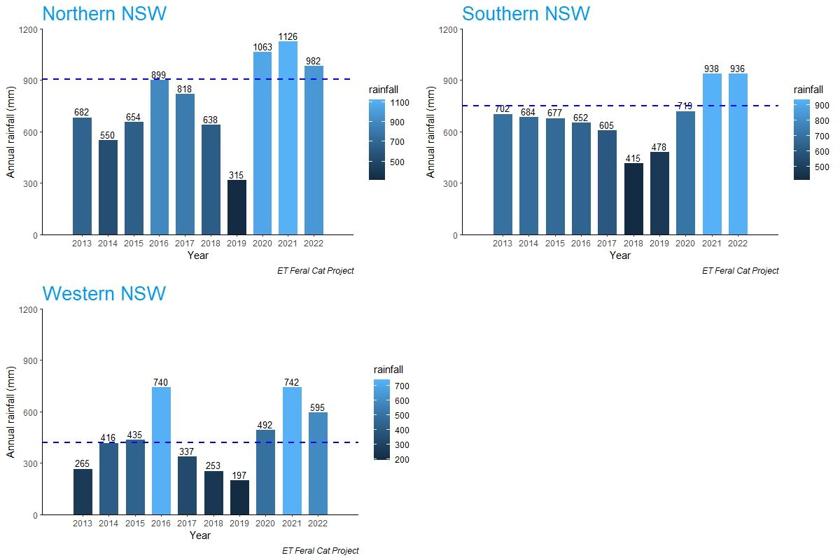
Our timing could have been better…

Slide 14
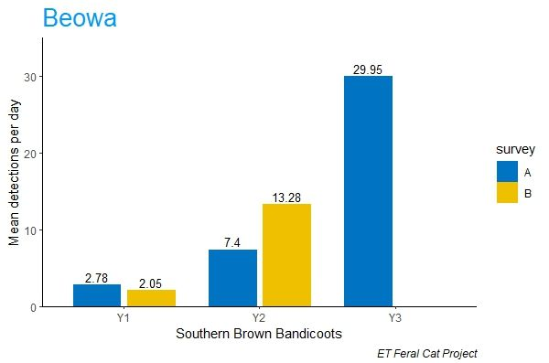
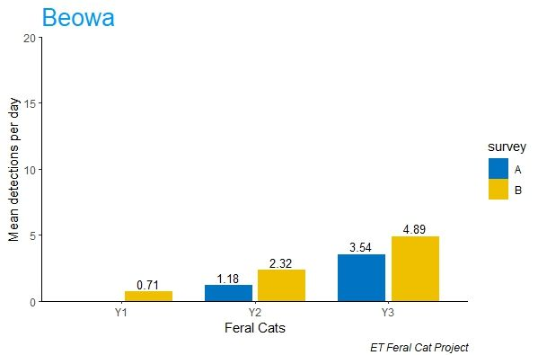
It’s been raining prey… and feral cats.

Slide 15
Decision Support Tool for managers
Dr Annalie Dorph (UNE) is developing an online tool to help guide managers of feral cats (and red foxes).
Feral cat research and management experts are contributing their time and knowledge to help others make management decisions with confidence.
In 2022, we held our first ‘expert elicitation workshop’
Expectations about management outcomes were quantified, and
Research priorities for feral cats were determined

Slide 16
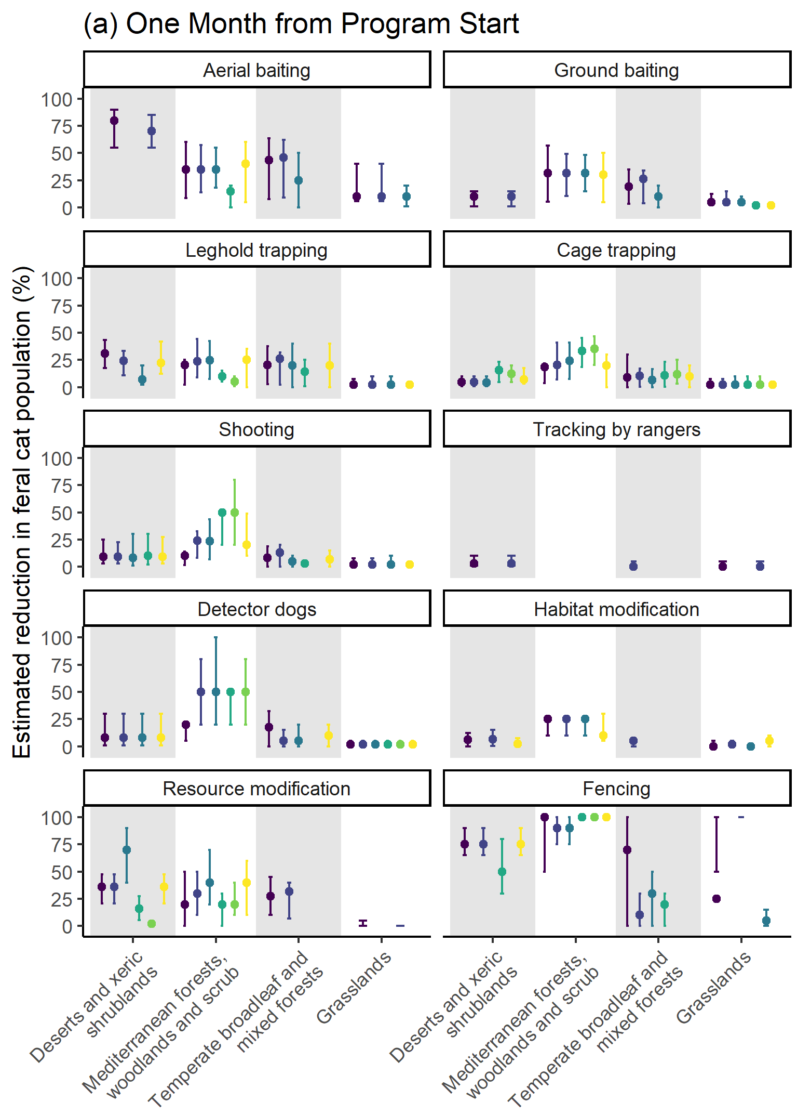
Expected impacts on cat populations
From Dorph et al. (in prep.)

Slide 17
National research priorities:
How should we monitor, to inform management?
What are the impacts of cats/foxes/dogs on prey species, with and without management?
What is the longevity of a management program (i.e. time to repopulation / reinvasion)?
How much transfer of cats occurs between urban and natural environments?
Which areas do we prioritise for eradication?

Slide 18
Coordination
Feral cat control (at useful scales) in open landscapes
Fenced areas to protect at-risk fauna
Effective domestic cat management
Reliable monitoring
Advanced technologies (esp. control and monitoring)
Science
Public support

Slide 19
Projects to improve landscape resilience
We are currently scoping new projects via the NESP Resilient Landscapes Hub
In line with the TSAP we are actively discussing work involving / related to:
Understanding changes in feral cat ecology as their densities are reduced
Cat-Fox interactions in managed and unmanaged areas
Roles of lures / deterrents in feral cat management
New tools to aid management and/or monitoring of feral cats

Slide 20
Acknowledgements
The NSW Environmental Trust
Resilient Landscapes NESP Hub
Local Land Services NSW
NSW National Parks and Wildlife Service
NSW Department of Primary Industries
University of New England
Technical staff and research students
Neighbours, collaborators and community research partners

