Slide 1
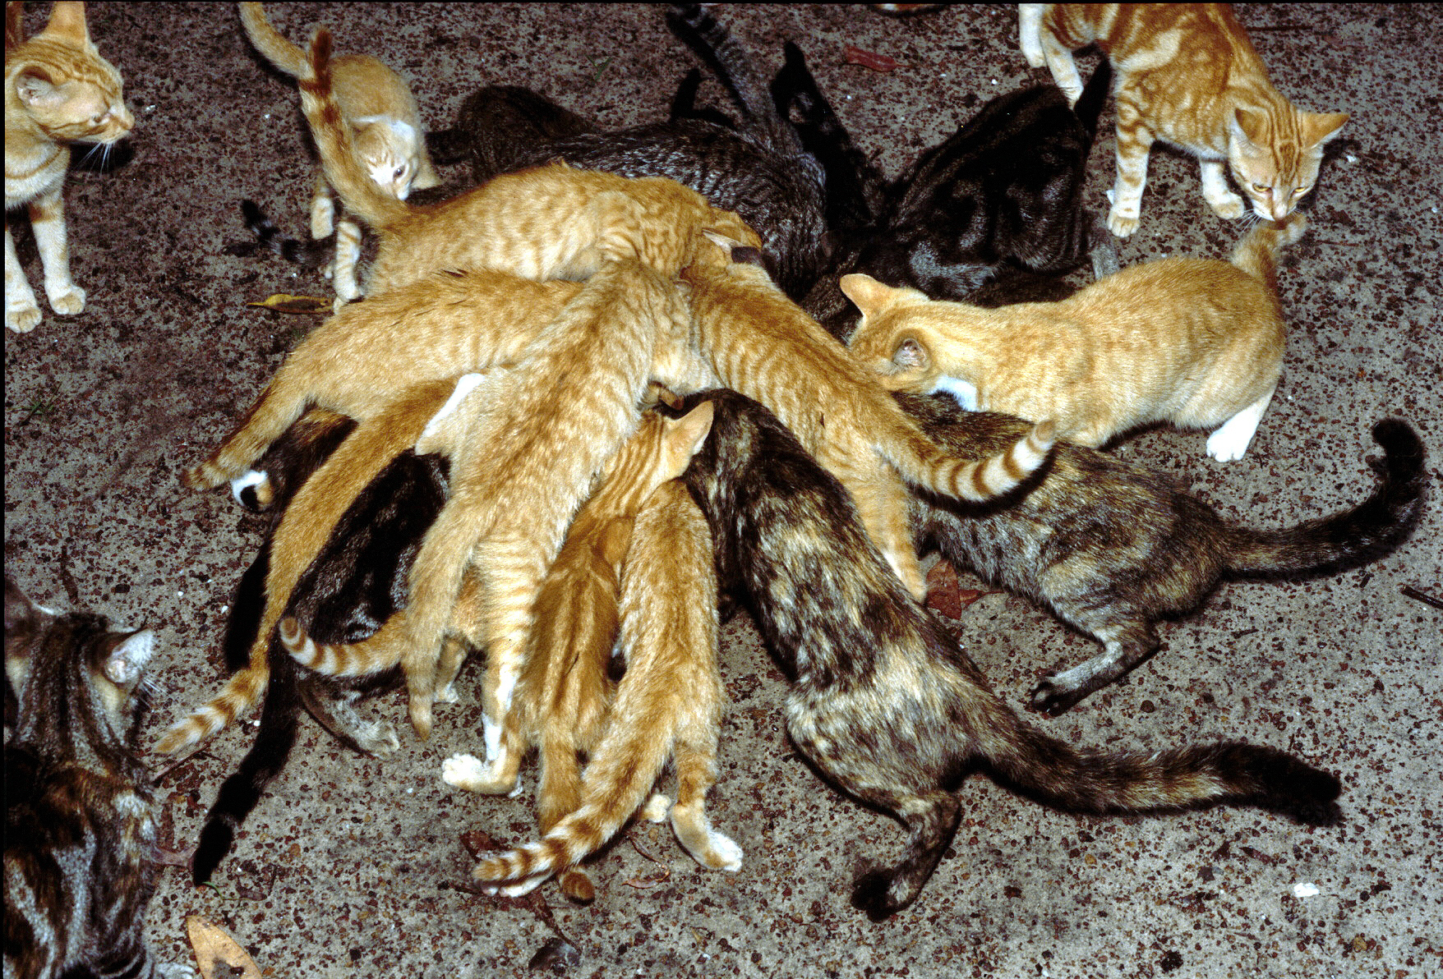
Pujukati* in remote Indigenous communities
Tida Nou¹, Jessica Hoopes¹, Bonny Cumming¹, Katrina Doody¹, Michelle Hayes¹, Brooke Rankmore¹
Animal Management in Rural and Remote Indigenous Communities (AMRRIC)
* Kimberley Kriol word for cats
Cats at a NT homeland
Image: Ian Morris
Notes:
Hi, I’m Tida. I work for a non-government organisation called Animal Management in Rural and Remote Indigenous Communities (or AMRRIC). It delivers veterinary services (particularly surgical desexing) in remote communities.
I’d like to preface this talk by noting that I am talking about this topic as privileged non-Indigenous person; it will cover some of the information AMRRIC has collected in remote communities, and we are sharing it out of concern about the potential implications of growing cat numbers in some communities.

Slide 2
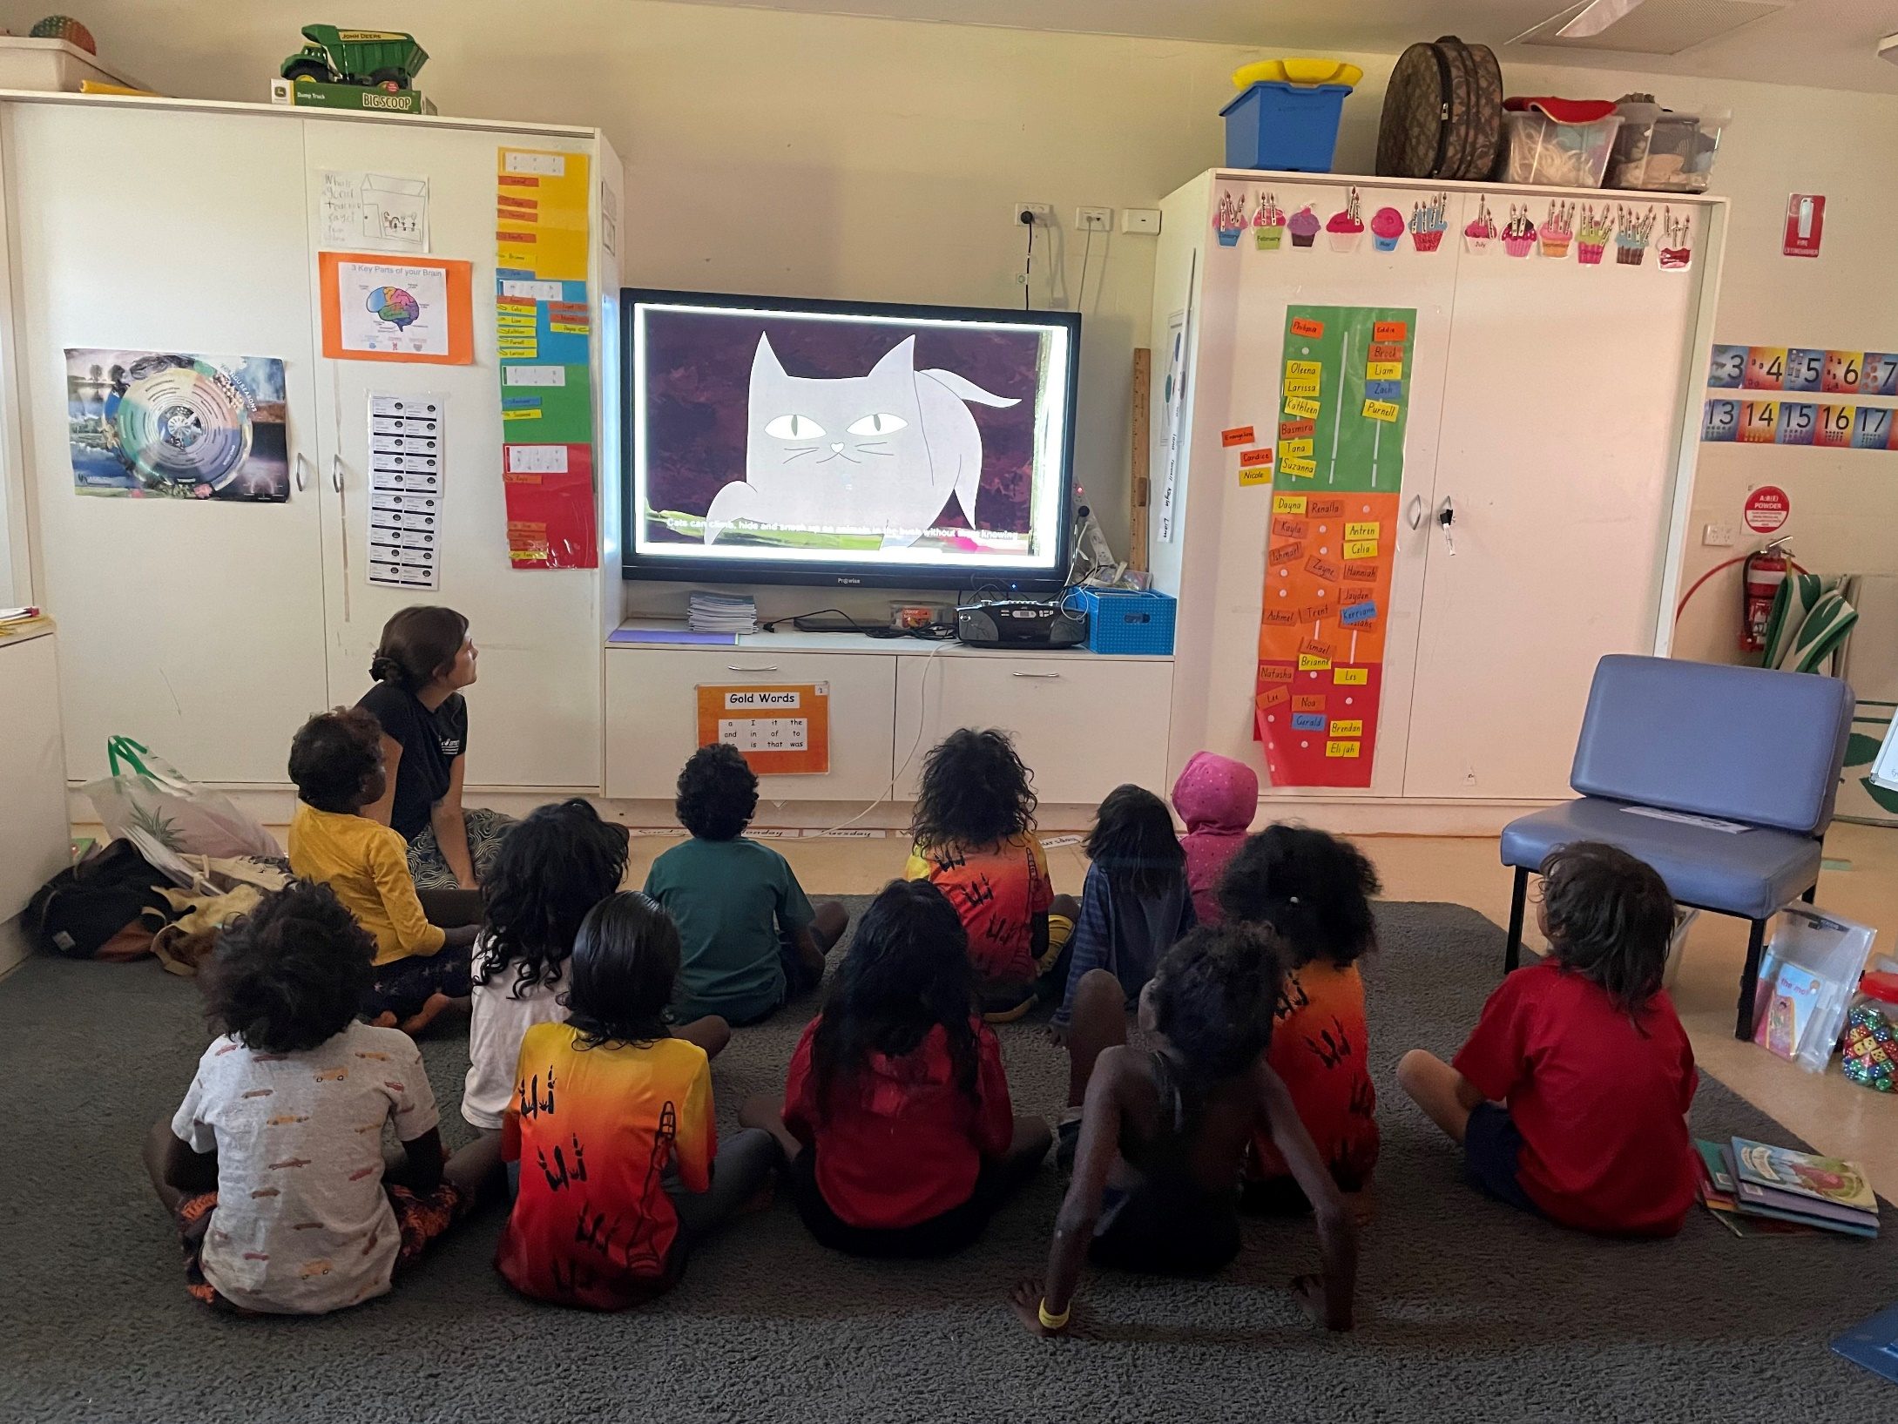
Acknowledgements
The AMRRIC office is located on the land of the Larrakia people. We are privileged to work in collaboration with many remote Aboriginal and Torres Strait Island communities. We acknowledge the Traditional Owners of all the lands on which we live and work, and pay respects to Elders past, present and future.
STEM program in eastern Arnhem Land
Image: AMRRIC
Notes:
I would like to acknowledge the Noogar Traditional Owners of the land we are gathering on today. I also acknowledge the Larrakia Traditional Owners of Darwin, where AMRRIC’s office is based and the Juggera/Turrbal Traditional Owners of the land where I live and work. I pay my respects to elders past and present, and extend a special thanks to the Indigenous rangers who care for land and sea country.

Slide 3
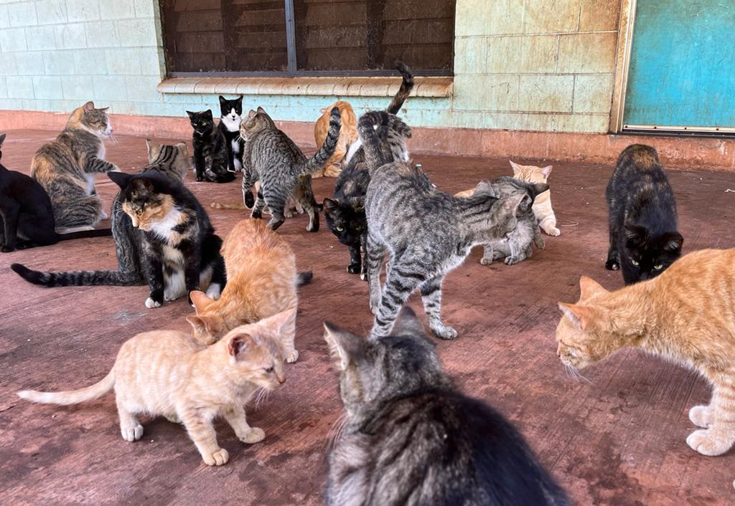
Management challenges
Remoteness
Socio-economic disadvantage
Free-roaming cats
Variable levels of socialisation in cats
Multi-lingual communities/variable community knowledge
Cats in Maningrida, NT
Photo: AMRRIC
Notes:
AMRRIC has been working in collaboration with remote Indigenous communities since 2004.
In the last 10-15 years, cats have become an increasingly popular and valued pet in remote communities-being kept for companionship, reducing numbers of introduced rodents, teaching kids about responsibility and keeping snakes away from houses.
Remoteness and high levels of socio-economic disadvantage serve as barriers to accessing to basic animal health care and veterinary services. Desexing rates are highly variable. Cat food is not readily available or is prohibitively expensive; cats are fed with leftovers from people’s meals, they also scavenge and hunt.
Cats are free-roaming, and there is likely a high level of interaction with people, wildlife and feral cats.
We recognise that there is deep and extensive Indigenous knowledge about Country and threats to Country. In the course of AMRRIC’s work, we have found that there are variable levels of knowledge about the breeding potential of cats, and diseases carried by cats-typically, information about these is typically in English.

Slide 4
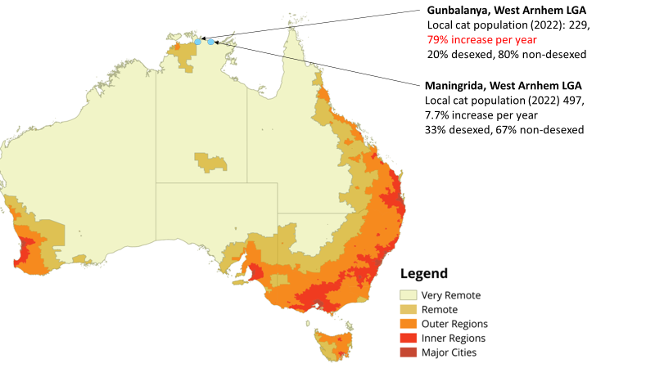
Notes:
In 2022 we extracted and collated our available cat census data.
We found that cats are present in most of the 67 communities visited in 2021-22; many of these are in areas with high conservation values.
We have comparison data for two communities, Gunbalanya and Maningrida in Arnhem Land. In both these communities, the rate of cat population growth is quite rapid, notably in Gunbalanya, where the cat population increased at a rate of 79% per year between 2018 and 2022.

Slide 5
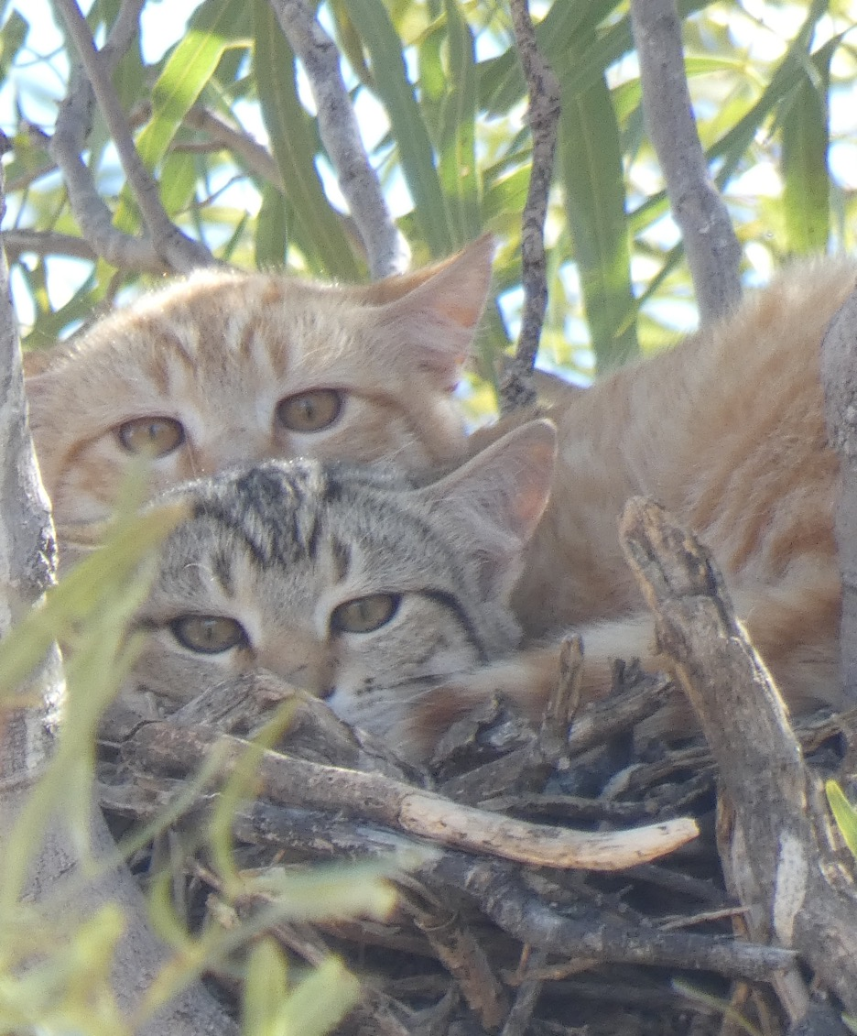
Other findings
Cat numbers also increasing in other communities
Desexing rates: 20% Gunbalanya, 33% Maningrida
Domestic cat populations are mainly female (75% in Maningrida and Gunbalanya)
Females as preferred pets?
Dispersal patterns: males dispersing and establishing home ranges (becoming feral)?
Feral cats on a letter-winged kite nest, QLD
Photo: Ivan Reynolds
Notes:
Our data also shows that cat numbers are increasing in the other 65 remote Indigenous communities visited; additionally we receive requests for assistance from other remote communities in SA and WA reporting rapid increases in cat numbers, suggesting the issue is widespread.
As mentioned-remoteness is a barrier to accessing veterinary services; these may be non-existent in small homelands, intermittent or infrequent. Desexing rates may be low (e.g. 20% in Gunbalanya, 33% in Maningrida)
Our data from these communities indicate the domestic cat populations are predominantly female; we hypothesise that males are dispersing and becoming feral.

Slide 6
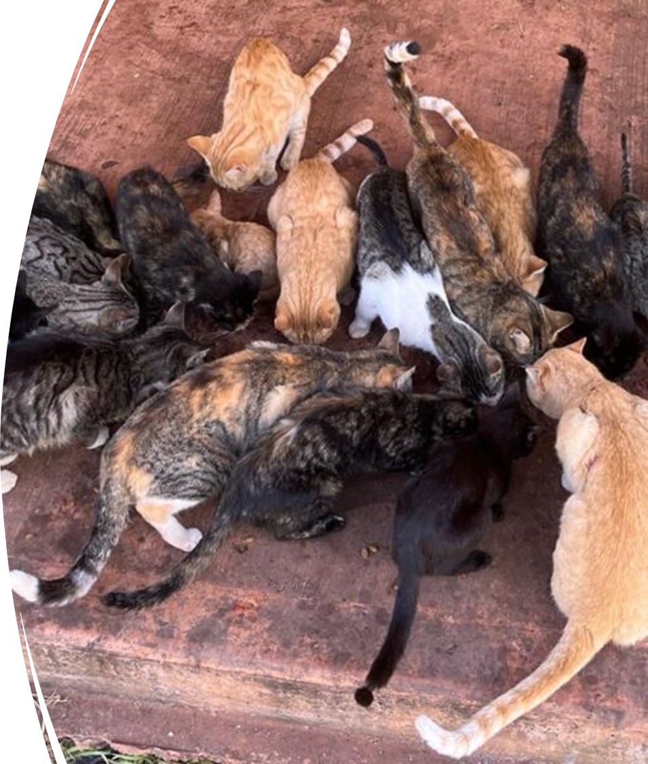
Knowledge gaps/
next steps
Data for WA communities?
Research gaps
Human health impacts
Transfer to feral cat population
Predation
Animal health impacts
Partnerships for improving domestic cat management?
Cats in Maningrida, NT
Photo: AMRRIC
Notes:
While our data set is relatively limited, it highlights there is a chance to act now. AMRRIC is hoping to undertake some intensive surgical desexing blitzes in Arnhem Land.
It’s been really fantastic to hear about the amazing work of Indigenous rangers over these last few days-in some cases this includes efforts to manage feral cats. The work by AMRRIC reinforces the need for integrated cat management in remote Indigenous communities, to stem the flow of domestic cats into the feral cat population, and we welcome partnerships with Indigenous ranger groups to work on this.

Slide 7
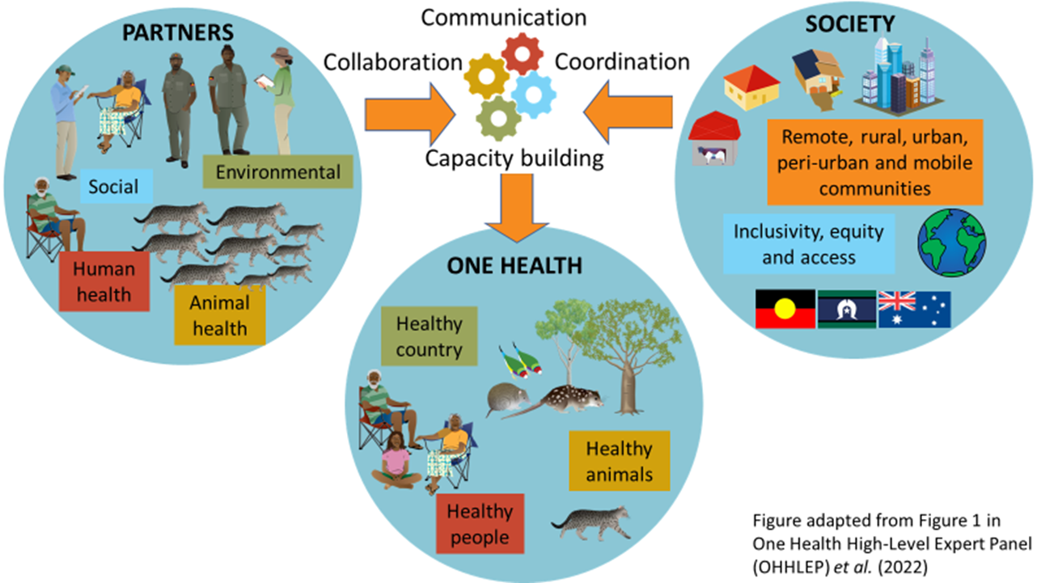
One Health and cat management
Symbols courtesy of the NESP Resilient Landscapes Hub (nesplandscapes.edu.au) and Tracy Saxby -Integration and Application Network Media Library (https://ian.umces.edu/media-library/symbols/).
Notes:
We highlight the One Health as a valuable approach for addressing a complex, multi-faceted issue involving free roaming pets, people and wildlife.
One Health recognises the links between the health of people, animals and the environment.
Applied to cats in remote communities, it would involve the management of cats to improve the health of people, animals and country.
One Health has not been widely applied in Australia; disciplines and funding are largely siloed.
We highlight the need for stronger transdisciplinary collaboration between the conservation, social science, human health and animal health sectors to do this.

Slide 8
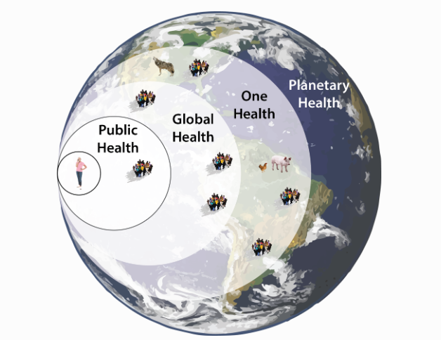
Public/Global/Eco/One/Planetary Health…
Image: Eric Marty
Notes:
There’s an array of “health” approaches/narratives being used-very confusing, how does it all fit together?
Public health considers the regulation of society, and how transmission of infectious diseases can be managed
Global health recognises that socio-economic factors are key determinants of health;
One health recognises that the health of people, wild and domestic animals, and country are connected,
Planetary health recognises that planet as a system; and is based on the premise that human health depends on the health of the Earth.

Slide 9
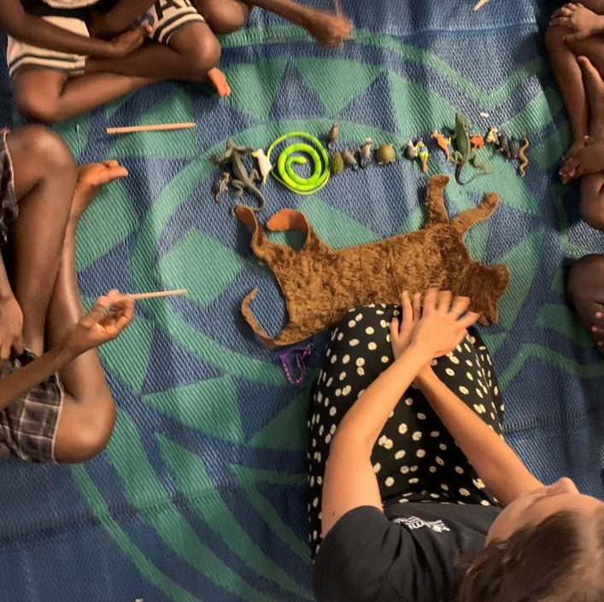
Key messages
We are concerned about the growing numbers of cats in communities.
Keen to support local approaches and develop partnerships
veterinary and education programs
resources in Indigenous languages?
‘Felt cat’ education kit, Groote Eylandt NT
Photo: AMRRIC
Notes:
AMRRIC is concerned about the rapid growth of cat numbers in remote communities, and implications for human health, wildlife and the health of country.
AMRRIC is interested in helping improve domestic cat management and reducing overflow to feral populations.
AMRRIC has been developing resources which we translate into Indigenous languages. One of our animations (on dogs) is now available in seven Indigenous languages. If there are resource needs that would support improved cat management, please get in touch.

Slide 10
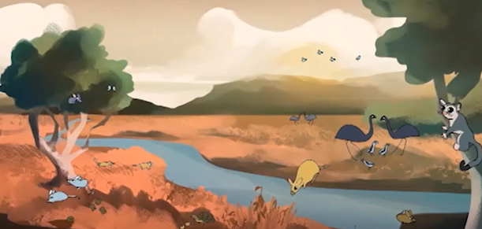
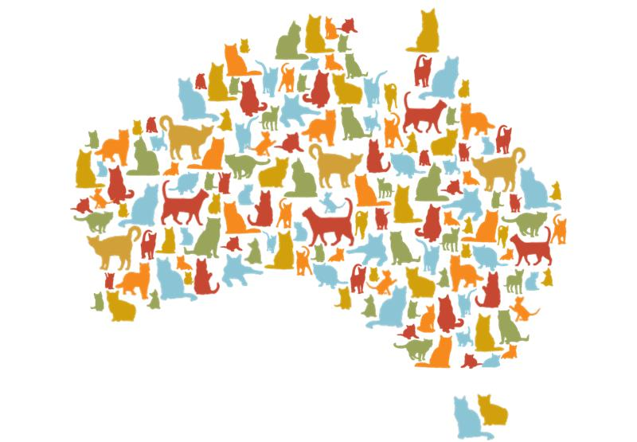
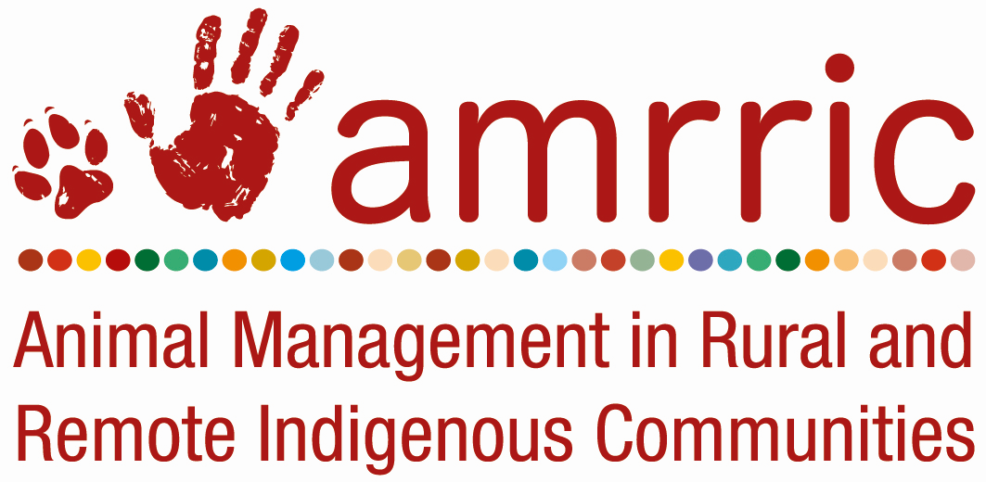
Questions?
‘Caring for country: managing cats’ animation available in Eastern Kriol and English;
two versions (savanna and arid zone wildlife).
Contact:
Tida Nou
Tida.nou@amrric.org

Slide 11
References
1. Woinarski JCZ, Legge SM, Dickman CR, Nou T, Garrard G, McGregor HW. Submission to the House of Representatives Standing Committee on the Environment and Energy: Inquiry into the problem of feral and domestic cats in Australia. Published online 2020. https://www.aph.gov.au/Parliamentary_Business/Committees/House/Former_Committees/Environment_and_Energy/Feralanddomesticcats/Submissions
2. O’Rourke P, Bowry C, Hoopes J, Doody K, Nou T. Emerging Issues and the Integral role of a One Health Approach for Improved Cat Management. Presented at: National Aboriginal and Torres Strait Islander Environmental Health Conference; September 2022; Darwin, Australia.
3. Kennedy BPA, Cumming B, Brown WY. Global Strategies for Population Management of Domestic Cats (Felis catus): A Systematic Review to Inform Best Practice Management for Remote Indigenous Communities in Australia. Animals. 2020;10:663.
4. Crawford HM, Calver MC, Fleming PA. Subsidised by junk foods: factors influencing body condition in stray cats (Felis catus). Journal of Urban Ecology. 2020;6(1):1-17.
5. Animal Medicines Australia. Pets and the pandemic: a social research snapshot of pets and people in the COVID-19 era. Published online 2021. https://animalmedicinesaustralia.org.au/report/pets-and-the-pandemic-a-social-research-snapshot-of-pets-and-people-in-the-covid-19-era-2/
6. Legge S, Woinarski JCZ, Dickman CR, Murphy BP, Woolley LA, Calver MC. We need to worry about Bella and Charlie: the impacts of pet cats on Australian wildlife. Wildlife Research. 2020;47(8):523-539.
7. Lawler OK, Allan HL, Baxter PWJ, et al. The COVID-19 pandemic is intricately linked to biodiversity loss and ecosystem health. The Lancet Planetary Health. 2021;5(11):e840-e850. doi:10.1016/S2542-5196(21)00258-8

