Slide 1
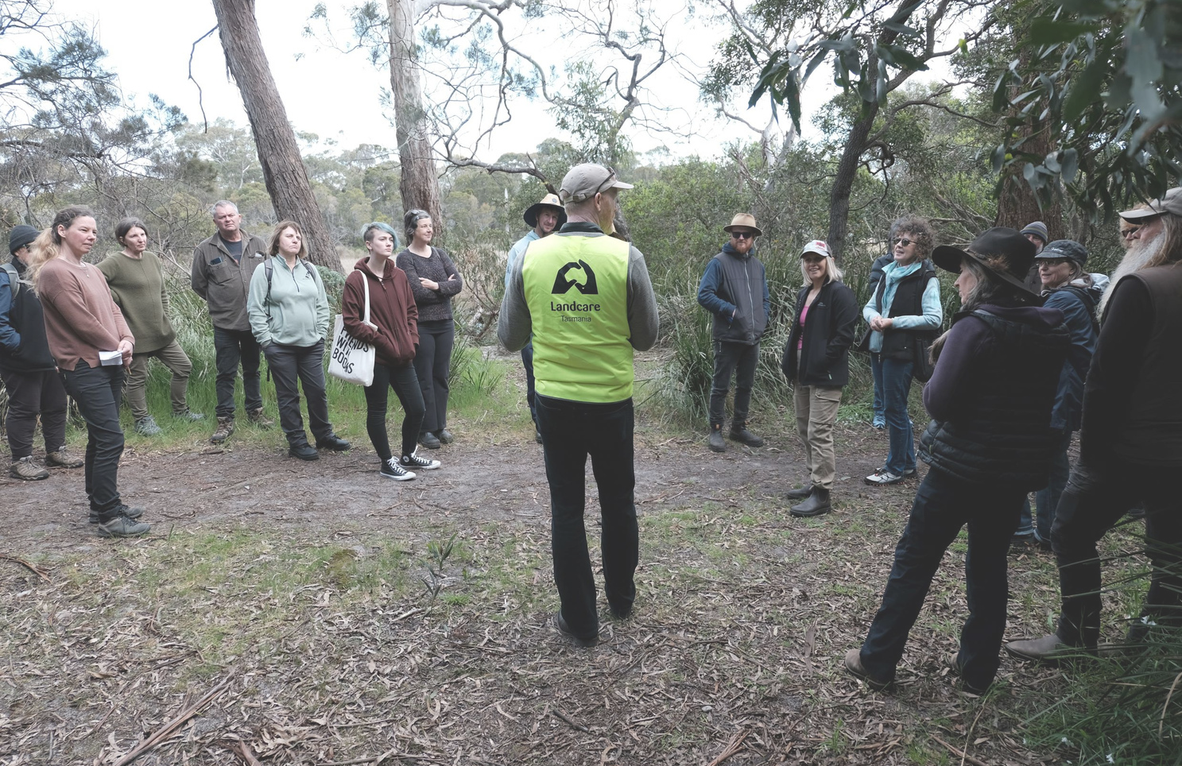
LANDCARE TASMANIA
COMMUNITY ENGAGEMENT ACROSS A LANDSCAPE
Feral Cat Symposium 2023

Slide 2
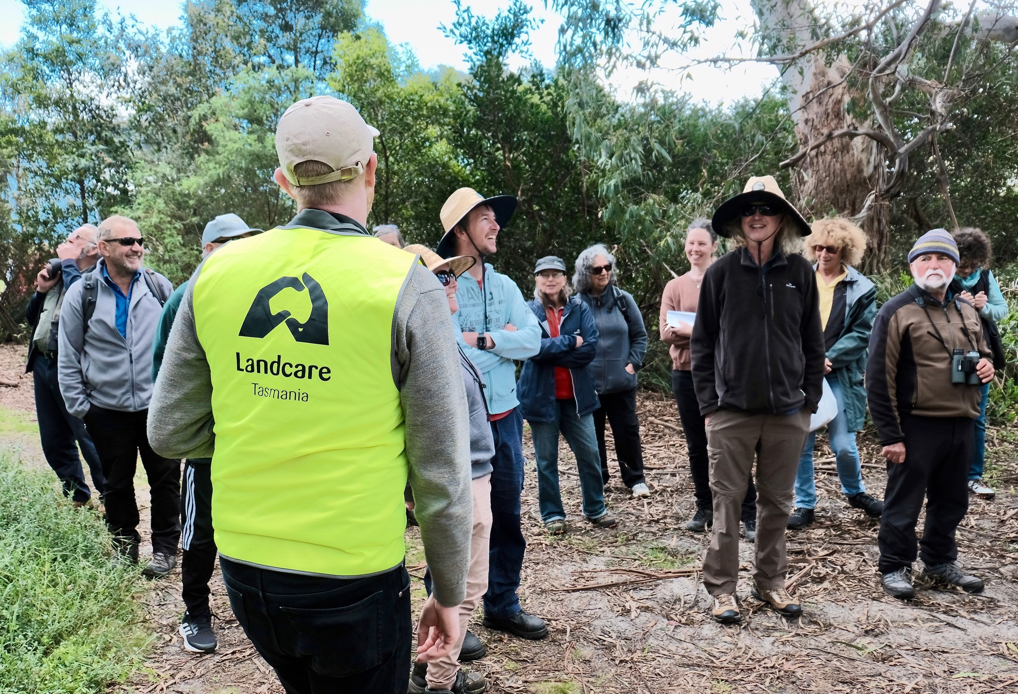
WHO IS LANDCARE TASMANIA?
Page 1

Slide 3
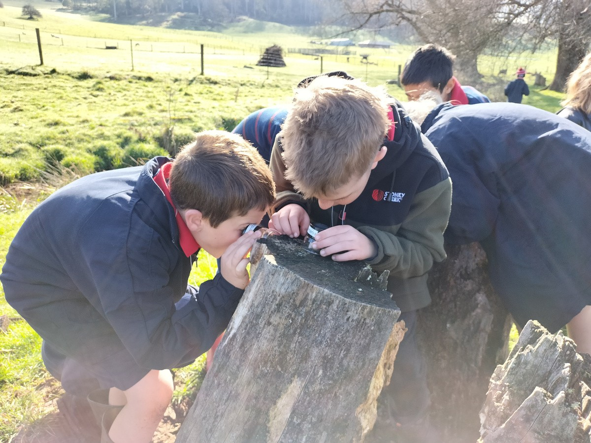
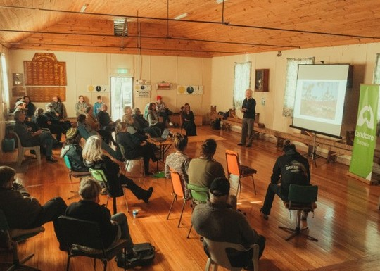
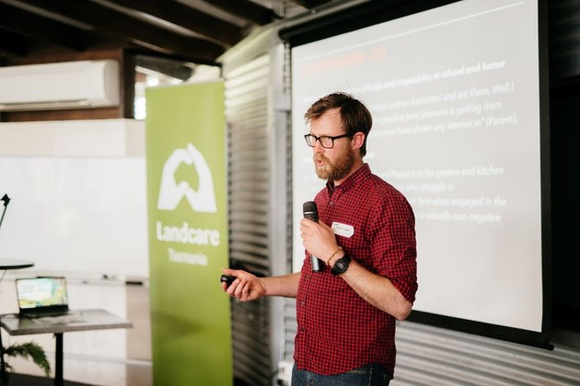
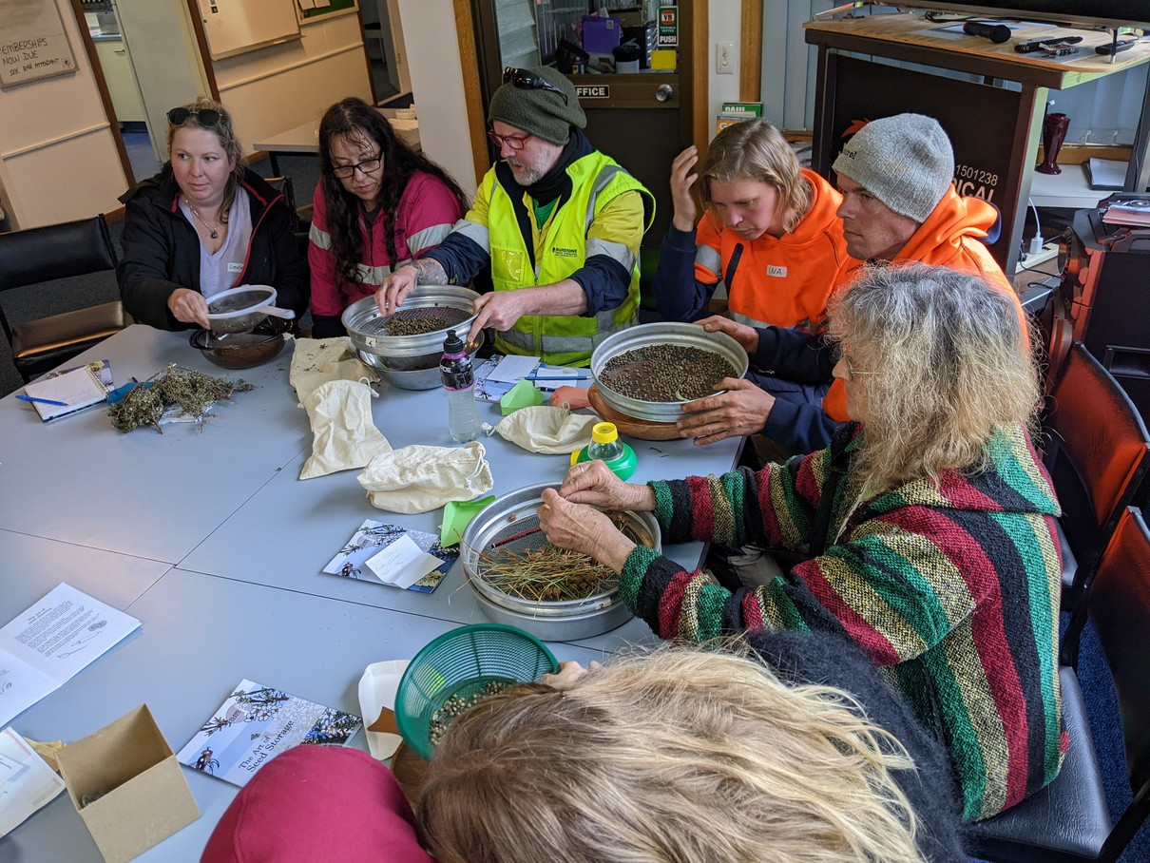
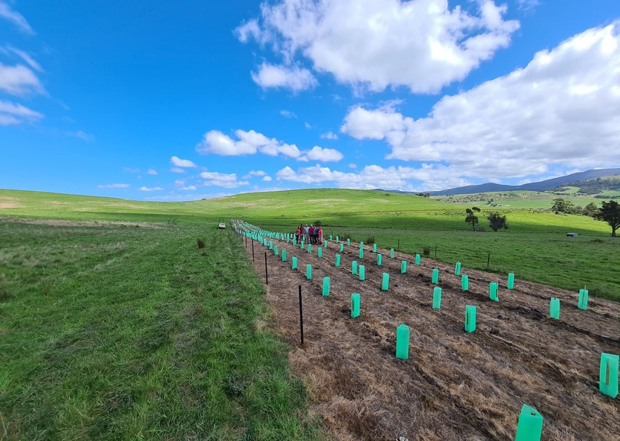
OUR PROGRAMS
EDUCATION
MEMBER SUPPORT
ADVOCACY
COMMUNITY OUTREACH
LANDSCAPE RESTORATION

Slide 4
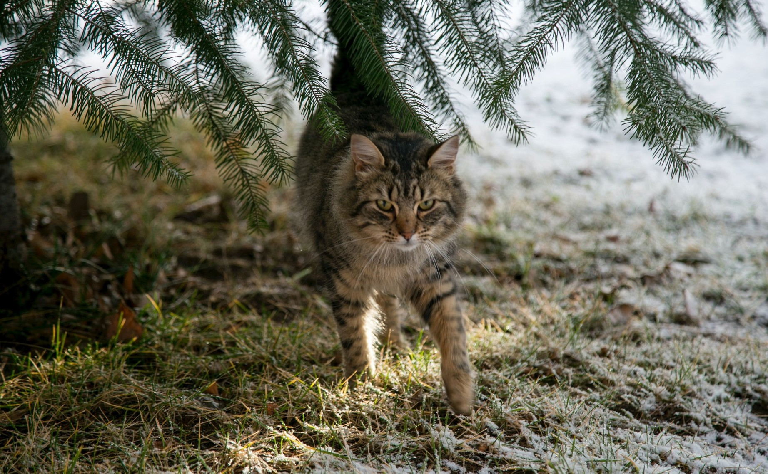
OUR FERAL CAT MANAGEMENT PROJECTS

Slide 5
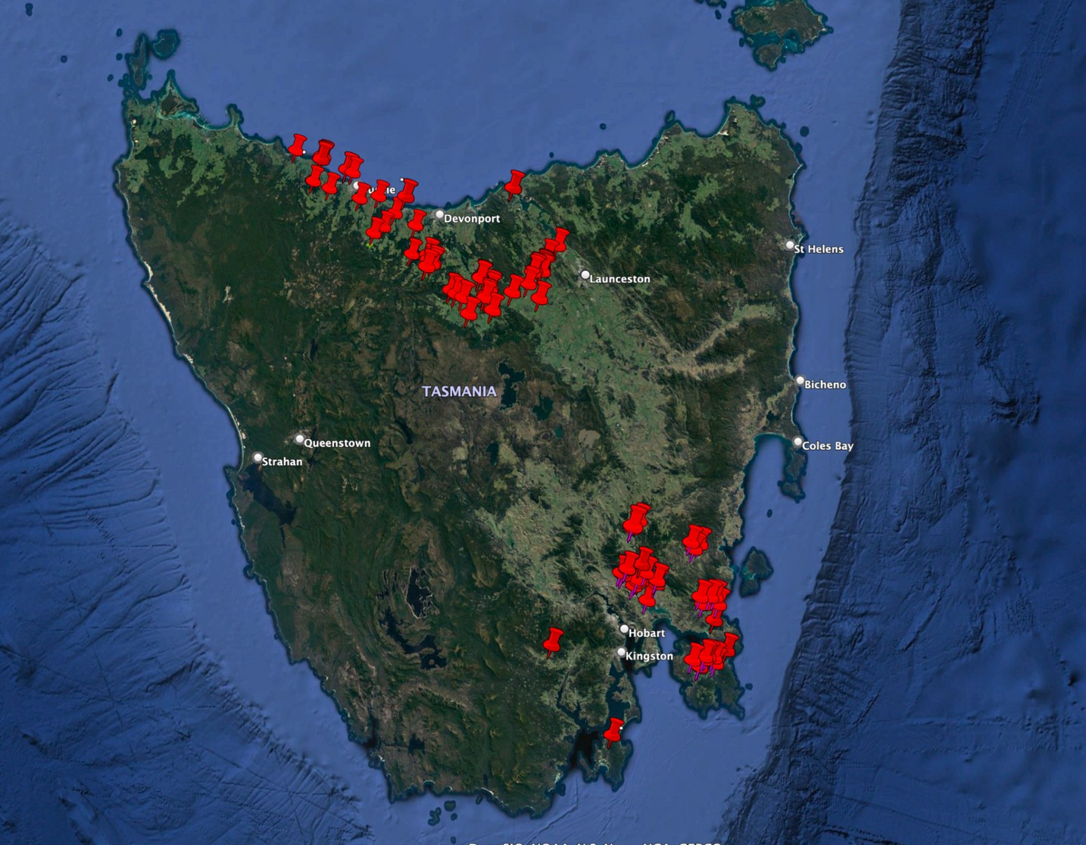
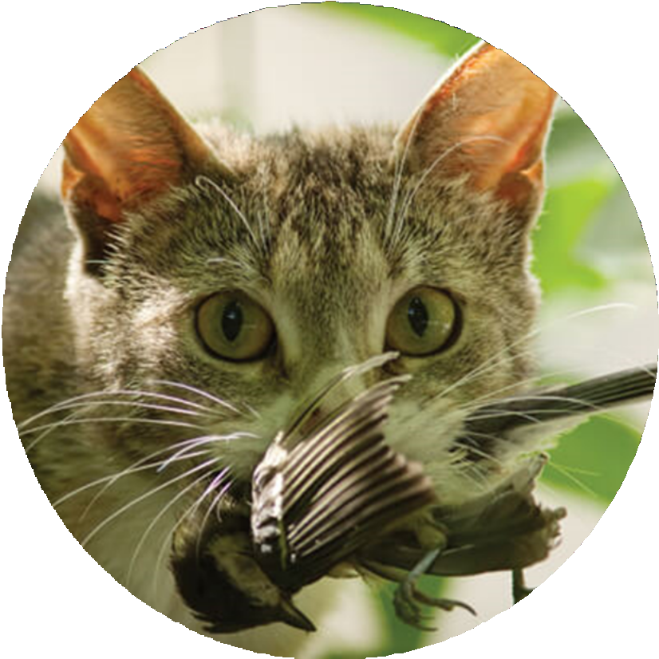
THE SITES...

Slide 6
OUR FERAL CAT MANAGEMENT PROJECTS
THREE STEP PLAN
2.Workshops
1. Info Sessions
3. Action Plans

Slide 7
1. Info Sessions
Local community engagement Q&A panel of experts Understand the impacts
Why we need to manage feral cats

Slide 8
2. Workshops
Coordinated approach Legislation
Practical tips Case studies

Slide 9
3. Action Plans
Supports groups to develop an action plan Practical advice
Landcare Tas lending library - access to trailcams, cat traps and scanners

Slide 10
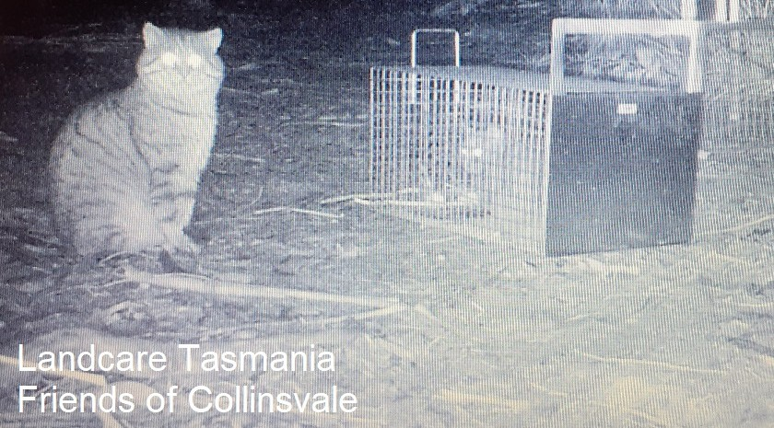

Slide 11
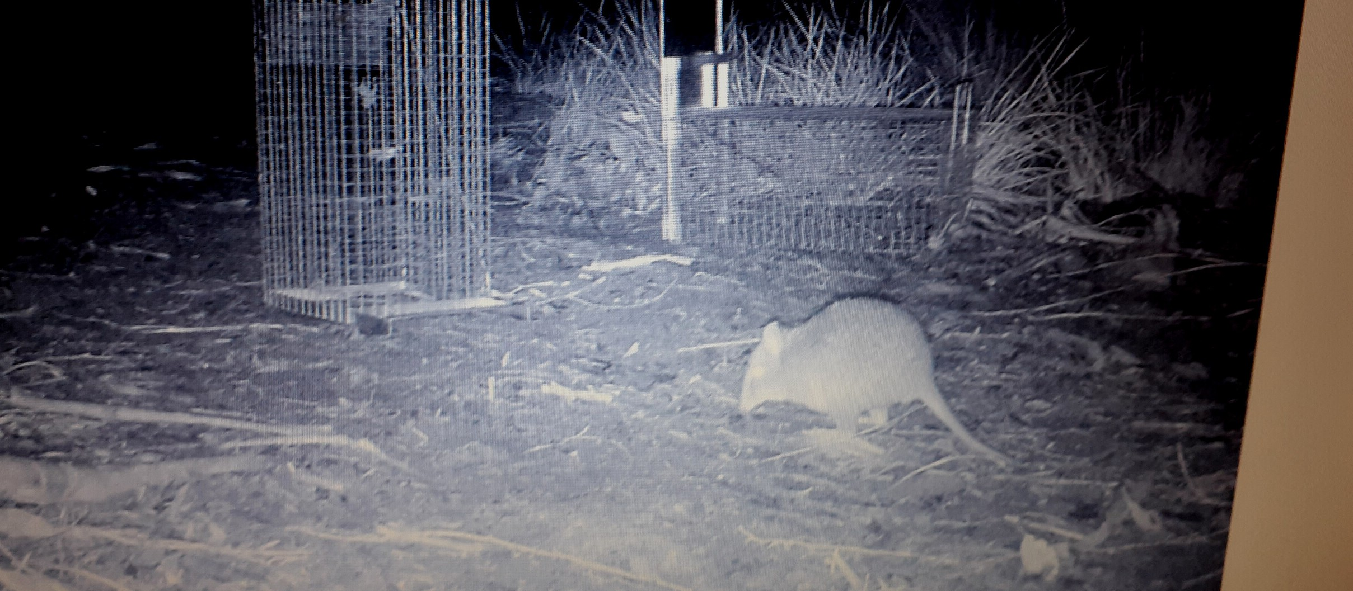
OUTCOMES

Slide 12
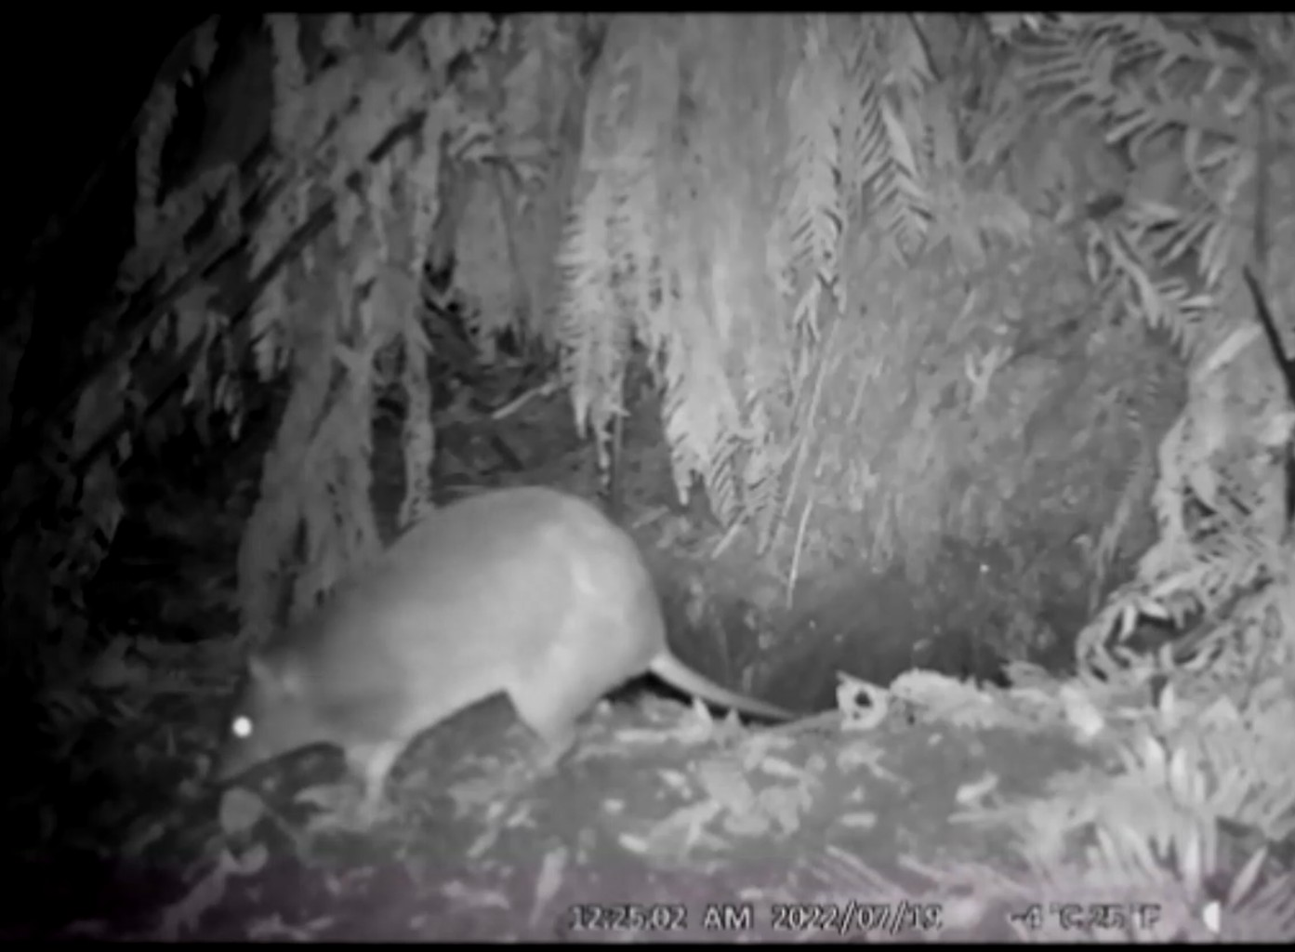
OUTCOMES
Improve landscape and biodiversity and resilience

Slide 13
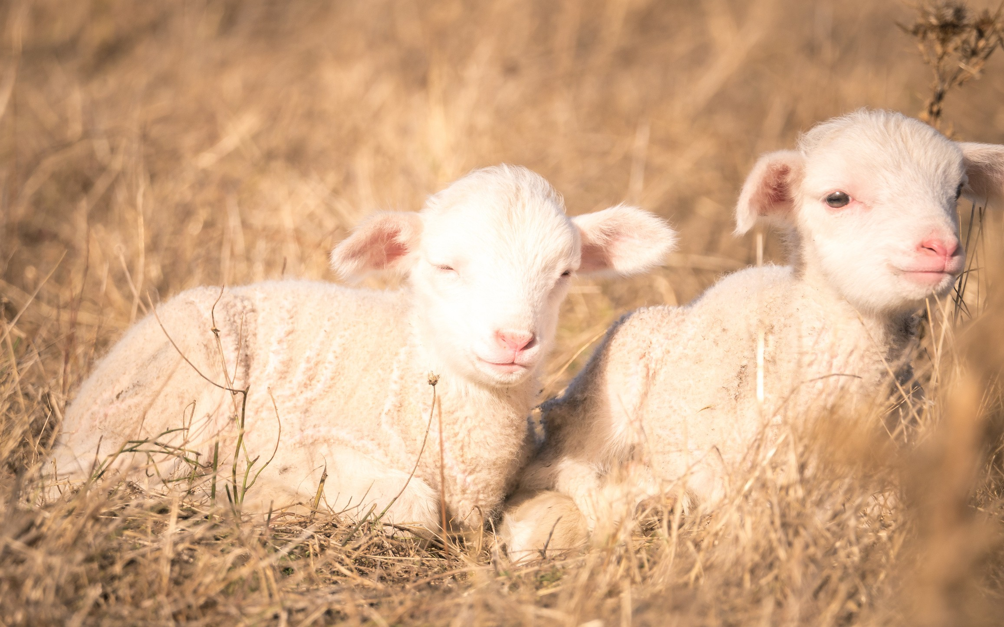
OUTCOMES
Reduce economic loss Reduce cat-borne disease in stock
Image: Huon Douglas

Slide 14
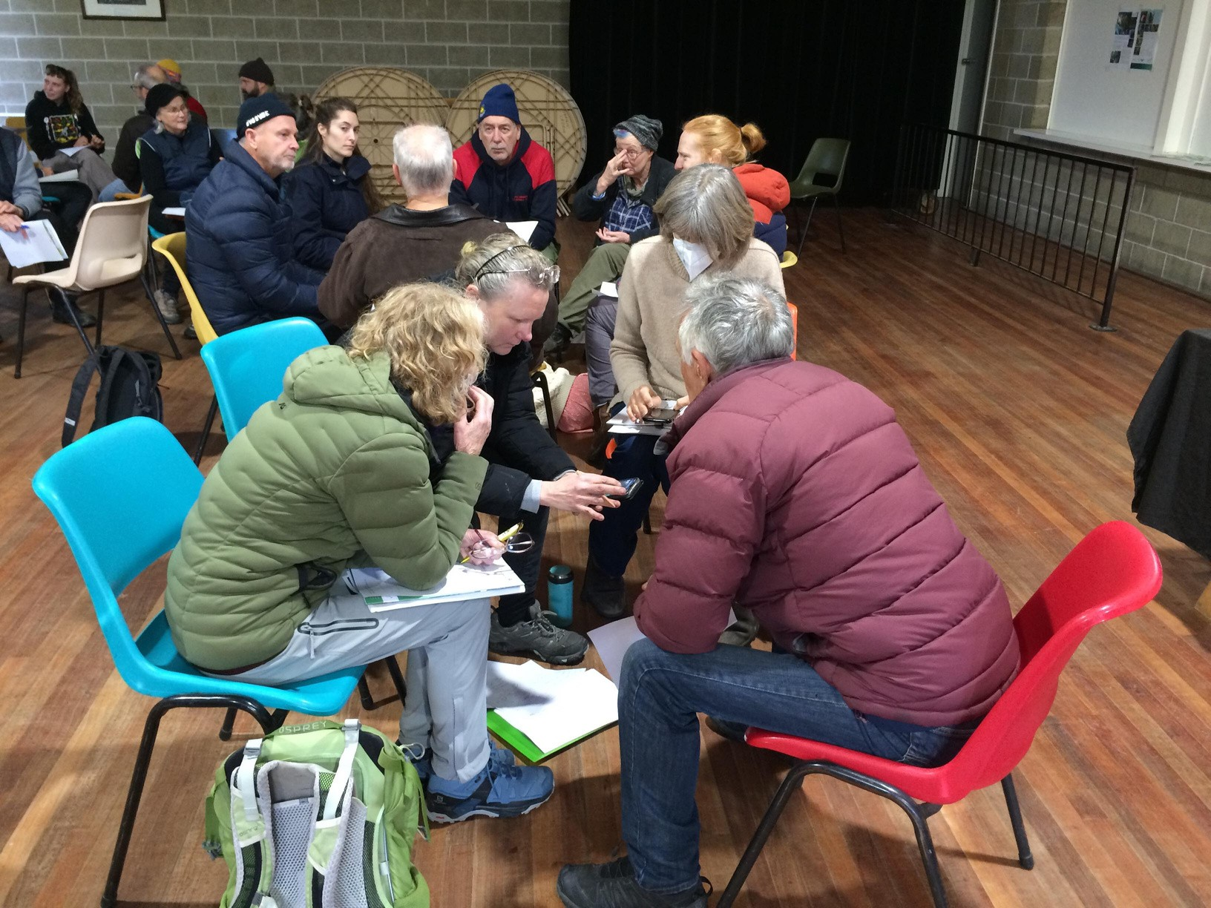
OUTCOMES
Support community to manage cats
Reduce human health impacts of disease

Slide 15
WHEN YOU'RE NEXT IN TASMANIA, COME AND SAY HELLO!

Slide 16
THANK YOU
Landcare Tasmania Inc. www.landcaretasmania.org.au 03 6234 7117

